Slide 1


Enabling business continuity in a time of transition
The purposeful and effective transfer of the working knowledge of the NHS Milton Keynes to their successors
DHID Knowledge Management
Sofia Layton | Rachel Hooper | Colin Evans
Notes:
1

Slide 2
Agenda
Agenda Item | Timing | Who
Introductions Background and Aims Goal and Context Framework Approach Today Next steps Questions Close | 13:00 13:10 13:20 13:30 13:40 15:00 15:45 16:00 | SL-B /All SL-B SL SL RH / All All All / SL-B

Slide 3
Aim : Supporting successful transition
A formula for knowledge sharing
Systems/process approach
Our priorities for the next two years.
Lego bricks
Notes:
To provide a knowledge based model to support knowledge sharing, collaboration and learning that will support successful transition to the new health service model
to take a systems/process approach, designing the “lego bricks” that could sit in any organisational form – the things that need doing
to consider our priorities for the next two years.
to ensure the approach will be applicable to all areas of health
to Illustrate readily accessible tools and techniques that can help transition
to promulgate and share learning more widely across the NHS
3

Slide 4
Action planning
Agree the priority “knowledge domains” for action
To develop a prioritised list of recommended actions
To agree on a draft plan for discussion and agreement by the Business Change Forum (BCF)

Slide 5
Goal
Present a model to support business continuity
2. Define the key priority areas
3. Outline design of a programme of work
Notes:
Present a model to support business continuity:
Take a ‘snapshot’ of the work of the PCT
Proactively support successors’ development needs
2. Define the key priority areas
Identify a legacy champion
Plan a programme of work
6

Slide 6
Why is this important?
Business continuity
Support the NHS for the future
Highlight success, progress, good practice
Leave a legacy
Easier handover of content
Enable handover of more experience and expertise
Enabling successors to build on existing good practice
Driving efficiency through learning from experience

Slide 7
Context
Notes:
‹#›

Slide 8
On the ground
So far –
Speed dating
Masterclasses
Quality MK
Notes:
NHS Milton Keynes ran GP Consortia Master Classes in February 2011 aimed at enabling GPs to enhance their awareness of the technical skills which consortia are likely to need as commissioners.
Feedback from GP Consortia Master Classes highlighted concerns at the scale and complexity of the transition into the new organisation models.
Locally NHS MK are utilising the Quality MK website as a central repository for knowledge transfer information
9

Slide 9
Two key challenges for the NHS are…
To preserve working knowledge of the current NHS organisations
To enable successor organisations to acquire knowledge from their predecessors
Notes:
‹#›

Slide 10
Framework
Notes:
‹#›

Slide 11
The Knowledge Management Framework
Creating a knowledge legacy: a learning after response
Learning before
Learning during
Learning after
Before action review peer assist
After action review
Retrospect
Join a CoP Identify and communicate with subject experts (SMEs)
Interact with peer and subject expert network
Contribute learning to the CoP or network
Access knowledge assets or relevant information sources
Access knowledge assets
Plan build of knowledge assets
Build and share knowledge asset
Notes:
‹#›

Slide 12
The Knowledge Management Framework: learning after
Creating a knowledge legacy: a learning after response
Learning before
Learning during
Learning after
Before action review peer assist
After action review
Retrospect
Join a CoP Identify and communicate with subject experts (SMEs)
Interact with peer and subject expert network
Contribute learning to the CoP or network
Access knowledge assets or relevant information sources
Access knowledge assets
Plan build of knowledge assets
Build and share knowledge asset
Notes:
‹#›

Slide 13
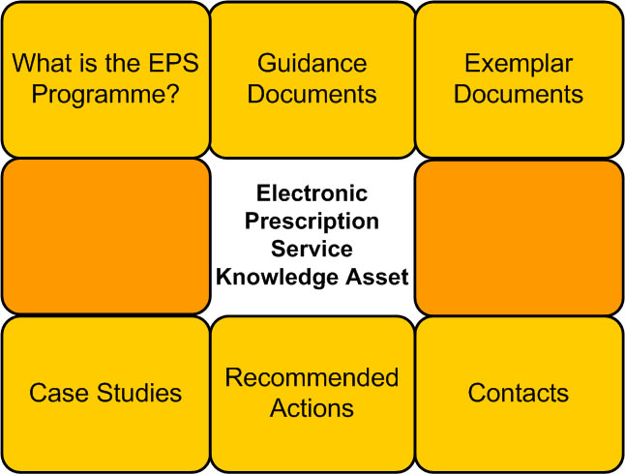
Creating a knowledge legacy: a learning after response
Publish and share knowledge from harvests and retrospects
Notes:
‹#›

Slide 14
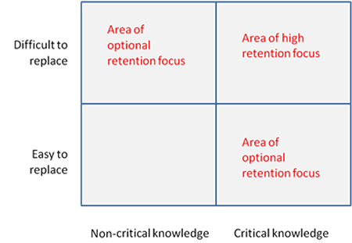
Knowledge harvesting
Capture the knowledge of people with critical or difficult to replace knowledge
Notes:
‹#›

Slide 15
Retrospect
Capture the knowledge of projects and teams
Notes:
‹#›

Slide 16
The Knowledge Management Framework: learning before
Creating a knowledge legacy: a learning before response
Learning before
Learning during
Learning after
Before action review peer assist
After action review
Retrospect
Join a CoP Identify and communicate with subject experts (SMEs)
Interact with peer and subject expert network
Contribute learning to the CoP or network
Access knowledge assets or relevant information sources
Access knowledge assets
Plan build of knowledge assets
Build and share knowledge asset
Notes:
‹#›

Slide 17
Acquire New Knowledge | a learning before response
Access legacy knowledge assets
Consider what issues might arise and what can be learnt from previous experience
Connecting people who have the know-how with the team that want to know
Notes:
‹#›

Slide 18
Case Study
Yorkshire & the Humber SHA
Creating an accessible knowledge legacy
Tested and refined the Knowledge Management Framework
Prioritised key programmes of work
Capture
  Team knowledge – e.g. Leeds EPS retrospective Review
  Individual knowledge – e.g. Hull PCT PM knowledge harvest
Share
  EPS Knowledge Asset
  Peer Assist between Leeds and PCTs implementing EPS
Successors not identified so prioritised making knowledge accessible
Notes:
‹#›

Slide 19
Opportunity for direct transfer
May
2011
March 2014
Retain Knowledge & Experience
PCT
Define
Plan
Do
Successor
Organisations
Access Knowledge & Experience
Define
Identify Work Areas
Identify Roles
Define Timescales
Prioritise Work Areas
Prioritise Roles
Start to Identify Recipients
Start to Identify Home for knowledge
Plan
Knowledge Harvest
Retrospective Reviews
Build Knowledge Assets
Manage Knowledge Assets
Peer Assists
Do
Access
Peer Assists
Before Action Reviews
Access Knowledge Assets
Notes:
17

Slide 20
Approach Today
Notes:
‹#›

Slide 21
Workshop
Define
Focus on “Define” area of Knowledge Retention model
Identify areas for retention
  Work areas
  People / Teams
  Timescales
Prioritise these areas
Agree action plan
Notes:
Introduction to workshop and the sessions
19

Slide 22
Things to consider
Define
Who will be the audience for the knowledge?
Where will this “knowledge” be retained and held?
  Knowledge assets
Promotion and awareness
Notes:
This slide shows some ideas of what needs to be considered.
Sue LB also added:-
What happens if the PCT systems fail
What happens when people leave or change role
What will need handing over and to whom
What should we be doing to support staff into their futures in terms of access to knowledge
20

Slide 23
Session 1
Define
What are your priorities of work
  Projects / Topics/ Functions
Who are your key people
Who is your key audience
Identify areas of responsibility not represented
Identify who needs to know (where we can)
Identify where knowledge to reside
Notes:
Break out into small groups according to how knowledge domains have been grouped and discuss the questions on the slide.
Document on post it notes .
Things to consider
For each issue
What is the desirable outcome?
What have we got/done already?
What is there still to do? (& who should do it?)
If possible document these according to your priority
21

Slide 24
Session 1 Prioritisation
Define
Notes:
22

Slide 25
Session 1
Prioritising matrix
Define
Subject / Topic | Contact(s) or Team(s) | Existing Knowledge Assets | Potential Customer | Domain | Criticality or Impact | Difficulty of Replacement | Critical Driver or Date | Critical Date
Notes:
23

Slide 26
Session 2
Define
Share outputs of initial session
Prioritise key retention areas based on matrix
Document agreed key areas for retention
Notes:
All groups come back together and talk through their outputs. If possible each team should just talk about which areas they feels are of high priority to them.
A group discussion should then be led to look at the matrix provided.
Focus on – hard to replace knowledge – do only specialists carry out this work
And critical knowledge – is this knowledge critical to the success of the organisation.
24

Slide 27
Session 3
Prioritising matrix
Define
Subject / Topic | Contact(s) or Team(s) | Existing Knowledge Assets | Potential Customer | Domain | Criticality or Impact | Difficulty of Replacement | Critical Driver or Date | Critical Date
Desktop PC Service cover | Jim Johnson, ICT Support Desk mgr. | Desktop PC + Peripheral service support contract 2009 (PCT DMS) |  | ICT | L | L | Current contract end | Dec-11
Community Nursing travel reimbursement | Anne Arbor, Regional Nursing & Delivery Manager | - | Commissioners of Community Nursing services | Nursing & Delivery | H | L
Local Health equality initiative | Ben Becular, Deputy Clinical Director | MOA with Local housing authority and Mental health trust | Medical Director(s) | Medical Direction | L | H
CT Scan Capacity expansion | Bob Burns, Commissioning office | Draft Invitation to Tender | Commissioners of acute services | Commissioners | H | H | Critical date for capacity gap | Mar-12
Notes:
25

Slide 28
Session 3
(to perhaps be completed after initial event)
Define
Agree an action plan of work
  Which techniques from the framework will be best suited to each retention requirement
  Who shall carry out the techniques
  Timescales
Notes:
26

Slide 29
Feedback & next steps
Share outputs of breakouts
Discuss and prioritise
Where this can sit?
Timescales
Notes:
Sofie to close our section and refer back and summarise – talking to this model
27

