Slide 1
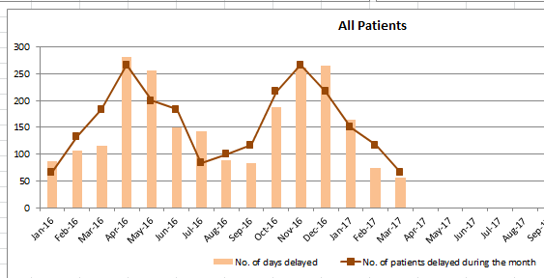
MANAGING DELAYED DISCHARGES AT MCSI
Resettlement and Community Liaison Team
IMPROVED PATHWAY
Estimated Discharge Date given on admission and at 1st or 2nd Goal Setting Meeting
Community Notified
Challenges
2015/2016 delayed discharges = 1,700 bed days lost
100 mile catchment area the team work with multiple CCG’s/LA’s working with
Not all community/nursing home teams doing Bowel/bladder management
Complexity and age of patients increasing
Lack of specialist care providers available in the community
Achievements
MDT Team approach/improved communication
Escalation processes
Dashboard introduced to monitor number patients and days delayed each month
Respiratory pathway in place
19 hour resettlement officer post to be advertised
Difficult Discharge Identified
Relevant CCG Notified
Relevant Social Services Notified
Funding for Care established
Continuing Healthcare
Social
Private
Specialist Equipment Requested
Delays in Provision of Care and Equipment identified
Patient classed as a Delayed Discharge
Escalated to CCG, Community Team
Spreadsheet updated DTOC emailed to all relevant parties within the Trust
Continuing healthcare Lead and
Social Worker contacted daily
Higher Standards of Care, Uncompromising Excellence in Medicine

