Slide 1

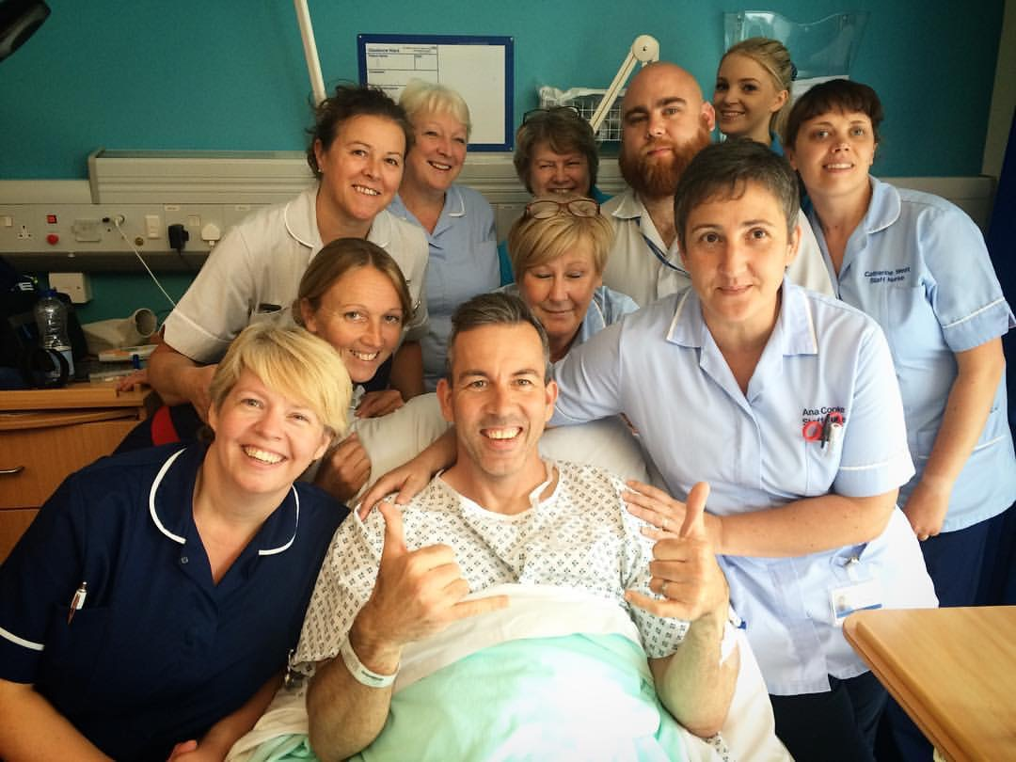
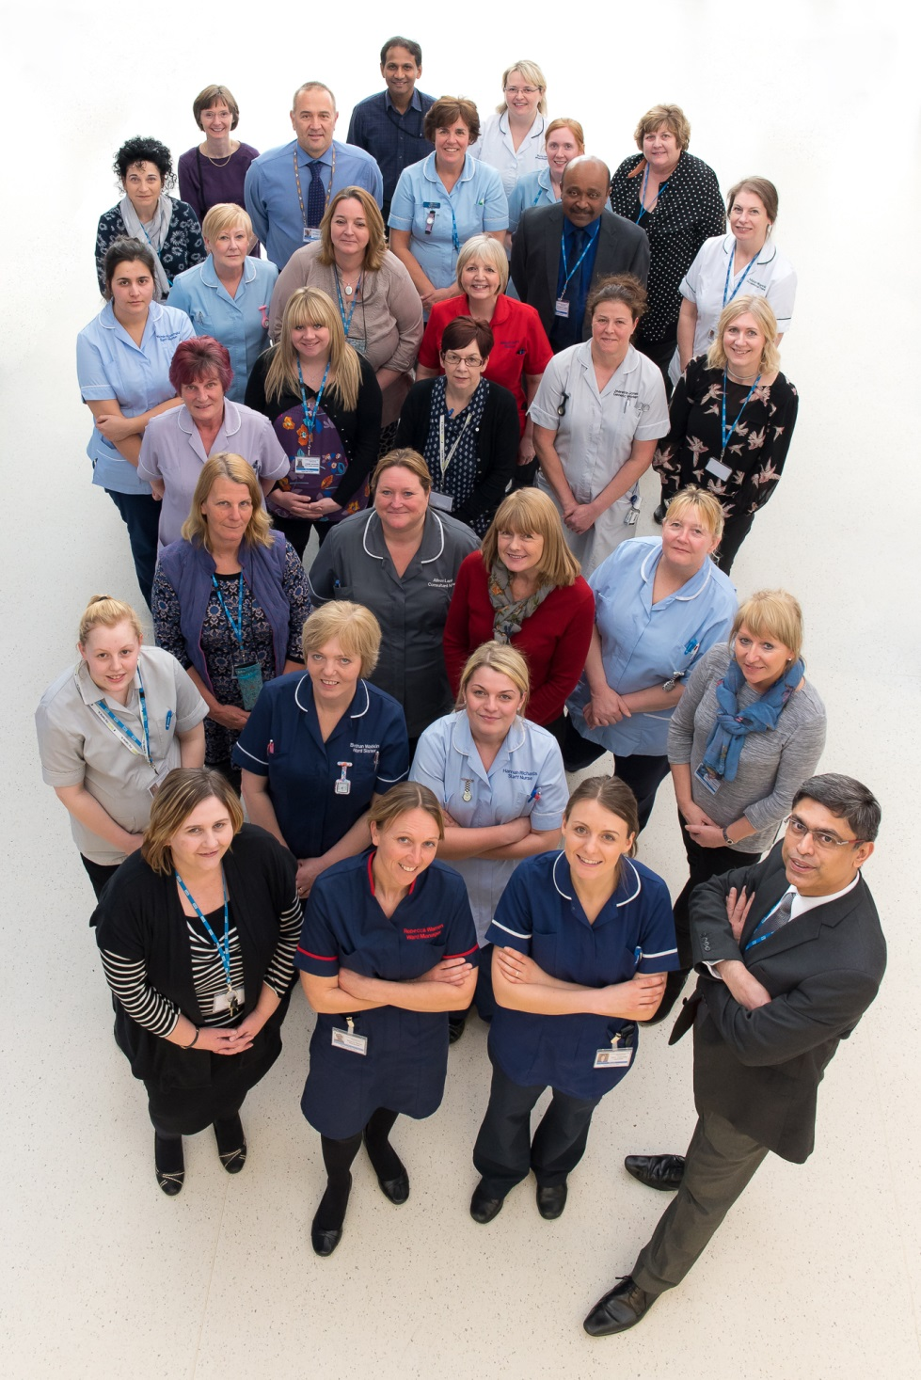
Midland Center For Spinal Injuries
Who Are We?
The Midland Centre for Spinal Injuries (MCSI) at the Robert Jones and Agnes Hunt Orthopaedic Hospital NHS Foundation Trust is one of 11 in the UK designated to receive and treat spinal cord injured patients.
The centre of excellence serves a catchment of 10 million from North Wales, Mid Wales, South Mersey, Cheshire and The West Midlands. The MCSI provides a lifelong service to a current population of 3,500 patients and admits on average 380 patients per year, of whom approximately 100 are in the acute phase of injury.
Approximately 2,000 patients have a full outpatient follow-up review each year.
The multi disciplinary team provides assessment, treatment and education to patients with a spinal cord injury. Support is also provided to partners and family members.
What Do We Do?
Our Team
We are all part of an Multidisciplinary team of dedicated compassionate staff. we are part of an awesome team that consist of over 100 staff. As a team we have seen many changes within the centre that has enabled a better experience for both patients and staff. Our work is recognised nationally and internationally.
A spinal cord injury (SCI) causes paralysis, sensory impairment, a multi-system physiological impairment and malfunction, as well as psychological, social, financial, environmental and vocational effects.
The MCSI is dedicated to the management of spinal injuries, maximising neurological recovery and function, minimising complications and disability, and through follow up appointments after discharge, maintaining health, independence and a good quality of life on an ongoing basis.
Services/specialisms:
Acute and Rehabilitation Care – Adult and Paediatrics
Urological care
Pressure Ulcer Clinic
Management of skeletal spasticity including Botulinum toxin injection and insertion of intrathecal (Baclofen) pumps.
Hand and Upper Limb management
Fertility clinics
Bladder care
Private patient facilities
Higher Standards of Care, Uncompromising Excellence in Medicine

