Slide 1








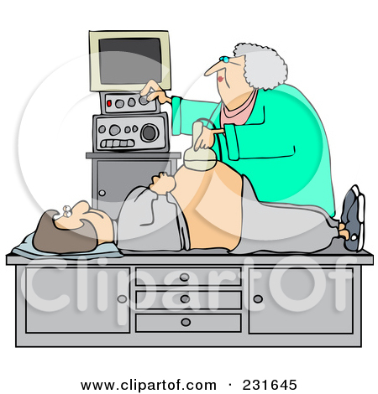
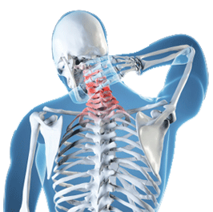
The patients journey through MCSI outpatient department for review with the
Multi-disciplinary team
Assessed by nurse,
Relevant issues discussed, samples taken
It is a comprehensive appointment, which on average takes 1-3 hours.
In 2016 approximately 2500 outpatient reviews took place.
Other clinics include
Nurse led Suprapubic catheter changes
Spasticity e.g. Botox
Intrathecal Baclofen refills
Pressure injury clinic
Fertility / Sexual function clinic
Paediatric clinic
Combined shoulder clinic
Upper limb clinic
Patient arrives
Greeted by receptionist
Patient weighed
Seen and examined by Consultant or specialist Doctor
Seen by physiotherapist
HOME
renal ultrasound scan
All patients are given as much time as required
Higher Standards of Care, Uncompromising Excellence in Medicine

