Slide 1


Connecting People to People: Peer assist
@NHS_HealthEdEng #HEELKS
Notes:
1

Slide 2
Connecting People to People: the definition
“Helping colleagues share ideas, question and learn; supporting networks and communities of practice”
Knowledge for Healthcare; a Development Framework p 23
Notes:
2

Slide 3
So…what is Peer Assist?
“A structured facilitated meeting or workshop where people are invited from other business units or other businesses to provide their experience, insights and knowledge to a team who have requested help.”

Slide 4
Peer Assist – the movie
How to help Bob
Notes:
4

Slide 5
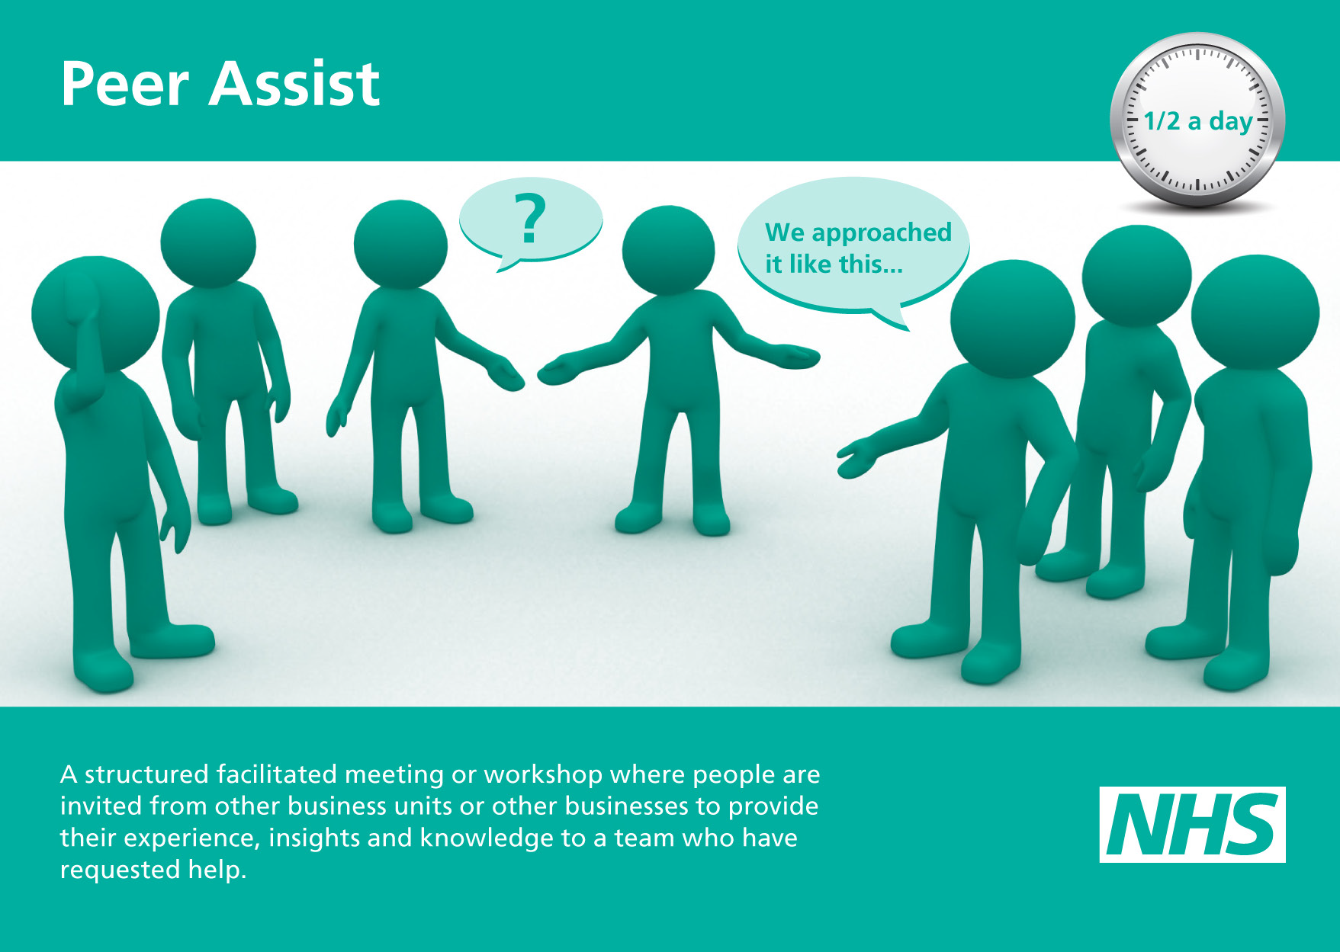
Peer assist
Notes:
Learning Before – Facilitated Learning (green postcards) – available on K4H blog under KM resources
5

Slide 6
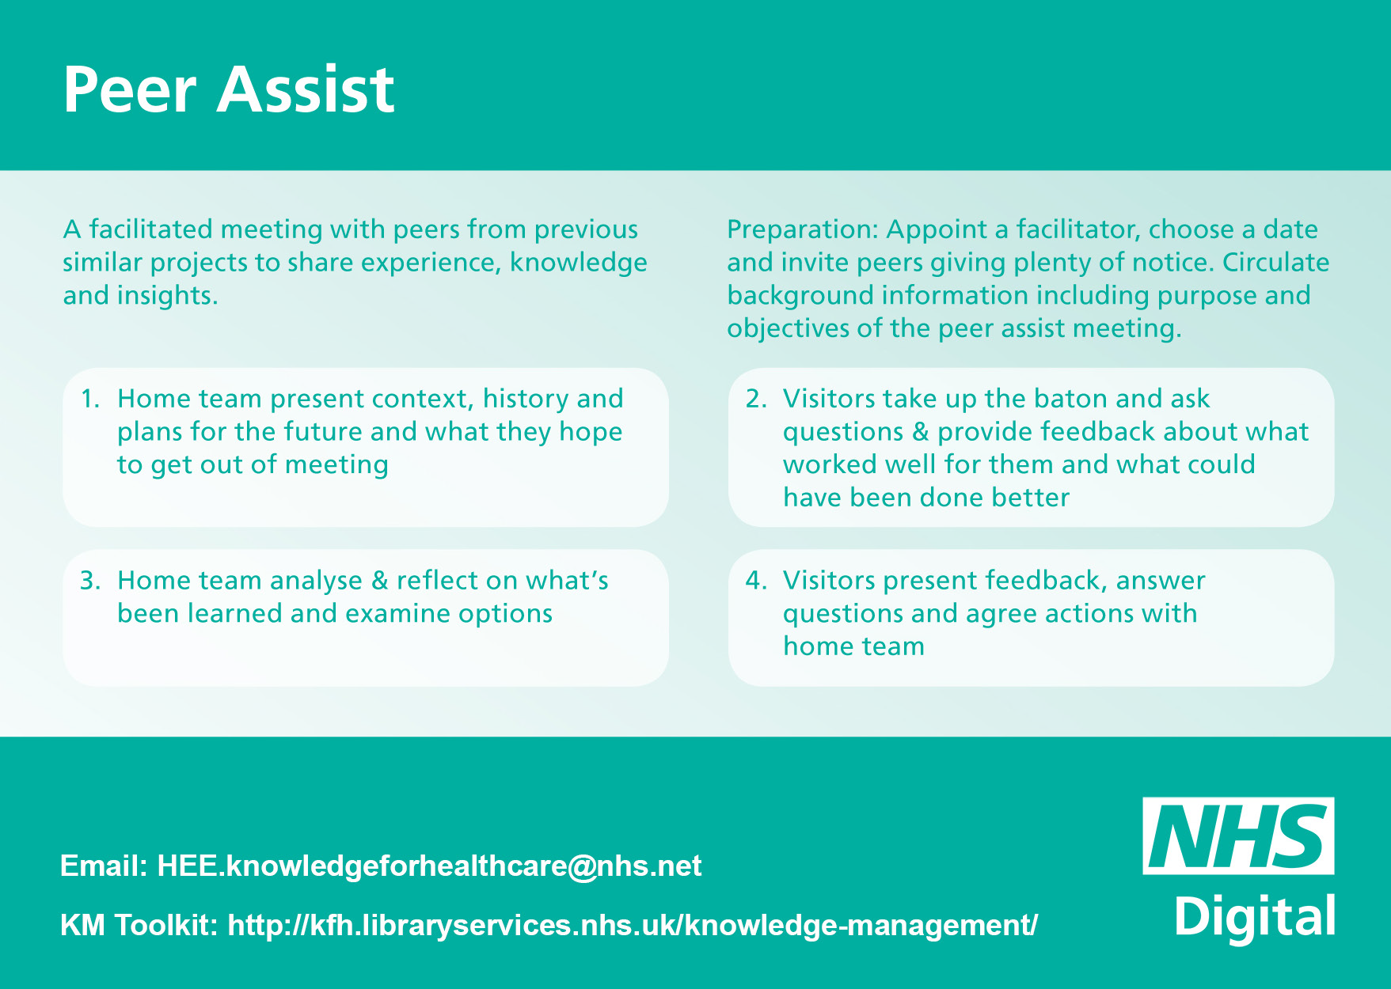
Peer assist 2
Notes:
6

Slide 7
Even NASA use Peer Assist!
Click the spaceship for more information
Notes:
7

Slide 8


What about an example from a Library?
To watch the film click here
Notes:
8

Slide 9
Interactive exercise
How do I engage an established Library team with a new concept or activity?
Answers on the whiteboard!
Notes:
9

Slide 10
Any other questions from the chatroom?

Slide 11
For more detailed information
Check out the Peer Assist pages on the Knowledge for Healthcare blog
Knowledge for Healthcare – Peer Assist

Slide 12
Thanks for listening!
The next webex is at 10am on Friday 29th Sep
People to Corporate Knowledge:
Knowledge Harvesting

