Slide 1


Connecting people to corporate knowledge: knowledge harvesting
@NHS_HealthEdEng #HEELKS
Notes:
Welcome
2nd in a series of webinars.
Today explore Knowledge Harvesting.
Consider what it is. Why and when it can be used, consider how you would undertake a Knowledge Harvest Interview and consider some alternative tools that can be used. We will have two discussion segments looking at how we as LKS prof can facilitate Knowledge Harvesting in our organisations.
1

Slide 2
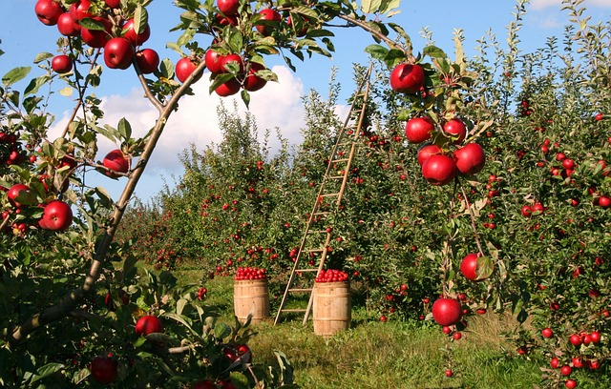
So…what is Knowledge Harvesting?
Notes:
A structured approach to help an organisation understand and record the knowledge and experience of people, often before they leave or move roles. A facilitator interviews the leaver then organises and packages the resulting knowledge into a knowledge asset to be published for the use of others taking over the role.
2

Slide 3


Knowledge harvest
To avoid the risk of losing knowledge from a team, project or organisation. To encourage shared learning and reduce “learning time” when a new colleague starts.
Why?
When?
During times of change, when people leave or move to new roles, when a project ends.
Structured facilitated interview, identifying priority areas, collating and repackaging resulting knowledge into knowledge assets
How?
Notes:
Why? To capture the tacit knowledge (that is the un-recorded internalised knowledge of an individual) that might otherwise be lost to the organisation when the person moves on.
3

Slide 4

Key steps to knowledge harvesting
Identify a risk of losing knowledge due to someone leaving their role
Assess how relevant the knowledge of the leaver is to the future of the team or organisation
Plan and conduct an interview or offer an alternative tool
Transcribe, edit and hand to interviewee for first edit
Final packaging – create a knowledge asset to be shared
Notes:
Prioritisation of ideas
4

Slide 5
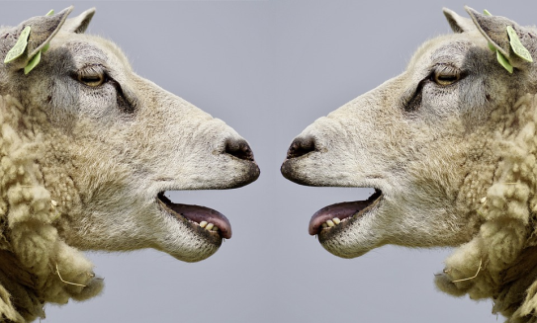
Discussion Activity
What skills do you feel you would need to conduct some knowledge harvesting activity in your organisation?
Notes:
5 minute group activity to share ideas / discuss what skills you may need to conduct knowledge harvesting. Chat responses
Facilitation
Information about leavers or projects – links with HR, PMO
Interview techniques
Transcribing skills
Identifying themes – group ideas
5

Slide 6
What skills do you feel you would need to conduct some knowledge harvesting activity in your organization?
Good note taking
Facilitation skills
How to capture and store
Interviewing - questioning
My first thought is for a listening skill - not always easy to sit and listen to people without wanting to interrupt!
being able to pull out the essentials
Guidance or toolkit for types of questions to ask
Summarising
knowing who else needs this information
interview skills eg. open ended questions
transcribing is also a key skill - to do accurately. (and it takes a lot of time
understanding the job role you are capturing
sensitivity - as to the context in which the interview is happening. Not everyone is happy to be leaving or wants to share
Notes:
Chat responses from webinar 29/9/17
6

Slide 7

Tips for undertaking a Knowledge Harvesting Interview
Be clear on timescales – start early and allow at least 4 hours for the interview process
Tips
Use a prioritisation matrix to help you and the leaver to decide what is critical information that must be harvested
Be clear on expectations for the leaver around time and outcomes
For interviews use the 5 Ws – What, Where, Why, When, Who
Group responses in themes or “branches”
Use future tense questions to help consider how the knowledge will be used by someone else
Notes:
What would be your advice for someone doing this in the future?
If you were doing this again, what would you do next time?
If you could go back in time and give yourself a message what would you tell yourself?
7

Slide 8
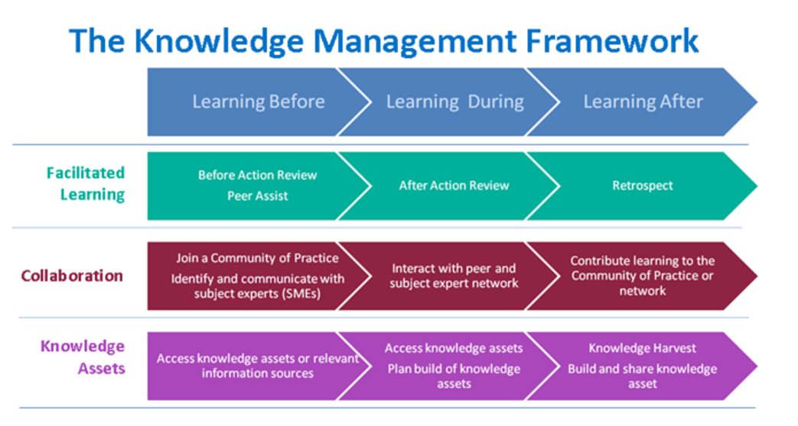
The knowledge management framework
http://www.ksslibraries.nhs.uk/elearning/km/#
Notes:
NHS Knowledge Management Framework regards Knowledge Harvesting as a Learning After activity to capture business critical and hard to replace knowledge. However, it can take place at any stage when crucial tacit knowledge needs to be captured and shared.
8

Slide 9
Sharing learning
Connecting People to Corporate Knowledge
Key activities: Developing an organisational memory | Promoting actionable knowledge tools | Collating and enabling shared access to directories, policies, guidance and protocols
Sharing Learning
Key activities: Making implicit knowledge explicit | Knowledge sharing – to spread the learning | Supporting innovation | Promoting actionable knowledge tools
Notes:
Knowledge for Healthcare KM Toolkit suggests that Knowledge Harvesting can be seen as an activity relating to Connecting People to Corporate Knowledge and Sharing Learning
9

Slide 10
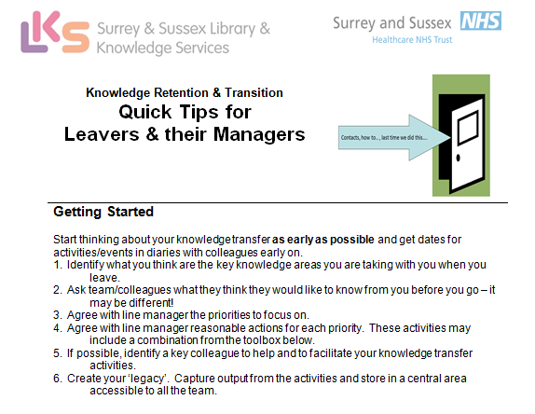


Other tools for knowledge retention and transfer aka Knowledge Harvesting
This is a comprehensive toolkit and I would advocate that it is very useful. I particularly like the calendar of my events & contact lists.
I think the earlier you start this with your team the better – its quite a workload if the notice period is short but really good for senior managers in positions of authority.
Matron Elderly Care Services (retired)
Notes:
The Leavers’ Toolkit
Rachel Cooke at Surrey & Sussex Healthcare NHS Trust has developed a Leavers toolkit which aims to “reduce the time and expense lost through the lack of continuity in critical, team, departmental and corporate knowledge,i.e. prevent the loss of knowledge that occurs when someone moves to a new role or leaves the organisation altogether”
Read Rachel’s case study about using this on the KM toolkit
10

Slide 11
15 Tools for Retention and Transfer
Create a table of the key priorities relating to your job
Handover folder
Collate emails and save as documents
Annotated key contacts list
Calendar of my job
Prune and organise electronic documents and files
‘Work in hand’ position statement
Useful resources to get things done
‘Audience with’ Q&A session with team
Knowledge Exchange – top 10 things
‘Masterclass’ in-depth training
Coaching/Baton passing
Notes:
Ideas and templates to gather knowledge. Can adapt this for local use and share whole document so individuals can choose the method that will work best for them.
11

Slide 12
Discussion Activity
Ways to facilitate Knowledge Harvesting in the health service by librarians and knowledge specialists?
Notes:
Whiteboard/discussion/chat: (If time otherwise take home activity)
Contact people you know are leaving/moving and offer them the tools in the leaver’s toolkit
Work with your HR department to incorporate the leavers toolkit for those leaving the organisation – add to leavers policy
Offer to facilitate an audience with session
Use with “friendly” teams, library users to practise the technique
Use in library service to capture tacit knowledge from projects
12

Slide 13
Ways to facilitate Knowledge Harvesting in the health service by librarians and knowledge specialists? RESPONSES
contact people we know are leaving and offer them the leavers toolkit
Linking in with HR and offering the toolkit
we already have many contacts through our roles, should use those to identify those that might be leaving
Providing storage for knowledge assets making them easily accessible
I have helped "de-brief" :) a member of another library team. has anyone done work with other non library teams?
Tweet a toolkit
e.g. A list of literature searches in the last month/3 months possibly
Notes:
Responses from chat on webinar 29/9/17
13

Slide 14

Re-cap
Understood what is meant by knowledge harvesting
Considered the steps involved in conducting a knowledge harvest interview
Explored the Leaver’s Toolkit and tools for knowledge retention and transfer
Discussed the skills we may need to facilitate knowledge harvesting
Discussed how we can facilitate knowledge harvesting in our organisations
Notes:
In this webinar we have considered
14

Slide 15

Homework:
Using the prioritisation table
in the leaver’s toolkit create your own knowledge prioritisation plan of the knowledge you have that you would want to pass on to your team or organisation should you leave
Happy Harvesting
Notes:
Use this tool to help with resilience and succession planning in your own team. Start to build your own knowledge prioritisation plan and update on a six monthly basis.
Use the prompt questions to help you.
15

Slide 16
For further information about Knowledge Harvesting:
Knowledge for Healthcare, Knowledge Management Toolkit
http://kfh.libraryservices.nhs.uk/knowledge-management/km-goals-tools-and-techniques/knowledge-harvesting/
NHS Knowledge Management Framework “Postcard”
http://kfh.libraryservices.nhs.uk/wp-content/uploads/2016/07/Knowledge_Harvesting.pdf
NHS Knowledge Management Framework e-learning: Knowledge Harvesting
http://www.ksslibraries.nhs.uk/elearning/km/k_harvesting/knowledge_harvesting/
Notes:
16

Slide 17
Questions?
Notes:
17

Slide 18
Thanks for listening!
Please join us for the next webex at
10am on Wednesday 4th October
People to People: Communities of Practice (CoP)
Notes:
18

