Slide 1


Connecting People to Best Practice : Communities of Practice
@NHS_HealthEdEng #HEELKS
Notes:
1

Slide 2
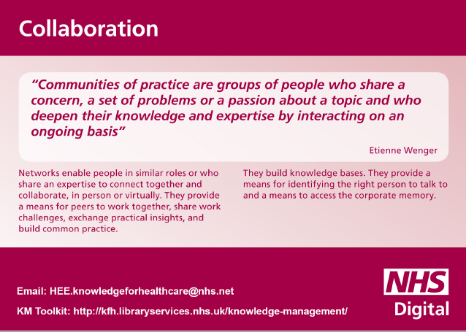
Collaboration
Notes:
Postcard – definition Etienne Wenger
2

Slide 3
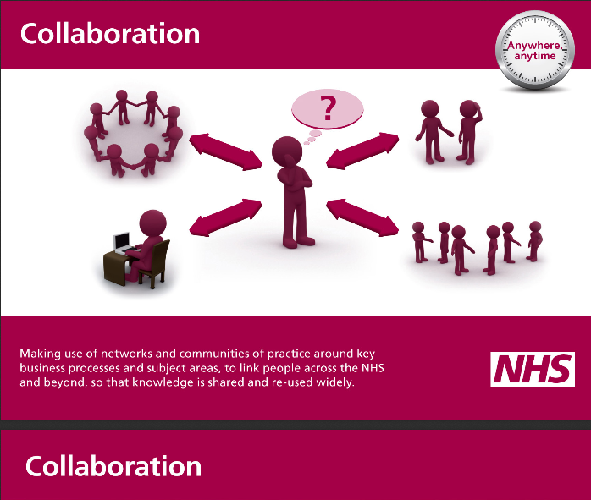
More collaboration
Notes:
CoP have no formal framework or way to organise them (eg Peer Assist)
3

Slide 4
What makes a Community of Practice?
Domain – shared focus of the community
Community – may be across multi-disciplinary backgrounds.
Practice – high levels of trust within CoPs which enable the sharing of tacit knowledge (personal experience, “how” rather than “what”
Notes:
From National Voices document
Domain
The domain is the shared focus of the community. This is a defined area in which
the community has the potential to develop its expertise, to push the boundaries of
current understanding around ‘good practice’, and – crucially - to which they share
a level of continuing commitment.
Community
Community of practice members may come from multi-disciplinary backgrounds.
For instance, Wellbeing Our Way’s communities of practice included people
working within charities and community organisations, those with experience of
using health and care services, alongside a smaller number of NHS and social care
colleagues. What matters is that through regular interaction, the community is able
to develop strong working relationships based on trust, reciprocal learning, and
shared accountability.
Practice
The high level of trust developed within communities of practice enables the
sharing of tacit knowledge
6
(knowledge gained from personal experience; often
described as knowing ‘how’ rather than ‘what’) around the defined domain of
interest.
4

Slide 5

Communities of Practice in health and social care
Click on here for more information
Notes:
5

Slide 6
Interactive exercise
Where can you see opportunities for Communities of Practice to be facilitated in your organisation?
Notes:
6

Slide 7
Interactive exercise - answers
In a multi-disciplinary way
Cross org team for education and engagement
QIs
Trust projects – falls prevention and PJ paralysis
Leadership
Managing guidelines, policies and procedures
New professions – assoc practitioners/perceptees
IT team for use of technology
Newly qualified
New consultants
Apprentices
Nurse revalidation
HR team – better communication
Community of TEL
R&D
Clinical skills – Trust staff working with local community
Notes:
7

Slide 8
How LKS can support CoPs
Facilitation
Safe space
Cut across boundaries
Ideal position to aid creative problem solving/act as a vehicle for change
Aid the continuation of interaction between multi disciplinary groups
@NHS_HealthEdEng #HEELKS
Notes:
Ideas from the elearning module from KSS on CoPs on the K4H blog - link from the CoP page
8

Slide 9
Interactive discussion
What methods of communication could you use for a Community of Practice?
Notes:
Traditional and non trad – emails, meetings but also yammer, slack, wiki, blog, padlet …..
9

Slide 10
Interactive discussion - answers
Twitter
Face to face at least twice a year
Webinars
Padlet – but not for sensitive comms
Linkedin group
Researchgate/Mendeley type communities ask group
Social media – FB, Twitter, instagram, Whatsapp etc
Email – with meaningful subject line/lists
Yammer masterclasses
Invited speakers/experts
Video conferencing/webex/Skype
Conversations in corridors
NHS Networks
Sharepoint team sites
Wikis
Telephone conferences
Notes:
Traditional and non trad – emails, meetings but also yammer, slack, wiki, blog, padlet …..
10

Slide 11

Case study – K4H blog
Notes:
Pennine Care NHS FT
Healthcare Professions Network – met on semi regular basis but wanted to keep momentum going between meetings …LKS set up chat rooms for different groups and one multi disciplinary one.
Kept up momentum between meetings/across a wide geographical area
Sharepoint – Wiki – blog – Padlet – other technologies – more traditional methods
11

Slide 12
Any other questions from the chatroom?
Notes:
12

Slide 13
NEW national KM COP
If you want to join this new group and contribute your ideas to help shape the national KM COP please contact your regional lead
Notes:
New national KM CoP -
13

Slide 14
Thanks for listening!
The next webex is at 10am on Monday 9th Oct
Sharing Learning:
Retrospect
Notes:
14

