Slide 1


Sharing Learning: Retrospect
@NHS_HealthEdEng #HEELKS
Notes:
Welcome
4th in a series of webinars.
Today explore retrospect.
Consider what it is. Why and when it can be used, consider the steps involved and how this differs from an After Action Review. We will have one discussion and one activity to explore Retrospect in more detail.
1

Slide 2

So…what is a Retrospect?
A process to capture team-based learning from an important project or initiative upon its completion.
Notes:
Looking back near the end of a major project and reflecting upon the learning arising from the project before the project team disbands
2

Slide 3
Why do a Retrospect?
To identify learning from a long term project.
To consider what contributed to success or failure.
To share and inform future projects and initiatives.
To help the project team have greater insight into their future work.
Notes:
Retrospect identifies the key factors and actions that contributed to success or failure and helps to ascertain in detail and across all relevant project activities what could be done to improve results in future. This learning is then developed into a resource that can be shared with others to inform new projects and initiatives.
3

Slide 4
What does a Retrospect involved?
A structured facilitated session with four distinct elements.
A Facilitator – not previously involved in the project
A Rapporteur to capture notes and key outputs from the Retrospect
Notes:
This is where LKS teams can offer assistance.
A facilitator helps the team to reflect on their work and analyse why things did or didn’t go well and formulate recommendations for the future based upon these. They help the team to remember, discuss, analyse and agree.
4

Slide 5
Who is invited to take part in a Retrospect?
It is also useful to invite people likely to benefit from the outputs
All the people and key stakeholders who were involved in the project.
If you have more than 12 members in a project team you may need to break into smaller sub-retrospects
Notes:
12 is suggested as an optimal number of people to involve in a retrospect – more than this and it may be necessary to break into smaller sub-retrospects for some of the elements and these will also require a facilitator and rapporteur.
In addition to the 12 it is advisable to invite a couple of observers this can help to sharpen the focus on the learning outputs. However, if presence of observers is likely to inhibit free sharing of experiences and insights – especially for projects that ran into difficulties or dealt with sensitive areas you can decide not to invite observers.
5

Slide 6
Step One: Scope
What was the objective of the project?
What did we set out to achieve?
What did or didn’t we achieve? Why?
Set the scope for the remainder of the review
Overview Focus
Planned Objectives achieved
Agree | Why? | Recommendations
Unplanned achievements
Agree | Why? | Recommendations
Disappointments
Agree | Why? | Recommendations
Participants: re-gel as a team, remember, analyse
Notes:
The first step takes about 15 to 20 minutes.
The purpose is to identify where the key learning is – so this sets the scope for the rest of the workshop.
Ask the participants first to state what they set out to achieve during the stage or six month period.
Get agreement on objectives.
Explore each objective discuss and agree the extent to which each objective was achieved, under achieved or over achieved.
Add a short note in a contrasting colour to indicate for each objective any areas that were under or over achieved. Just place a tick against any objective that turned out exactly as expected.
6

Slide 7
Step Two: Detail part 1
What were the successes?
Why?
How can we or others repeat the success in the future?
Identifies good practice.
Each participant writes sticky notes with work area, key success and recommendations to replicate
Cluster the work areas
Read | Analyse| Agree Recommendations | Cluster
Participants: agree and celebrate successes, recognise causes, agree actions to replicate
Notes:
Detail area. Facilitator aims to encourage the team to identify all the key things that went well during the project and then for each, to analyse and agree on the reasons for the success and on any recommendations that could help a team to repeat these successes.
Once most people have finished writing, it is time to look at each success in turn as a whole team. Anayse and agree success and make recommendations – cluster
To help with the analysis you may use the 5 Whys technique creating a fishbone diagram of causes or undertake a more detailed root cause analysis
.
7

Slide 8
Step Three: Detail part 2
What were the disappointments?
Why?
How can we or others avoid them in the future?
Indicates scope for improvement
Ask each participant for sticky notes with work area, key disappointment and recommendations to avoid
Cluster the work areas
Read | Analyse| Agree Recommendations | Cluster
Notes:
Detail looking at disappointments. Agree what could have been done better, recognize causes and agree actions to avoid.
Remind participants to confine themselves to the scope as set out in the first stage; ask them to write what happened on post-it notes, one thing that happened per note.
8

Slide 9
Step Four: Wrap-Up
Marks out of 10 for the project as a whole?
What would have made it a 10?
Indicates highest priority learning
Is there anything else that still puzzles us?
Write on sticky notes marks out of 10 and why.
Reveal in turns
What would have made it a 10
Discuss and agree
Actions for anything new
Participants: agree key learning and recommendations.
Notes:
Useful way to highlight key learning to take away and do something with quickly.
Types of priority question “looking back, how satisfied are you with the activity outcome - marks out of ten?” People who have said the outcome was fine will often still score it an eight, which enables you to then ask “what would have made it a ten for you?”
Then ask each person in turn, what is the key learning that has contributed to this score (positive) and what is the key lesson that would have made it a ten (disappointment). Note what each person says then report back that this list can be considered to be their highest priority learning.
Sometimes at this stage may also ask Is there anything that still puzzles us? Identifying the unanswered questions.
9

Slide 10

Discussion Activity
For a retrospect to work effectively what do you think needs to be established?
Notes:
5 minute group activity to share ideas / discuss.
Whiteboard and Chat responses
Establishing trust
Openness
No blame
10

Slide 11
For a retrospect to work effectively what do you think needs to be established?
Trust. No Blame. Openness. Sharing.
Time to undertake - allow between 2 – 4 hours to all day depending upon complexity of the project
Be clear it is not a performance review or audit - Emphasise the focus on learning
Ground rules – everyone to have a voice, no hierarchy
Facilitator to spend time with project lead to understand aims of project
Stay focused on the process and results not on roles of specific individuals
Notes:
11

Slide 12

Tips for Success
Ensure all participants understand that the Retrospect is a time for learning
Don’t delve too much into micro-level lessons – this needs to be a broader and long-term focus
Identify improvement ideas which are specific and actionable
Keep conversation focused on process and results
Give everyone an opportunity to talk.
Use a range of facilitation skills
Notes:
Fundamental tip for success - before Retrospect is held all participants understand that it is a time for learning. Be clear that is assumed that “everyone did as well as they could in the situation they faced”.
Do not use Retrospect for performance evaluation – will lead to failure
If project succeeded, project team leader wants to learn and share and if project team communicates well it is easier to succeed in retrospect. If only some of these in place it may be more challenging and a wider range of facilitation skills may then be required
12

Slide 13
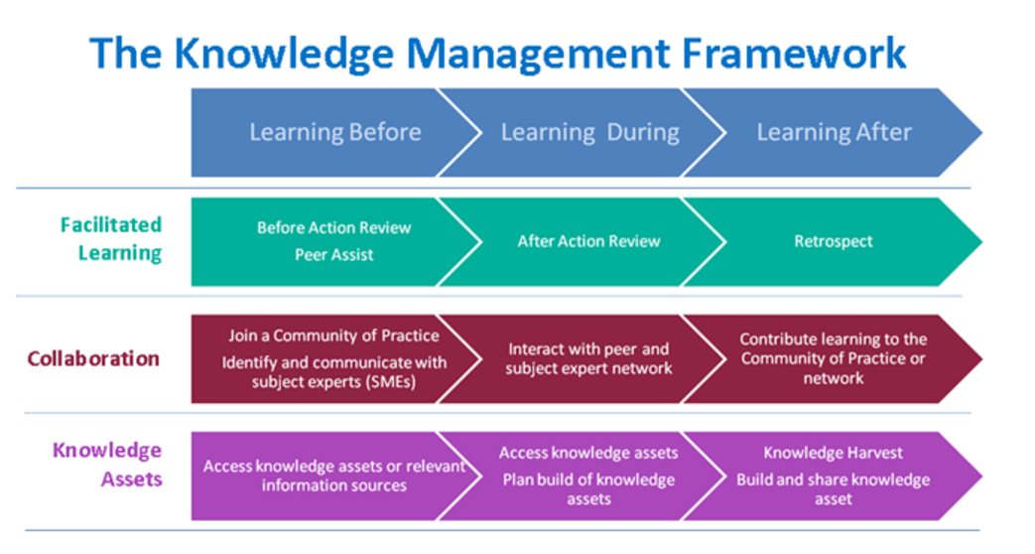
The knowledge management framework
http://www.ksslibraries.nhs.uk/elearning/km/#
Notes:
NHS Knowledge Management Framework regards Retrospect as a Learning After activity
13

Slide 14
Sharing learning
Connecting people to knowledge/ the evidence base
Key activities: Using knowledge to inform healthcare policy | Knowledge sharing – to spread the learning | Supporting innovation | Meeting the information needs of staff | Meeting the information needs of patients | Promoting actionable knowledge tools | Signposting to services and knowledge
Sharing Learning
Key activities: Making implicit knowledge explicit | Knowledge sharing – to spread the learning | Supporting innovation | Promoting actionable knowledge tools
Notes:
Knowledge for Healthcare KM Toolkit suggests that Retrospect can be seen as an activity relating to Sharing Learning and Connecting People to Knowledge
14

Slide 15
How is this different from an
After Action Review ?
After Action Reviews (AARs) take place during a project rather than at end
AARs focus more on specific activities and gather short-term learning to develop quick corrections to practice
AARs tend to less formal and have a brief action plan which is shared with members of the project team only
Both benefit from facilitation and help to share learning
Notes:
The Retrospect and After Action Review are complimentary.
The After Action Review takes place during a project rather than at the final end and focuses on specific activities to gather short-term learning and develop quick corrections to practice.
After Action reviews tend to be less formal and have a brief action plan which is shared with members of the project team only.
See the After Action Review Postcard for further information about how to conduct an After Action Review
15

Slide 16
Re-cap
Understood what is meant by Retrospect and why it may be useful
Outlined the four steps involved in conducting a Retrospect
Thought about what is required for a retrospect to be successful
Considered some tips to help facilitate a Retrospct
Explained how a Retrospect is different to an After Action Review
Notes:
In this webinar we have considered
16

Slide 17
Activity
Using the 1 – 10 Project Rating Tool to conclude a Retrospect.
Notes:
Whiteboard/discussion
A good way to conclude a Retrospect to give participants a final opportunity to raise any lingering issues to is to use the 1-10 Project Rating Tool.
Step 1: Thinking about this webinar rate how well you have felt the learning objectives have been met on a scale of 1 – 10 (1 low and 10 high). Alongside this number consider what else you would have liked included to make this a score of 10. Write your response on the whiteboard or in the chat window alongside your initials.
17

Slide 18
Priority rating for this webinar – score and what would have made it a 10
7 list L.O. At beginning of session
9 more on involvement of a librarian
9 more on root cause analysis
9 a video on showing facilitation of a Retrospect
9 practical example of how a librarian can get involved
9 a worked example so can see how it would work in practice
9 example of where a library has facilitated a retrospect
9 example or template to create a knowledge asset
7 examples of findings
Notes:
Whiteboard/discussion
A good way to conclude a Retrospect to give participants a final opportunity to raise any lingering issues to is to use the 1-10 Project Rating Tool.
Step 1: Thinking about this webinar rate how well you have felt the learning objectives have been met on a scale of 1 – 10 (1 low and 10 high). Alongside this number consider what else you would have liked included to make this a score of 10. Write your response on the whiteboard or in the chat window alongside your initials.
18

Slide 19
Homework:
For a recent piece of work you have been involved in:
Identify one success
Identify one disappointment
Express each as a Recommendation that is Specific and Measurable
Identify one person who can benefit from this knowledge
Notes:
19

Slide 20
For further information
Knowledge for Healthcare, Knowledge Management Toolkit
http://kfh.libraryservices.nhs.uk/knowledge-management/km-goals-tools-and-techniques/retrospective-baton-passing/
NHS Knowledge Management “Postcard” Retrospect
http://kfh.libraryservices.nhs.uk/wp-content/uploads/2016/07/Retrospect.pdf
NHS Knowledge Management Framework e-learning: Retrospect
http://www.ksslibraries.nhs.uk/elearning/km/retrospects/km_retrospects/index.htm
Unicef KE Toolbox Retrospect
https://www.unicef.org/knowledge-exchange/files/Retrospect_production.pdf
Video clip: Experience of a Retrospect http://www.ksslibraries.nhs.uk/elearning/km/retrospects/km_retrospects/lao/m2_lao.swf
Video clip: Observing a Retrospect http://www.ksslibraries.nhs.uk/elearning/km/retrospects/km_retrospects/tomlinson/m3_tomlinson.swf
Notes:
20

Slide 21
Questions?
Notes:
21

Slide 22
Thanks for listening!
Please join us for the next WebEx at
10am on Tuesday 17th October
Helping People to keep up to date: Alerting services
Notes:
22

