Slide 1


Connecting people to people: Self- Assessment Tool
@NHS_HealthEdEng #HEELKS
Notes:
Welcome
5th in a series of webinars.
Today explore self-assessment tools as a method of connecting people to people. There will be an opportunity for discussion and to take part in an activity to explore a particular self-assessment tool in more detail.
1

Slide 2
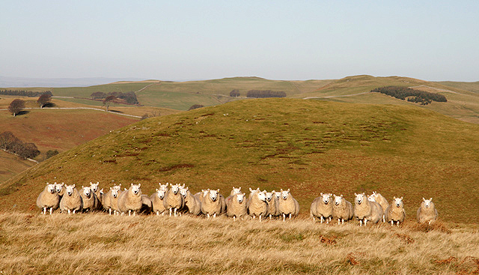
Describe how self-assessment tools can be used to share learning and encourage knowledge exchange
Focus in particular upon the self-assessment tool designed to be used by librarians and knowledge specialists with executive teams of health organisations to assess how well an organisation is using evidence and organisational knowledge.
Consider how self-assessment can be used within an organisation and how this can help the library and knowledge service to devise and deliver an action plan to use knowledge effectively to meet organisational objectives
Notes:
The line-up for today
2

Slide 3
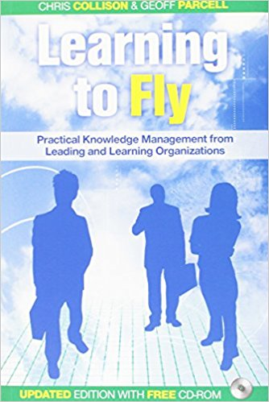
So…what is a KM self-assessment tool?
Finding a common language to identify how well teams are performing in key operational areas and identifying areas for improvement
Not about a performance score but is about encouraging conversations and identifying opportunities tor teams to share knowledge and learn from each other
Notes:
According to Chris Collinson and Geoff Parcell in their book Learning to Fly it is a way to find a common language in order to share.
They devised a set of common operational practices for BP, 25 in all, and five levels of competency so teams and individuals could assess how they were doing and identify areas for improvement.
By assessing their own situation individuals/teams are more likely to determine and implement their own solutions - it is more than just an audit or benchmarking exercise – it is not about getting a performance score but is about encouraging conversations to identify opportunities to share learning and knowledge.
3

Slide 4
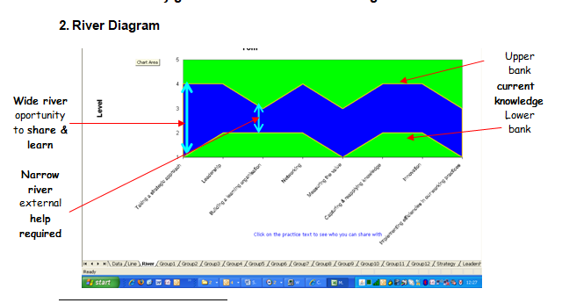
Rivers
http://www.ksslibraries.nhs.uk/elearning/km/useful_links.html
Notes:
Teams at BP were asked to plot their current position or competency level for each criteria and target levels. By plotting these in Excel it is possible to visualise the results. It is a quick way to see where there are gaps and where one team can learn from another.
Where the river is widest there will be opportunities for sharing.
Plotting competence and priority of team assessments on a stairs diagram shows which people can be put in touch with other people that can help them to attain their target.
The knowledge management team can then assist by setting up opportunities for knowledge exchange events.
4

Slide 5
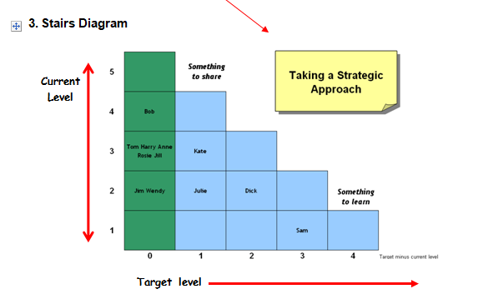
Stairs
Bob is currently working on level 4.
Jim and Wendy are on Level 2 but it is not a priority for development for their team
Dick is also on level 2 but has a target level of 2 higher than current position – he wants to get to level 4. He could talk to Bob or someone who is already on level 3
http://www.ksslibraries.nhs.uk/elearning/km/useful_links.html
Notes:
The Stairs diagram plots competence and priority for each criteria. This shows which people can be put in touch with other people that can help them to attain their target.
The knowledge management team can then assist by setting up opportunities for knowledge exchange events using a range of KM tools and techniques such as Peer Assist, Action Learning Sets, Communities of Practice, Retrospects or Knowledge Cafes.
5

Slide 6
Connecting people to people
Connecting people to people
Key activities: Knowledge sharing – to spread the learning | Supporting innovation | Promoting actionable knowledge tools | Helping colleagues share ideas, question and learn
Notes:
Knowledge for Healthcare KM Toolkit suggests that self assessment can be seen as an activity relating to Connecting People to People
6

Slide 7
The self assessment tool
 | 1. Nothing in place yet | 2. In early stages | 3. Pockets of good practice | 4. Business as usual
Use of externally generated evidence | No demonstrable use of external research evidence and best practice | Makes best use of the knowledge they already have | Relevant research evidence has been accessed and evaluated | Decisions are underpinned by robust evidence which has been evaluated
Taking a strategic view of using external evidence and organisation knowledge | There is no strategic commitment to using external evidence or organisational knowledge | There is some strategic commitment to optimising the use of evidence and organisational knowledge | The expectation to apply evidence and knowledge is explicit and embedded within strategic documents | There is a nominated strategic lead, committed resource and established effective processes
Leadership to support the use of external evidence and organisational knowledge | There is no visible leadership or support | Some leaders ensure staff are encouraged and supported | Some leaders set an example is accessing evidence, sharing, and learning from each other | There is strong leadership from the top at board level, all leaders act as role models
Approach to innovation | There is no process in place to scan and consider innovation | Teams consider innovations they are aware of | Some teams seek, assess, and adopt innovation | There is an established process to identify, review, and adopt innovations
Approach to keeping up to date | Staff are focussed on the internal agenda | Staff make best use of news and updating services with which they are familiar | Staff are proactive in requesting alerts in priority areas | Proactive targeted alerts are routinely distributed to the right people at the right time
Demonstrating the impact | People are sceptical as to the benefits of knowledge sharing and reluctant to commit time | Anecdotal stories demonstrate that sharing knowledge adds value | Some readily acknowledge ways in which access to the evidence base and sharing knowledge add value | Formal processes to gather and opportunities to showcase the impact of knowledge sharing are in place
 | 1 2 3 | 4 5 6 | 7 8 9 | 10 11 12
Notes:
Based upon the work Chris Collinson and Geoff Parcell, Rachel Cooke and others at the NHS Institute for Innovation and Improvement devised an NHS KM Maturity Model. In 2017 this was further revised to focus upon how well an organisation uses evidence and shares organisational knowledge.
Wouldn’t it be good if there was a way to review how well an organisation is using evidence and sharing organisational knowledge?
This tool provides an opportunity for library and knowledge services to facilitate a self-assessment session with executive leaders to assess what is working well and what more could be done; to set priorities for better mobilising evidence and organisational knowledge and to devise and deliver an action plan so LKS can support and help the Board to meet their objectives.
7

Slide 8
Why use the self-assessment tool?
To meet current challenges by quickly assessing opportunities to make better use of evidence and knowledge.
To assess what is working well and what more could be done.
To spot practical initiatives on which librarians can lead to help meet organisational objectives .
To set priorities for better mobilising evidence and knowledge
Notes:
Way to consider how well an organisation is drawing upon the knowledge of staff and feeding evidence into decision-making.
Wouldn’t it be great if you could have a dedicated conversation with the senior leaders of an organisation to prioritise the opportunities that the library and knowledge service can deliver to help them to meet their objectives?
8

Slide 9

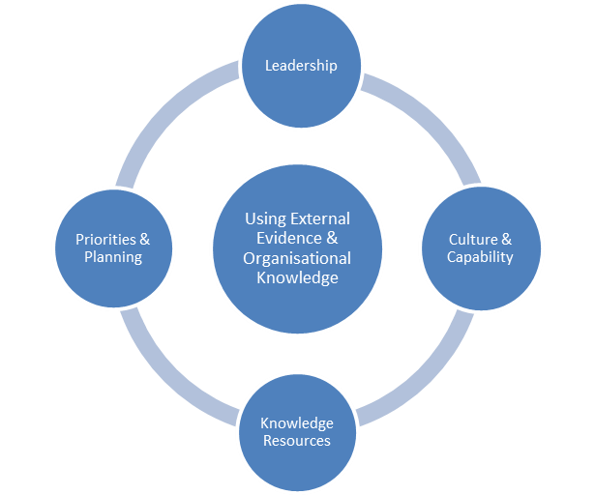
Feedback from using the tool
This has given us the opportunity to change the way we deliver care and should enable better patient outcomes.”
Nicola Shopland, Medical Division Chief Nurse, Surrey and Sussex Healthcare NHS Trust at the Medical Division Board
“Completing the Board tool has completely change the way we will work and our use of knowledge”
“The library team should be our knowledge stewards in the same way as microbiology are the antibiotic stewards for the Trust.”
Ben Mearns Chief of Medicine, Surrey and Sussex Healthcare NHS Trust at the Medical Division Board
“Really useful as an exemplar of best practice and as a way of setting up expectations and methods to support this” Director HR/OD Poole Hospital
Notes:
The self-assessment tool was piloted at Surrey and Sussex Healthcare NHS Trust (SASH) and Poole Hospital NHS FT.
We thought it would be difficult to get busy senior managers to engage with the tool (we thought it was probably a bit long) but were pleasantly surprised by their level of engagement and the positive response to running the sessions.
Senior managers could see the relevance of completing the tool and at SASH this has led to an invitation for a librarian to regularly attend Divisional Meetings to remind them of the need to use knowledge and evidence and work on organising divisional policies and guidance – including supplying evidence, organisation, archiving, acting as Guardian and alerting when requiring review.
One thing we should remember is how useful this tool is for preparations for CQC visits. With CQC focussed upon how evidence is used it is great for the Board to show that this has been actively addressed in their organisation by using this self-assessment tool.
9

Slide 10
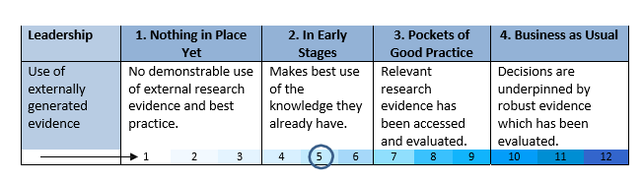
Introducing the tool
For each criteria read across the page from left to right and identify the statement that best describes the current situation within your team or organisation - within your selection, circle to indicate if you are at a low, medium or high level of maturity
Notes:
The tool consists of four sections – Leadership, Culture and capability, Knowledge Resources and Priorities and Planning. There are a total of 20 criteria.
The Librarian or knowledge specialist facilitates the self assessment working with Executives to review what is already in place, consider which initiatives will make the most impact, prioritise these and task LKS manager to draw up an action plan.
It can be used via a discussion in an executive team meeting, at a Board Seminar or in a conversation between the CEO and LKS manager. A more comprehensive review can be achieved by each Directorate or Division completing individual assessments. These can then be compared to help the organisation develop best practice through targeted support and sharing learning.
10

Slide 11

Discussion Activity
What would you need to put into place before you facilitate the self-assessment in your organisation?
Notes:
5 minute group activity to share ideas / discuss.
Whiteboard and Chat responses
Confidence
Familiarity with the tool
A trial run
Understanding the opportunities
Contacts and opportunity to use with Executive
Understand corporate objectives and link the tool with this
11

Slide 12
What would you need to put into
place before you facilitate
the self-assessment in your organisation? RESPONSES FROM WEBINAR
Confidence
Staff
Establish contact with Board
Be clear on how to describe it
Link to improvement work already going on
Decide which group you want to speak to – may not be the Board
Develop patter to introduce it
Work through it ourselves as a service
Champion to help sell the idea
Buy-in from stakeholders
Examples of action plans from others using the tool
Increase own knowledge
Contacts, Names
Notes:
5 minute group activity to share ideas / discuss.
Whiteboard and Chat responses
Confidence
Familiarity with the tool
A trial run
Understanding the opportunities
Contacts and opportunity to use with Executive
Understand corporate objectives and link the tool with this
12

Slide 13
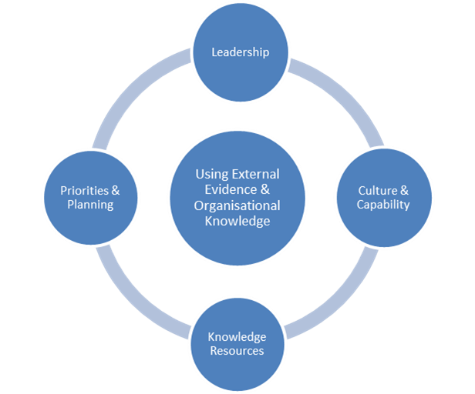
How to use the tool
Ownership of the process
Role of the Library and Knowledge Specialist as a facilitator
Preparation for participants
At the meeting
Following the meeting
Notes:
Ownership of the process
The self-assessment can be discussed by the Board or individual Executive Directors independently but ideally a member of the Library and Knowledge Service team should facilitate the discussion, answer any questions that may arise and work with participants on setting priorities for further work
Familiarise yourself with the tool and especially the list of opportunities in section four.
Consider local examples of the opportunities that you can refer to.
Identify who you will target to participate in the session.
Schedule the session and time after the session to prepare the action plan.
Preparation for participants
When the date is confirmed send the self-assessment to participants to read through in advance so they will have time to fully consider the criteria.
At the meeting
Briefly introduce the self-assessment re-iterating the purpose
Score each criterion. Reading from left to right ask each participant to circle the appropriate level of maturity.
Prioritise opportunities. Use section four to prioritise the opportunities you will adopt for each section of the tool.
Identify and agree actions that the library and knowledge service will take to address the issues raised in the self-assessment.
Following the meeting
Summarise the key outcomes from the session and thank participants for their input
Prepare an action plan to exploit the opportunities prioritised
Feed back to LKS colleagues in your region or nationally via the KfH Blog about the process
Start to deliver your actions
13

Slide 14
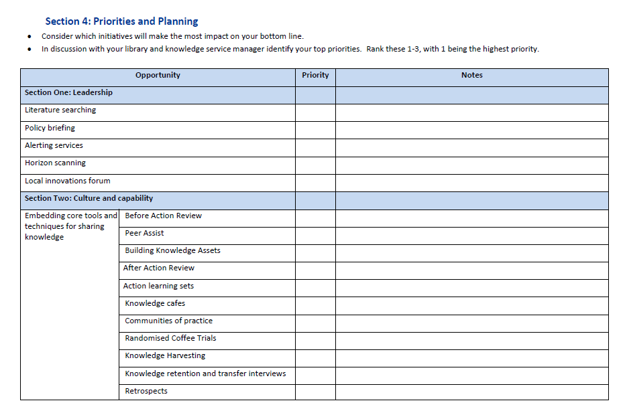
Priorities and Planning
A selection of opportunities, tools and techniques to facilitate mobilisation of evidence and knowledge
Notes:
The fourth section provides an opportunity for the librarian as facilitator to present a range of opportunities to help the team or organisation to develop. These form the basis of an action plan.
14

Slide 15
Activity: Section Four Priorities and Planning
Use a tick to indicate which of the listed “opportunities” are for you business as usual or which will extend your role. You can also indicate which you want to find out more about.
Notes:
Activity to familiairse yourself with the tools and techniques offered in section 4 of the self-assessment tool which will form the basis of an action plan – you wouldn’t select all of these – maybe just two from each section to develop for an organisation
So you should see a table on you screen. From the tool bar select the icon with a square and change it to a tick you can also change the colour of the tick if you wish by selecting a colour from the palette. Place a tick in the column that best describes how you feel about he opportunity – e.g. Lit searching is this business as usual, something beyond what you normally do or something you want to find out more about.
15

Slide 16
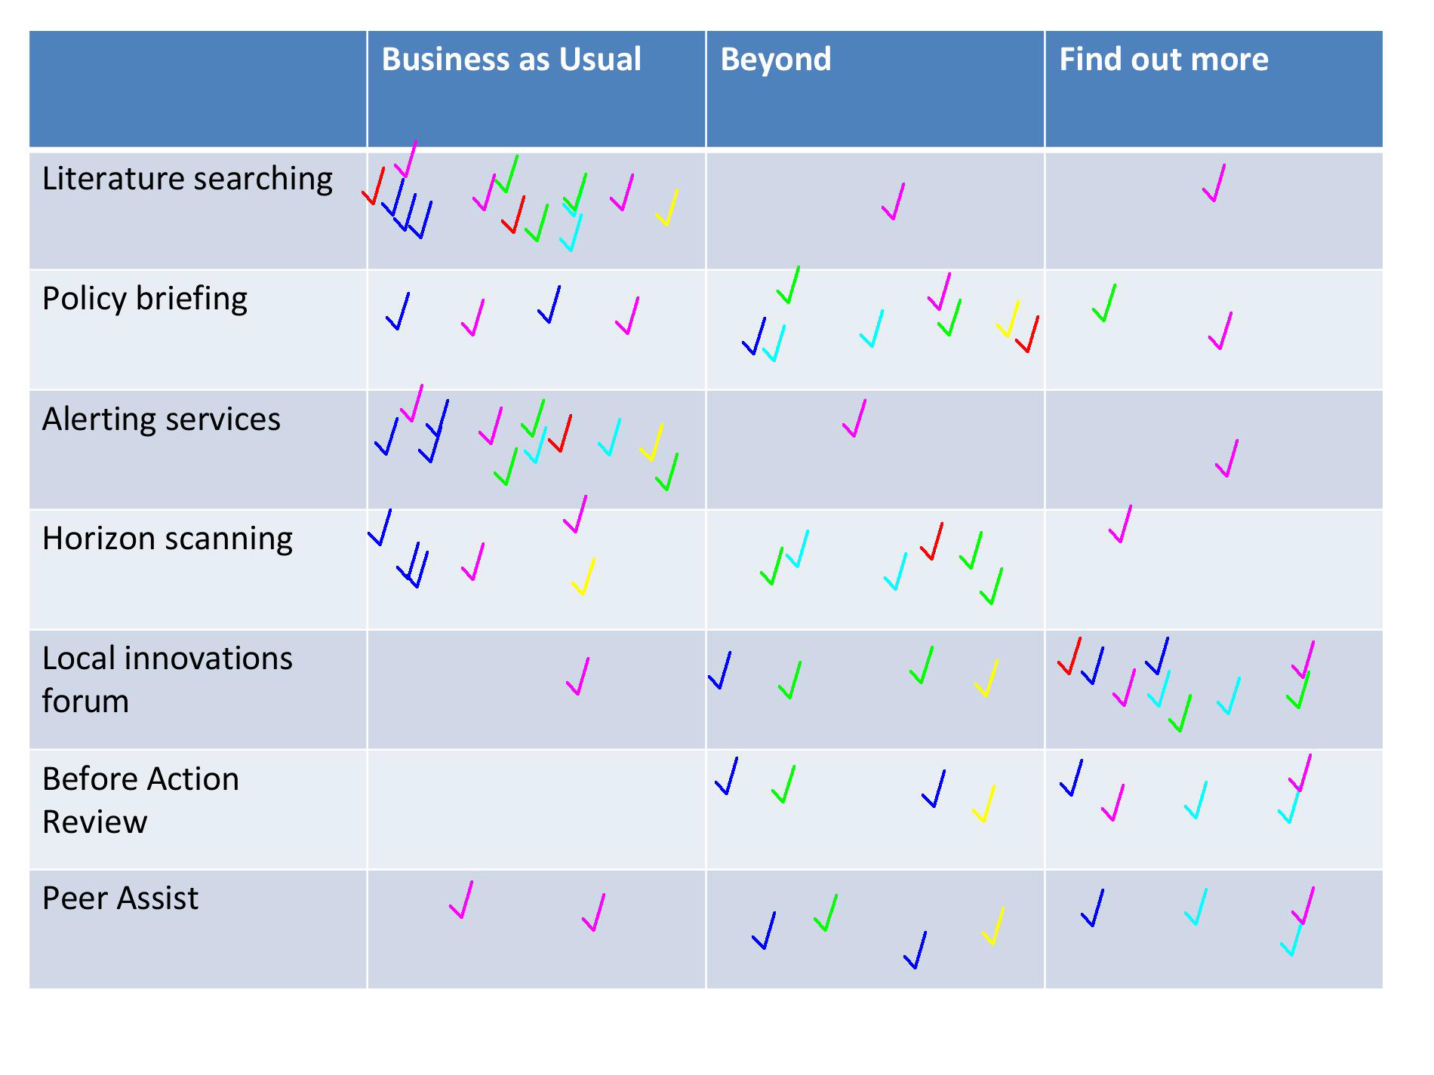
Activity results 1
Notes:
16

Slide 17
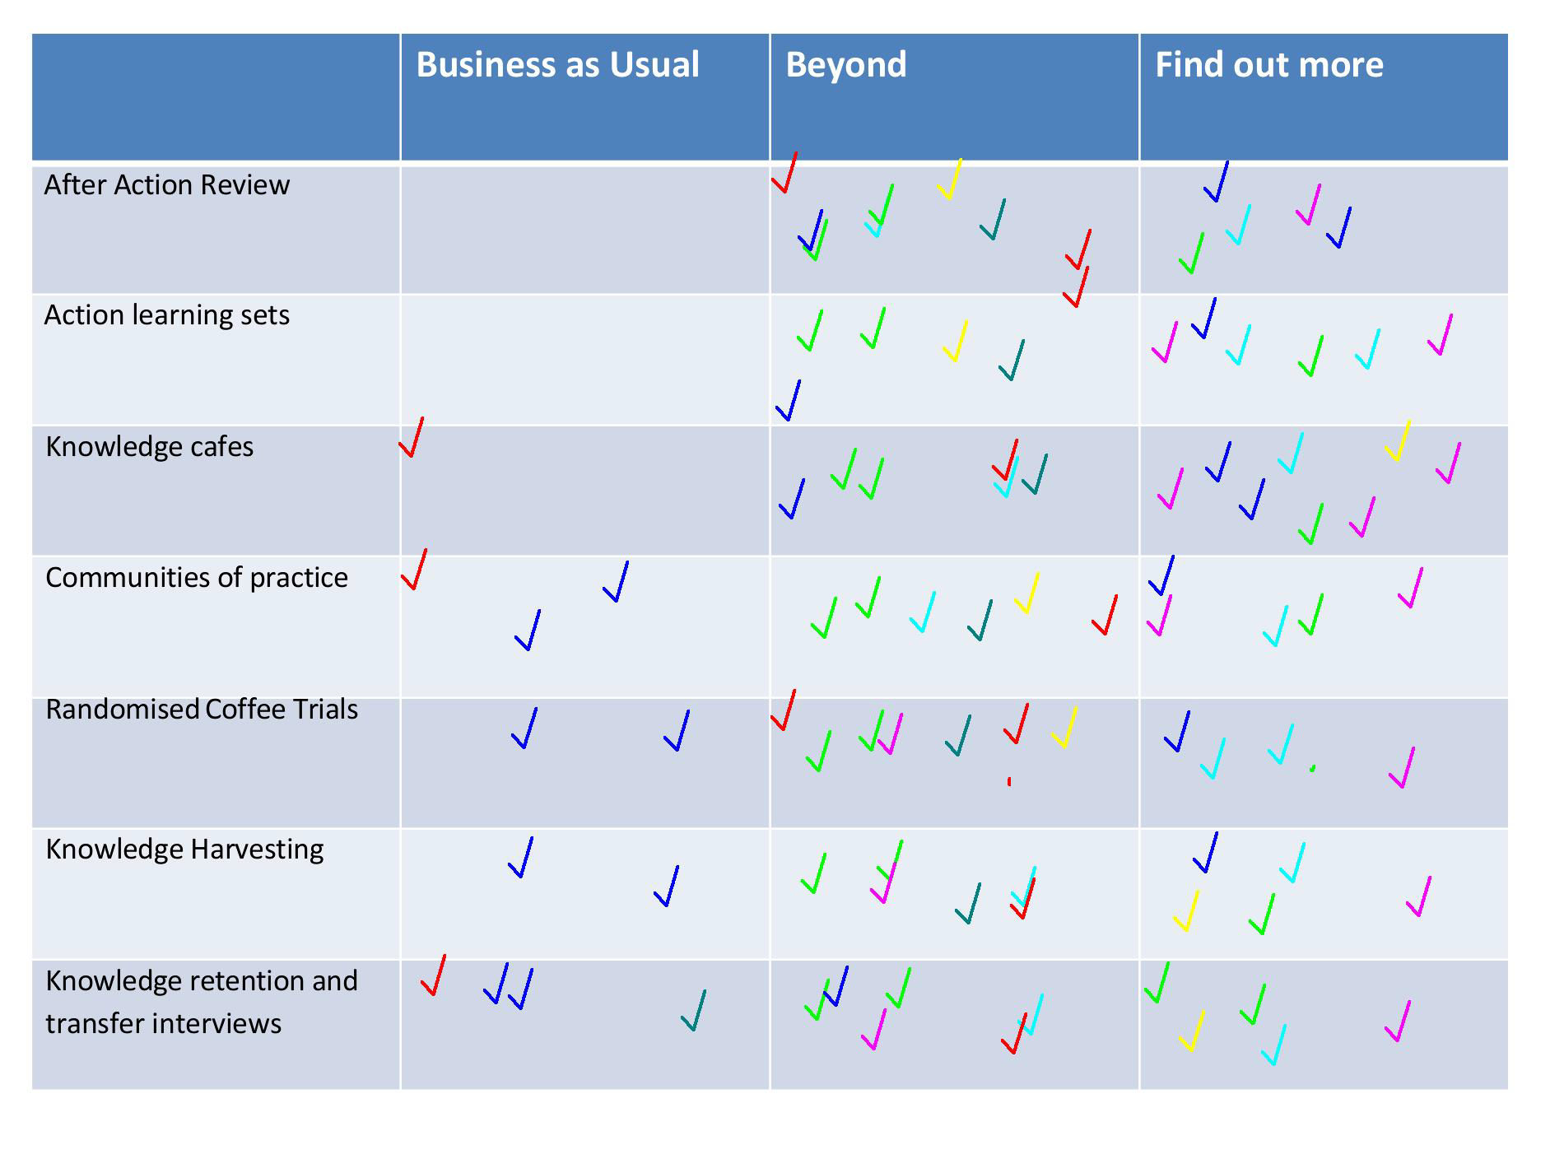
Activity results 2
Notes:
17

Slide 18
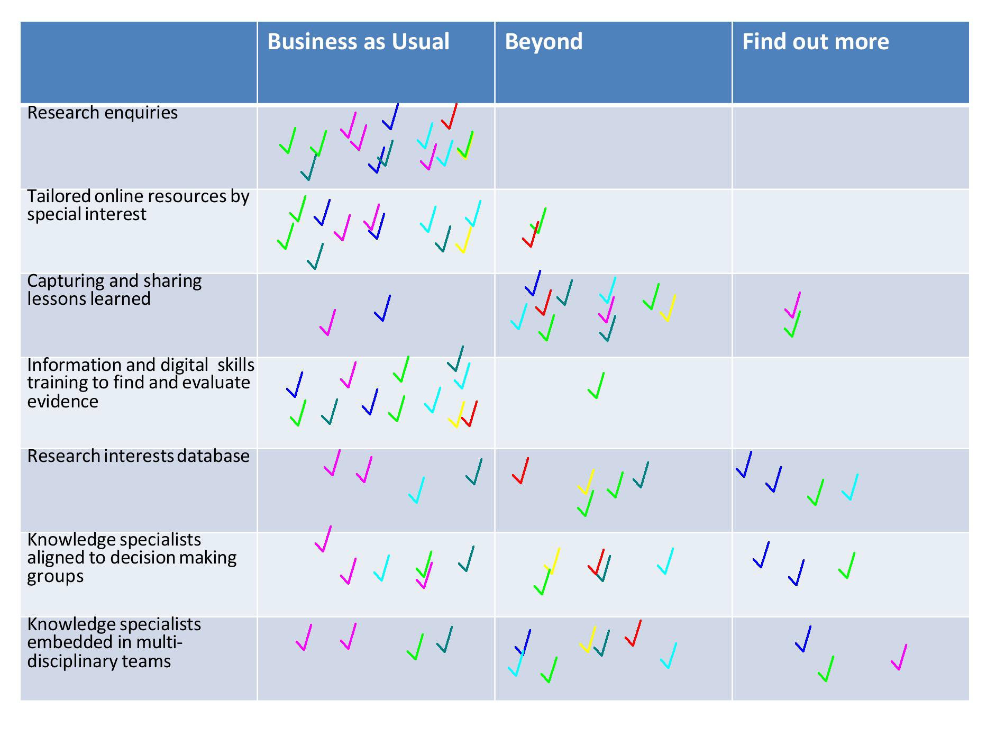
Activity results 3
Notes:
18

Slide 19
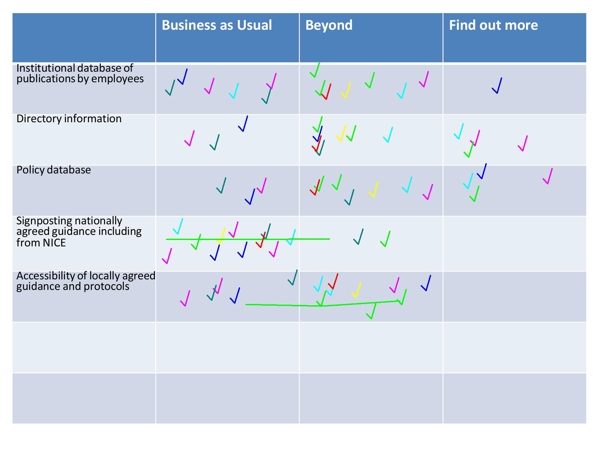
Activity results 4
Notes:
19

Slide 20
Re-cap
Considered how self assessment tools can be used to share learning and encourage knowledge exchange
Outlined why you would use a self-assessment tool
Introduced the Using evidence and organisational knowledge self assessment tool
Discussed how this tool has been developed and used successfully in an NHS Trust
Explained how t he self assessment tool works
Thought about the action plan associated with a self-assessment
Notes:
That activity was to help you think about the tools and techniques you could use to help your organisation and hopefully identified any areas where you need to find out more. If you would like to repeat the exercise but have your own copy then follow the link in the references.
20

Slide 21

Tips for Success
Familiarise yourself with the self-assessment tool prior to arranging a facilitated session
Remember you can use the tool with any senior staff group – perhaps practise on your local senior team before trying with the Executive Board
Consider using local examples to illustrate the opportunities
Remember that in the pilot the tool was received enthusiastically – this is of interest to executives
Don’t be put off if the planned session gets postponed - persevere
Notes:
Familiarise yourself with the self-assessment tool prior to arranging a facilitated session
Remember you can use the tool with any senior staff group – perhaps practise on your local senior team before trying with the Executive Board
Consider using local examples to illustrate the opportunities
Remember that in the pilot the tool was received enthusiastically – this is of interest to executives
Don’t be put off if the planned session gets postponed - persevere
21

Slide 22
Homework: Key Actions for Implementation
Have you identified the “opportunity” areas you need to find out more about?
Who will you approach first about this in your organisation?
OD Manager; My Manager; Non-Execs; my boss; Director HR; Clinical Informatics Officers; Programme Management Office
Who else will you use the self-assessment tool with?
When will you schedule facilitation of the self-assessment?
Who else will you contact for further help should you need it?
Notes:
22

Slide 23
For further information
Knowledge for Healthcare, Knowledge Management Toolkit
http://kfh.libraryservices.nhs.uk/knowledge-management/km-goals-tools-and-techniques/
NHS Knowledge Management Framework e-learning: Taking Stock
http://www.ksslibraries.nhs.uk/elearning/km/ts/
Using external evidence and organisational knowledge: A self assessment
http://kfh.libraryservices.nhs.uk/wp-content/uploads/2017/03/FINAL-Utilising-External-Evidence-and-Organisational-Knowledge-self-assessment-tool.pdf
Activity: Business as usual or beyond?
Activity Implementation Action Card
Development of the self-assessment framework
Guidance for LKS staff How to use the Utilising External Evidence and Organisational Knowledge self-assessment tool
Notes:
23

Slide 24

Questions?
Notes:
24

Slide 25
Thanks for listening!
Please join us for the next WebEx at
10am on Wednesday 8th November
Connecting People to Best Practice: An innovations and best practice database
Notes:
Samantha Unamboowe, winner of the 2017 Sally Hernando Award for Innovation, will be joining us to discuss the creation of her innovation and best practice database
25

