Slide 1


Connecting people to best practice: an innovations and best practice database
@NHS_HealthEdEng #HEELKS
Notes:
Welcome
6th in a series of webinars.
Today we will explore one way to connect people to best practice. We will describe the project of a small team of librarians who devised a model to encourage someone new to knowledge management to get involved in using some knowledge management tools and activities. As a result of this work one of the members of the team, Samantha Unamboowe from the Royal Brompton and Harefield Hospitals NHS Foundation Trust won the 2017 Sally Hernando Innovation Award with the development of an innovations database.
Delighted that Sam is joining us today to demonstrate the database and take part in a knowledge exchange about how it was developed.
If you have questions for Sam, or I (I was worked with Sam on the project team), please
1

Slide 2
Connecting people to best practice
Key activities: Using knowledge to inform healthcare policy | Knowledge sharing – to spread the learning | Embedding best evidence into practice | Supporting innovation | Meeting the information needs of staff | Meeting the information needs of patients | Promoting actionable knowledge tools
Notes:
This is how the Knowledge for Healthcare KM Toolkit describes connecting people to best practice.
2

Slide 3
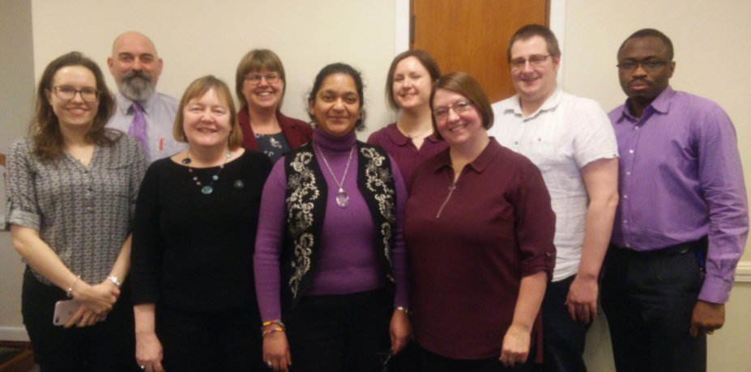
The Knowledge for Healthcare Leadership Programme: Project Group Two
Notes:
Connecting people to best practice was the challenge set in a project to be completed by seven participants from the first cohort of the HEE Knowledge for Healthcare Leadership Programme.
KfH Leadership Programme cohort 1 KM Project
Alison Day, Ayo Ogundipe , Carol McCormick, Chris Johns, Kaye Bagshaw, Samantha Unamboowe, Tim Jacobs
3

Slide 4

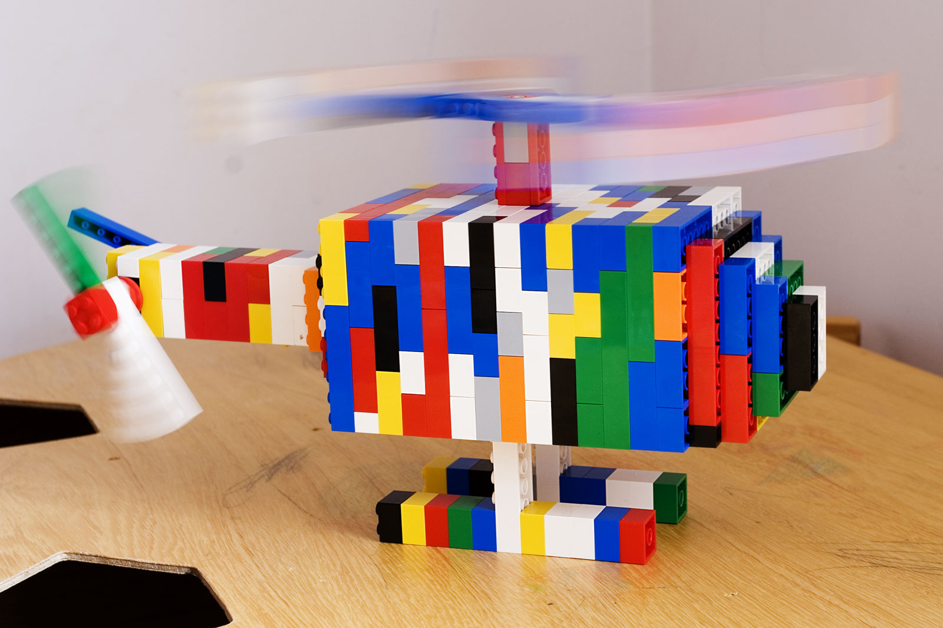
The Project
A project exploring and using various knowledge management tools.
The resulting model shares experience and tips on developing ways to capture, store and share knowledge about best practice and innovation for an organisation.
The model provides the building blocks to help other library and knowledge teams to get involved in some aspect of knowledge management.
By Taken byfir0002 | flagstaffotos.com.au Canon 20D + Tamron 28-75mm f/2.8 - Own work, GFDL 1.2, https://commons.wikimedia.org/w/index.php?curid=989692
Notes:
Asked to devise a database to encourage people in an organisation to share best practice and innovations. We extended this to outline all the steps a librarian would need to consider to implement some kind of knowledge management process within their organisation particularly focusing upon the capture, storage and sharing of knowledge around best practice and innovation.
Already knew about several national and international databases but our scope was to develop ways to encourage sharing at an organisational level beyond individual wards or departments to benefit the whole organisation.
The model also explores the project team’s skills and knowledge development from using the KM toolkit. All involved agreed that they lacked confidence in using KM tools at the start but by using the toolkit all came to recognise the value of doing KM activities and saw this extension of role as being highly rewarding and enjoyable.
The full model and experiences of the project group can be found in the KM Toolkit
Sam was the member of the group who managed to setup the database and the see the process through from start to finish.
4

Slide 5
So…what is a Knowledge Exchange
A way to pick up tips and understanding from someone in order to learn about how they have approached something
Devise 10 questions to ask your visitor to understand and learn from their experience
Ask your visitor to devise 10 questions that they may want to ask or that they expect you to ask
Ideally share the questions before the session or if not time just use the questions to structure the conversation and highlight learning points
Notes:
So, for our session today with Samantha we are going to use a knowledge management technique called Knowledge Exchange to find out more about how she developed her database. Knowledge exchange is often used to gather knowledge before someone leaves but the method works equally well when you want to learn about something that someone has been involved with.
There are various ways to conduct a knowledge exchange but on this occasion I have split the process into two main segments. I have devised a series of 10 key questions to prompt Samantha to tell us more about her database and have then invited Samantha to ask questions to clarify our understanding. Sam has also kindly offered to give us a demonstration of the database.
If there are further questions that you would like to ask Samantha please use the chat facility and send them to the Host who can then ask these on your behalf.
5

Slide 6
Questions for Samantha
Who did you approach with your idea to create an innovations database?
How long did it take to set up?
Did you need lots of technical expertise to create the database?
Roughly how much time a month does it take to keep up to date?
How do you encourage people to add entries and make use of the database?
Has the database improved the spread of ideas and encouraged people in your organisation to contact each other more?
What are your future plans for development of the database?
What would you do differently if you set this up again?
What benefits have there been for your service from managing the database?
What three lessons did you learn from doing this that you would share with others?
Notes:
6

Slide 7
Questions from Samantha
Why would you need an innovations database?
Would your organization appreciate the utility of an innovations database?
Which aspect of creating an innovations database would be easy to achieve?
Can you use what you do well already as stepping stones to new achievements?
What would be your biggest challenge to set up an innovations database?
What would you have to change to get past any challenges?
Are there alternative solutions / options which could mitigate any challenges?
Why would an innovations database add value to a library service?
Would an innovations database be of benefit your clinicians?
Could creating an innovations database impact on improving patient care?
Notes:
7

Slide 8
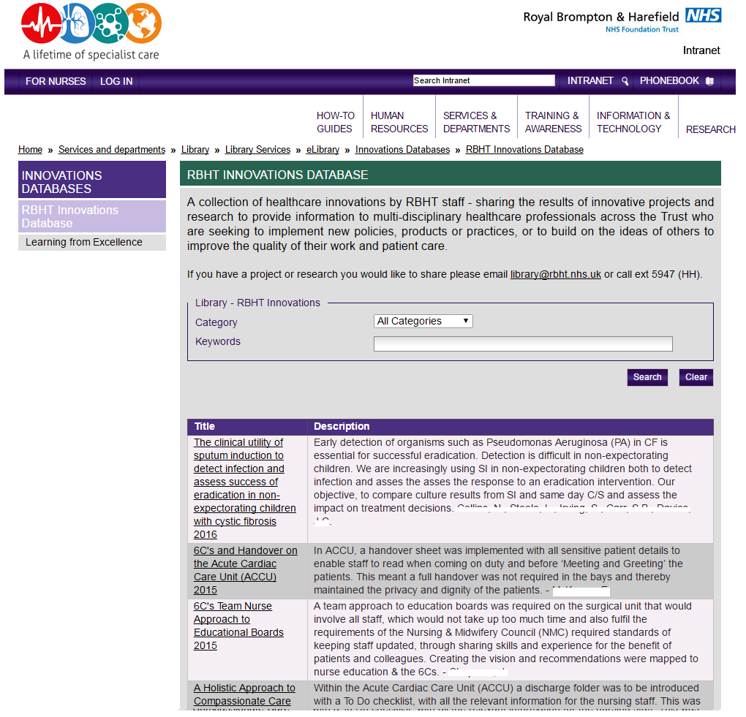
Example innovation database 1
Notes:
Sam to provide demonstration of database
8

Slide 9
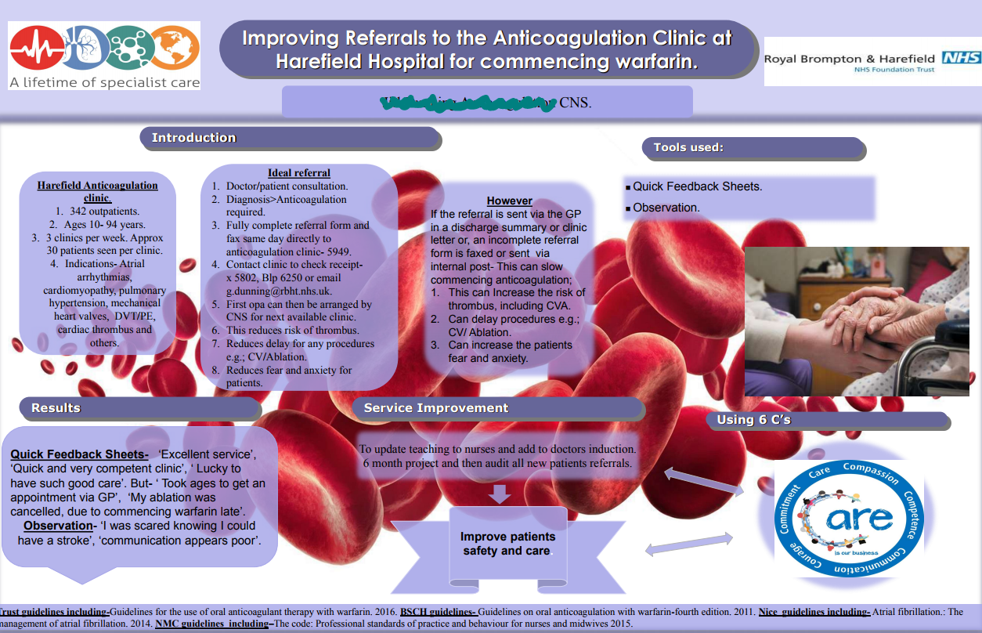
Example innovation database 2
Notes:
‹#›

Slide 10
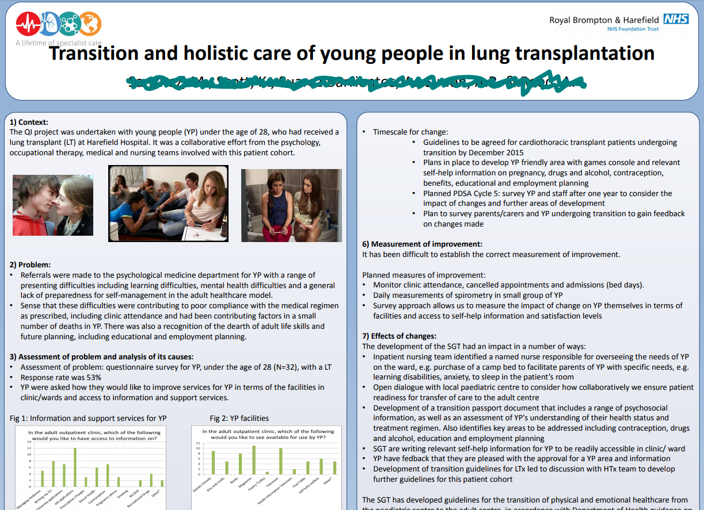
Example innovation database 3
Notes:
‹#›

Slide 11
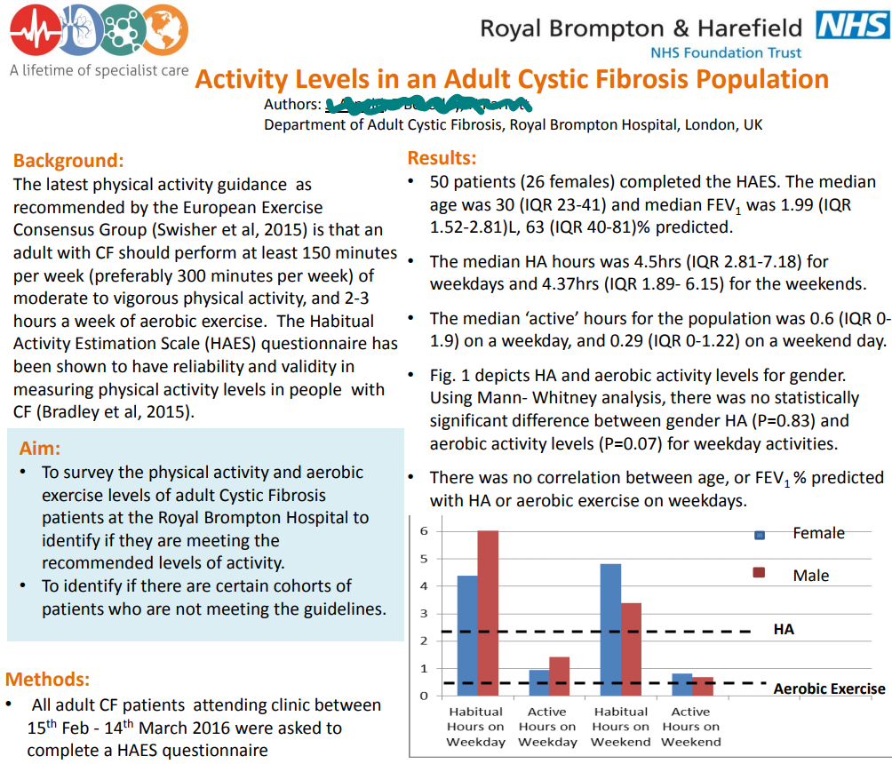
Activity levels in an adult cystic fibrosis population
Notes:
‹#›

Slide 12
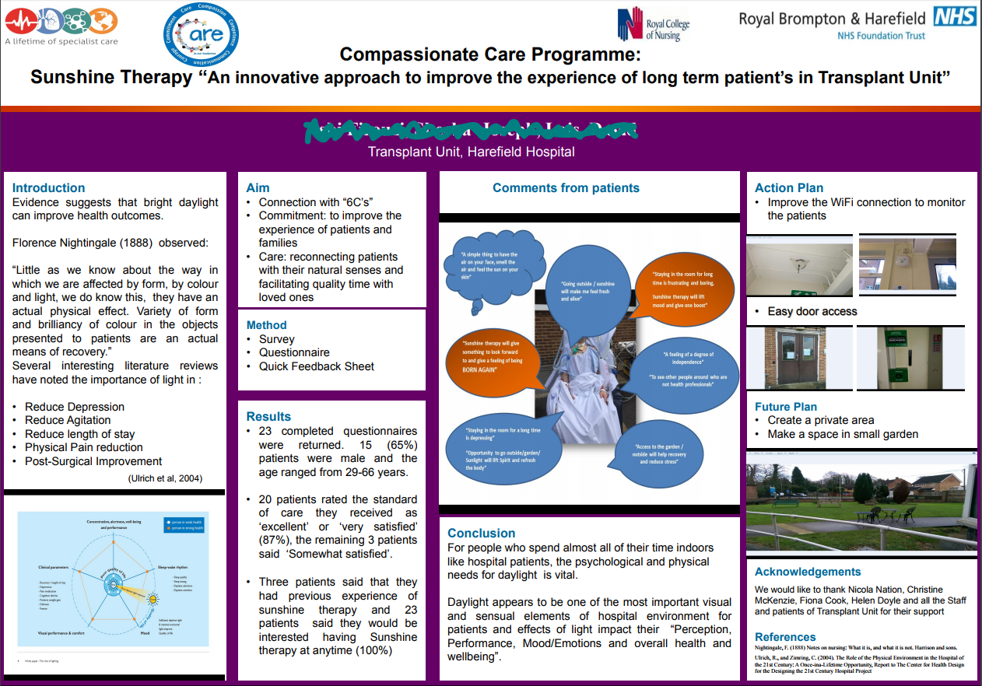
Compassionate care programme
Notes:
‹#›

Slide 13
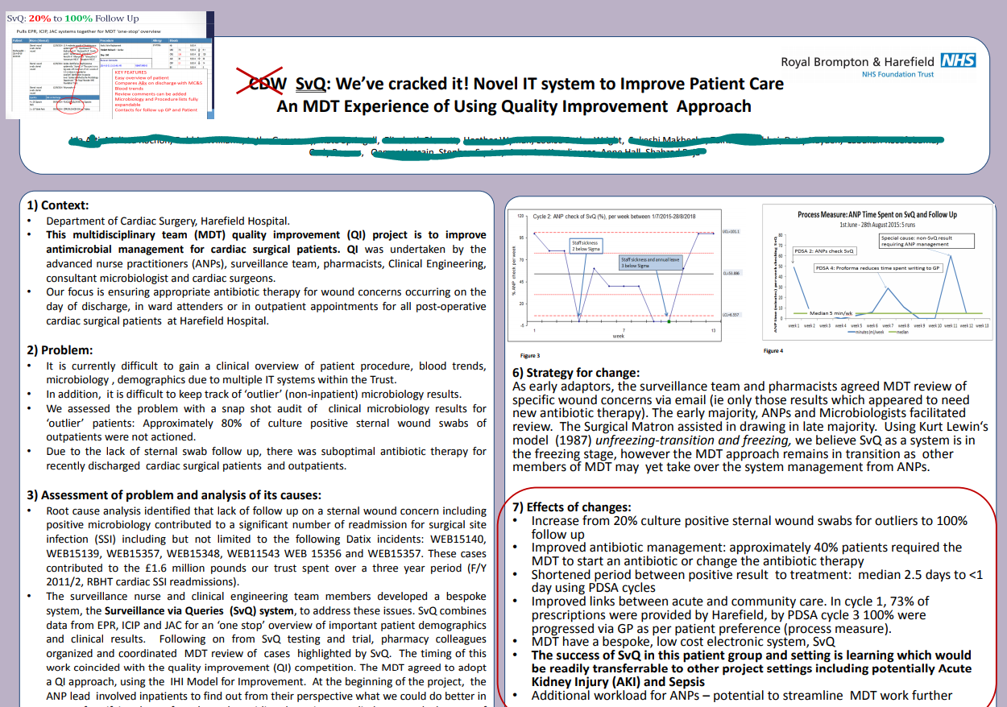
Novel IT system to improve patient care
Notes:
‹#›

Slide 14
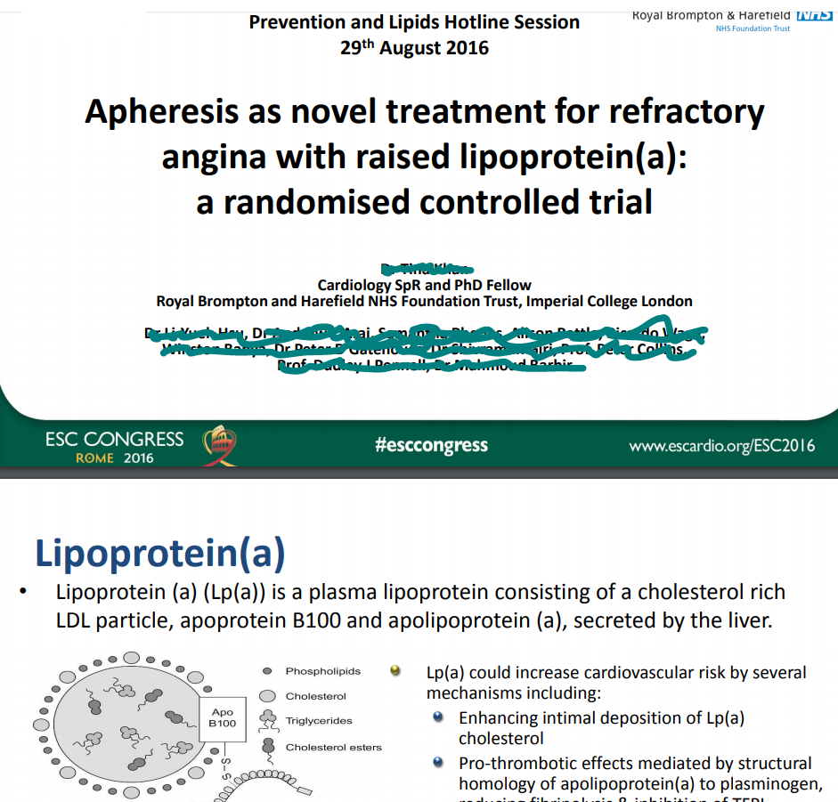
Apheresis as novel treatment for refractory angina with raised lipoprotein(a): a randomised controlled trial
Notes:
‹#›

Slide 15
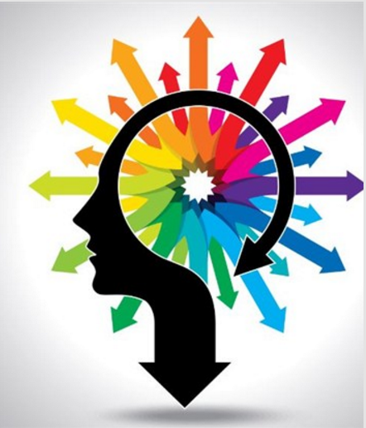
“Much more than just a database”
“… the KM database is much more that just a database, it has become part of a process to celebrate achievement and enables sharing of these achievements, serves to inspire clinicians to innovate or build on what has gone before, also promotes the library as a common meeting ground for the diverse professions that practice here.”
  Samantha Unamboowe
  Royal Brompton & Harefield NHS Foundation Trust
Notes:
Sam
15

Slide 16

Questions?
Notes:
Further questions from participants for Sam about her database or Alison and Sam about the project
16

Slide 17
For further information
Knowledge for Healthcare, Knowledge Management Toolkit
http://kfh.libraryservices.nhs.uk/knowledge-management/km-goals-tools-and-techniques
A model to encourage library and knowledge team involvement in developing ways to capture, store and share knowledge about best practice and innovation for an organisation. Final report from the Knowledge for Healthcare Leadership Programme Project Group Two
http://kfh.libraryservices.nhs.uk/wp-content/uploads/2017/02/Main-Report.pdf
“Knowledge Management by Numbers”
A beginner’s guide to getting started
with KM in your organisation.
Presented at 12th International Congress on Medical Librarianship.
Dublin, 14th – 16th June 2017
http://kfh.libraryservices.nhs.uk/wp-content/uploads/2017/02/AD-EAHIL-KM-by-numbers.ppt
Notes:
17

Slide 18
Thanks for listening!
Please look out for details of our next Webinars
TBC - Connecting People to knowledge : Knowledge Assets
Mid December - Helping people to keep up-to-date: Alerting services
Notes:
18

