Slide 1


Connecting People to Best Practice : Knowledge Assets
@NHS_HealthEdEng #HEELKS
Notes:
OPTIONAL POLL
Have you ever created a knowledge asset?
Have you ever created a resource around a particular topic?
Welcome
Today explore we are considering how to connect people to best practice and in particular looking at Knowledge Assets
1

Slide 2
Learning objectives for this session
Understanding the concept of a Knowledge Asset
Exploring case studies from the
Knowledge Management Toolkit
Learning the steps involved in building a knowledge asset
Considering how LKS can facilitate the creation of a Knowledge Asset
Notes:
We will look at a definition of a knowledge asset, consider why you would use a KA, and think about the standard contents of a KA.
We will explore some case studies from the KM toolkit and think about the steps involved in building a KA.
There will be two discussion activities which will help us to consider how LKS can facilitate the creation of a KA.
2

Slide 3

So…what is a knowledge asset
An approach to capturing operational
knowledge and provides the context to make sense of it.
It essentially provides a format and a method by which one team or person can transfer their knowledge to many teams or people, at any time they desire and to any required location.
Notes:
3

Slide 4

Example of an everyday knowledge asset
Notes:
A cookbook!
Takes expert’s experience, in this case preparing a meal, and suggests optimum tools and techniques to deliver best results which the end user can utilise when and where they desire. Most cook books also provide hints, anecdotes and tips which can make them more interesting.
4

Slide 5
Why create knowledge assets ?
To package and transfer your own learning to make it available to someone else at a different time or place.
To refer to when starting a new work activity so you can benefit from the knowledge of those who have completed similar tasks
Notes:
5

Slide 6
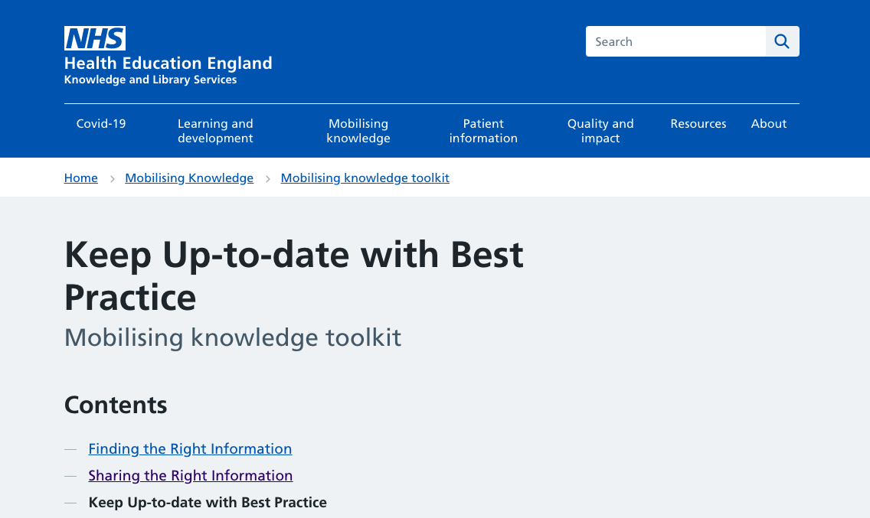
KM toolkit
Notes:
Knowledge for Healthcare KM Toolkit suggests that collection of knowledge assets results from many different knowledge Management activities – e.g. supporting a community of practice, lessons learnt from after action reviews or retrospects, results from knowledge harvests. You can find out more about all of these techniques by looking at the KM toolkit or viewing the webinar recordings in this series.
6

Slide 7

Discussion Activity
Imagine you are about to start-out on a new piece of work – perhaps you have been asked to create a database of publications by local authors.
What are the key questions you would ask yourself before starting?
Notes:
7

Slide 8
Whiteboard Responses
What IT support can I get?
Has anyone done this before?
IT compatibility of my database with the NHS network?
Who will use it?
How are we going to store and access the knowledge?
Who else can we work with?
How does it relate to Trust and departmental objectives and needs?
Have we got a champion?
Who will update it?
What is the deadline?
Notes:
8

Slide 9
Discussion Activity 2
Imagine you are about to start-out on a new piece of work – perhaps you have been asked to create a local authors publication database.
What are the key questions you would ask yourself before starting?
What key information do I need to complete the task?
What are the biggest issues facing me?
What are the processes, techniques, tools people I need to know about?
How did others get on doing this?
What are the critical success factors?
Notes:
These questions help to form the general content of a knowledge asset –
9

Slide 10
Content of a standard knowledge asset
What are the most important things I need to know?
Process Maps
Guidelines
Useful contacts
Lessons Learned
Templates
Procedures
Notes:
Context specific information
10

Slide 11
Knowledge vs information
“the realisation that knowledge and information are not the same. Information is relatively easy to identify, store and transfer, but it is not the same for knowledge.”
Nazim & Mukherjee Knowledge Management in Libraries: Concepts, Tools and Approaches
So a lot of the content in a knowledge asset will be information, something which we package and share all the time.
Notes:
So a lot of the content in a knowledge asset will be information, something which we package and share all the time.
11

Slide 12
Categories of knowledge
Tacit – “know-how” based on practice acquired by personal experience
Explicit – formal and systematic, so easy to share
Procedural – step by step procedures
Cultural – value statements for the organisation
Notes:
A good knowledge asset will include various categories of knowledge
Nazim and Muhherjee describe the different types of knowledge and how they are packaged together to produce a Knowledge Asset
Tacit – can be difficult to share
Explicit – object based – products, software codes, patents etc rule based – policies & procedured
Cultural – eg NHS Trust/charity values
12

Slide 13
Contents of a standard knowledge asset
What are the most important things I need to know?
Process Maps
Lessons Learned
Templates
Guidelines
Procedures
Useful contacts
Stories
Case Studies
Quotes
Insights
Notes:
So in addition to the information a knowledge asset will also contain stories, case studies, quotes and insights which enliven the content
13

Slide 14

Case study 1 – K4H blog
Library Book of Revalidation
Armed Forces Champion resource
Notes:
Library Book of Revalidation – West Suffolk
The booklet provides a one-stop shop not only for Revalidation resources and guides on how to complete a revalidation, it also contains useful information about database searching and critical appraisal, and local training opportunities through the library.
It serves two main functions:
To act as a guide and template for a successful revalidation.
To act as a useful and effective promotional tool for library services.
Armed forces champion resource – HEE North West
Our colleague, and the Network, wanted a bank of resources to support the Champions and encourage each other to collaborate virtually, share resources and knowledge. Each organisation had materials they thought it would be useful to share with the Network across the region and they wanted a kind of one-stop-shop where all these materials could be hosted as well somewhere they could look for information to signpost colleagues to.
Suite of resources
14

Slide 15


Case study 2 – K4H blog
Emergency Medicine handbook App
Obs and Gynae Intranet
Notes:
Emergency Medicine Handbook App Royal Liverpool & Broadgreen University Hospitals NHS Trust LKS approached to transfer paper handbook to an app format
The handbook covered the management of common acute conditions that may be presented by either in-patients or people arriving at the Emergency Department. It links in with relevant Trust Policies & protocols, useful contact information & also local, regional and national guidelines.
“The app is a great idea and I have used the app when treating patients with a wide variety of illnesses to ensure their management is in keeping with the latest guidance. This handy app has links to current guidelines, useful contacts and trust policies as well as advanced life support protocols making it an invaluable patient safety reference tool.” Dr
Obstetrics and Gynaecology Database
Brighton and Sussex University Hospitals NHS Trust
To have a way of bringing together local guidelines with related national guidance, local audit work and research in order to have an overview of evidence in each area. – intranet site
15

Slide 16

Activity: what will you do?
Hopefully the examples from the toolkit will have given you some ideas about the kinds of Knowledge Assets you could help to create for your organisations.
Share areas/topics where you have already created, or may consider developing, a Knowledge Asset.
Please add your ideas to the white board
Notes:
16

Slide 17
Whiteboard Responses
Junior Drs who run the QI Academy
Rheumatology staff based off the main site
Research department
Neonatal staff, pain team, clinical skills/simulation team
Think tank database – talent database showing who to ask
Seems to be an ongoing need for mentorship and reflective writing
Nurse revalidation resources
Research published by Trust staff
Updating end of life care pathway
Notes:
17

Slide 18
Building a Knowledge Asset
Context: consider the purpose and intended audience for your asset
Capture: Access and collate knowledge - including methods to gather knowledge from people’s heads
Collate and Validate: Collate findings from previous events and re-package. Check that these resonate with the audience for the asset.
Develop: consider the format for your asset
Structure: easy to follow with knowledge in increasing levels of detail
Publish: ensure it can be easily accessed by future knowledge customers
Maintain and Embed: ensure asset is utilised and that there is a knowledge owner who is responsible for ensuring it is updated as required
Notes:
Context – purpose, scope and customer
Capture – Most effective way to gather knowledge within people’s heads is based on dialogue. Processes for gathering this using Km tools such as After Action reviews, Retrospect's, Knowledge harvesting are useful ways of getting stories and case studies to enliven your asset
Collate and Validate: This may be about distilling lessons from previous undertakings, looking back at what happened and turning this into forward-looking advice for the future. These can be presented as recommendations, questions that should be asked or a checklist for future users to follow. Validation is crucial to ensuring that the knowledge resonates with future users.
Develop: wiki, intranet page, open webpage, app, hypertext document – text-based, video, pictures. Content should as a minimum include context, history of the project, guidance for future teams with supporting tools and techniques, links to relevant documents – guidance etc., contact details of people who have contributed
Structure: to make it as useful as possible for the reader and easy to follow and understand
Publish: placed where future customers can find it in future. In a “community space” is ideal and let cop know it has been published.
Maintain: Knowledge goes out of date if it is not kept fresh – seek feedback and appoint a Knowledge Owner from the team or area of business that requested the asset to ensure the asset is updated regularly. Ensure asset is being used for future business, training programmes etc.
18

Slide 19
Re-cap
Considered what is a knowledge asset, why it is useful
Thought about questions to develop the contents of a knowledge asset and the difference between information and knowledge
Looked at examples of knowledge assets created by library and knowledge services and considered areas where we may be able to create a knowledge asset for our own organisations
Outlined the steps involved in building a knowledge asset
Notes:
19

Slide 20

Questions?
Notes:
20

Slide 21
For further information
Knowledge Assets Postcard
http://kfh.libraryservices.nhs.uk/wp-content/uploads/2016/07/Knowledge_Assets.pdf
Knowledge Assets e-learning
http://www.ksslibraries.nhs.uk/elearning/km/k_assets/knowledge_assets/
Knowledge Management Toolkit Case Studies
http://kfh.libraryservices.nhs.uk/knowledge-management/knowledge-management-story/
Notes:
21

Slide 22
Thanks for listening!
Recordings of all the webinars in this series and copies of the presentation slides can be accessed at
http://kfh.libraryservices.nhs.uk/knowledge-management/meok-cascade-resources/
Notes:
22

