Slide 1
Table of contents
Slide 1 – Title page
Slide 3 – Welcome and housekeeping
Slide 4 – Aims
Slides 5 to 8 – HEE and the PPI picture
Slides 10 to 12 – Knowledge for healthcare
Slides 13 to 22 – Partnerships
Slides 23 to 36 – PPI task and finish group background and work so far
@NHS_HealthEdEng @K4H_PPI #HEELKS

Slide 2

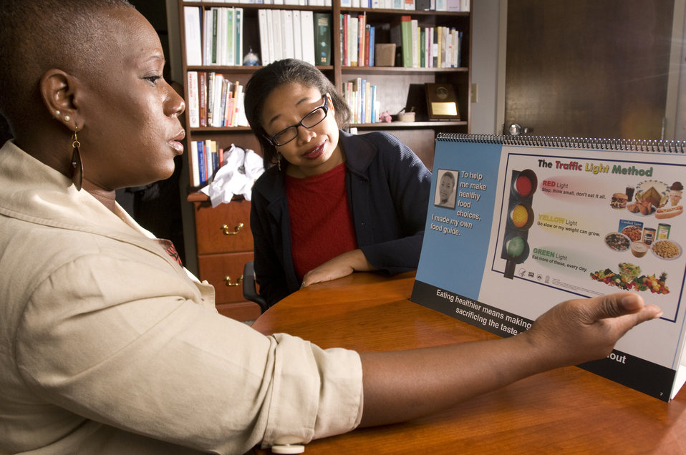

Title of Presentation
Name of Presenter
Job title of presenter
@NHS_HealthEdEng @K4H_PPI #HEELKS

Slide 3
Welcome!
House keeping
@NHS_HealthEdEng @K4H_PPI #HEELKS

Slide 4
Aims of this workshop
We hope you leave today’s workshop with:
A better understanding of how LKS staff support the provision of patients and public with information and why we are the right group to do it
Increased confidence in your role in patient and public information
Increased capabilities to deal with enquiries
Quick wins, straightforward actions and ideas for you to make an impact
@NHS_HealthEdEng @K4H_PPI #HEELKS

Slide 5
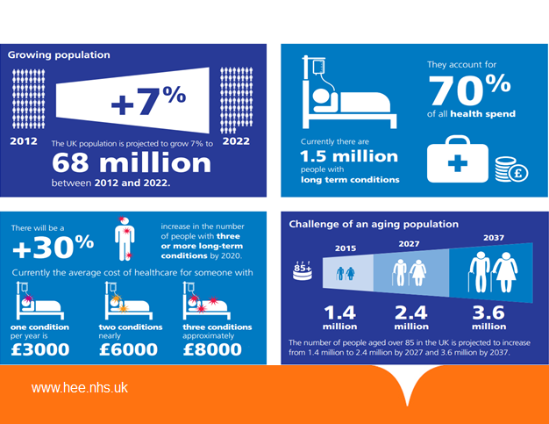
Demographics
Notes:
1.5 million people with long-term conditions
There will be a 30% increase in the number of people with 3 or more long-term conditions by 2020

Slide 6
Why do patients and public need health information?
There are powerful legal, moral, ethical and financial incentives for providing quality information to enable people to better manage their health and wellbeing and make fully informed decisions about their treatment and care. (PiF Making the Case)
Patients are being encouraged to self-manage, share decision-making and be partners in their own care
Low literacy levels: 42% of working-age adults (aged 16-65) are unable to understand or make use of everyday health information
@NHS_HealthEdEng @K4H_PPI #HEELKS
Notes:
NHS libraries are uniquely positioned to help throughout the patient journey
Point 1 :
As NHS Librarians we are used to playing a key role in providing evidence for patient care as part of our service to healthcare staff. Think of all our literature searches, especially those of you who may work as Clinical Librarians. I was often asked for information for consultants to discuss with patients We have skills in finding the evidence, appraising it and making it readily available in formats needed by our healthcare colleagues. We are already partners in patient care.
Point 2
We may also need to look at ways of expanding our library services to healthcare staff as they strive to engage with patients with varying literacy levels. Our training skills can be utilised to include facilitating health literacy awareness for all healthcare professionals.
Point 3
There is a real need for patients and the public to have access to high quality, reliable health information. As patients are being encouraged to self-manage and be partners in their care they need access to a range of resources tailored to their literacy level.
Our colleagues in public libraries are already involved in this area.
We in NHS libraries can act as signposts to the information that these groups need to empower them to be active participants in their health and well-being.
The evidence shows that providing high quality health information is beneficial. It has a positive impact on service utilization and health costs, patients’ experience of
healthcare and patients’ health behaviour and status.
Patient engagement is vital to help people manage their health, make informed decisions about their healthcare, and mitigate financial pressure on the health service.
So in the current crisis patient information and self management may be one of the keys to reducing demand.

Slide 7
Health Education England
HEE’s purpose is to improve the health and wellbeing of the people of England by developing a workforce with the right skills and values to always deliver outstanding healthcare:
  We deliver workforce reform
  We support workforce transformation
  We commission new staff
  We develop existing workforce through reskilling and upskilling
@NHS_HealthEdEng @K4H_PPI #HEELKS

Slide 8

NHS funded library and knowledge services
Financial investment and strategic leadership comes from HEE, through four regions
Funding for the 215 NHS funded healthcare Library and Knowledge Services in England comes from HEE via four regions
Their mission is to play a pivotal role in helping the NHS to improve the quality of patient care and become more productive and efficient
@NHS_HealthEdEng @K4H_PPI #HEELKS

Slide 9
Library and Knowledge Services staff are…
Uniquely positioned to provide healthcare information to the public and patients
Play a key role in providing evidence for patient care as part of our service to healthcare staff
Skills in finding the evidence, appraising it and making it readily available in formats needed by our healthcare colleagues.
Can use these same skills in our interactions with the public, patients and carers
Can act as signposts to the information that the public, patients and carers need to empower them to be active participants in their health and well-being
Training skills can be utilised to facilitate health literacy awareness

Slide 10
Knowledge for Healthcare
@NHS_HealthEdEng @K4H_PPI #HEELKS

Slide 11

About Knowledge for Healthcare
Full framework and a short briefing are available at:
http://www.hee.nhs.uk/our-work/research-learning-innovation/library-knowledge-services
Knowledge for Healthcare website
http://kfh.libraryservices.nhs.uk/
@NHS_HealthEdEng @K4H_PPI #HEELKS

Slide 12
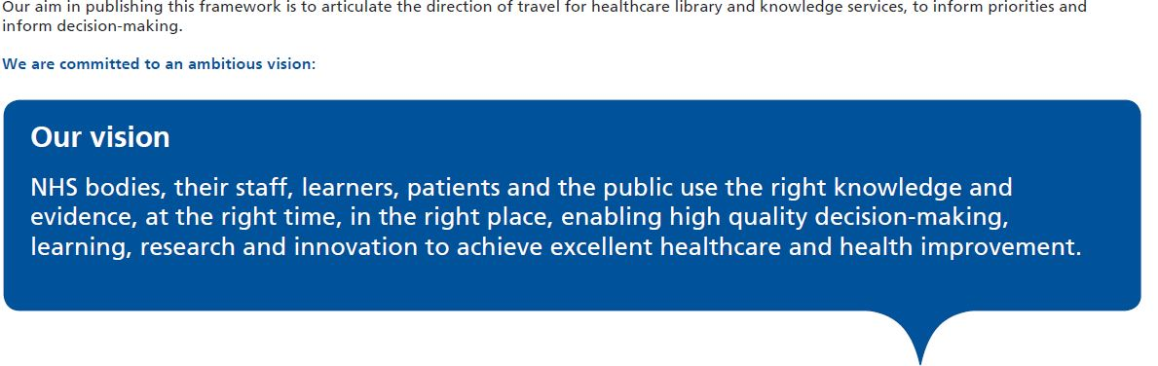
An ambitious vision
There is often a large gap between evidence-based treatment guidelines and current practice (Nolte and McKee, 2008).
@NHS_HealthEdEng @K4H_PPI #HEELKS
Notes:
Therefore, there is much to do to achieve this vision.

Slide 13
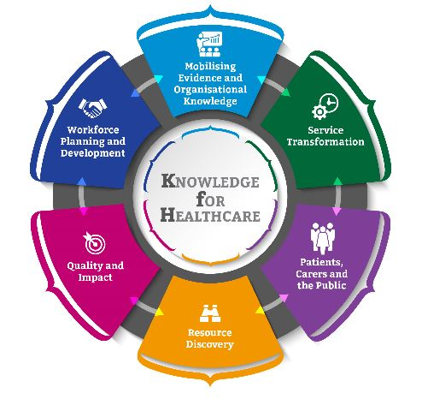
Partnerships are central
Health Education England is committed to :
learning from and partnering with other organisations across different sectors
to strengthening working relationships across the library community
PHE
@NHS_HealthEdEng @K4H_PPI #HEELKS

Slide 14

Current partnerships within PPI
Public Health England (PHE)
NHS England
NHS Digital
Health Education England (HEE)
Society of Chief Librarians (SCL)
Reading Agency
Patient Information Forum (PiF)
Macmillan
and many more...
Image courtesy of Ben Schonewille at FreeDigitalPhotos.net
@NHS_HealthEdEng @K4H_PPI #HEELKS
Notes:
We have representatives from these organisations on the PPI Working Group and we are working closely to make the most of existing resources and avoid duplication.
In the next slides we will say a bit more about some of these organisations.

Slide 15







More partnerships

Slide 16
Public Health England
Public Health England exists to protect and improve the nation's health and wellbeing, and reduce health inequalities.
Part of this involves facilitating access to good quality consumer health information, so that the general public can manage their health more effectively. The PHE Knowledge and Library Service does this by providing:
Workshops for:
  Public libraries
  Local authorities
  NHS England Information Standard information providers
A flow chart of levels of evidence for patient information providers
Guides to finding the evidence for:
  Organisations which produce patient information products
  Health inequalities
@NHS_HealthEdEng @K4H_PPI #HEELKS

Slide 17
NHS England
NHS England leads the National Health Service (NHS) in England.
They set the priorities and direction of the NHS and encourage and inform the national debate to improve health and care.
The Information Standard - a highly regarded,
voluntary certification scheme for health
and social care information.
https://www.england.nhs.uk/tis/
The Accessibility Information Standard – compulsory
LKS staff should know your organisation’s policy on AIS and where to go for information in different formats; add a field to enquiry forms to ask what format is required; raise awareness of the AIS with other staff. https://www.england.nhs.uk/ourwork/accessibleinfo/
@NHS_HealthEdEng @K4H_PPI #HEELKS

Slide 18
NHS Digital
Goal is to improve health and social care in England by making better use of technology, data and information
With partners across the country, they support the health and care system, helping patients make good choices about their care while ensuring their data is kept safe
They are responsible for NHS Choices
@NHS_HealthEdEng @K4H_PPI #HEELKS

Slide 19
Society of Chief Librarians
'Public Library Health Offer' articulates the role that libraries can play in promoting the health & wellbeing of local communities
Public libraries are clear about their role in signposting the public to quality resources whilst not providing medical advice or guidance.
Public library staff have customer service and enquiry skills to help the public find information but would value more specialised health training from NHS Librarians
NHS librarians would value customer service skills used by public library staff
Opportunities for joint working and sharing of expertise and resources
goscl.com/universal-offers/health-offer/
Notes:
Please note, not every public library will be offering exactly the same projects/information. Invite an external speaker from your local Public Library to present what they are doing to support health and wellbeing in the community. Please provide contact details of the regional SCL lead so that attendees have the opportunity for partnership working. (Ask sarah.greening@wm.hee.nhs.uk for contacts)
Other areas where Public Libraries may provide advantages partnerships;
Customer service skills (dealing with members of the public rather than our usual users)
Joint training sessions
Book exchanges (Public Library book collections in NHS Libraries)

Slide 20



The Reading Agency
Reading Well Books on Prescription and subsequent book lists
Health benefits of reading and reading groups
NHS Librarian involved in developing BoP Long Term Conditions list for July 2017
readingagency.org.uk
@NHS_HealthEdEng @K4H_PPI #HEELKS
Notes:
Reading Well Books on Prescription was launched in 2013 to support people with common mental health diagnoses, such as depression and anxiety. Reading Well is available in 91% of English public library authorities and can either be accessed by ‘self-referral’ ( a library user choosing a book on their own) or by being ‘prescribed’ by a health professional. There are approx. 7000 prescribers in England. This was followed by further reading lists; mood boosting books, ‘Shelf Help’ for teens and young adults and a dementia reading list. The Reading Agency are currently compiling a new list on Long Term Conditions (due June 2017), which an NHS librarian is helping to shortlist. Many Public Libraries provide supplementary services alongside these collections. (Statistics taken from https://readingagency.org.uk/adults/impact/research/reading-well-books-on-prescription.html )
Many NHS Libraries already hold a collection or collections of Reading Well stock

Slide 21

Patient Information Forum (PIF)
PIF is a UK membership organisation, and network, for people working in, and involved with, healthcare information and support.
Guides, tools and resources
Regular events
www.pifonline.org.uk
@NHS_HealthEdEng @K4H_PPI #HEELKS

Slide 22
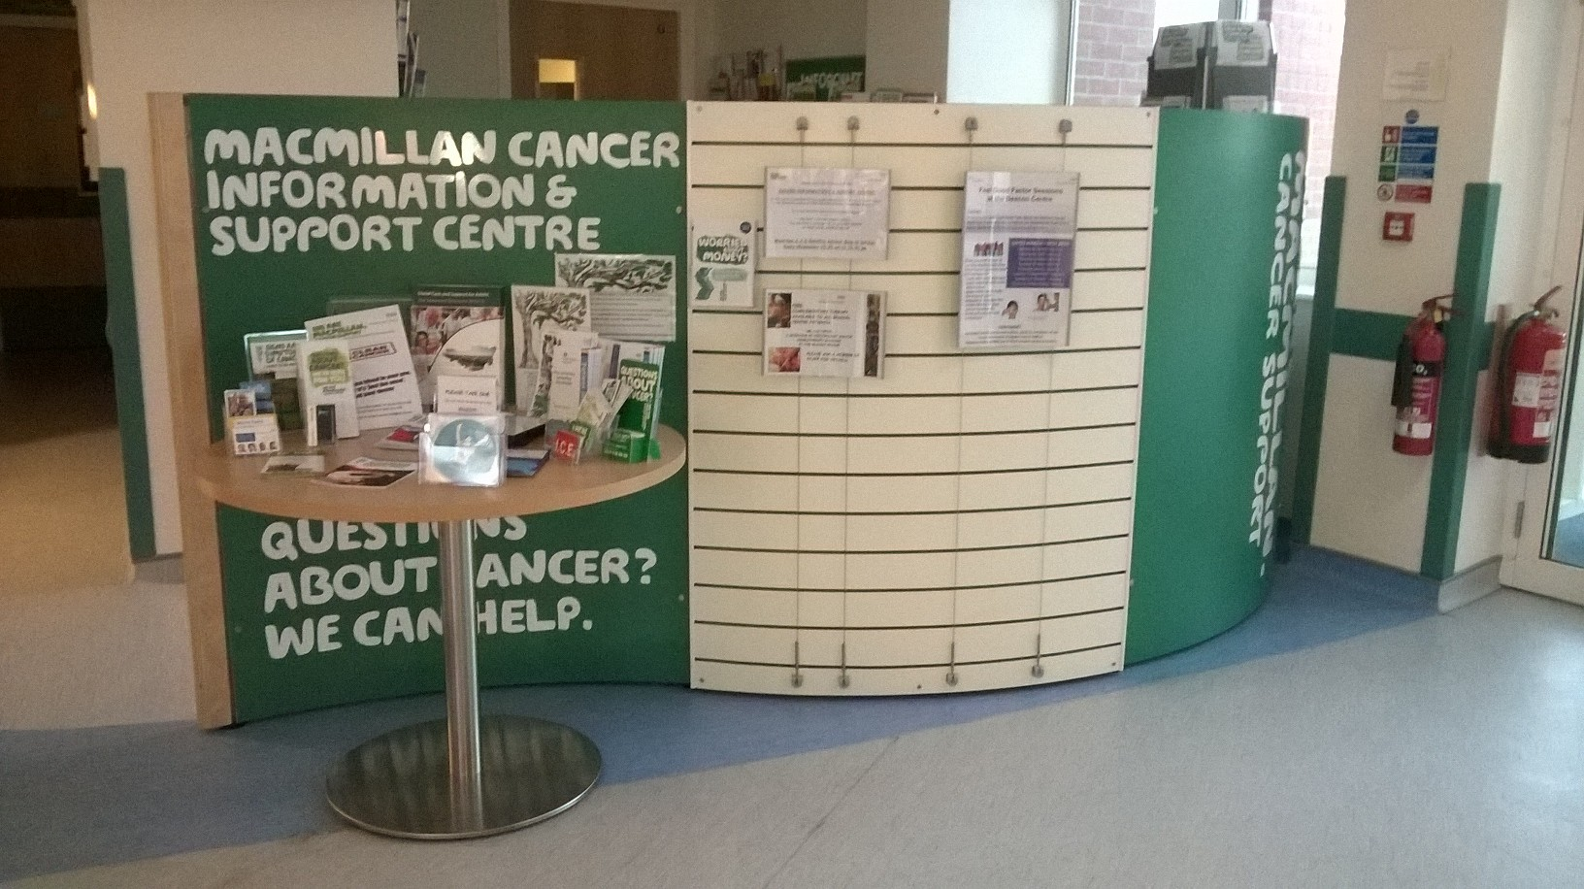
Macmillan Cancer Support
Breadth of information and support services (local cancer information and support services, Macmillan Support Line etc.)
Breadth of information resources (print, digital, British Sign Language, Braille etc.)
Accessing content to use in enquiries
Signposting for support
Partnership options
Member of the K4H PPI steering group
Find your local Macmillan contact:
www.macmillan.org.uk/in-your-area/choose-location.html
@NHS_HealthEdEng @K4H_PPI #HEELKS
Notes:
Invite a member of Macmillan to present to the group. Other areas where they can support NHS Libraries health information provision:
Communication with patients
Dealing with enquiries
Judging the level of literacy required
Giving information not advice
Provide contact details of local Macmillan name for partnership working

Slide 23
KfH Patients and Public Information Workstream
@NHS_HealthEdEng @K4H_PPI #HEELKS

Slide 24
Task and Finish group: Year 1 2015-16
The Patient and Public Information Task and Finish Group came together as part of the Service Transformation workstream of Knowledge for Healthcare. Since our inception we have
identified, started and developed partnerships
created Guidance to support NHS Libraries and their staff to get involved with patient and public information
created the Ideas Bank to share and publish what is already happening around England to support the PPI agenda
@NHS_HealthEdEng @K4H_PPI #HEELKS

Slide 25
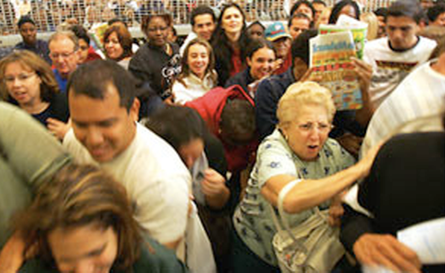
Guidance
Getting involved in Patient Information does not mean hordes of patients making their way to the library!
http://kfh.libraryservices.nhs.uk/patient-and-public-information/
@NHS_HealthEdEng @K4H_PPI #HEELKS
Notes:
The Guidance was published in March 2016 and was updated in Dec 2016.
The main comments received were “our library cannot be accessed by patients” Let’s have a look at what’s in the guidance and how it could help you.

Slide 26
What’s in the Guidance for you?
Specifically for all NHS Library and Knowledge Service staff
Rationale for NHS libraries getting involved with the PPI agenda
Types of service you could offer
Advice on dealing with enquiries
Links to the Ideas Bank and case studies
List of links to websites, key documents and signposts to patient information
@NHS_HealthEdEng @K4H_PPI #HEELKS

Slide 27
Types of Service
Facilitating healthcare staff to provide patient information
Walk in reference use of print resources
Enquiry service
Collaboration with local public library service
Facilitating patient / public health literacy
The library as a public space
@NHS_HealthEdEng @K4H_PPI #HEELKS
Notes:
Use guidance to talk through these. and then add some personal comment about each
1. Facilitating healthcare staff to provide patient information
Libraries contributing to Information Standard Accreditation, evidence for patient leaflets, Health Information Week support, training on health literacy, training for volunteers
2. Walk in reference use of print resources
PERSONAL EXPERIENCE:
Patient wanted a fiction book while an in patient . He walked in with drip attached on trolley! Issued this to him. He left it with ward staff when discharged but grateful and perhaps we helped improve his patient experience.
3. Enquiry service, for example a patient asking for information on Parkinson's and exercise
Leaflet on quality health information on the internet which we give out. We would use the information from NHS Choices and print this for them.
4. Collaboration with local public library service
Many NHS Libraries already have Public Library stock, information sharing meetings, joint training or events.
5. Facilitating patient / public health literacy
NHS Libraries have developed patient reading groups, become involved in literacy training, run training sessions for users on search techniques, provide displays for awareness weeks.
6. The library as a public space
PERSONAL EXPERIENCE:
Library now signposted from concourse , we have patients come in to sit and read the paper.
This has meant that if staff want to answer their bleeps we do direct them to the office rather than let then use the desk phone.
Some staff have asked use about issues around ward staff not knowing were patients are but this is no different to patients who leave the wards to visit the hospital shops or cafes. If you are concerned you could always ask the patient if they re ok. I sometimes do.

Slide 28

Ideas Bank
List of ideas for LKS staff with links to further information, case studies and support
Published in November 2015
Used Sally Hernando innovations, HLG conference abstracts & LQAF submissions
Updated Jan 2017 and regularly reviewed
http://kfh.libraryservices.nhs.uk/patient-and-public-information/
@NHS_HealthEdEng @K4H_PPI #HEELKS
Notes:
This was the result of our initial scoping exercise and some comments made during a Twitter event on PPI.
We collated examples for LQAF returns , HLG conferences and Sally Hernando innovations.
It is a main section in the guidance.
We have used it as a key resource with our stakeholders to showcase the work that NHS libraries are already engaged in. Most have asked to have copies of it.
So how can it help you. lets look at some examples
Highlight some examples to quote
Do visit the KfH website and explore if you haven't looked at it

Slide 29
Patients and Public Information Workstream Year 2 2016-17
Membership has expanded into 4 Task & Finish groups and a Steering Group.
The Steering Group has objectives to:
formalise national partnerships
promote the PPI learning materials and resources through our partners
promote health literacy; actively engage with partners and senior stakeholders to do this
@NHS_HealthEdEng @K4H_PPI #HEELKS
Notes:
The next few slides will go into more detail about the Task & Finish Groups

Slide 30

Year 2 2016-17 TaF Group 2
Key objectives:
Communicate the standards required of all NHS organisations in providing high quality information for the public, patients and carers
Advocate the ways in which library and knowledge staff can assist healthcare organisations to meet their responsibility to provide high quality information to their patients and carers
@NHS_HealthEdEng @K4H_PPI #HEELKS

Slide 31
2016-17 TaF Group 2 Progress
Document: The Standards Required for Health Information including:
How LKS staff can get involved in their Trust’s Information Standard application.
Case studies from library staff who have been involved in Information Standard and associated activities
Driver summaries: Using the MAP Toolkit to compile national drivers which will support involvement of LKS
in patient and public information projects.
All outputs are published on the KfH website
@NHS_HealthEdEng @K4H_PPI #HEELKS

Slide 32

Year 2 2016-17 TaF Group 3
Key objectives:
Encourage and support development of local networks of health information providers.
Work with NHS Choices to ensure that training is available to healthcare library and knowledge services staff.
Develop materials for regional meetings and workshops to engage and support healthcare library and knowledge services staff including the ideas bank and guidance.
@NHS_HealthEdEng @K4H_PPI #HEELKS

Slide 33
2016-17 TaF Group 3 Progress
Guidance on forming partnerships and networks including supporting documents: MOU and TOR published
PPI Contacts Database – list of local contacts from many sectors and organisations
NHS Choices Guide has been published
Workshop materials: Powerpoint slide pack, activity sheets, workshop programme, evaluation form
All outputs published on the KfH website
@NHS_HealthEdEng @K4H_PPI #HEELKS
Notes:
MOU = Memorandum of Understanding
TOR = Terms of Reference

Slide 34

NHS Choices
NHS Choices provides a comprehensive health information service with thousands of articles, videos and tools, helping visitors to make decisions about their health and lifestyle, but also about making the most of NHS and social care services in England.
Guidance on utilising NHS Choices efficiently is now available on the Knowledge for Healthcare PPI pages
  For LKS staff to know how to use to support patients asking for health information, but also to support your users who need high quality patient information
www.nhs.uk
Notes:
Optional: NHS Choices activity session - If tablet/laptop available per table – set tasks to find specific information – competition to use least clicks Or could set as pre-workshop task and participant with least clicks on a search can demonstrate how they did it

Slide 35
Year 2 2016-17 TaF Group 4
Key objectives;
Develop guidance and resources to support those healthcare library and knowledge services staff that directly provide the public, patients and carers with high quality health and wellbeing information.
Identify appropriate CPD interventions for healthcare library and knowledge staff working directly with the public, patients and carers e.g. in-house customer care training for front line staff.
@NHS_HealthEdEng @K4H_PPI #HEELKS

Slide 36
2016-17 TaF Group 4 Progress
Guidance updated
Ideas Bank updated and some new ideas added
Training materials identified and shared on the KfH website – request for LKS staff to suggest other resources to add
Used the Training Needs Analysis to assess requirements and identify any gaps in current training availability.
All outputs are published on the KfH website
TaF Group 1 has been initiated to develop additional training for LKS staff
@NHS_HealthEdEng @K4H_PPI #HEELKS

Slide 37
Any Questions
?
@NHS_HealthEdEng @K4H_PPI #HEELKS

