Slide 1
Contents
Slide 2 – Title page
Slides 3 to 7 – Health literacy
Slides 8 to 13 – LQAF
Slides 14 to 20 – Health Information Week
Slides 21 to 22 – Collaborating with public libraries
Slides 23 to 27 – The Information Standard
Slides 28 to 31 – Sustainability and Transformation Plans (STPs)

Slide 2


Getting Started
Ideas, information and reasons to get involved with Patient and public information
@NHS_HealthEdEng @K4H_PPI #HEELKS

Slide 3
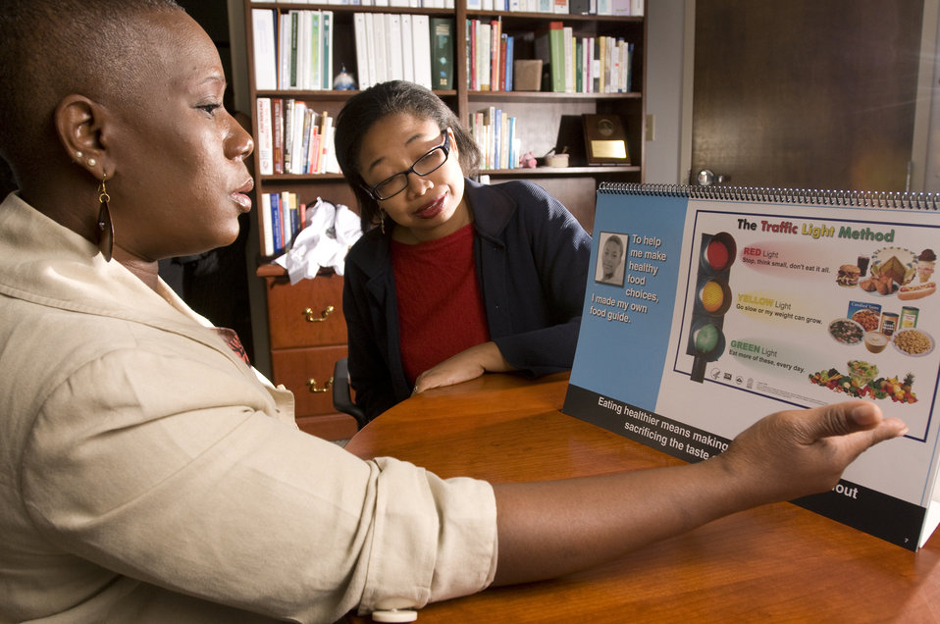

Health Literacy

Slide 4

What is health literacy?
“The personal characteristics and social resources needed for individuals and communities to access, understand, appraise and use information and services to make decisions about health”
World Health Organization
Source: WHO Regional Office for South-East Asia.(2015) Health literacy toolkit for low- and middle-income countries: A series of information sheets to empower communities and strengthen health systems. World Health Organization [URL: http://www.searo.who.int/entity/healthpromotion/documents/hl_tookit/en/]
@NHS_HealthEdEng @K4H_PPI #HEELKS
Notes:
This is the latest definition for health literacy. Defined in 2015 by the World Health Organization, this definition doesn’t just focus on the ability of a patient to understand instructions given to them by their health professional, it builds on this, to encompass the skills needed to identify a gap in their knowledge, and then know what sources to use to find the information, appraise it, and use it to make an informed treatment choice.
Health literacy is about far more than the ability to read, although this is part of it. There are three parts to health literacy:
1. People's skills, knowledge, understanding and confidence
2. How people use health services
3. How those health services, and the people that work in them, meet people's individual needs

Slide 5
NHS Drivers for Health Literacy
The NHS Constitution says that health literacy is an important part of high quality health services. It says services should offer easily accessible, reliable information in a form that people can use and understand.
The Five Year Forward View also says that health literacy is important. It says that health services should be person-centred, support people to be healthier, and enable people to be informed and involved in their care.
@NHS_HealthEdEng @K4H_PPI #HEELKS
Notes:
Studies suggest that everyday health information is too difficult for 43% of 16-65 year olds to be able to understand and use. This increases to 61% when numerical information is included. For example, many people will struggle to calculate a childhood paracetamol dose. This means, having health literacy can really affect a person's ability to stay healthy and well.

Slide 6
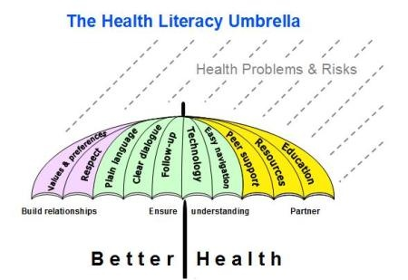
Addressing health literacy is important because it:
Will tackle health inequalities
Enables people to understand and use health and care information
Improves wellbeing
Increases health knowledge and skills
Supports people to follow medication advice
Increases individuals confidence as well as their involvement and engagement in their health
Enables people to effectively manage long-term conditions
@NHS_HealthEdEng @K4H_PPI #HEELKS

Slide 7

What can NHS libraries do?
Participate in training of healthcare staff
Make healthcare staff aware of suitable resources for patients
Promote resources specifically written for the public, eg NHS Choices Guide
Run specific health information events for patients / support patient support groups
Promote resources accredited by the Information Standard
Support Making Every Contact Count
Collaborate with public libraries in health events
@NHS_HealthEdEng @K4H_PPI #HEELKS
Notes:
LKS staff need to be aware of the necessity for patients and the public to be able to find health information, evaluate the sources of the information, and understand it, ie the most important aspect for patients is being able to look at health information and tell good health information from bad health information…being able to look at web pages, and…seeing which ones appear to have information that you can trust, and which ones are out of date, contain misleading information etc
Participate in training of healthcare staff eg
Offer sessions around finding quality health information , many staff are unaware of things like the Information Standard
Demonstrate NHS Choices to staff especially HCAs or volunteers
See the Information literacy section in the Ideas bank for more ideas
Make healthcare staff aware of suitable resources for patients eg
Develop a patient information section on the library webpage to highlight resources
Promote resources specifically written for the public, eg
NHS Choices display, either on library notice boards or at relevant Trust events. Do you have a carers hub you can support?
Run specific health information events for patients / support patient support groups eg
Approach CNSs to offer to run a session on finding health information to their patient groups
Promote resources accredited by the Information Standard
Support Making Every Contact Count
Collaborate with public libraries in health events eg
See the Health promotion section in the Ideas Bank

Slide 8
Library Quality Assurance Framework (LQAF):
@NHS_HealthEdEng @K4H_PPI #HEELKS

Slide 9
Library Quality Assurance Framework (LQAF): Introduction
“The Library Quality Assurance Framework (LQAF) is generic to any type of knowledge service, whether a library, a resource centre, information unit or an individual in a specialized role.”
  Enables a robust quality assessment
  Compliance to national standards
  Offering clarity of direction
  Identify any gaps in service
  Requirement for NHS funded Library/Knowledge services (LKS)
@NHS_HealthEdEng @K4H_PPI #HEELKS
Notes:
“The Framework is generic to any type of knowledge service, whether a library, a resource centre, information unit or an individual in a specialized role. “
“The Framework enables a robust quality assessment of library/knowledge services so that an organisation can assess its level of compliance to national standards and demonstrate the fitness for purpose that our 21st century health system demands. It provides a clear focus for action planning across all NHS organisations, offering clarity of direction for service managers and transparency of development to meet business and client need.”
“Self-assessment against the criteria of the standards within the LQAF will enable each library/knowledge service to identify any gaps in their service management and provision so that these requirements can be built into their business and service planning.”

Slide 10
PPI section in LQAF
*5.3l : Library/knowledge services are developed to support information provision for the patient and/or the public.
“Not applicable” was acceptable in 2016. From 2017 options must be either:
  Non compliant (No service)
  Partial compliance (Service use but not promoted)
  Full compliance (Service; promoted and support enquiry)
* Please note pending changes for 2018, criteria may change for 5.3l
@NHS_HealthEdEng @K4H_PPI #HEELKS
Notes:
For NHS LKS
Criterion 5.3l Patient and Public information guidance has been revised by the Patient and Public Information Task and Finish Group.
“At present library/knowledge services which are not required by the organisation[s] to provide services to patients and/or the public may opt to regard this criterion as “not applicable”. From 2017, all NHS-funded library/knowledge services will be expected to evidence some level of direct or indirect contribution to patient and public information.”
Pre 2016 “Not applicable” was acceptable. 2017 options now;
▪ Non complaint
▪ Partial compliance
▪ Full compliance
'Partial' compliance: A library/knowledge service exists for use by patients and/or the public but is not widely promoted.
'Full' compliance: A library/knowledge service exists for use by patients and/or public AND promoted AND library/knowledge staff are able to support enquirers.
5.3l : Library/knowledge services are developed to support information provision for the patient and/or the public.

Slide 11
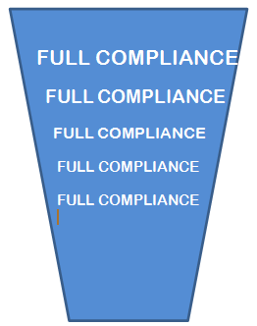
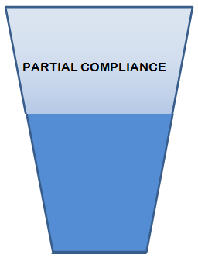
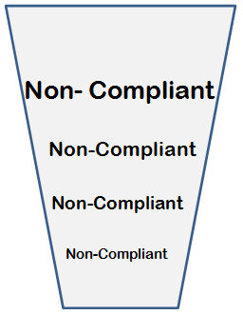

Glass diagram
Service exists
not Promoted
Service exists,
Promoted & Supports enquiry
No service
Partnership working
Links to Health Promotion
Links to PALS
Relevant section in strategy
Training Volunteers
Website
Library leaflets
Blog
URL or screenshot
Public inductions
Info Centre library leaflet
@NHS_HealthEdEng @K4H_PPI #HEELKS
Notes:
NOTE: At present library/knowledge services which are not required by the organisation[s] to provide services to patients and/or the public may opt to regard this criterion as “not applicable”.
From 2017, all NHS-funded library/knowledge services will be expected to evidence some level of direct or indirect contribution to patient and public information.
Examples of services might include:
• Walk-in use of print resources for reference.
• Helping healthcare staff to provide high quality patient information.
• Patients and the public having full access to library/knowledge service resources. LKS staff can signpost these users to high quality reliable information.
• Providing information leaflets via patient advice and liaison services (PALS) and front-line staff.
Further guidance and examples of best practice can be found in
NHS Library and Knowledge Services: Guidance for providing Patient and Public Information http://kfh.libraryservices.nhs.uk/patient-and-public-information/
Suggested admissible evidence -
• Evidence of partnership working with the public library service.
• Links to Health Promotion Services.
• Links to Patient Advice and Liaison Services (PALS).
• Examples of specific services provided.
• Relevant sections from library/knowledge service strategy and/or implementation plan.
• Consumer Health Information strategy.
• URL or screenshot of page from library/knowledge service website/blog detailing the availability of the service.

Slide 12
LQAF : Ideas Bank & Examples
Ideas Bank
Engagement with Public Libraries
Information Literacy
Patient & Carer support
Health information promotion
Internal staff partnerships
Voluntary Organisations
Health Information Week
Examples and Useful links available KfH Website PPI
@NHS_HealthEdEng @K4H_PPI #HEELKS
Notes:
Engagement with Public Libraries e.g. Librarian exchange / job shadowing / visits; Joint training with public library staff; Arrange a procedure for referral of complex queries; Stock Books on Prescription (Reading Well)
Information Literacy: e.g Hospital patients reading groups or book clubs; Poetry on the wall; Encourage reading for staff and patients -The Reading Agency ; Literacy training; Patient /Public User ed etc
Patient & Carer support : e.g Dementia reminiscence collections; Information Prescriptions; Self-management support (Dynamed patient information/BMJ Best practice ); Patient stories collation; Promote safe use of internet information; Cataloguing of patient information resources; Patient information leaflet provision; Support awareness campaigns (1.1c, 4.1a, 5.2d, 5.3a)
Health information promotion: e.g. Join Health Information Week / hold your own events; Have health promotion stock; Start a Health Information unit
Internal staff partnerships: e.g Be pro-active in engaging with other information providers in your Trust; Offer work experience; Revisit previously closed doors
Voluntary Organisations: e.g. Partnership with other sectors

Slide 13

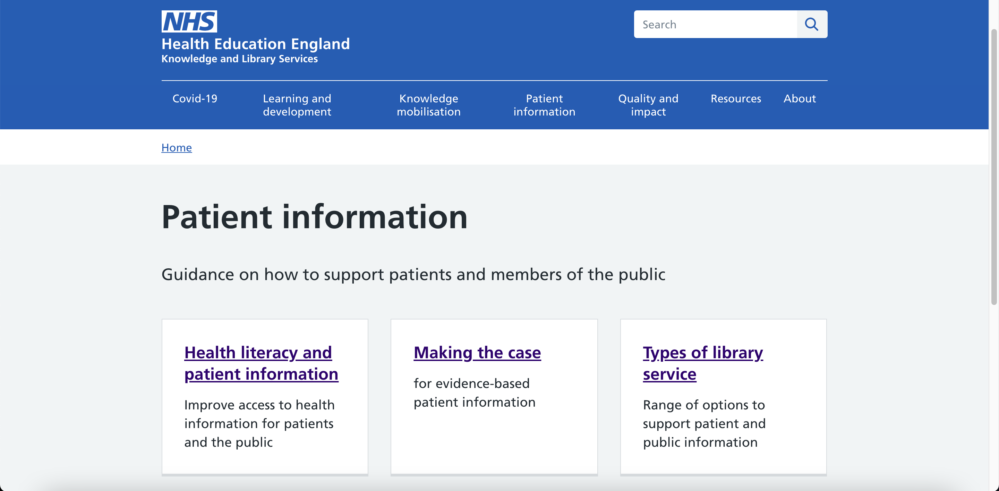

Support available
@NHS_HealthEdEng @K4H_PPI #HEELKS
Notes:
Support and more information

Slide 14
Health Information Week
@NHS_HealthEdEng @K4H_PPI #HEELKS

Slide 15
Health Information Week
3th – 9th July 2017 (always the first week in July)
Health Information Week (HIW) is an annual, multi-sector campaign to promote the good quality health resources that are available to the public and to encourage partnership working across sectors.
    Started in 2005 in West Midlands
    2016 – spread to Midlands & East
    2017 – national
    Endorsed and supported by HEE, NHS England, SCL, PHE
Supporting Health Literacy is a key workstream in the delivery of the KfH vision in order to enable the public, patients and carers to use the right information to improve health and wellbeing, for self-care and to support shared decision-making.
@NHS_HealthEdEng @K4H_PPI #HEELKS

Slide 16

Why get involved in Health Information Week?
Improving access to health information for the public
Improving partnership working
Improving health literacy
Getting to know your local fellow information providers
Sharing resources and knowledge
A quick LQAF win!
Photo by Stuart Miles. Published on 08 August 2016
Stock photo - Image ID: 100447512
@NHS_HealthEdEng @K4H_PPI #HEELKS

Slide 17
HIW - Examples from previous years
Many larger libraries hold health fairs with manned stands including complementary health clinics. Ask local voluntary orgs, NHS community staff etc. to man their own displays, run competitions, free fruit, leaflets, use health visitors / pharmacists / practice nurses to run blood checks etc. & focussed publicity
Info displays at supermarkets, shopping centres, leisure centres etc.
Competitions on local radio, event opened by MP
Comput@bus or mobile library to target rural areas - asking public health what areas and topics to target
@NHS_HealthEdEng @K4H_PPI #HEELKS

Slide 18
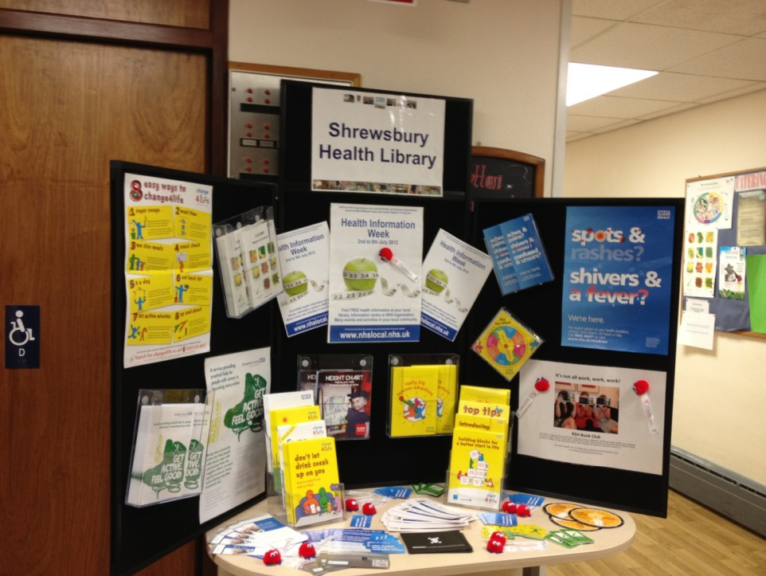
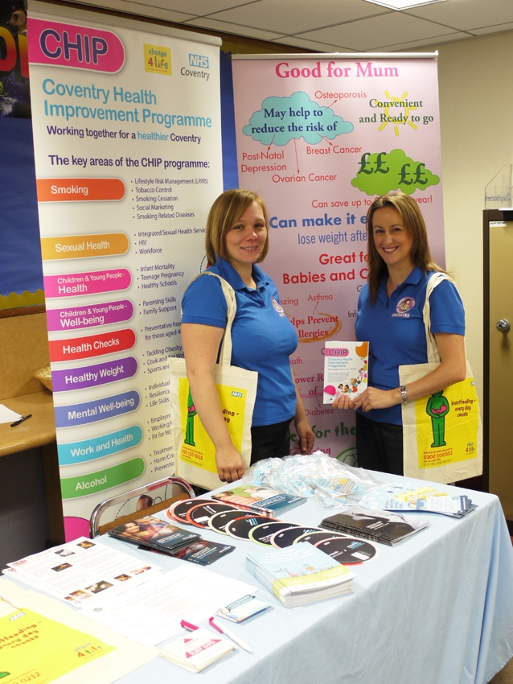
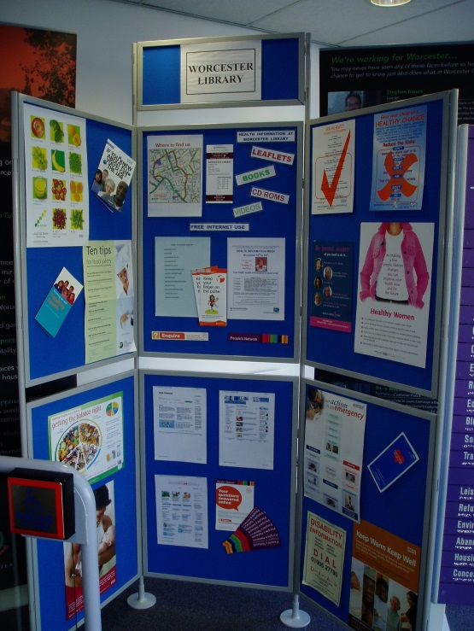
Examples
@NHS_HealthEdEng @K4H_PPI #HEELKS

Slide 19
#HIW2017 LKS examples
NHS librarians giving health information searching tutorials at public libraries
Promote Books on Prescription, reading challenges, Mood Boosting books etc.
Health walks
Promote new NHS Choices Guide or Safe use of Internet leaflet to staff/public
Info displays in unusual places away from your organisation
Provide training for staff on patient information resources
Raise awareness of your fiction stock, PPI stock, etc
@NHS_HealthEdEng @K4H_PPI #HEELKS

Slide 20
#HIW2017 support
Help available centrally
HIW Aims
Ideas and suggestions for events
Recommended leaflets list
Press release
A4 e-poster template
Diary of events – tell Sarah about your events
Assistance with meeting other peers in your area
Social media promotion #HIW2017 & daily email bulletins

Slide 21

Local Collaborations
@NHS_HealthEdEng @K4H_PPI #HEELKS

Slide 22
Collaborating with your local Public Libraries
Depending on the capacity of your local public library services, you could;
Collection of fiction books in your library for staff to borrow or patients to read
Joint events/displays
Building a local health information network
Joint training sessions (health information literacy, dealing with difficult customers)
Develop a referral procedure for complex enquiries
@NHS_HealthEdEng @K4H_PPI #HEELKS

Slide 23
Other local collaborations
Who else is providing patient and public information locally?
Voluntary organisations: Could you work with local charities who provide information to the public
Your local Macmillan Cancer Support Centre: Could they support your staff with a training session on difficult conversations with patients?
Local Authorities: Local Public Health or Social Care teams, could you collaborate for Health Information Week?
@NHS_HealthEdEng @K4H_PPI #HEELKS

Slide 24
The Information Standard (TIS)
@NHS_HealthEdEng @K4H_PPI #HEELKS
Notes:
Add intro

Slide 25
The Information Standard (TIS)
A highly regarded, voluntary certification scheme for health and social care information producers.
The Standard is made up of six principles with underpinning requirements, informed by best practice for producing and commissioning good quality usable information.
Organisations wishing to join the scheme must be able to demonstrate, with supporting evidence, how they meet these requirements.
@NHS_HealthEdEng @K4H_PPI #HEELKS

Slide 26

The Information Standard Kite Mark
Certified members carry the certification kite mark.
When you see The Information Standard quality mark on any materials, you can be assured that the organisation has undergone a rigorous assessment and that the information they produce and commission is high quality and people can use it. This will help people to make informed decisions, for themselves and their family, when it comes to considering health and care options.
https://www.england.nhs.uk/tis/

Slide 27
Achieving the Information Standard
There is no cost to join the scheme.
Certification is renewed through an annual assessment process.
TIS demonstrates good practice for all NHS Organisations
NHS England promotes TIS as a quality Standard, with continuous development. It supports organisations to reflect the principles of TIS, aiming to improve both practice and quality.
https://www.england.nhs.uk/tis/
@NHS_HealthEdEng @K4H_PPI #HEELKS

Slide 28
Accessible Information Standard (AIS)
From 1st August 2016 onwards, all NHS and Adult Social Care providers must comply with the Accessible Information Standard (AIS).
AIS directs and defines a consistent approach to identifying, recording, flagging, sharing and meeting the information and communication needs of individuals with a disability, impairment or sensory loss.
LKS staff are advised to:
  ensure that you know your organisation’s policy on AIS and where to go for information in different formats
  add a field to enquiry forms to ask what format is required
  raise awareness of the AIS with other staff
https://www.england.nhs.uk/ourwork/accessibleinfo/
Notes:
LKS staff can access resources to support their (and other staff) understanding of the information needs of people with a disability, impairment or sensory loss – all at https://www.england.nhs.uk/ourwork/accessibleinfo/resources/. For example our e-learning modules for the Standard (at http://www.e-lfh.org.uk/programmes/accessible-information-standard/open-access-sessions/) or the glossary of terms produced by Sense (https://www.sense.org.uk/sites/default/files/Accessible%20Information%20Standard%20Glossary.pdf).

Slide 29

Could you support TIS in your organisation?
Do you already contribute towards commissioning or production of patient information in your organisation?
Could you help your Trust or any of the organisations you work with apply for the Information Standard?
Could the services you provide help support any of the TIS principles?
Does your organisation have a documented process for the commissioning or production of health information? If so, are your services mentioned?
@NHS_HealthEdEng @K4H_PPI #HEELKS

Slide 30
Sustainability and Transformation Plans
(STPs)
@NHS_HealthEdEng @K4H_PPI #HEELKS

Slide 31
Sustainability and Transformation Plans
STPs will drive transformation in health and care outcomes between 2016 and 2021
To deliver these plans, NHS providers, CCGs, Local Authorities, and other health and care services have come together to form 44 STP ‘footprints’
Prevention, well being and patient self management are key to these plans
https://www.england.nhs.uk/ourwork/futurenhs/deliver-forward-view/stp/
Notes:
The NHS Five Year Forward View Shared Planning Guidance required every local health and care system in England to create a Sustainability and Transformation Plan (STP).
These will be place-based, multi-year plans built around the needs of local populations.
Please note: CCGs are Clinical Commissioning Groups

Slide 32
STPs – How LKS can support through PPI
Patient and public information is especially pertinent to:
How are you going to prevent ill health and moderate demand for healthcare?
How are you engaging patients, communities and NHS staff?
How will you improve quality and safety?
Check out this blog post on the KfH website about how two library services engaged their STPs with PPI http://kfh.libraryservices.nhs.uk/stps-and-patient-information/
@NHS_HealthEdEng @K4H_PPI #HEELKS
Notes:
STPs have 10 questions to address and PPI is key to 3.
Contact your STP lead or similar to discuss how your LKS can support. So far Patient and Public information has created interest.

Slide 33
STPs – How LKS can support through PPI (2)
Direct support eg:
Email alerts on health and wellbeing topics
Case studies on PPI
Indirect support eg:
Involvement with public libraries on health initiatives
Involvement in local projects such as Symphony Care Hub
@NHS_HealthEdEng @K4H_PPI #HEELKS
Notes:
Symphony Care Hub is http://www.yeovilhospital.co.uk/patients-visitors/symphony-care-hub/ is an STP initiative local to the Somerset STP.

