Slide 1

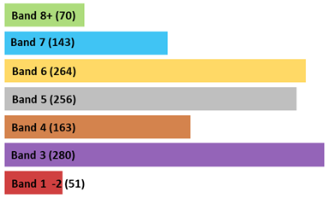
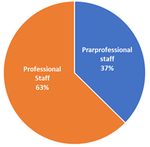


NHS funded knowledge and library services in England 2021-22 Source: 2021-22 NHS KLS stats return
Pay Banding of KLS Staff in England
Whole time equivalent KLS staff in England
Paraprofessional Posts (Bands 1- 4) = 375
Professional Posts (Bands 5 – 8+) = 633
Total 1,008
Notes:
Introductions –
Are we going round the participants?

