Slide 1
Virtual Reality
as a
Library Resource
Ben Vella, Library Assistant
Contact details -
Benjamin.Vella@uhbristol.nhs.uk; Library@uhbristol.nhs.uk

Slide 2
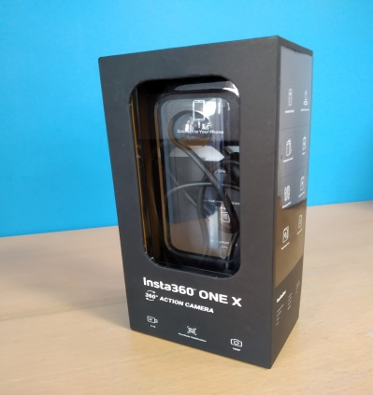
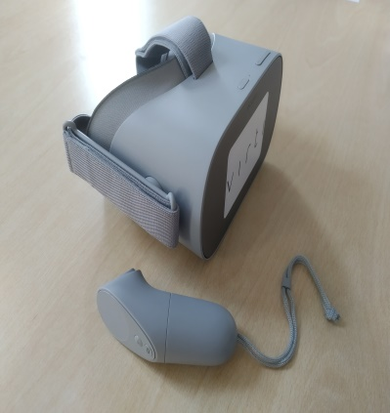
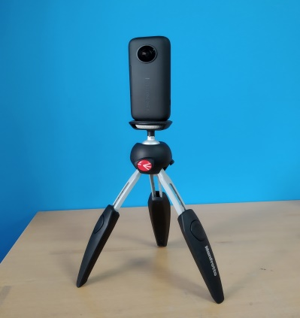
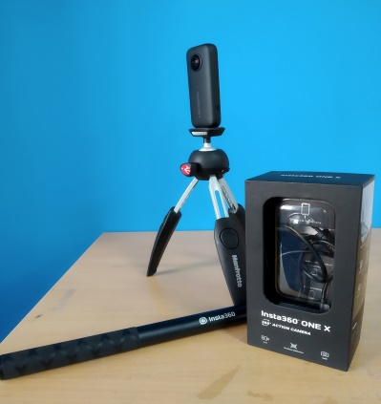
Equipment
Insta360 onex 360 camera
Included with camera are an adjustable tripod and invisible selfie stick
Oculus go, including controller
Further product details:
https://www.insta360.com/product/insta360-onex/
https://www.oculus.com/go/
Possible future purchases/leases
  More headsets
  Steady-cam harness

Slide 3
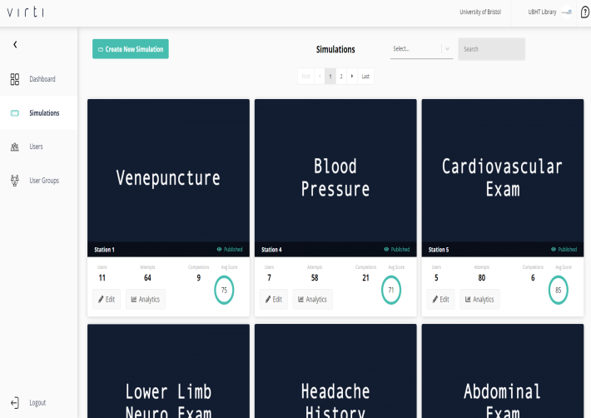
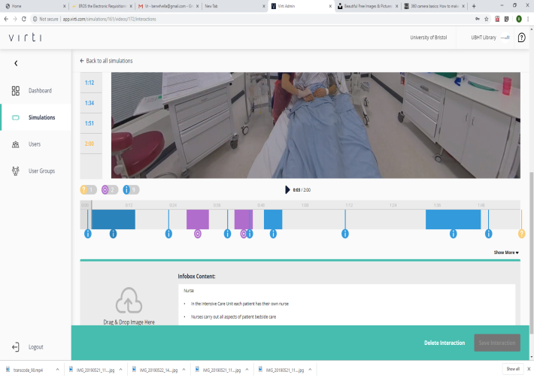
Service Providers - VIRTI
https://virti.com/
Provide an editing and sharing platform for projects involving extended reality(XR):
  virtual reality (VR),
  mixed reality (MR),
  augmented reality (AR),
  cinematic reality (CR).
Currently already hosts content created by the Simulation Centre
Cost - £4000 for the financial year

Slide 4
Library Projects
Loaning out of equipment to different departments, along with training.
Tour of the library for promotional purposes.
Interactive map for patients to get to core areas of Hospital.
E-learning on a more intimate scale

Slide 5
Hospital applications
Simulations for those undergoing surgical procedures.
Interactive videos simulating medical procedures for students.
Headset loans to patients for entertainment and therapy purposes.

