Slide 1


Loanable virtual reality headsets
A pilot project
Catherine Micklethwaite
Library Manager
Catherine.micklethwaite@nhs.net
@TrustLib

Slide 2
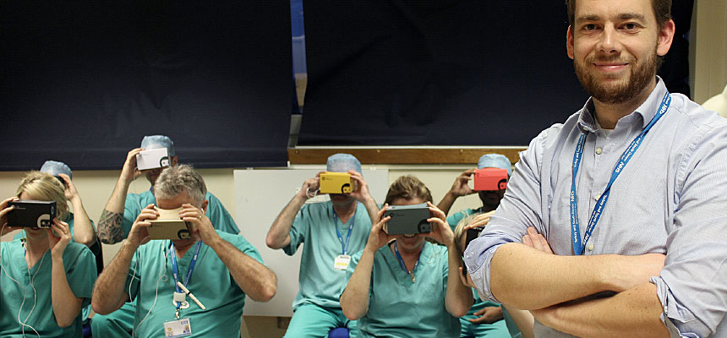
Why go down this route?
inspired by work done by Nick Peres in our Trust
virtual reality (VR) becoming more popular in academic and public libraries
wanted to offer our library users an alternative method of learning “not everyone learns the same way”
staff wellbeing agenda is a high priority

Slide 3
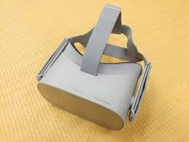
Our pilot project
2x Oculus Go headsets loanable for 7 day periods
pack including headset, handset, rechargeable batteries, battery chargers, USB charge cable, and instructions
evaluation form:
  which apps were used
  what they thought of them
  any negative side effects
  thoughts on VR as a learning tool
  thoughts on VR as a wellbeing tool
Oculus Go headset

Slide 4
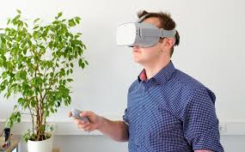
Story so far
hoping to go live in June 2019
lack of medical apps (check what is compatible with your headsets first before buying)
  human anatomy VR complete
  RCSI medical training sim
  Random42
wealth of wellbeing apps available
loading apps takes time

