Slide 1
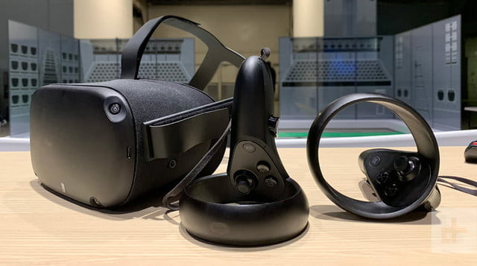
Oculus Go and Quest
Practical uses of portable VR

Slide 2
Portable VR
Pros:
standalone - No computer required
no cables. Can be used anywhere
significantly cheaper and without IT issues
Cons:
lower Specifications (Although the new Oculus Quest is more powerful)
less ‘Simulation type’ apps

Slide 3
For patients:
aversion therapy
cue exposure therapy
pediatric injection distraction
reminiscence therapy
curated experiences
pain reduction
patient education

Slide 4
For staff:
empathy training
meditation and relaxation
anatomy education

Slide 5
Easy wins:
Occupational Health
Meditation and relaxation apps can be used by Occupational Health for staff wellness. Offering a 15 minute meditation session in VR before difficult conversations.
Wellness and patient wellbeing
Volunteers can offer meditation, experiences and ‘VR Holidays’ to bed bound patients. They can also be available for ‘Injection Distraction’ for anxious patients.

Slide 6
Longer Term:
Reminiscence therapy
Smaller libraries have limited space. Supporting therapy operations with curated reminiscence VR headsets, or even producing local VR content using 360 cameras is a longer term possibility
Mental health therapies
Supporting VR headsets for cue-exposure and exposure therapies could show significant benefits, as the low cost of standalone VR compares very favorably to commercial solutions.

Slide 7
Contact
Contact details can be found at johnbarbrook.info
@stackingbooks
Draft paper available at
https://bit.ly/2QfFgnL

