Slide 1

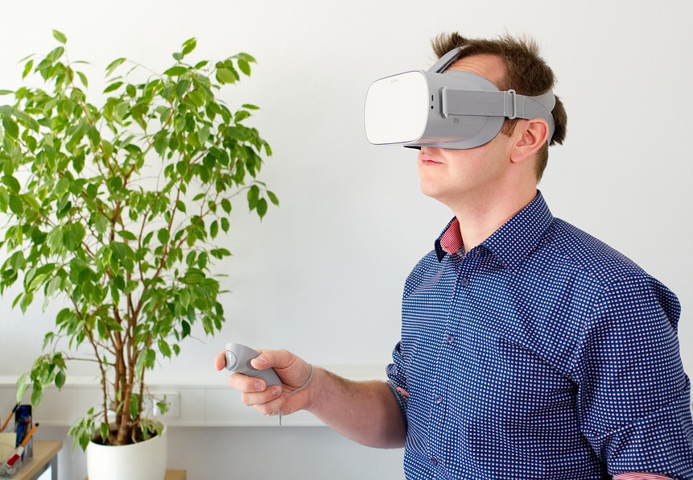
VR: A two pronged approach
The Christie Library & Knowledge Service
Enabling care, discovery, learning
Supported by
Tim Jacobs & Mary Hill
Notes:
1

Slide 2
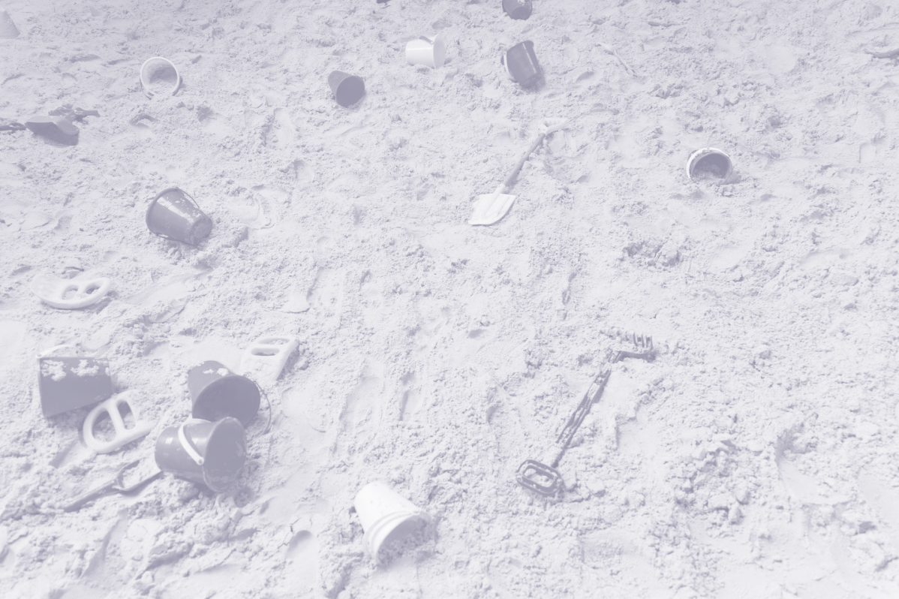
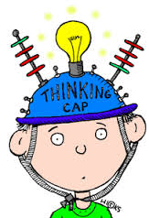
The Sandpit
Samsung gear with, initially, Frailty learning package
Oculus Go & Quest: Anatomy
HP and/or Vive
360 Camera; loan of equipment

Slide 3
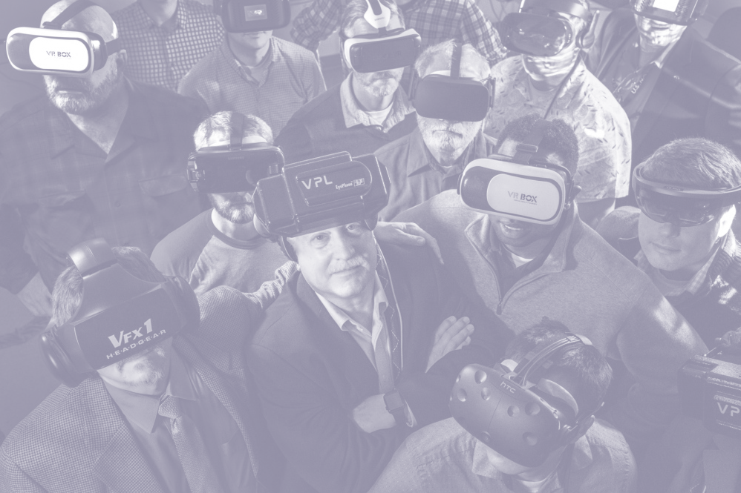
Developing our own VR
3 staff attended VR course
Basic life support module already started: story board & script
360 degree tours
VR for radiotherapy
Notes:
3

