Slide 1
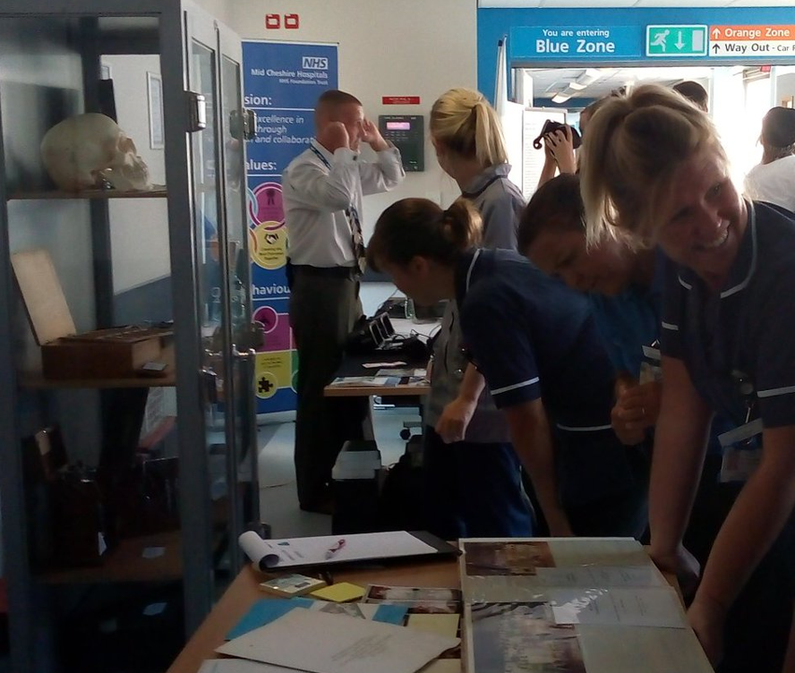
The Vision of HoloLens 2
(Coming end July 2019)
Susan Smith, Senior Librarian
susan.smith@chester.ac.uk
@MCHFTJetLibrary
Scott Howard demonstrating VR
Notes:
The JET Library is a partnership service between Mid Cheshire Hospitals NHS Foundation Trust and The University of Chester. Our library journey about VR started with an idea for an exhibition to show the changing face of education as part of the NHS 70th celebrations. On one side we borrowed a ‘toy box’ of old medical equipment to play with from local museums, with a collection of graduation photos on the other we had a demonstration of the virtual reality of a white blood cell chasing down an infection and project AR on a QR coded t-shirt.
The event was attended by many staff, public and patients with the Director of Finance joining in the fun! It sparked the debate of how recent history can be used to support service development and change.
The Trust was an early adopter of Office 365 and the library helped implement development and had already invested in Skype equipment to support the roll out and help people realise the benefits for technology.

Slide 2

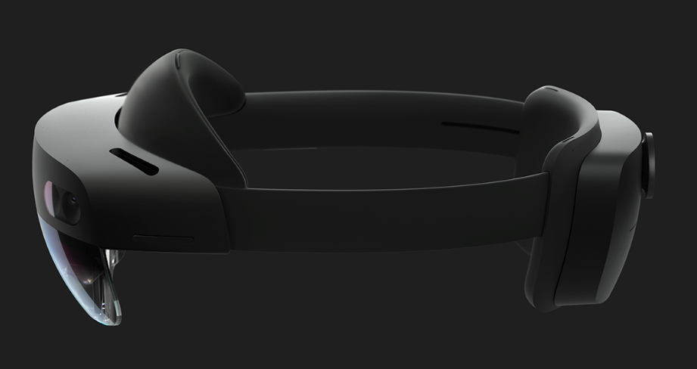
Why choose Hololens?
Standard integration with Office 365 & Windows 10
Integration with clinical systems e.g. Cerner
Choice of apps and plenty of case studies
Development opportunities (Open system & our team is already familiar with Unity Programming)
Microsoft support
Considered future proofed
Quality of product (medical grade)
AR v VR – you can control whether to be immersive or awareness of surroundings
Lightweight (carbon fibre)
Standalone (wireless and no need for PC connection)
User is free to move as normal
Non-disruptive (no-one else can hear)
Take external pictures with overlay of AR
Multiplayer (view from the same angle)
Fast processing for real time data exchange
Versatile (can be used by clinicians, execs or estates)
Can be used over glasses
Draw backs:
Limited battery life
Delayed release (now due July 2019)
Finance for additional development
Education & culture change
Notes:
HoloLens supported the conversation of how do we support knowledge exchange and communication in a rural area. With few GPs how can we provide adequate support for training, does technology hold the key?
I was successful in a bid for end of year HEE monies to invest in technological systems like Microsoft HoloLens & Surface Hub. The procurement was matched funded by the GPs.
Just as the money came through Microsoft withdrew the equipment awaiting the launch of the new kit.
The Topol review has been useful to maintain momentum within the organisation, with the library becoming integrated in the Workforce & Organisational Development Strategy to develop a learning organisation and support the implementation of the Topol Review.
We have been attending events with staff and students using the local history display panels of the NHS 70th exhibition to point out the changes that have improved patient care and working lives and look at what the future of health care might look like.

Slide 3

What is the plan?
Developing a collection of loanable tech – we have x2 HoloLens 2 Developers packages on order for lending (1 week loans initially)
Might get a trial AR Gruffalo for the library & Paeds ward – conversations ongoing (safe place to discover and test the tech)
Use apps to initially roll out
Collect case studies to build the business cases for future investment
Develop local support network (MCHFT, University of Chester & Reaseheath College)
Link with national Microsoft community of practice (in development)
E-learning Team & Simulation Team planning to use TEL resources to develop 360 degree sims
Planned integration with Surface Hub for clinical use and teaching
This project has been part funded by GPs – teach the clinicians to then teach the patient. Interested in remote consultation and supervision support.
Notes:
As the library is considered a safe neutral space, we are beginning to develop a collection of tech to support the aims of IT and bridge some of the gaps between education and reality of the workplace.
We have the kit to lend, we give people ideas of how it can be used and use knowledge mobilisation to begin to have the necessary conversations to change the culture of the organisation.
We work with champions, we hold open events and we promote improved networking in the organisation.
We are already working across Corporate division to plant the ideas of use and several clinical departments are beginning to line up to try. Our nursing students think this will be way better than books!
In addition we are building support networks. We are sharing learning with Universities with already developed research and implementation, with other organisations with experience of the first generation kit. We have been looking at possibilities of linking with the local agricultural college and recently attended the demo of the Anamotage Table for their vet nurses.
Our purpose – to create a culture of curiosity.

