Slide 1


Introduction to
NHS Knowledge & Library Hub
Via
EBSCO Discovery Service (EDS)
connect.ebsco.com
Notes:
An introduction to the NHS Knowledge & Library Hub through EBSCO Discovery Service.

Slide 2

Notes:
The NHS Knowledge and Library Hub gives quick and easy access to health and care evidence to support clinical practice, service improvement, research and professional development. In the next few minutes, we’ll look at how to access the Hub, how to search it and the main features that will help you find the information you need.
The Hub provides access to a wide range of medical, nursing, allied health and managerial resources, including books, journals and databases.

Slide 3
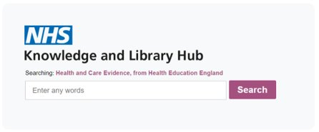
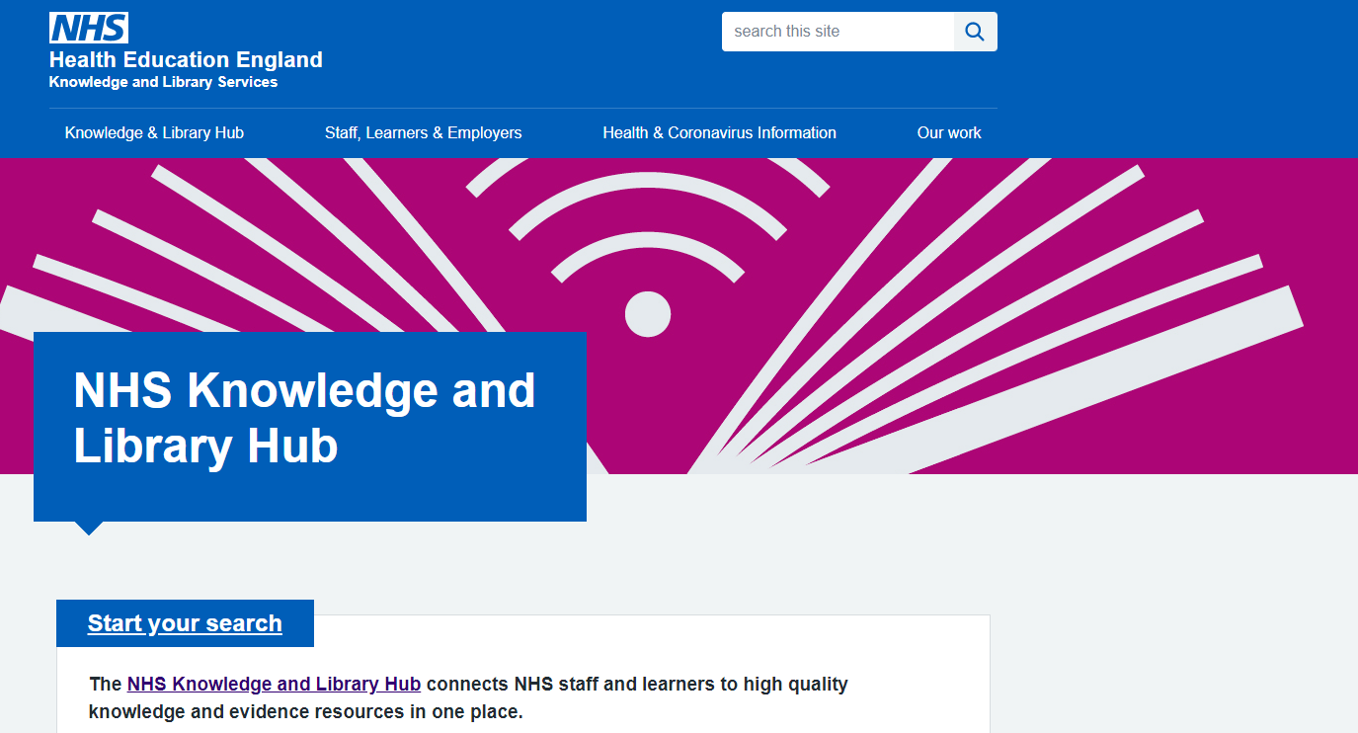


How to access the NHS Knowledge and Library Hub
https://library.nhs.uk/knowledgehub/
Notes:
The NHS Knowledge and Library Hub is available through the national website at https://library.nhs.uk/knowledgehub/

Slide 4
How to access the NHS Knowledge and Library Hub
https://library.nhs.uk/knowledgehub/
Notes:
If you have a Trust knowledge and library service, you can access it through their website or intranet site.

Slide 5
How to access the NHS Knowledge and Library Hub
https://library.nhs.uk/knowledgehub/
Notes:
or you may be able to access it directly through a desktop link.

Slide 6
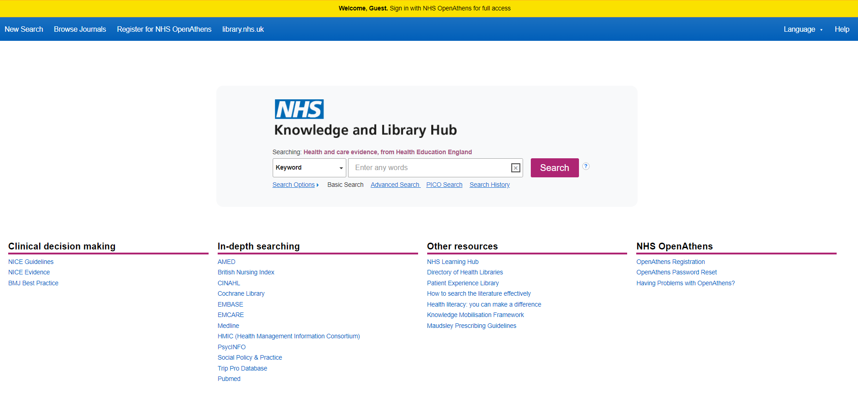

Sign-in with OpenAthens
Notes:
You will need an NHS OpenAthens account to access any of the resources on the Hub, although you can search it without logging in. For the best experience, we recommend that you sign in first before searching by clicking on the yellow bar at the top of the page and entering your OpenAthens username and password.

Slide 7
Sign-in with OpenAthens
Notes:
If you do not have an OpenAthens account, you can register for one using the link towards the top of the page.

Slide 8
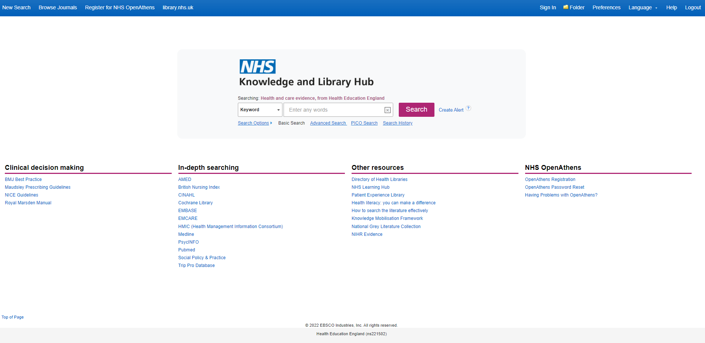
Sign-in with OpenAthens
Notes:
When you are signed-in with OpenAthens, you will be taken to the correct version of the NHS Knowledge Hub for your NHS organization. The yellow bar at the top of the screen will disappear and you will see the name of your organization at the bottom of the screen. As well as the main search box, you will also find links from this page to other resources that may be of interest.

Slide 9
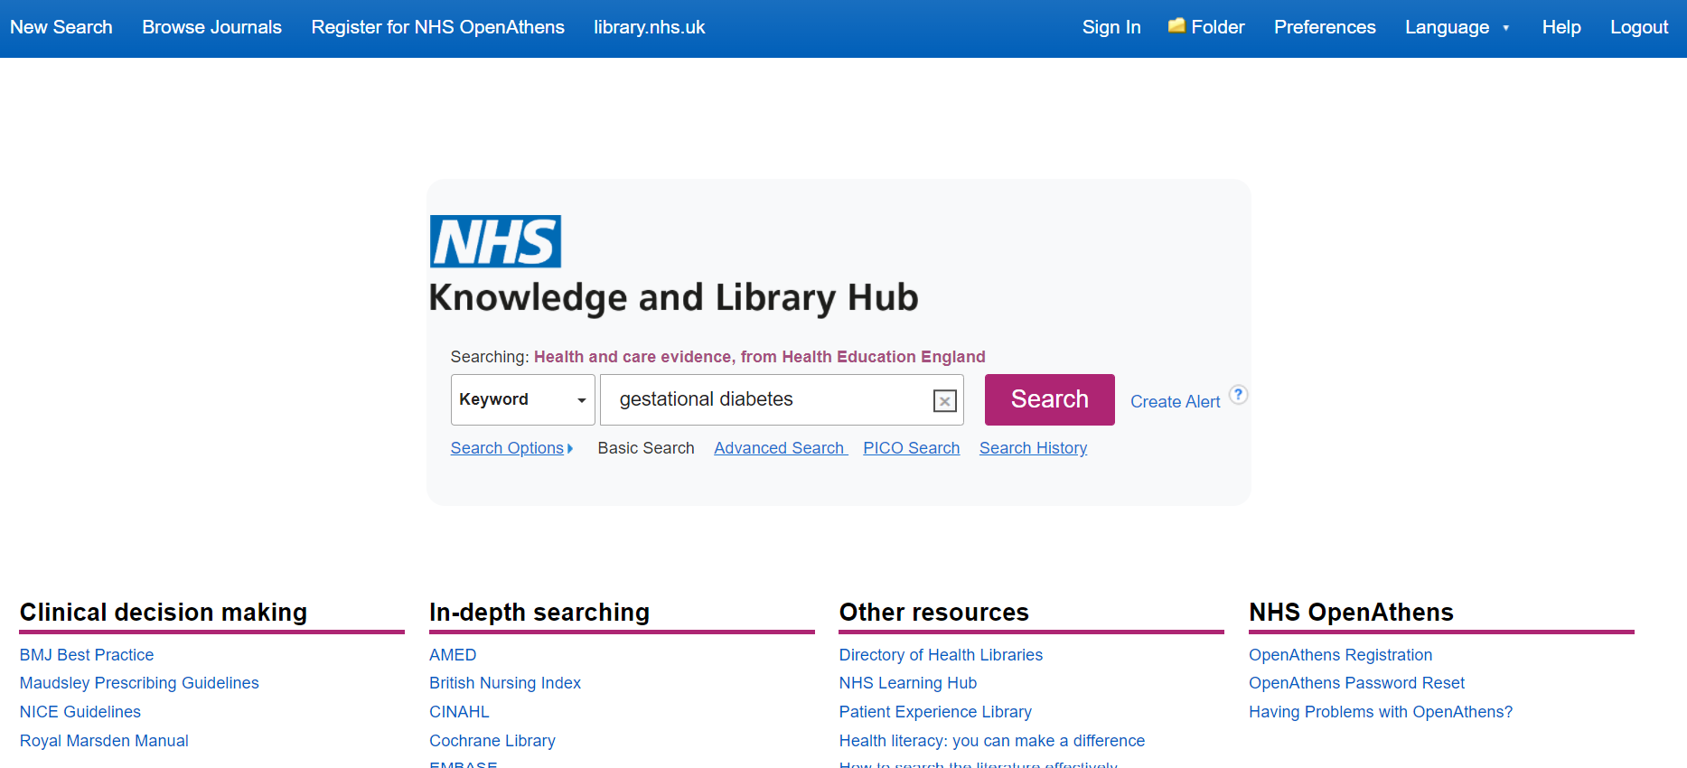
Simple searching
.
Notes:
The NHS Knowledge Hub allows you to perform both simple and advanced searches. To do a simple search, just put your keywords into the search box and press the search button. In this example, we’re going to use “gestational diabetes”.

Slide 10
Advanced searching
.
Notes:
However, if you want to do a more structured search you could try the advanced or PICO search options.

Slide 11
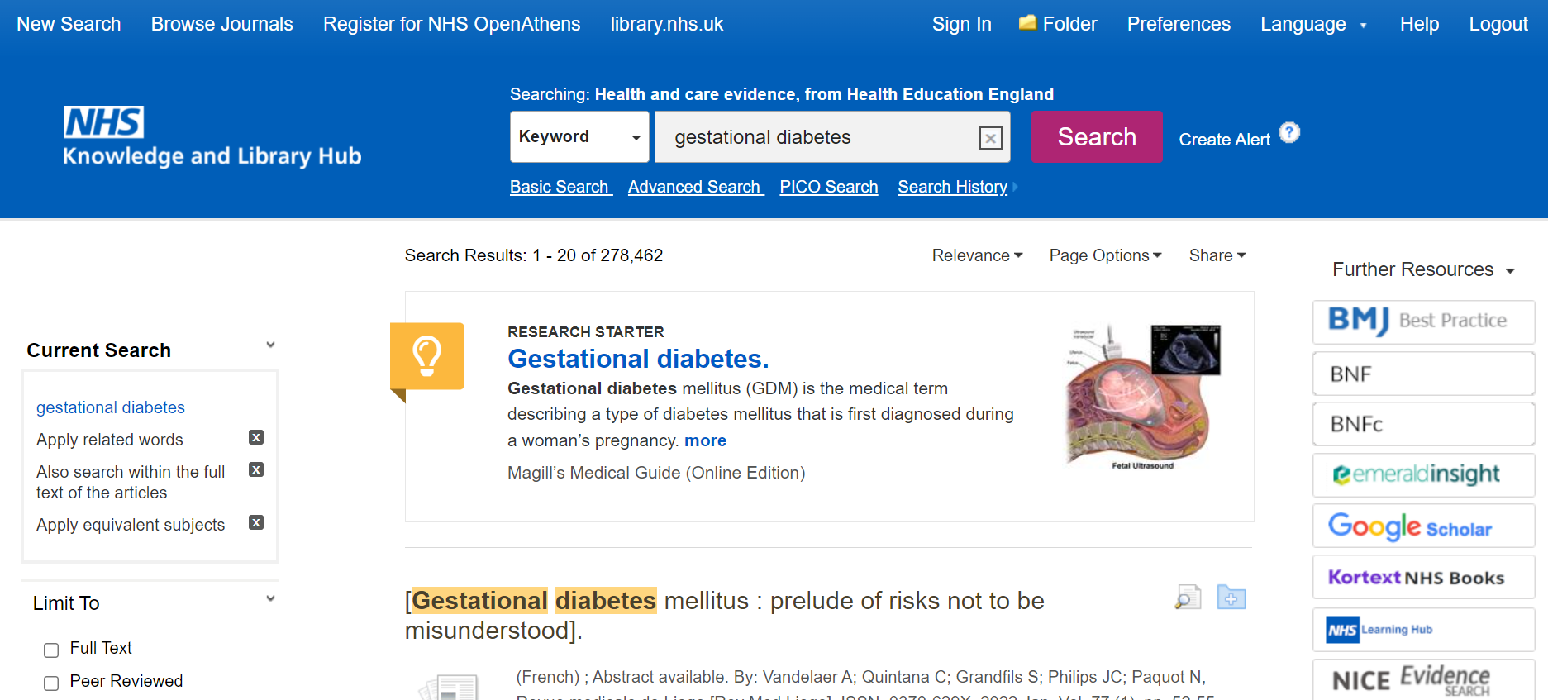
Search Results
Notes:
When you have entered your search terms using either simple or advanced search options, you will then be taken to your results page.

Slide 12
Search Results
Notes:
If a Research Starter is available for your search term, it will appear at the top of the search results list. Research Starters include links to relevant articles, images, videos, and audio clips.

Slide 13
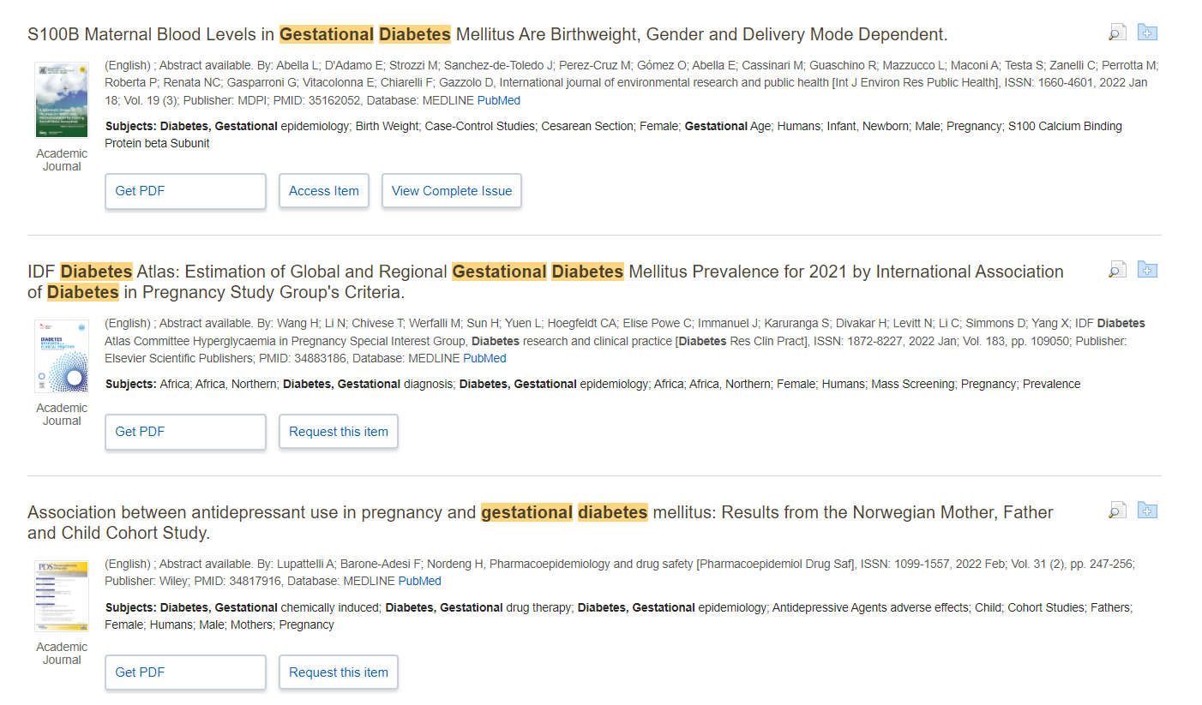
Search Results
Notes:
As you scroll through your results you will see lots of resources in including journal articles and books. You can see more information about each article by hovering over or clicking the review icon.

Slide 14
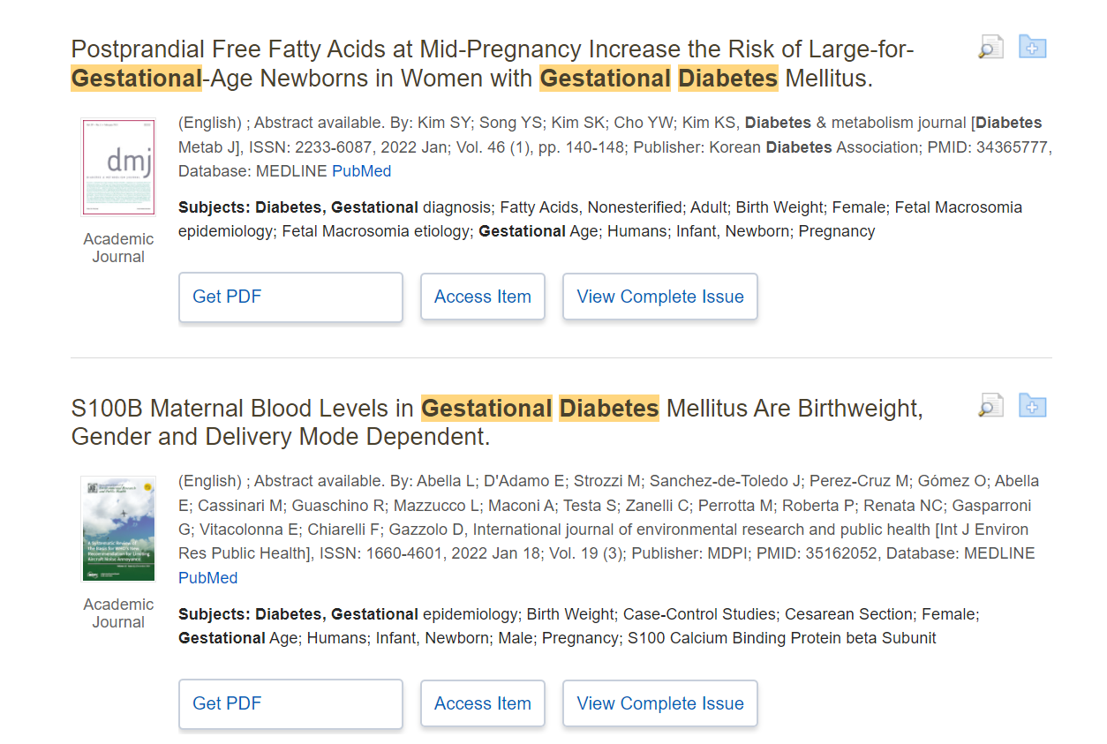
Full text
Notes:
You can access the full text if its available by clicking on either the Get PDF or Access Item buttons. If available, you can also view the complete issue of a journal. The NHS Knowledge and Library Hub gives you seamless access to the full text of licensed and open access articles.

Slide 15
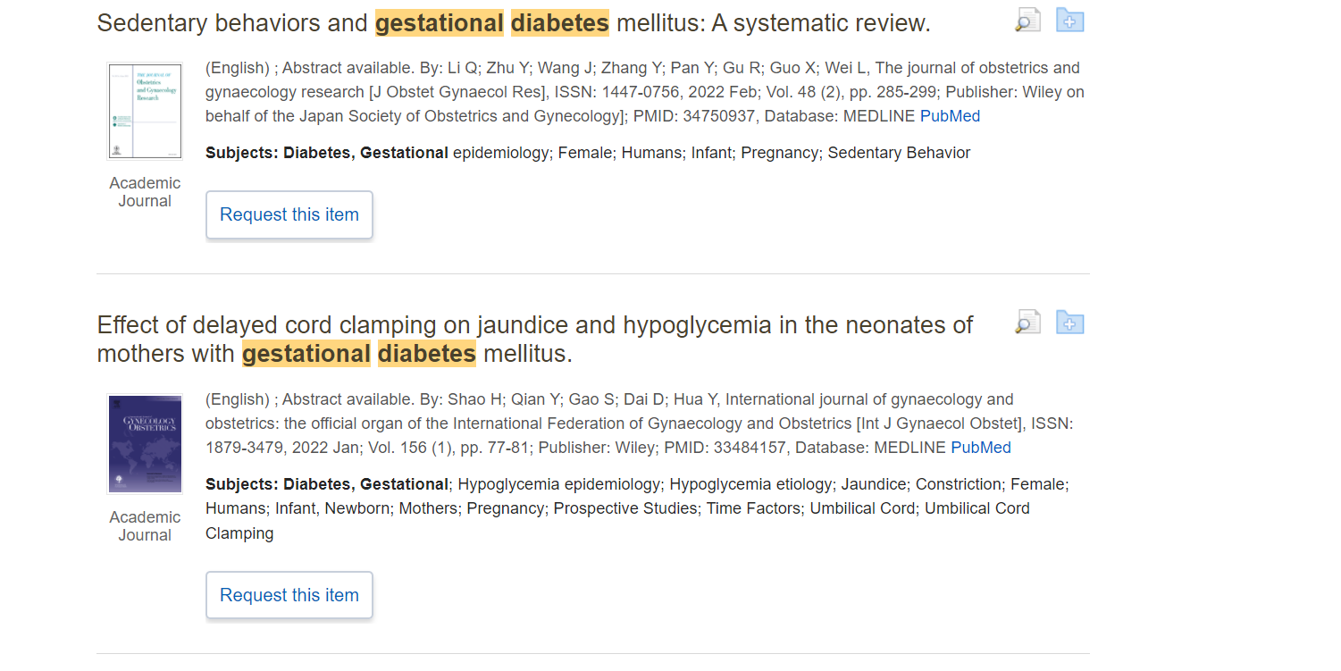
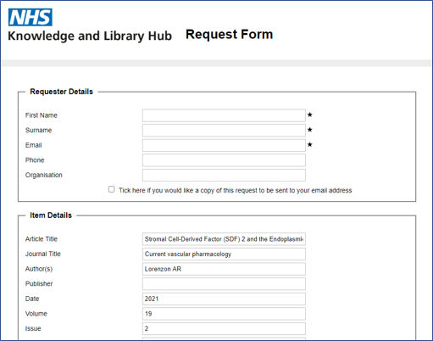

Request a copy
Notes:
If you do not have full text access to a resource, you may be able to request a copy of an article from your NHS library. Click on the request button to send a pre-populated form to your library. You just need to complete your name and contact details to make the request.

Slide 16
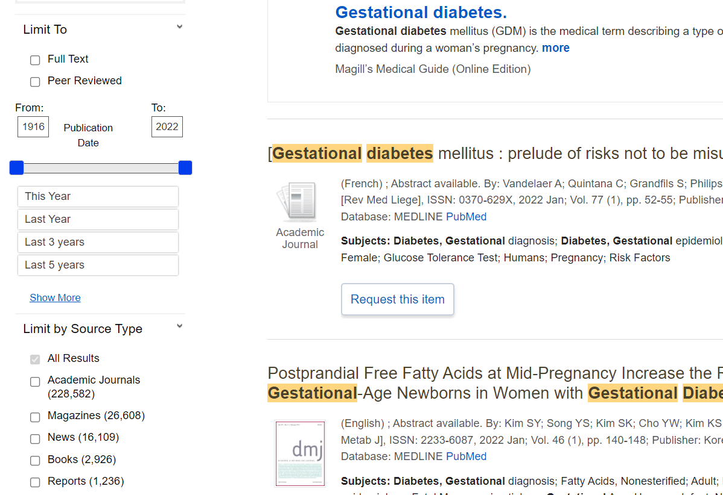
Filters
Notes:
If you are looking to refine your search from the Result List, you can apply some limits – these are found on the left-hand side of the screen. For example, you can limit by publication date, source type and subject terms.

Slide 17
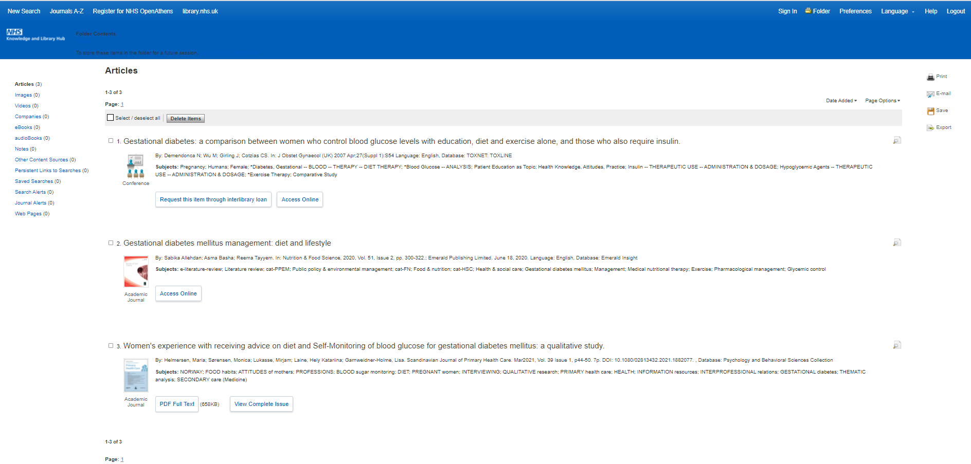
Folders
Notes:
If you want to save your articles and results for a later date, click on the folder button at the top of the page to use the folder feature. If you see a sign-in button click on that first.

Slide 18
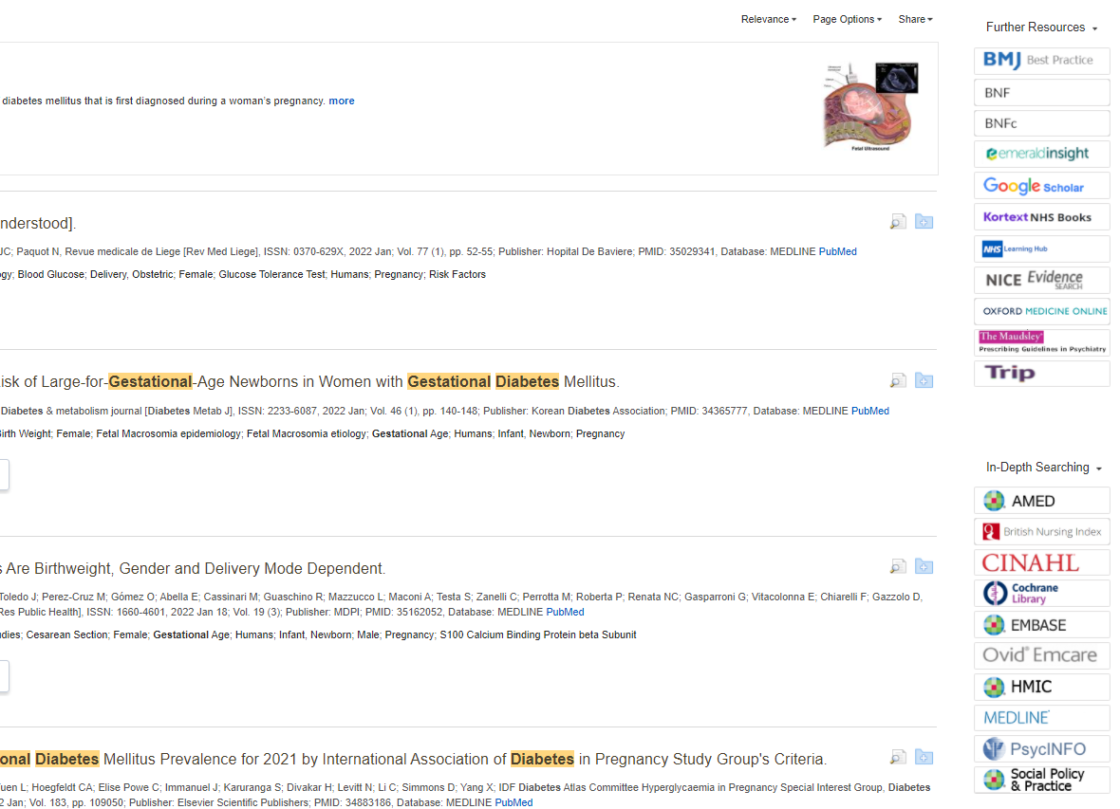
Further searching
Notes:
If you want to expand your search, on the right hand side of the screen you will see buttons that link you to lots of further resources and you can repeat your search with a single click. This includes resources such as BMJ Best Practice.

Slide 19
Further searching
Notes:
If you want to do an advanced search you can click on the buttons for an individual databases, such as Medline, CINAHL or PsycInfo

Slide 20
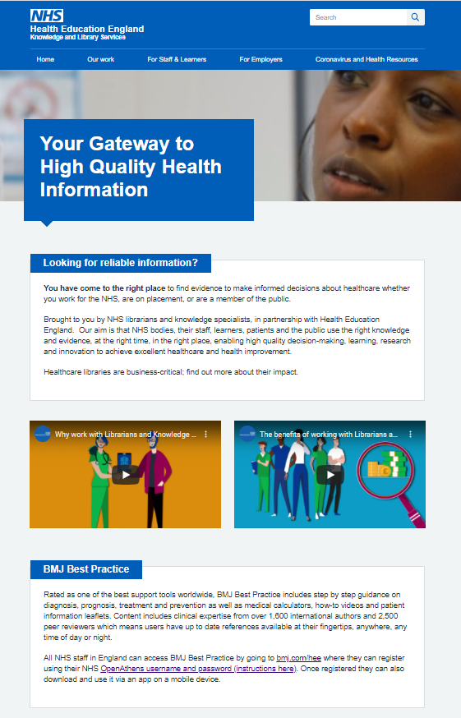



Find your NHS Knowledge and Library Service
hlsid.org
library.nhs.uk
Notes:
Go to library.nhs.uk to find out more about the Hub or use hlisd.org to find your local NHS library service.
You can also reach NHS knowledge and library staff through the Ask A Librarian function in the NHS Knowledge and Library Hub.

