Slide 1
A portal to (Meta)data
Dena Tahvildari - Bruna dos Santos Vieira
FAIR Data Team
Imaging Group Kick-off 31August 2023

Slide 2
The Vision
To have a smart research infrastructure where users (people and machines) easily find, exchange resources and reuse them

Slide 3
Requirements:
1. International standards – metadata schema
Describe our resources according to common metadata standards with rich semantics
To allow unique identifiability
To allow interoperability with EU portals
To make our resources unambiguous, reusable, interpretable (for people and digital applications)
2. Metadata catalogue / Health-RI portal
Implements the common metadata schema
Detailed Metadata Descriptions
Categorization & Classification
Search & Discovery
Agile development

Slide 4
HRI Core Metadata Schema
Core -- Health-RI provides a generic schema for descrbing resources to increase findability of resources (e.g. datasets)
F1: Data and metadata are assigned a globally unique and persistent identifier.
F2: Data are described with rich metadata.
F3: Metadata clearly and explicitly include the identifier of the data they describe.
F4: Data and metadata are registered or indexed in a searchable resource.
Leaves -- Nodes extend the core model for covering the specialised domain metadata requirements
Built on DCAT, DCAT-AP for data exchange between portals
Represented it in graph model (rdf compliant)
Notes:
F1: Data and metadata are assigned a globally unique and persistent identifier.
F2: Data are described with rich metadata.
F3: Metadata clearly and explicitly include the identifier of the data they describe.
F4: Data and metadata are registered or indexed in a searchable resource.

Slide 5
The Sunflower 1.0
Proteo
KWF
NWO
Metab
Transcrip
Omics
ZonMw
Funders
What Apart from DCAT AP Potals?
Core: Minimal DCAT AP Portals Extended: Health-RI
Leaves (Petals?): - Domain: Imaging data - sub-domains (neuroimaging)
https://github.com/Health-RI/health-ri-metadata/
DCAT AP Portals
(mandatory fields)
Clinical
Biobank
0.9
2.0
CDEs
Cohorts
Rare Diseases
Imaging
PROMS
neuroimaging
DCDEs
Notes:
To find stuff = We need to Describe stuff (be searchable before findable)
Findability = semantically enriched Metadata (unambiguous)

Slide 6
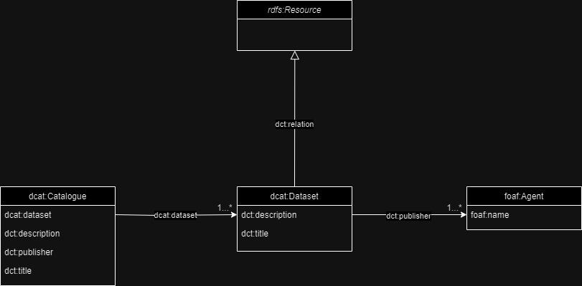
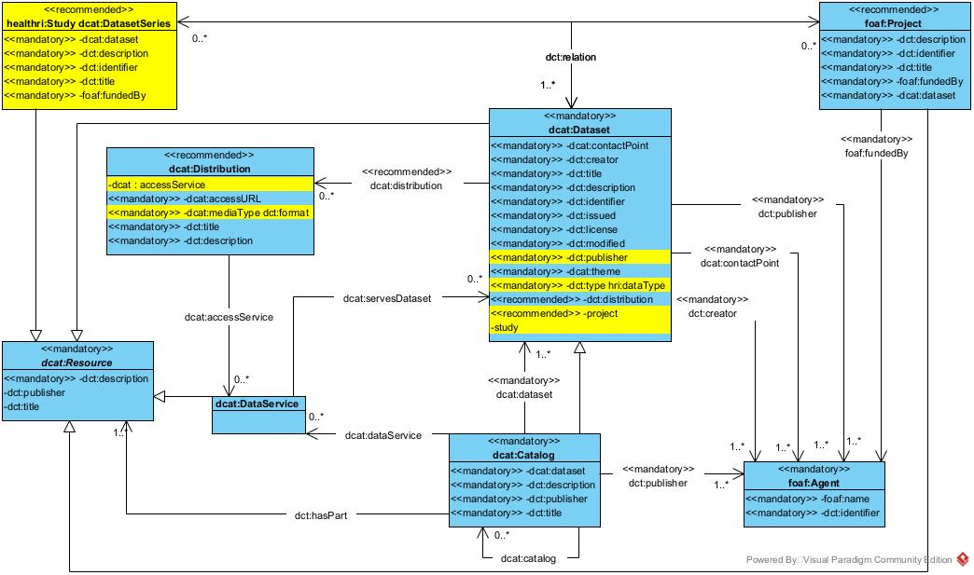
All resources must describe/ provide the core metadata with the core metadata schema
Health-RI core metadata schemas
Funders
Omics
What Apart from DCAT AP Potals?
https://joinup.ec.europa.eu/collection/semic-support-centre/solution/dcat-application-profile-data-portals-europe
DCAT AP Portals
(mandatory fields)
Clinical
Biobank
0.9
2.0
Rare Diseases
Cohorts
Imaging
https://github.com/Health-RI/health-ri-metadata

Slide 7
Defining Core
Currently we have:
Identified EU standards (DCAT, DCAT AP Portals, DCAT AP Health)
Collected some NL Nodes and Health-RI metadata schemas (RUMC, AUMC, Princess Maxima, Covid Portal)
Mapped all of the above here
For HRI portal release 0.9:
Minimal Core: DCAT-AP Portals mandatory fields
For later (HRI portal release 2.0):
Plan to release HRI Core metadata schema answering: What apart from DCAT AP Portals mandatory fields should be in the HRI core?

Slide 8
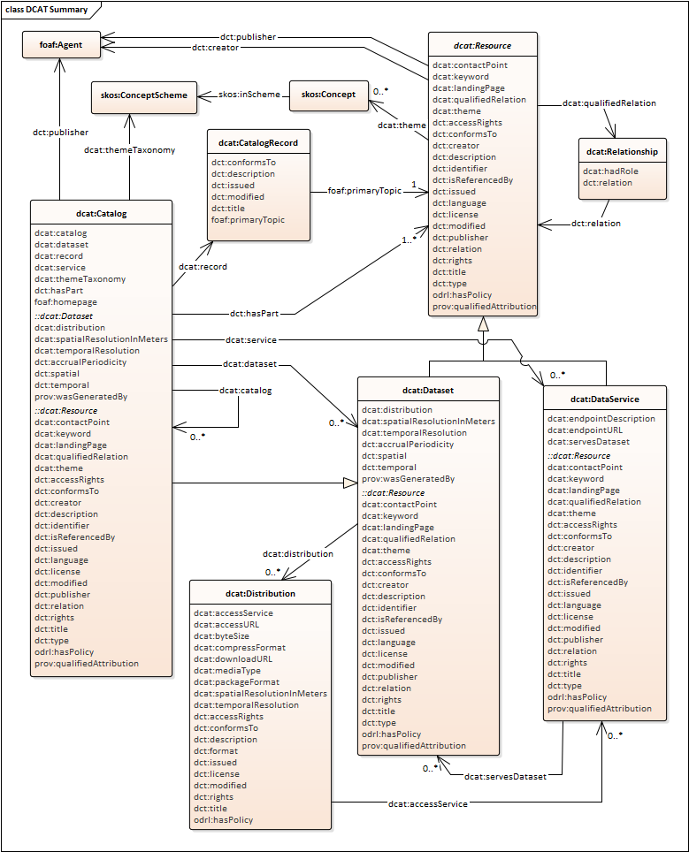
DCAT
DCAT is an RDF[1] vocabulary designed to facilitate interoperability between data catalogues published on the Web.
prefix dcat: <http://www.w3.org/ns/dcat#> .
Main classes:
dcat:Catalogue
dcat:Dataset
dcat:Distribution
[1]RDF: Resource Description Framework

Slide 9
Objectives of DCAT-AP
Supporting the discovery of/access to data in a cross border and cross domain environment, by harvesting data from distributed portals.
In the form of an application profile of W3C DCAT, by:
Expressing constraints and usages notes on DCAT properties and classes, and
Including additional properties and usages of controlled vocabularies
In such a way that the metadata descriptions are maximally harmonized across Europe, and provide a reliable source for the European Data Portal
Extensions exists to serve different communities better, BregDCAT-AP, GEODCAT-AP, StatDCAT-AP.
Link to the specification -- https://www.w3.org/TR/vocab-dcat-2/
You can also find it on health-ri git https://github.com/Health-RI/health-ri-metadata/tree/master/DCAT-AP

Slide 10
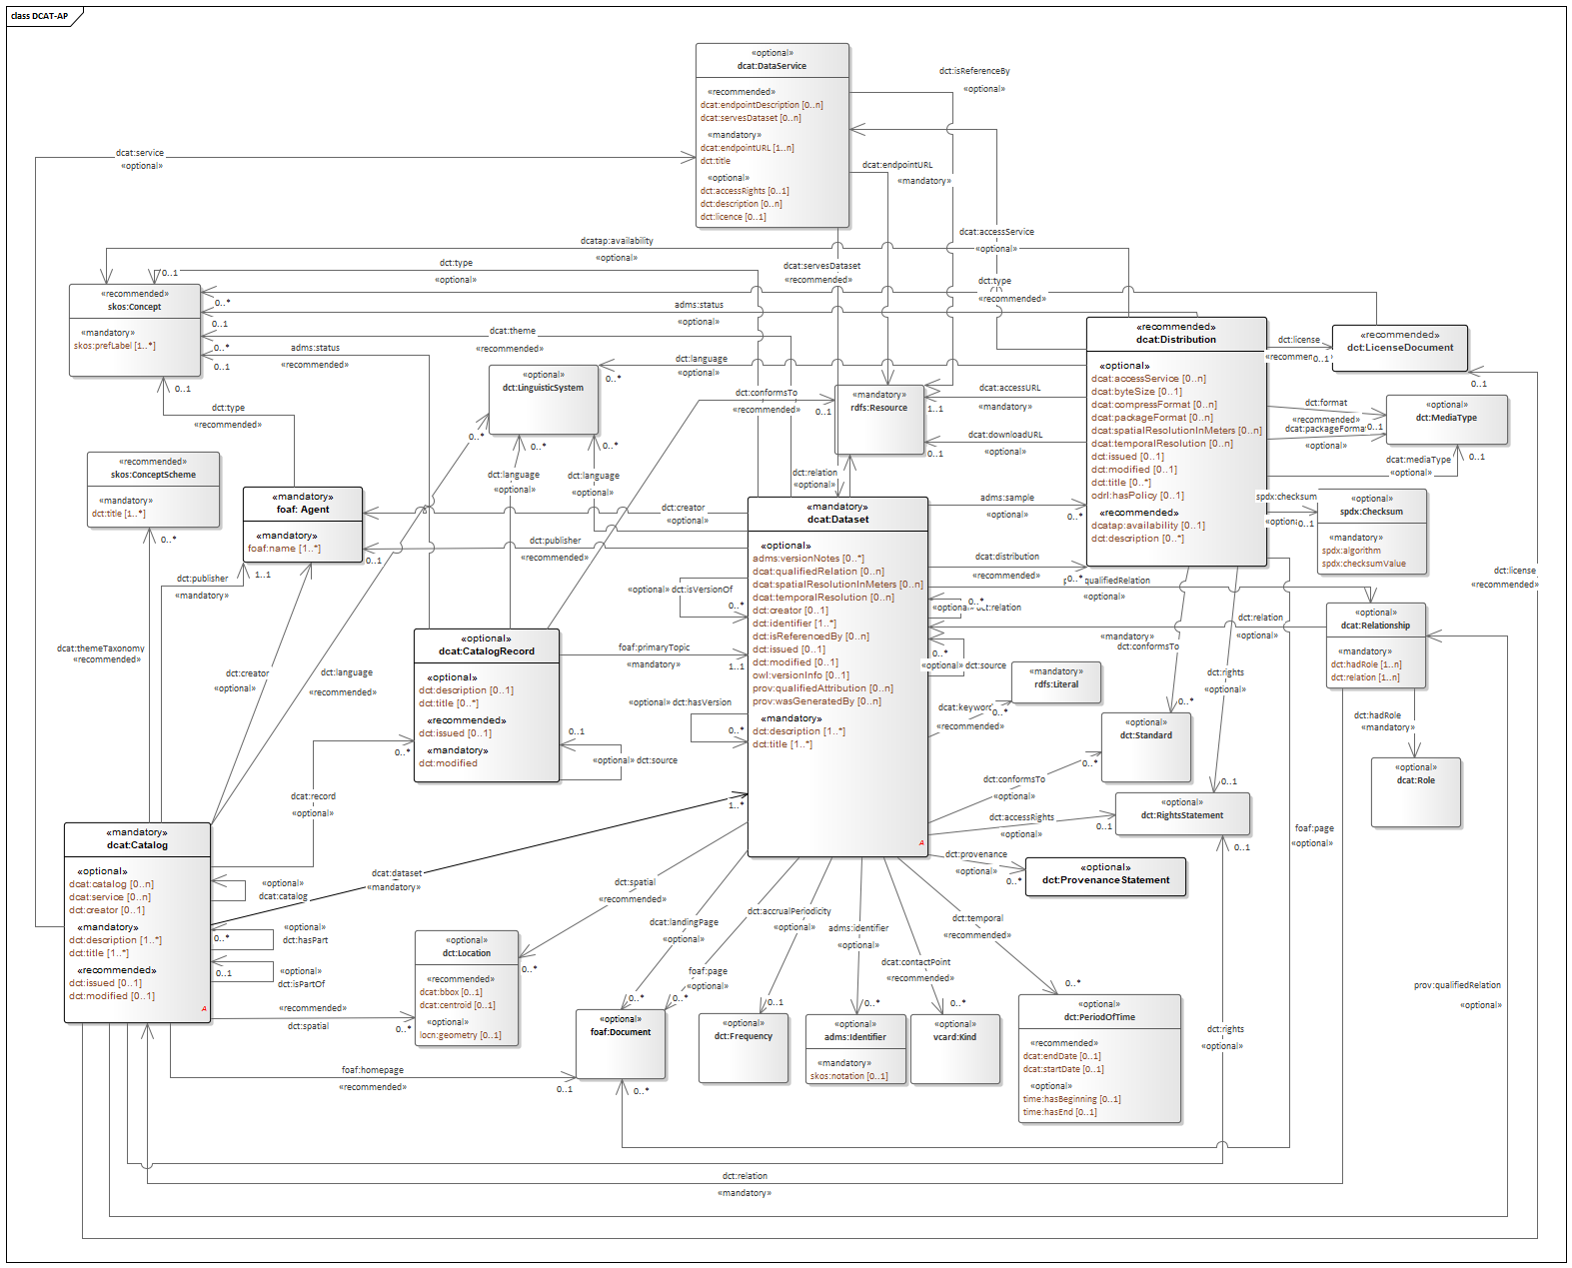
DCAT-AP Portal

Slide 11
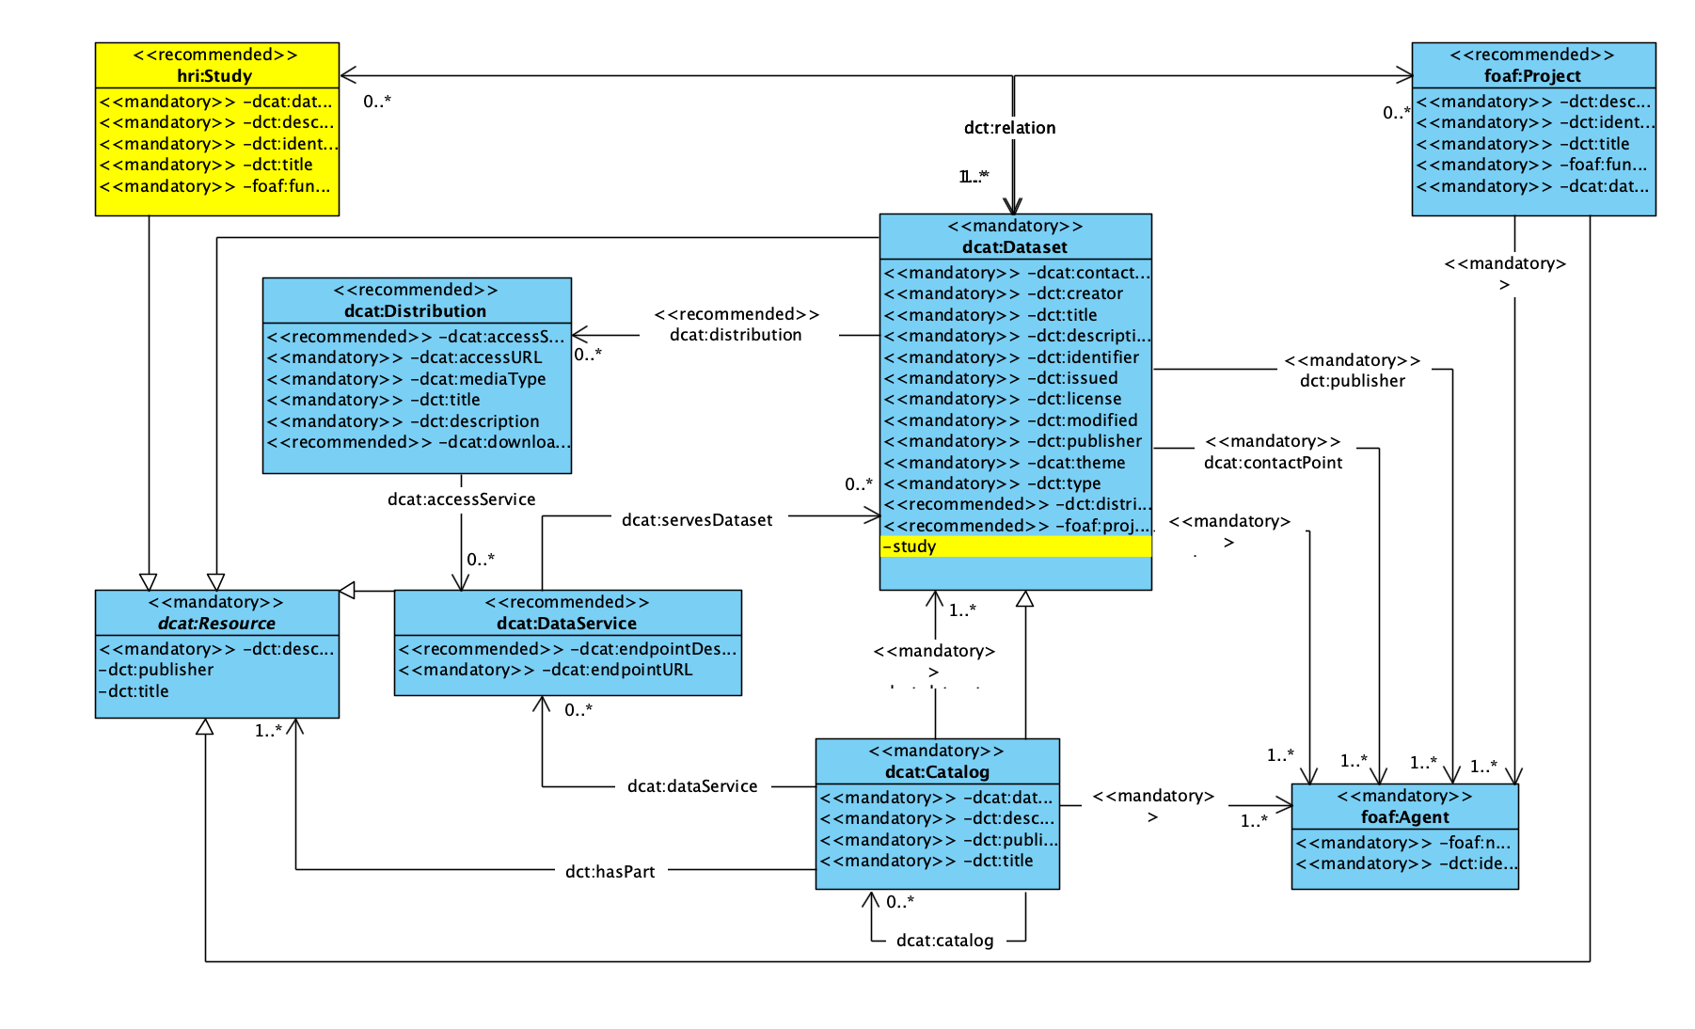
HRI Core schema 0.9 release

Slide 12
Practical steps for aligning with the core metadata schema
All resources must describe/ provide the core metadata with the core metadata schema
Map and align your metadata models to dcat-ap
Think of listing the resources and collect metadata instances that will be part of health-ri portal

Slide 13
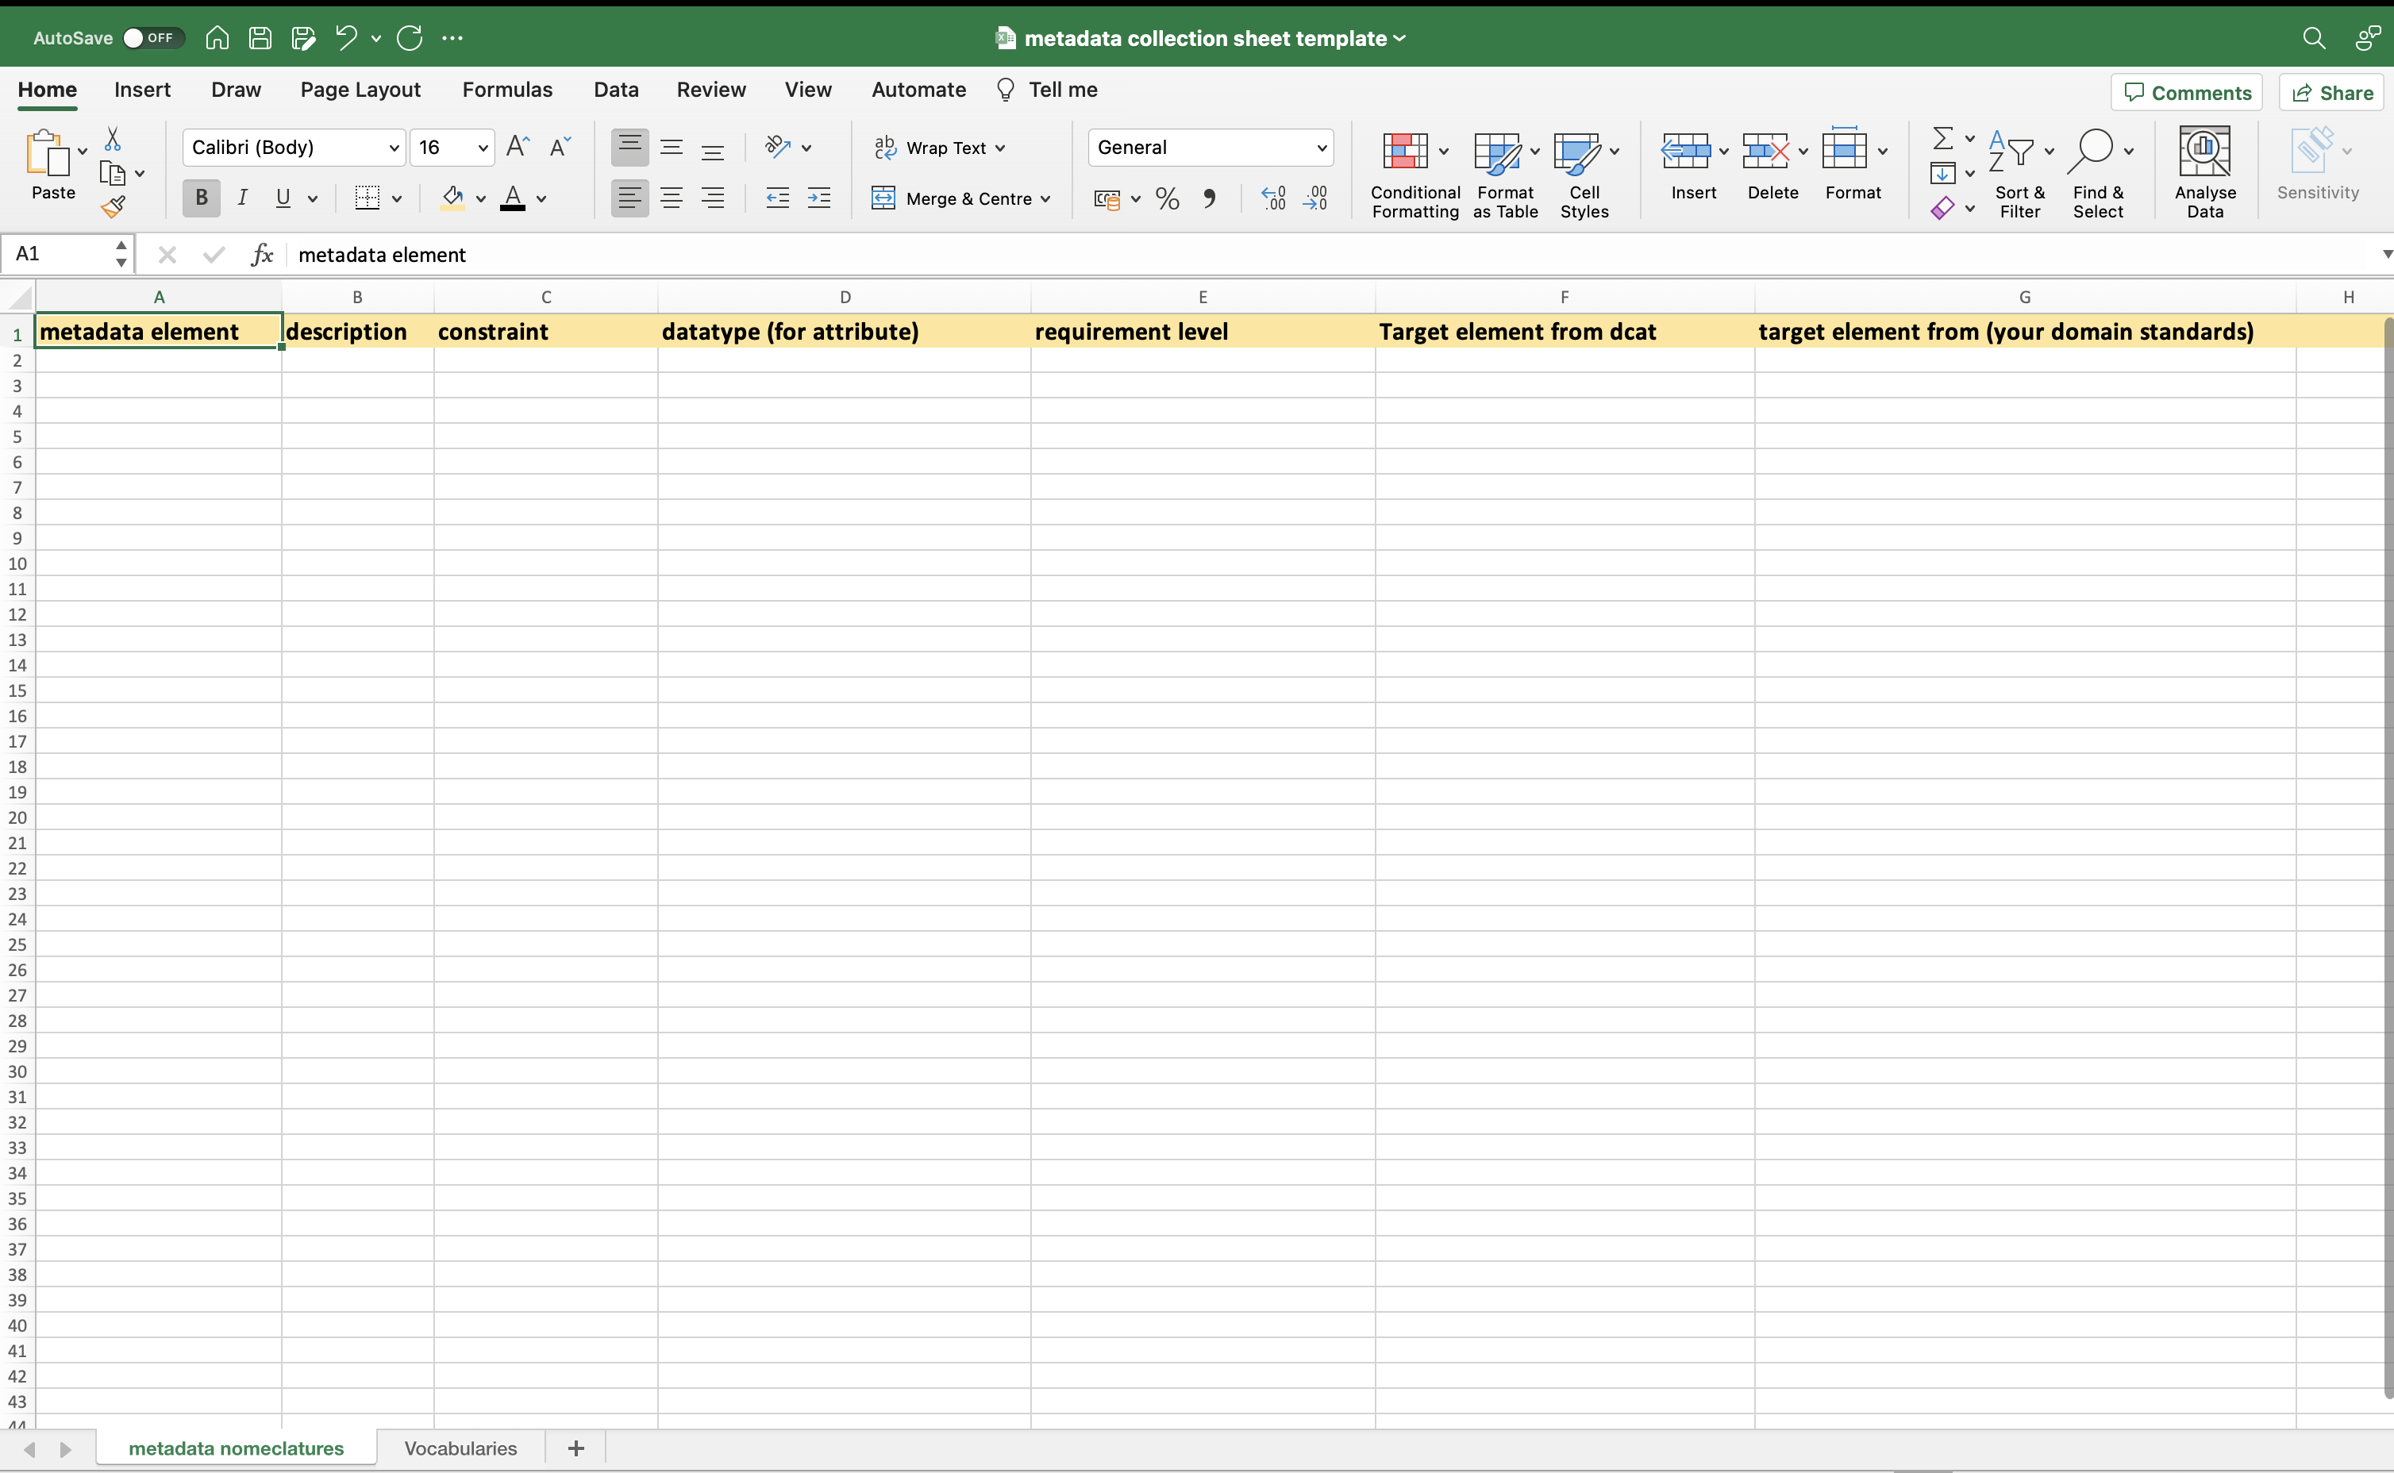
Health-RI domain (leaves) metadata schemas
Biobanks and collections
Funders
Omics
What Apart from DCAT AP Potals?
DCAT AP Portals
(mandatory fields)
Clinical
Biobank
0.9
2.0
Resources in a domain must offer, extra to the core, their minimal metadata to find their domain resources
Rare Diseases
Cohorts
imaging

Slide 14
Defining Leaves – domain-specific Metadata
Domains (e.g. Imaging group, omics, biobanks & collections) will specialize the generic/core schema into their needs and properties.
What metadata should you prioritise?
FAIR
Important to find your dataset (e.g. diagnosis, sample size, subjects (people, demo)
Increase accessibility (sharing protocol/access constraints)
Increase interoperability (which vocabulary, coding language was used in your data)
Increase reusability (consent/license, provenance, standards used for coding your data, study protocols as a quality standard, pointer to the data)
Other
Important for the “visuals” of the portal (e.g. Logo URL, Landing Page URL)
Important for your domain (e.g. imaging example)

Slide 15
Steps towards Leaves – Health-RI Git
Go to https://github.com/Health-RI/health-ri-metadata
Request Jeroen Beliën 🧙 to add you to the HRI Metadata repo
health-ri-metadata/Leaves
Metadata schema
Health-RI metadata schema diagram
DCAT-AP specification
DCAT-AP in SHACL and RDF
Leaves
Metadata requirements collection template (terminology inventory)
Omics → active
Imaging
Biobank → starting
Feedback / Result from Domain working groups are expected to be shared via Git
Make a new issue on git and assign to Dena and/or Bruna

Slide 16
Steps towards Leaves – Collect Requirements
Collect requirments and define scope in form of competency queries.
Define them using natural language
To understand what kind of metadata is required to make data findable, reusable and etcetera.
From the pov of the user that is requesting data (searching)
These questions will later be translated to Formal queries
For example: (see next slide)
Notes:
A user requires MRI scans of patients taken over a span of years, ideally both from patients who eventually developed Alzheimer's and those who did not. These longitudinal datasets can help her trace the progression and potential early signs of the disease. She turns to a well-known medical metadata catalogue that hosts a vast array of medical imaging data from various hospitals and research institutions.
Using the Metadata Catalogue:
Search by Modality:
Dr. Mitchell starts by filtering datasets that only contain MRI scans, ensuring she's looking at the right type of imaging data.
Focus on Brain Scans:
Among MRI scans, she further refines her search to only include datasets with brain imaging, excluding other parts of the body.
Time Period:
She's interested in data spanning the last 20 years, so she sets the date range from 2003 to 2023.
Patient Demographics:
Dr. Mitchell wants a diverse dataset. She looks for datasets that include a breakdown of patient age, gender, and ethnicity.
Clinical Annotations:
Datasets that come with clinical notes or annotations indicating whether a patient was later diagnosed with Alzheimer's are of particular value. She filters to prioritize these.
Resolution and Quality:
High-resolution MRI scans are essential for her analysis, so she specifies a minimum acceptable resolution.
Data Usage Policies:
Dr. Mitchell checks for datasets with clear licensing and usage terms. She prefers datasets that are available for academic research without stringent restrictions.
Associated Metadata:
Metadata about the MRI machine model, settings, and software can influence the imaging results. She prefers datasets that provide this information for consistency and to understand any potential biases.
Feedback and Citations:
The metadata catalogue has a feature where researchers can leave feedback or cite datasets they've used. Dr. Mitchell checks datasets with positive feedback and those frequently used in published research.
Dataset Download:

Slide 17
Example of Competency Queries
The story: A researcher requires MRI scans of patients taken over a span of years, ideally both from patients who eventually developed Alzheimer's and those who did not. These longitudinal datasets can help her trace the progression and potential early signs of the disease. He turns to a health-ri medical metadata catalogue that hosts a vast array of medical imaging data from various hospitals and research institutions.
As a researcher in neurology I want to:
Using the Metadata Catalogue Portal:
Search by Modality:
I would like to filters datasets that only contain MRI scans, ensuring that I am looking at the right type of imaging data.
Focus on Brain Scans: (body parts)
Among MRI scans, I further want to refine my search search to only include datasets with brain imaging, excluding other parts of the body.
Time Period:
I am interested in data spanning the last 20 years, so she sets the date range from 2003 to 2023.
Patient Demographics:
The user wants a diverse dataset. he looks for datasets that include a breakdown of patient age, gender, and ethnicity.

Slide 18
2 Creat terminology inventory
By analysing the competency queries (search examples) you can extract imporant terminologies, get hints to the domain vocabualries, data dictionaries, standards, data types and so on.
Document your domain specific requirements
term | definiton | role | Rules and constraint | vocabularies
Image mudularity
time
age
sex

Slide 19
3. Reuse Existing Standard
leveraging pre-existing, widely accepted ontologies, vocabularies, or frameworks instead of creating new ones from scratch (Interoperability, validation, and consistency)
Digital Imaging and Communications in Medicine (DICOM), is a standard for transmitting, storing, retrieving, printing, processing, and displaying medical imaging information -- Widely used in hospitals, clinics, and medical research settings. https://www.dicomstandard.org/, (Mildenberger et al, 2002)

Slide 20
Next step: Sematic Modelling
. Represent the terms in rdf compliant manner -- semantic modelling
Classes: an abstraction mechanism for creating a collection of objects with similar characteristics. The Objects called instances of a class. (e.g. Class(Dataset) and individual(dataset-100) is an instance of it).
Class Axioms: Class can have hierarchical relationships (subclass) which allows for inheritance and subsumption.
Enumeration: Categorical data (controlled vocabularies)
Datatype Property: these are relationships between instances of classes. (e.g. dataset’s title is a datatype property that related all the instance of the class dataset to a string datatype).
Object Property: These are relationships between instances of two classes. For example ”hasDistribution” is an object property that related all the instances of class dataset to instances of class distribution.

Slide 21
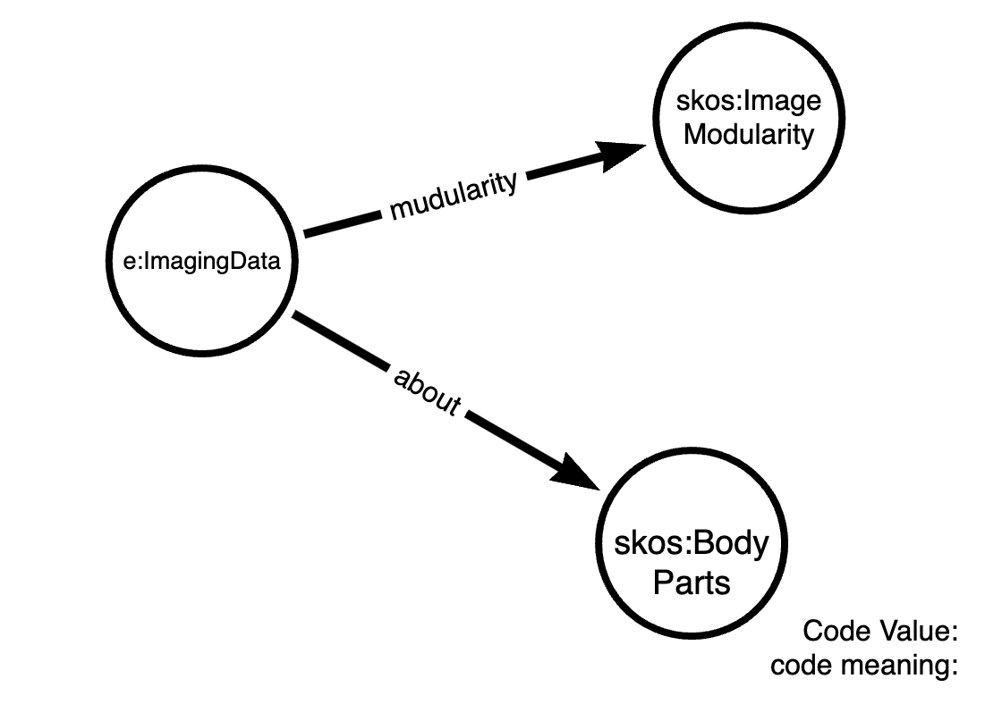
Example of a semanti model
https://dicom.nema.org/medical/dicom/current/output/chtml/part16/chapter_L.html#chapter_L

Slide 22
Next step: Implement the model (Formal)
Encode the domain specific metadata model in RDF/OWL/shacl
Use SKOS for modelling Controlled vocabularies and
Use Shape Schema language for representation Data constraints and validation rules
Translate the requirements to sparql queries for evaluation and testing in the final stage

Slide 23
Team: HRI Core Metadata Schemas 🌻
Technical Metadata Team (TMT ) will support the technical part of building a metadata schema (Bruna, Dena, Luiz, Kees)
Only domain experts (working groups and portal teams) can define the metadata properties (content).
TMT add main properties from DCAT, DCAT AP portals, and supplied schemas from the nodes
Who will tell, apart from DCAT, which are the other obligatory fields?
Once domain schemas are out for review, TMT can check and embed the obligatory fields in the core schema
Portal groups will review taking into account usability of the schema in health-ri infrastructure (Portal) etc

Slide 24
The next step: Semantic modelling
Create:
Classes: is an abstraction mechanism for creating a collection of objects with similar characteristics. The Objects call instances of a class. (e.g. Class(Dataset) and individual(dataset-100) is an instance of it). Class can have hierarchical relationships (subclass) which allows for inheritance and subsumption.
Enumeration: Categorical data (controlled vocabularies)
Class axiom: subclass and hierarchies
Datatype Property: these are relationships between instances of classes. (e.g. dataset’s title is a datatype property that related all the instance of the class dataset to a string datatype).
Object Property: These are relationships between instances of two classes. For example ”hasDistribution” is an object property that related all the instances of class dataset to instances of class distribution.

Slide 25
Metadata schema is a Graph
Collection
Image modality
Metadata
model
modality
rdf:type
rdf:type
CLASS
Col-1
hasDistribution
Mamography
Instance of
the metadata
Instance
Relations

Slide 26
Health-RI git repo
DCAT-AP specification and models
https://github.com/Health-RI/health-ri-metadata/tree/master/DCAT-AP
Metadata Requirement sheet
https://github.com/Health-RI/health-ri-metadata/blob/master/Leaves_Petals/metadata%20collection%20sheet%20template.xlsx

Slide 27


Take away
Define your metadata scope and requirements
Identify pre-existing standards in your field and map your requirements to it, “DICOM” Ontology
Request Rob (or Jeroen) for GitHub access
Model your requirement in graph model (class, properties , relations).
Make you data and metadata DCAT-AP compliant.
Keep your versioning in GitHub 🌻
Need specialised help? Talk to your group leaders 🧙
Need more Metadata/Modelling/FDP help? Talk to Bruna Vieira, Dena Tahvildari, Luiz Bonino, Kees Burgers.
Want to offer help? Contact us!

