Slide 1
Proteo
NWO
The Sunflower 1.0
Metab
KWF
Transcrip
Omics
ZonMw
Funders
What Apart from DCAT AP Potals?
Core: Minimal DCAT AP Portals Extended: Health-RI
Leaves (Petals?): -Domain:Your Omics -sub-domains (transcriptomics)
https://github.com/Health-RI/health-ri-metadata/
DCAT AP Portals
(mandatory fields)
Clinical
Biobank
0.9
2.0
CDEs
Cohorts
Rare Diseases
PROMS
DCDEs

Slide 2
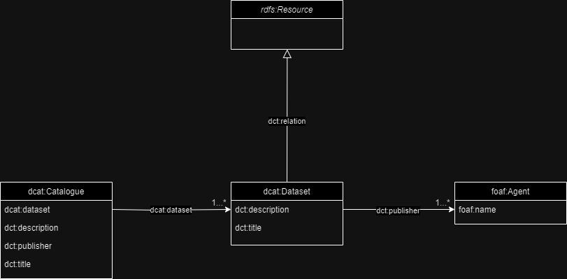
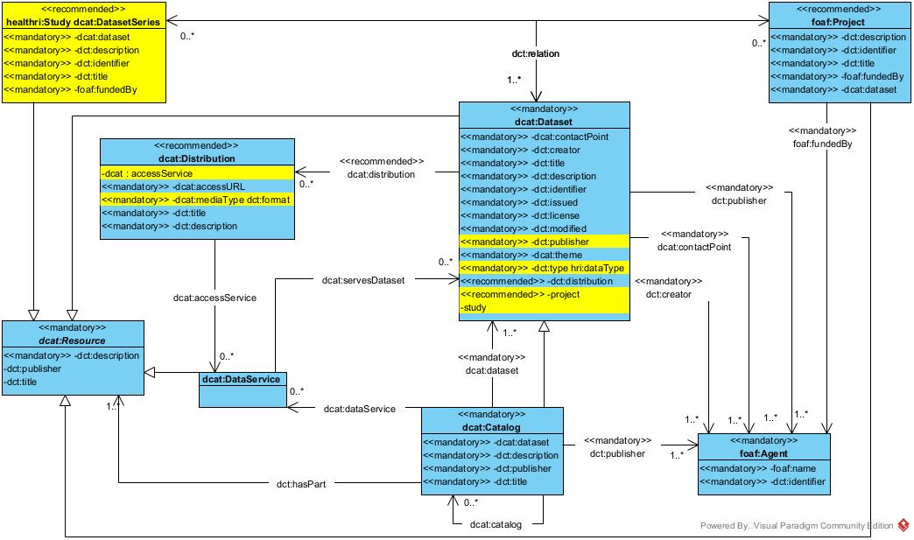
Health-RI core metadata schemas
All resources must describe provide the core metadata
Funders
Omics
What Apart from DCAT AP Potals?
DCAT AP Portals
(mandatory fields)
Clinical
Biobank
https://joinup.ec.europa.eu/collection/semic-support-centre/solution/dcat-application-profile-data-portals-europe
0.9
2.0
Rare Diseases
Cohorts
https://github.com/Health-RI/health-ri-metadata

Slide 3
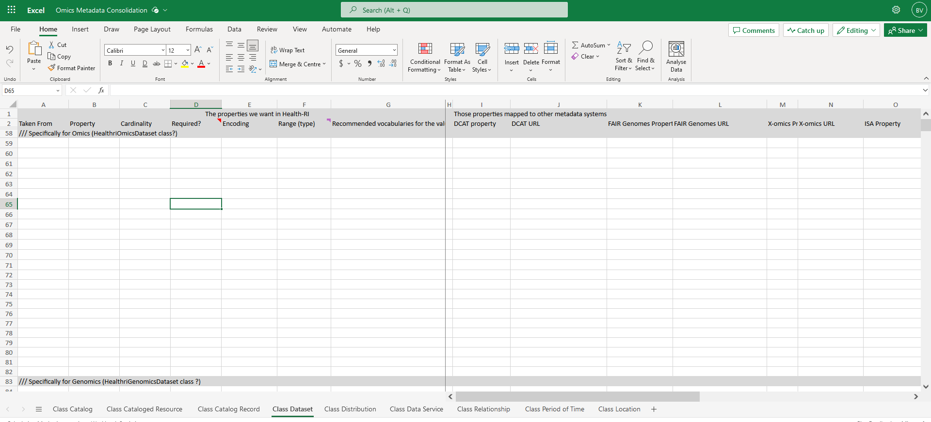
Health-RI domain (petal) metadata schemas
Funders
Omics
What Apart from DCAT AP Potals?
DCAT AP Portals
(mandatory fields)
Clinical
Biobank
0.9
2.0
Resources in a domain must offer, extra to the core, their minimal metadata to find their domain resources
Rare Diseases
Cohorts

Slide 4

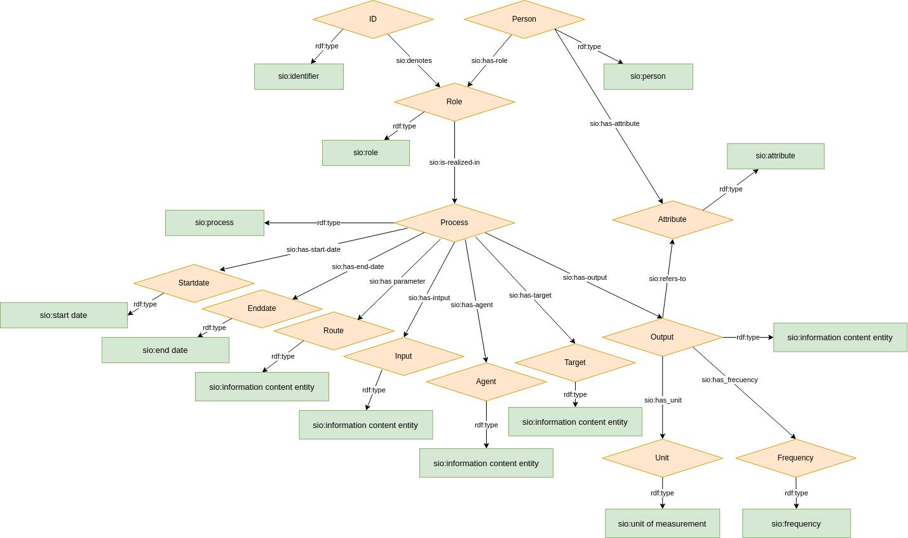
Health-RI data models
Omics
Funders
What Apart from DCAT AP Potals?
Variables, values, relations in a domain or project, example rare disease cde model, mldi, etc
DCAT AP Portals
(mandatory fields)
Clinical
Biobank
0.9
2.0
Cohorts
Rare Diseases
https://github.com/ejp-rd-vp/CDE-semantic-model

Slide 5
Domain
Health-RI
FAIR self declaration
Funder
DCAT
Data Type

Slide 6
Domain
Health-RI
FAIR self declaration
Funder
DCAT
Data Type

Slide 7
Oncology
Omics
ZonMW
Domain
KWF
Health-RI
FAIR self declaration
Funder
DCAT
NWO
Sequencing
DAC
Data Type
Text

Slide 8
Oncology
Omics
ZonMW
Domain
KWF
Health-RI
DCAT
FAIR self declaration
Funder
Catalogue:
Description
Title
publisher
Dataset:
Description
Title
Distribution:
- Access URL
Creator
Key words
NWO
Sequencing
Data Type
Text

