Slide 1




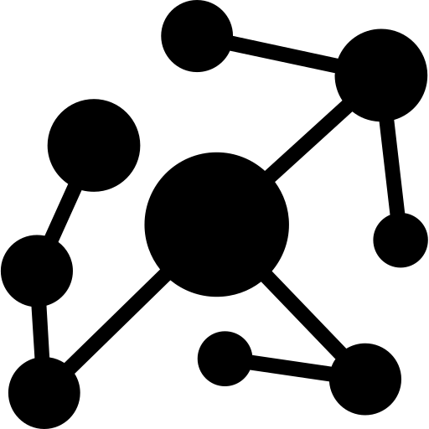


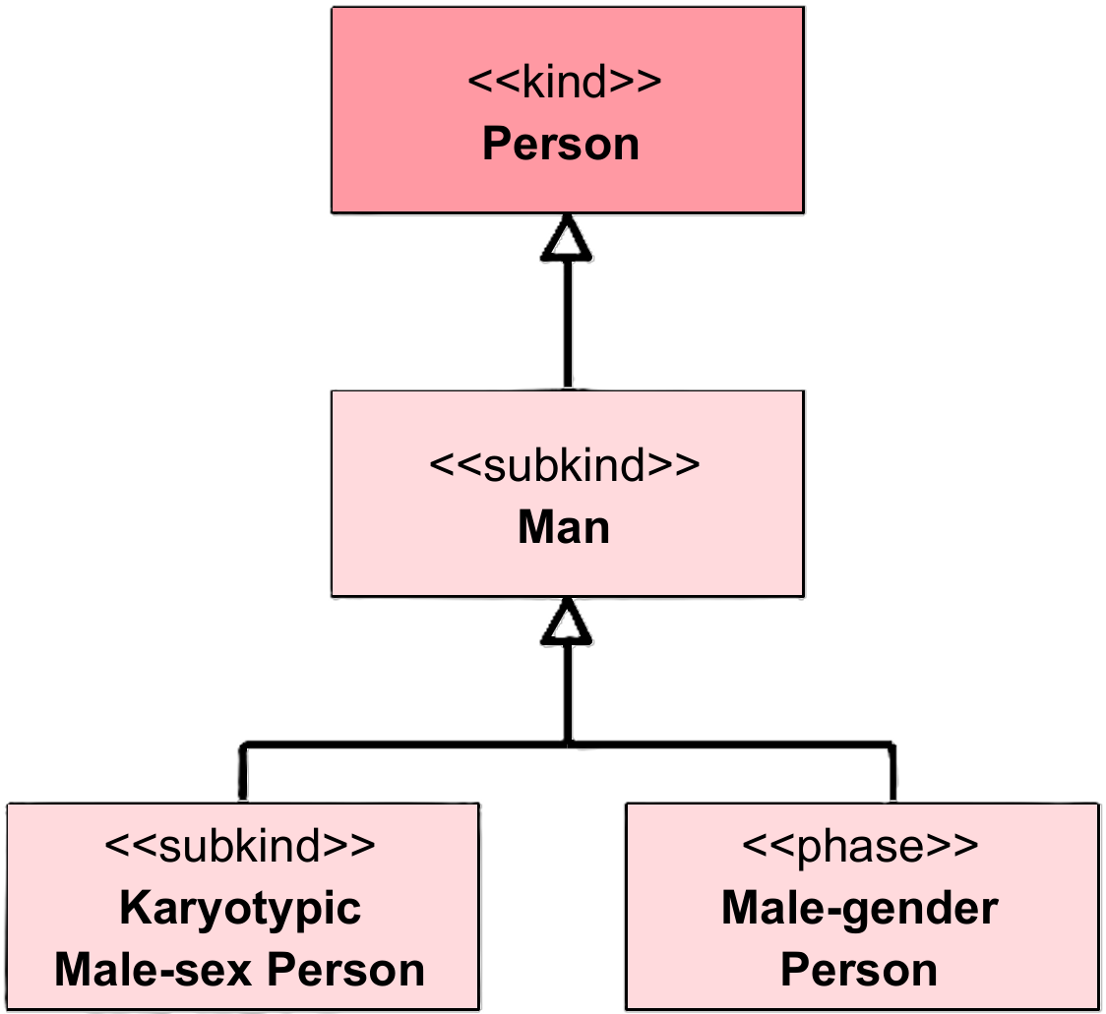
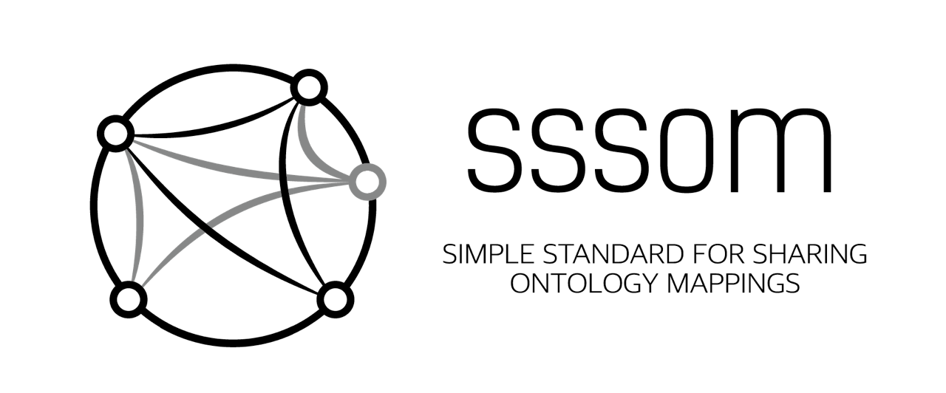

Enabling Semantic Traceability in Health Data: The Health-RI Semantic Interoperability Initiative
Pedro Paulo F. Barcelos¹, Niek van Ulzen¹, Reinier Groeneveld¹, Ana Konrad¹,
Qasim Khalid², Shuxin Zhang³, Annemarie Trompert¹, and Janet Vos¹
Building a single national comprehensive infrastructure to enable
ground-breaking Personalized Medicine & Health research: Health-RI
On behalf of the Dutch BBMRI node
BACKGROUND AND MOTIVATION
ENABLING SEMANTIC TRACEABILITY
Fragmented landscape
MEANING
Semiotic View
MDA View
Health data are distributed across many standards, data models, and local schemas
The same domain concepts are represented differently across care, research, and infrastructure settings
conceptualization
⬅ refers to
referent
conceptualization
⬅ represents
meaning of ➔
represents ➔
refers to ➔
CIM
meaning of ➔
Semantic gap
Data may be exchanged syntactically while meaning is not preserved across systems
Similar labels, codes, or formal structures do not guarantee the same conceptualization
This may create false agreement: systems may appear aligned while remaining semantically misaligned
implements ➔
⬅ represents
refers to ➔
PIM
meaning of ➔
⬅ represents
REPRESENTATION
referent
REFERENT
Limits of current practice
Semantic traceability in the Health-RI Semantic Interoperability Initiative’s architecture. The semiotic view (left) shows OntoUML as a representation of a shared conceptualization of the referent domain. The MDA view (right) shows HRIO OntoUML as the CIM and the HRIO gUFO/OWL ontology as the PIM, with the PIM implementing the CIM.
Interoperability still depends heavily on manual, case-by-case pairwise mappings
These mappings are difficult to scale, maintain, and revise as standards and local schemas evolve
Meaning-level assumptions often remain implicit, incomplete, and hard to compare across artifacts
(directly) represents
(indirectly) represents
What is needed
hrio:Person
hriv:hasExactMeaning
std1:Human
A common semantic reference model is needed to make intended meaning explicit and traceable across artifacts
Standards and local schemas should connect to this shared reference through reusable mappings, rather than being repeatedly reconciled pairwise
hrio:MalePerson
rdfs:subClassOf
rdfs:subClassOf
hrio:Karyotypical
Male
hriv:hasExactMeaning
std1:Man
rdfs:subClassOf
hrio:PersonWith
MaleGender
hriv:hasExactMeaning
std2:Man
Why this matters
Clearer semantic alignment can help reduce misinterpretation, mitigate false agreement, and support more trustworthy integration
It can improve comparability, reuse, and FAIR-aligned interoperability across institutions and use cases
Example of semantic traceability: a fragment of HRIO OntoUML for Person’s sex and gender is implemented in HRIO gUFO/OWL, and external ontologies’ OWL classes are aligned via HRIV mappings, distinguishing direct and indirect representation relations. The semantics of the external classes are traceable to their corresponding meanings modeled in OntoUML.
ARTIFACTS
REFERENCES
HRIM
Mapping Set
HRIO
Conceptual
https://w3id.org/health-ri/
semantic-interoperability
HRIO
Computational
Barcelos, P. P. F., van Ulzen, N., Groeneveld, R., Konrad, A., Khalid, Q., Zhang, S., Trompert, A., & Vos, J. (2026, March 24–25). Enabling semantic traceability in health data: The Health-RI Semantic Interoperability Initiative. SWAT4HCLS 2026: Semantic Web Applications and Tools for Health Care and Life Sciences, Amsterdam, the Netherlands.
¹ Health-RI, Jaarbeursplein 6, 3521 AL, Utrecht, The Netherlands
² Leiden University Medical Center (LUMC), Albinusdreef 2, 2333 ZA Leiden, The Netherlands
³ Amsterdam University Medical Center, Meibergdreef 9, 1105 AZ, Amsterdam-Zuidoost, The Netherlands

