Slide 1



Analysing Effects of the Menstrual Cycle in Digital Health: Mental Health & Heart Rate Data
MCAnalysis Package on Github
Kyra Delray, Statistics PhD Student, University of Oxford
Data: Health Apps, Flo & Juli
Funded by ESPRC (previously NIHR, UCL)
MCAnalysis Package
Notes:
3 minutes
Intro – I created a package for menstrual cycle analysis
Main- use cases
Results- show off plots , describe what they mean – show one mood or similar and one heart rate
-mention there are several others.
Package QR code at the corner on all pages
1 for package and one for blog.
Thank you
Have linkedin profile
20 seconds

Slide 2
Introduction
Women make up only 39% of physiology studies.
MCAnalysis Package
Notes:
20 seconds?

Slide 3
Introduction
Women make up only 39% of physiology studies.
Because of the need for better understanding of menstrual cycle
MCAnalysis Package
Notes:
20 seconds?

Slide 4
Introduction
Women make up only 39% of physiology studies.
Because of the need for better understanding of menstrual cycle
Complex to analyse, so I created a package that does it for you
MCAnalysis Package
Notes:
20 seconds?

Slide 5
Introduction
Women make up only 39% of physiology studies.
Because of the need for better understanding of menstrual cycle
Complex to analyse, so I created a package that does it for you
Just need period dates, dated outcomes and confounders
MCAnalysis Package
Notes:
20 seconds?

Slide 6
Methodology
Removes errors
Labels Days -14 to 20
Remove erroneous/ irregular cycles
Enforces lower bound
Normalises outcome
Cyclical
Continuous
Flexible
Additive
General Additive Model (GAM) with Fourier basis
Typical cycle GAM
Overlayed linear regression models at turning point days
MCAnalysis Package
Notes:
1 minute

Slide 7

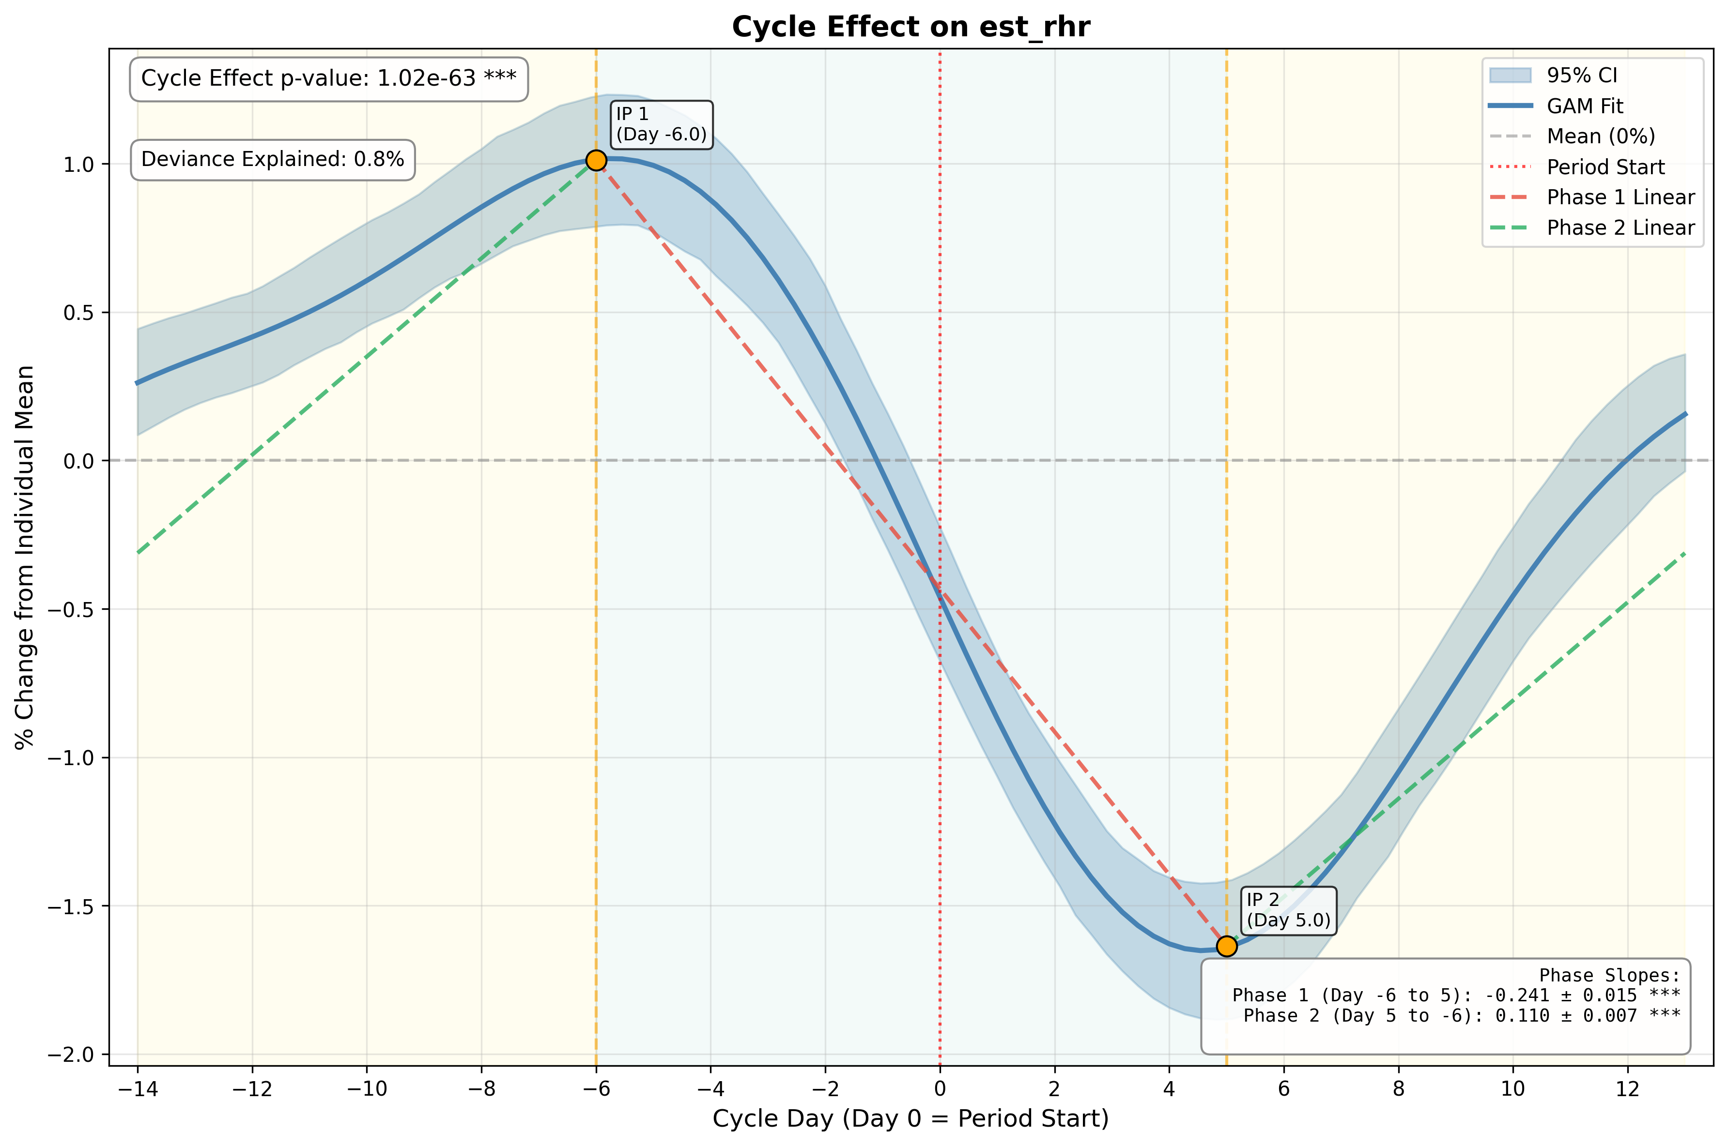
Heart Rate Results
Day 5 to -6
0.1 % increase per day
Day -6 to +5
0.2% decrease per day
Output Produced with MCAnalysis Package
MCAnalysis Package
Notes:
40 seconds

Slide 8

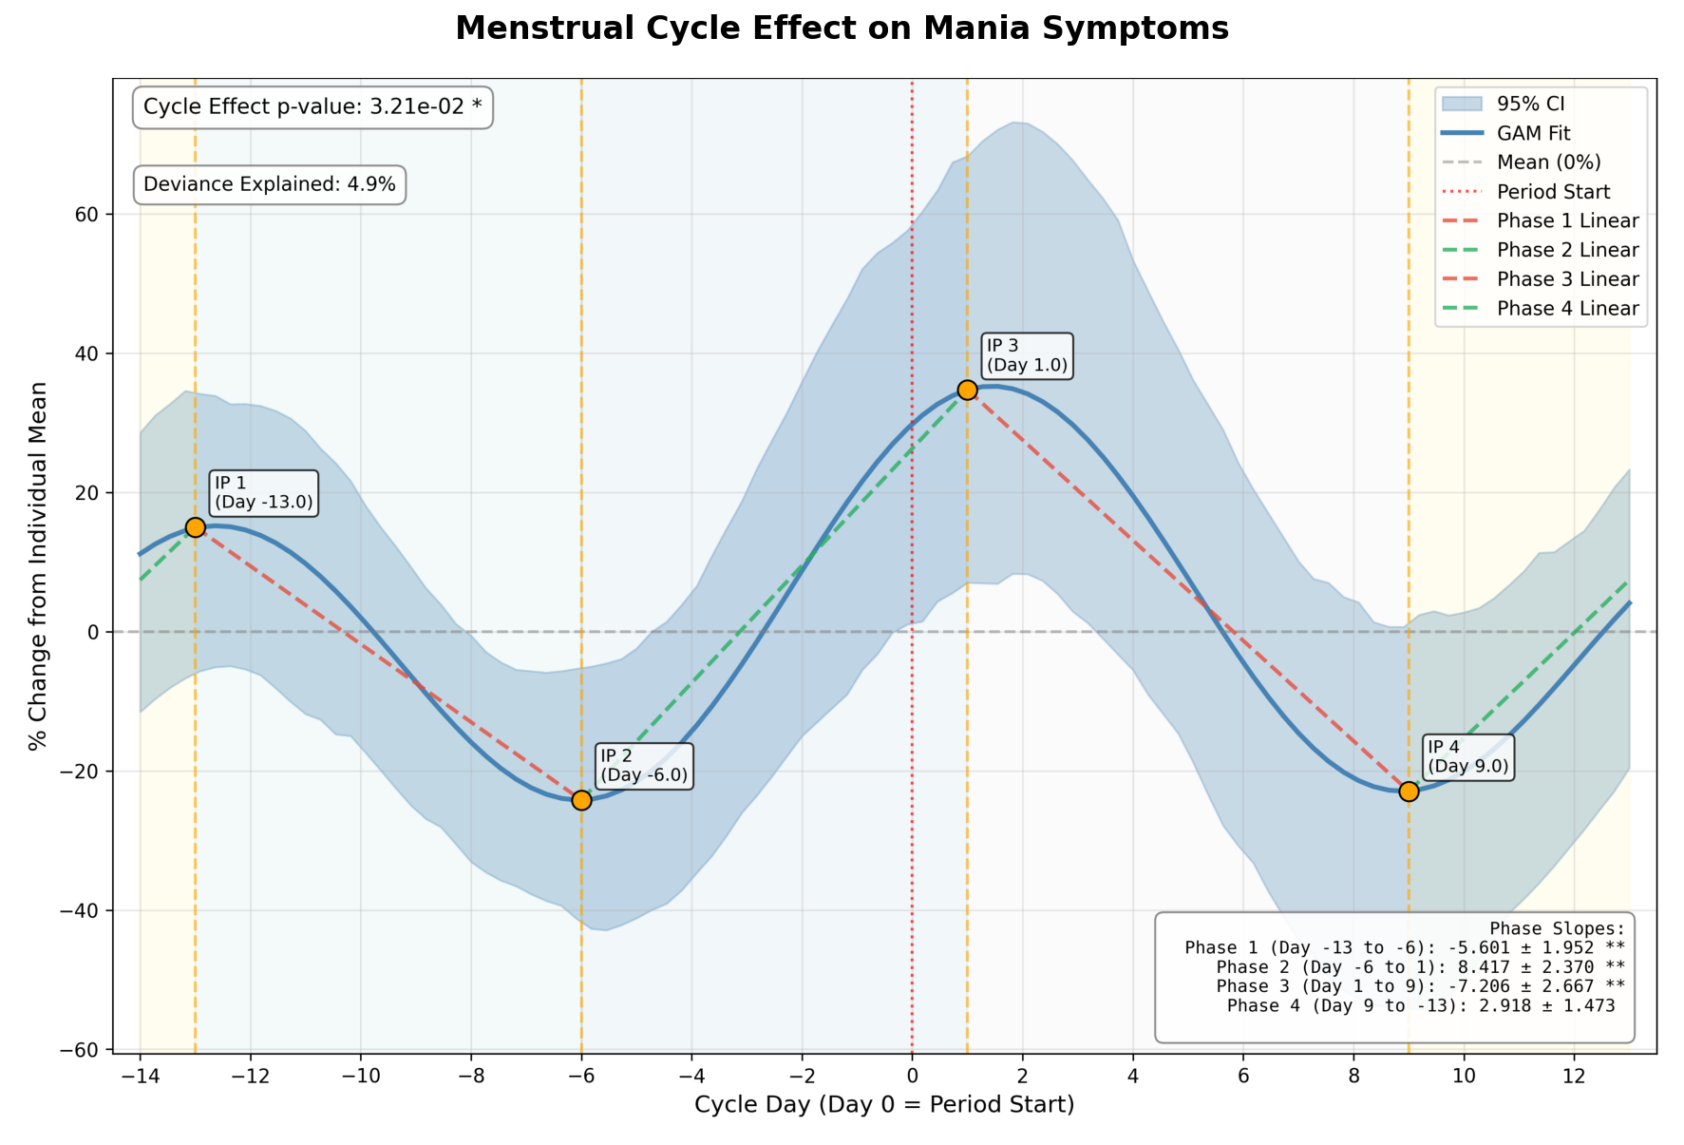
Mental Health Results
Day -13 to -6
Decrease 5.6% per day
Day -6 to +1
Increase 8.4% per day
Day + 1 to 9
Decrease 7.2% per day
Day 9 to 13
Increase 3% per day
Output Produced with MCAnalysis Package
MCAnalysis Package
Notes:
20 seconds
Part of a PHQ-8 questionnaire
Clinical marker of depression.
Note we found a significant relationship between both mood symptoms and heart rate data, so it opens up the option to passively estimate mood from a wearable.

Slide 9
Other Significant Findings
Minutes of sleep
Steps
Headache
Time outdoors
Daily average heart rate
and more…
MCAnalysis Package

Slide 10
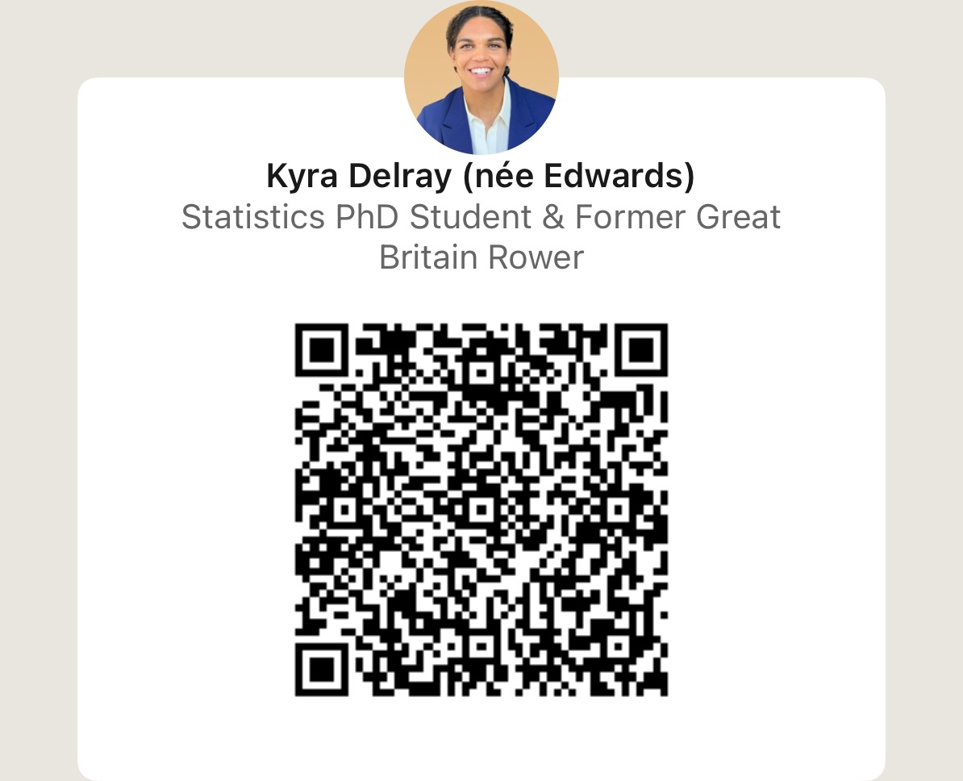
Thank you!
MCAnalysis Package
Notes:
10 seconds

