Slide 1

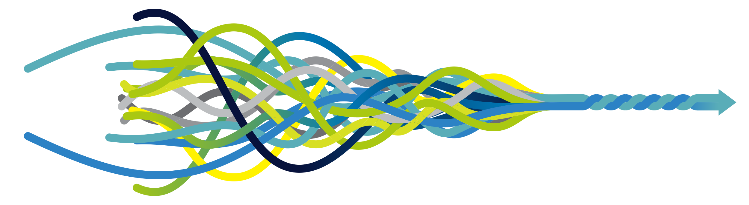
Digital signatures of asthma
Enabling proactive monitoring
Dr Luke Daines
GP and Clinical Lecturer

Slide 2


Slide 3
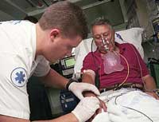
Why is this important?
Problem
60,000 hospital admissions every year (UK)
Avoidable asthma deaths
High-risk period after discharge

Slide 4
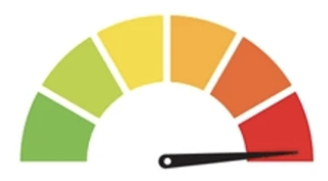
Why is this important?
Problem
Gap
60,000 hospital admissions every year (UK)
Avoidable asthma deaths
High-risk period after discharge
Lack of objective markers
Warning signs are missed
Notes:
Lots of scope for wearables and digital technology.
This can benefit patients, health systems.
A real opportunity for UK to be a world leader in high quality health research.

Slide 5
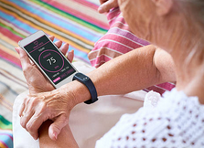
Why is this important?
Vision X
To enable proactive monitoring of asthma in daily life
Problem
Gap
Solution
60,000 hospital admissions every year (UK)
Avoidable asthma deaths
High-risk period after discharge
Lack of objective markers
Warning signs are missed
Intensive Care level monitoring now possible beyond hospital

Slide 6




Study design
Asthma (n=64)
Assessments
Controls (n=64)
Assessments
Acute asthma

Slide 7






Study design
Asthma
Assessments
Controls
Assessments
Wearable
1
1
Acute asthma
Clinical data
Phenotyping
2
Patient Reported Outcomes
Health care use
2
30 days
Follow up
Assessments
3

Slide 8
Summary
UK has some of the worst asthma outcomes among high-income countries
Current monitoring is inadequate
I will establish new digital signatures of asthma
This will minimise the high-risk period after discharge…
… and pave the way for proactive monitoring.
X

