Slide 1
Sharing R Shiny Apps Without a Server
3rd December 2018
Alan Yeung
Analyst in BBV/STI team

Slide 2
Outline
Background
Problem scenarios
R-Portable
How it works in brief
Demo
From normal Shiny app to portable shiny app in around 10 minutes
The good and the bad (limitations and further work)
Actions
Interactive presentation format so stop me at any time

Slide 3

Acknowledgements
This is not my work. Thanks to
U.S. Bureau of Labour Statistics
Brandon Kopp
Anna Price

Slide 4
Problem Scenarios (1)
“I am creating a Shiny app that uses confidential data and therefore, cannot upload this to shinyapps.io, etc.”
Solutions:
Upload the app to a private Shiny Server.
Store the Shiny app on a shared network drive so that a colleague can load it up on their machine.
Option 1 is the best solution but is not currently possible in PHI.
Option 2 is fine when sharing with other competent R users but not otherwise.
This leads us to the next problem scenario...

Slide 5
Problem Scenarios (2)
“I need to share a Shiny app with a colleague who does not have R installed and has zero knowledge of R.”
Solutions:
Get them to set up R and teach them it (converting them into an R user forever more)
Create a ‘portable’ Shiny app that they can load up in a web browser just by running a script file in Windows.
Option 1 is the best solution but may be time-consuming (and you may face some resistance).
Option 2 is a good solution and the focus of this talk but
Setting up requires technical knowledge
Total app size may be large
Requires R-Portable (more on this shortly)

Slide 6
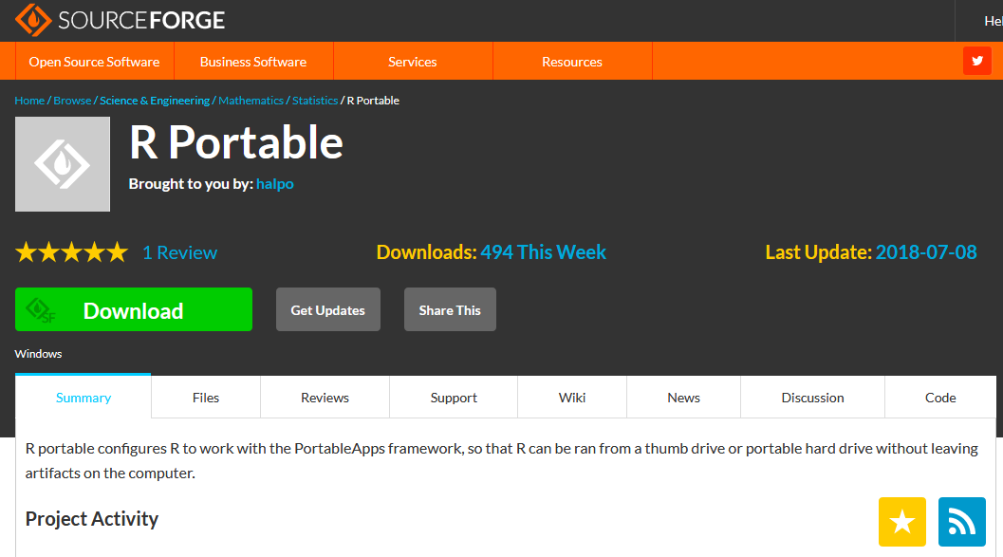
R-Portable
“R portable configures R to work with the PortableApps framework, so that R can be ran from a thumb drive or portable hard drive without leaving artifacts on the computer.”

Slide 7
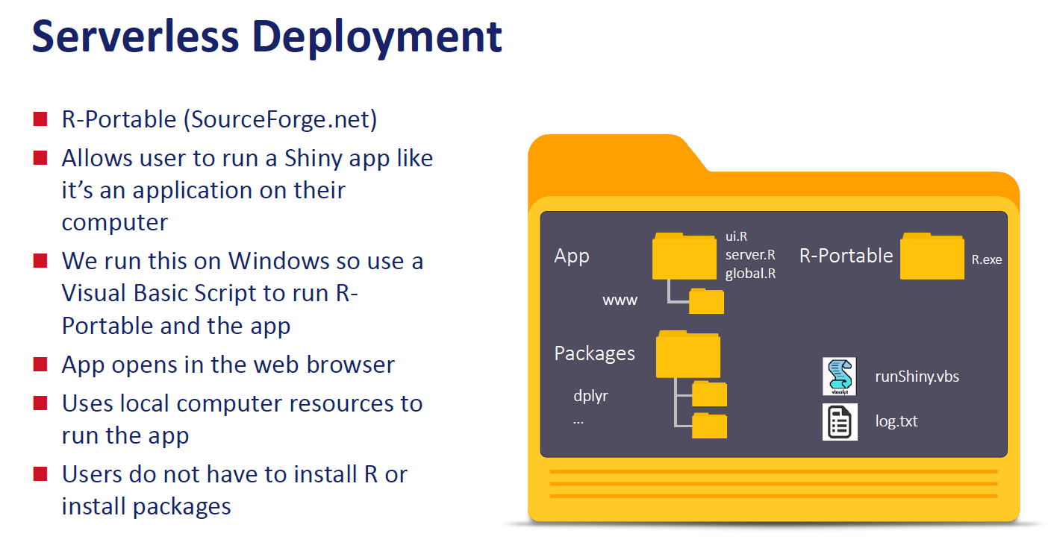
Brandon Kopp, U.S. Bureau of Labour Statistics

Slide 8
Demo:
How to make a portable Shiny app
Where it’s all going to go wrong...

Slide 9
1. Create your Shiny app as normal
Open up RStudio and show the app running on a desktop version of R
Note: the order of the process I use does not strictly need to be followed

Slide 10
2. Set up the folder structure
Main App folder
Local
Remote
shiny-app (copy ui.R, server.R into here)
My set up order:
Remote folder
Local folder

Slide 11
3. Copy required packages
Open R, run the app, which will load all required packages
Run copy_loaded_packages() function
Based off MovePackages script provided by Brandon
Finds all loaded packages using sessionInfo()
Move the packages folder into the ‘Remote’ folder
copy_loaded_packages <- function(src = .libPaths()[1], dst = file.path(getwd(), "packages")) {
si <- sessionInfo()
other_pkg <- vapply(si$otherPkgs, function (x) unname(x[["Package"]]), character(1))
loaded_pkg <- vapply(si$loadedOnly, function (x) unname(x[["Package"]]), character(1))
req_pkg <- c(other_pkg, loaded_pkg)
names(req_pkg) <- NULL
if (!dir.exists(dst)) {
dir.create(dst)
}
for(i in req_pkg) {
if (dir.exists(file.path(src, i))) {
cat("Copying", i, "from src to dst\n")
file.copy(from = file.path(src, i),
to = dst,
overwrite = TRUE,
copy.mode = TRUE,
recursive = TRUE)
} else {
cat(i, "is not in src\n")
}
}
}

Slide 12
4. Amend server.R
At the top, add in code so that R can find packages
.libPaths("../packages")
At the end, add in code that terminates the R session when you close your browser
session$onSessionEnded(function() {
tools::pskill(Sys.getpid()) # Ends R Session
})

Slide 13
5. Extract R-Portable to Local Folder
That is all.

Slide 14
6. Create runShinyApp.R script in Local
.libPaths("../Remote/packages")
shiny::runApp(appDir = "../Remote/shiny-app", launch.browser = TRUE)

Slide 15
7. Create runShiny.vbs in Local
CreateObject("Wscript.Shell").Run "R-Portable\App\R-Portable\bin\i386\R.exe CMD BATCH --vanilla --slave runShinyApp.R log.txt", 0, False
Note: Points to 32-bit R (can also create script for 64-bit R)
CMD BATCH run R ‘non-interactively’
--vanilla implies --no-site-file, --no-init-file, --no-environ
--slave commands are not printed with output to ‘log.txt’
0 Hide the window (and activate another window)
False Do not wait for the command to complete before continuing execution of the wsh script

Slide 16
8. Open the VBA script
Recommend creating shortcut for easy access.
Open Task Manager to show R is running (Rterm.exe).
Note: May not work properly in old versions of Internet Explorer.

Slide 17
Issues and Limitations
Technical knowledge required to set up.
Need to know if you have 32-bit or 64-bit machine (can we create a VBA script to auto-detect?).
Large app size as it includes R and all necessary libraries.
May get ‘messy’ if lots of people are doing this.
Updating apps may require updates of packages.
May not be suitable for sending externally.
R-Portable not currently supported by IT (more on this soon).
May require new versions of R-portable as R gets updated.
To explore:
Capability to serve multiple concurrent users.
Speed of apps using large datasets (particularly on network drives)

Slide 18
The Good
It works!
Pragmatic solution while a private Shiny server is not available
Particularly for sharing with colleagues who do not have R.
Does not take too long to set up.
Future Work: function to ‘automatically’ create a portable Shiny app (demand dependant).
Should be ‘secure’ as long as apps are placed in directories with appropriate access restrictions.
Disclaimer: I am not an IT security expert!

Slide 19
Some Actions
The wish list:
IT gives us a private RShiny server (soon).
IT allows us to download R-Portable.
Actions:
Collate examples of when you needed to share a Shiny app but could not (e.g. due to confidentiality).
Inform senior colleagues of demand.
Inform IT of demand (maybe).
Discuss at R Users meeting.
Give talk again at the Public Sector Shiny Meeting.
May be good opportunity to share this wider and get better understanding.

