Slide 1

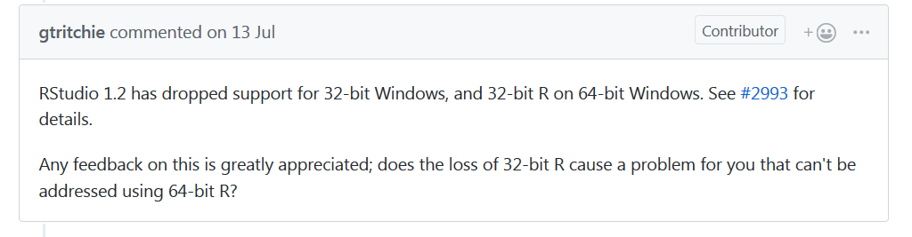
R News – RStudio 1.2
RStudio 1.2 Preview
Better integration with SQL, Python, D3, C++
Easier to create Web APIs
https://blog.rstudio.com/
Potential Issue: 32-bit R may not be supported

Slide 2
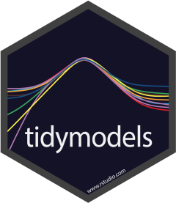
R News – tidymodels
tidymodels is a metapackage to install and load tidyverse packages related to modelling
Loads some standard tidyverse packages as well as some modelling-specific packages
dplyr, ggplot2, purrr, tibble
broom, infer, recipes, rsample, yardstick, tidypredict, tidyposterior, tidytext, parsnip
parsnip is new on CRAN
Standardises the interface for fitting models and retrieving model output

Slide 3
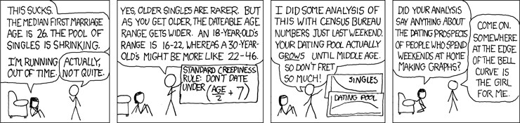
Source: xkcd
Alan Yeung
Analyst in BBV/STI team
alan.yeung@nhs.net

