Slide 1
uRos 2019
Use of R in Official Statistics: Bucharest, 21st – 22nd May 2019
Nikos Alexandrou, Ciara Gribben,
Terry McLaughlin

Slide 2

uRos Conference
An annual conference bringing together official statisticians, scientists, and prominent members of the R community to share ideas in the area of official statistics.
The 2019 conference was held in Bucharest, Romania, the original home of the conference.
There were 104 participants from 30 countries.
Slides are available here.
The 2020 conference will be held in Vienna, Austria.

Slide 3
R at the Italian National Institute of Statistics: a twelve-year story
Presentation by keynote speaker Giulio Barcaroli (ISTAT).
Until 2007, ISTAT was hugely dependent on proprietary software, specifically SAS.
SAS was used in: different phases of the survey process (e.g., drawing samples), data manipulation, imputing data by inference, aggregation and tabulation, and complex statistical models.
ISTAT could only rent SAS, not acquire it. If the contract was not renewed, all SAS-based applications would stop working. Also, SAS Institute always determined the final cost of the contract unilaterally.

Slide 4
R at the Italian National Institute of Statistics: a twelve-year story
SAS annual cost: between €818,000 and €1,024,000.
Government directive “to favour software solutions that (a) make IT systems independent of a single supplier, and (b) guarantee the availability of the source code”.
R immediately identified as the best alternative to SAS, as some employees had already acquired R skills starting from the early 2000s. Plus, R has a massive community of developers.
Main objectives after switching to R:
Mass training on R.
Migration of SAS-based tools to R.

Slide 5
R at the Italian National Institute of Statistics: a twelve-year story
Training began with a 5-day course that taught employees the essentials (mostly using the ‘base’ package):
How to search for, and install, packages.
Reading and writing external files.
Working with objects.
Basic data analysis.
Recently, more courses were launched, all taught by ISTAT employees:
(a) Intermediate R – data visualisation and modelling.
(b) Short courses on specific themes like: GIS, data imputation, string processing with ‘stringr’, reshaping data with ‘tidyr’ and ‘reshape’, function and package development, etc.

Slide 6
R at the Italian National Institute of Statistics: a twelve-year story
Gradually, every single SAS-based tool was migrated to R, leading to the following R-based tools:
Sampling design: MAUSS-R, FS4, BEAT, SamplingStrata, MultiWay.
Record linkage and statistical matching: RELAIS, StatMatch.
Automatic coding: CIRCE.
Selective editing: SeleMix.
Weighting and sampling variance estimation: ReGenesees.
All of these available here.
ISTAT now pays only a maintenance fee for SAS, approx. €200,000 per year, meaning they are paying only 1/4 or 1/5 of what they used to.

Slide 7
Mapping a Table of Data with Esri Shapefiles in R
Tutorial by Mervyn O’Luing (Central Statistics Office, Ireland): https://rpubs.com/moluing/494829
Steps:
Extract GDP data for Tanzania from PDF publication to CSV file.
Install and load the necessary packages (shiny, sf, ggplot2, rgdal, ggsn, tmap, leaflet).
Read in the CSV file as a data-frame.
Download two shape-files: one for the regions and one for the different water bodies.
Use st_read() to read in the shape-files as data-frames.

Slide 8
Mapping a Table of Data with Esri Shapefiles in R
Merge the regions shape-file with the GDP data using merge().
Use ggplot() to create a static map. The geom_sf() argument identifies the year to be used as fill. Null values are coloured yellow. Overlay the water bodies map.
Alternatively, you can use the tmap package to easily create an interactive map: tm_shape() reads in the merged file, tm_polygons() specifies the year to be used as fill and selects the palette, and tm_legend() controls the legend attributes. Importantly, you must set tmap_mode() to “view” for the map to become interactive!

Slide 9
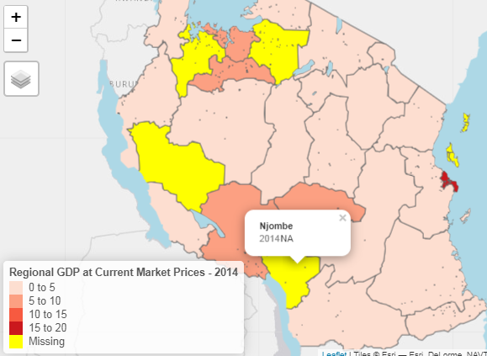

Slide 10
A generic shiny/js dashboard for data validation
results
Presentation by Mark van der Loo (Statistics Netherlands). Link here.
Using the package validate, Statistics Netherlands check to see if their data is fit for purpose. E.g., if working hours are not zero, then the “employed” dummy variable shouldn’t be zero either.
Following this, they use the package validatereport to display the validation results in a JSON-based generic message format.
Even though the above methods work well, the organisation also wanted to create a validation dashboard, to add a visual aspect to the validation process.

Slide 11
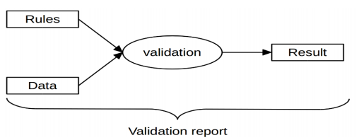
A generic shiny/js dashboard for data validation
results
Architecture components:
crossfilter.js
dc.js
Datatables
HTML widgets library to integrate the results in Shiny.
Demo.

Slide 12
Google Analytics, Shiny apps and EU/UK law
Presentation by Joseph Adams (NRS).
Google Analytics (GA) is commonly used with Shiny apps.
GA uses cookies to “remember” what a user has done.
If your Shiny app uses GA, take the following steps in order to ensure compliance with relevant legislation (GDPR, PECR):
Inform the user that your app uses cookies.
Explain what the cookies are doing and why.
Ask the user for permission to store a cookie on their device.

Slide 13

Google Analytics, Shiny apps and EU/UK law
Cookie Control is a feature you can add to your Shiny app(s), which:
presents users with clear information on how their behaviour is to be tracked, and
offers simple, intuitive controls for explicitly granting, and revoking consent.
Demo.
Guidance available on GitHub.
Further advice from SG GA trainers: anonymise IP addresses by deleting the last three digits.

Slide 14


Implementation of the Cell Key Random Noise Approach in R
Presentation by Tobias Enderle (Federal Statistical Office of Germany (Destatis) and Bernhard Meindl (Statistics Austria)
Developed by to protect flexible census tables available by a web front end.
This is a Post Tabular Disclosure Control Method
The idea is to create uncertainty as the values of the frequency tables are the sum of the original values plus random noise.

Slide 15
Implementation of the Cell Key Random Noise Approach in R
Certain parameters should be set:
Maximum perturbation (how much the values can be moved by),
Level of uncertainty,
Probability of no change to value (optional)
Counts that are still small after perturbation can be hidden and the process can be restricted so that zeroes remain unchanged.
Advantages:
Information Loss can be controlled by the parameters,
Allows flexible analysis,
The approach is high quality and consistent
Disadvantages:
It is not easy to understand straight away,
There is a high loss of information at small frequencies
We lose additivity because the table values do not sum to the totals

Slide 16
Modern Package Development in R
Tutorial by Bernhard Meindl, Statistics Austria:
https://github.com/bernhard-da/uros19_tutorial
Traditionally we use utils::package_skeleton() to develop
packages which needs a lot of manual input.
A new way is to use the package ‘usethis’ to create package skeleton and corresponding r studio project:
usethis::create_package()
Top tips for creating a package:
Choose a short name for your package,
Use the package ‘available’ which lets you check for available package names,
Think about why package should exists and what functionality it should contain

Slide 17
Modern Package Development in R
Always use GitHub to version your code. The package ‘usethis’ works with GitHub to set up authentication, create a local repo and create a document to keep track of changes to the package:
usethis::browse_github_pat()
usethis::use_git
usethis::use_news_md()
Other useful packages:
‘roxygen2’ – Generates documentation
‘testthat’ – Tests code to check the percentage covered by Unit Testing
‘styler’ – Automated code formatting
‘lintr’ – Allows automated code checking
‘goodpractice’ – suggests improvements to code

Slide 18
Semiautomatic Reports with R Markdown
Max Grutter, Statistical Office of the Canton of Zurich
Began publishing reports using automated and reproducible methods e.g. Cluster Report
Developed complete workflow in R Markdown following Reproducible Analytical Pipeline (RAP) methodology.
Developed ‘statR’ package (Corporate Design Toolbox) for producing publication quality graphics:
zhpal – colour palettes;
theme_stat – ggplot2 theme.
Developed ‘statRmd’ package – LaTeX-based R Markdown templates for publication quality report layouts.
Issues with Windows fonts on Linux – resolved using ‘extrafont’ package.
Notes:
Cluster Report - Report on industry groups that play a significant role in Zurich due to the high density of companies, research and educational institutions as well as specialist organisations.

Slide 19
Reproducible Corporate Publications using pagedown
Romain Lesur, Ministere de la Justice, France
New R package that uses HTML / CSS, Chrome, Paged.js and ReLaXed to produce paginated PDF documents from R Markdown.
Co-developed by Yihui Xie (Software Engineer at RStudio, of knitr fame) and Romain Lesur.
Layout with CSS allows those with existing web design skills to translate these to print documents.
Includes various templates for documents, letters and posters.
Requires recent version of Chrome (or Chromium-based browser) and Pandoc >= 2.2.3
Recommended to install RStudio v1.2.1335 for bundled Pandoc 2.x.

