Slide 1
HEALTHY BUDDY – A CALORIE TRACKING/FITNESS APP
PIP104 University Project-II
Review-4
Batch Number: CSE-G03
Under the Supervision of,
Ms. Akkamahadevi
Assistant Professor
School of Computer Science & Engineering
Presidency University
SL.No | Name | Roll Number
1. | A Raghuram | 20211CSE0521
2. | Ayan Sharma | 20211CSE0523
3. | Jaideep Singh Dudi | 20211CSE0502

Slide 2
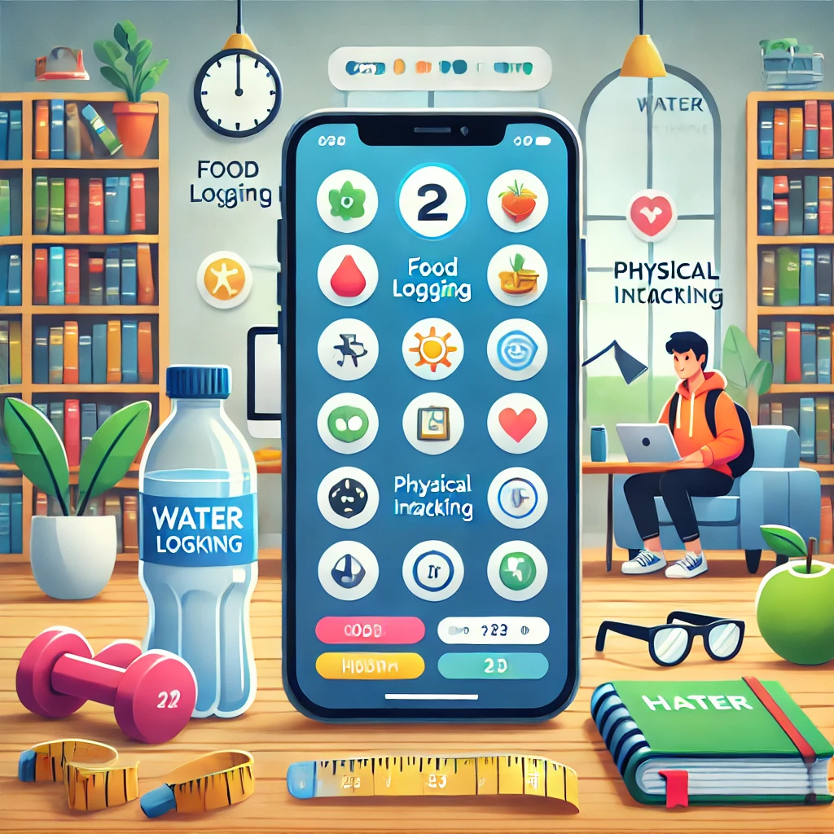
Introduction
The health buddy app offers a comprehensive solution for monitoring nutrition, hydration, and physical activity, addressing challenges faced by individuals, especially students, in maintaining a balanced lifestyle. By allowing users to log daily food intake, the app leverages machine learning to predict essential nutrient consumption and identify potential deficiencies over time, providing early warnings about possible health risks. It also includes a water intake tracker with reminders and tracks physical activity, calculating calories burned for a holistic view of health habits. This data-driven approach empowers users to make informed decisions and maintain a healthier lifestyle.

Slide 3
Literature Review
Research Paper | Author(s) | Summary
The behavior change technique taxonomy (v1) | Michie et al. (2013) | Discusses how behavior change techniques can encourage healthier habits.
Engagement features and behavior change | Perski et al. (2017) | Explores how personalization in health apps increases adherence rates.
Gamification and health behavior change | Johnson et al. (2016) | Analyzes the impact of gamification elements on user motivation.
Holistic wellness in health apps | Hutchinson et al. (2020) | Emphasizes the need for comprehensive wellness metrics in health apps.
Digital health data privacy | Lupton (2016) | Examines data privacy concerns and suggests methods for protecting user data.
Machine learning in dietary analysis | Touvier et al. (2019) | Demonstrates how machine learning models improve dietary assessments.
Deep learning for dietary intake | Tran et al. (2020) | Explores the use of deep learning for identifying dietary intake from images.
Nutrient deficiency detection through analysis | Mahan and Escott-Stump (2021) | Shows that analyzing dietary intake patterns can predict micronutrient deficiencies.
Impact of hydration tracking apps | Popkin et al. (2021) | Investigates how tracking water intake increases daily hydration levels.
Dehydration monitoring and prevention | Rosinger et al. (2020) | Notes that consistent monitoring of hydration helps prevent dehydration.
Integration of activity and diet data | Schoeller et al. (2019) | Highlights the benefits of combining physical activity tracking with dietary and hydration data.
Personalized feedback based on activity | Henriksson et al. (2021) | Shows that personalized feedback on activity levels enhances understanding of health metrics.
Longitudinal health data in apps | Ma et al. (2020) | Emphasizes the importance of incorporating longitudinal data in health monitoring apps.

Slide 4
Existing method Drawback
1. Accuracy of Predictions
Machine learning model accuracy may vary based on the quality and variety of training data, potentially leading to inaccurate nutrient estimates.
2. User Compliance and Data Quality
Inconsistent logging of food, water, and activities can reduce the accuracy of predictions and insights provided by the app.
3. Potential for Overemphasis on Metrics
Focusing on numerical goals might encourage obsessive behavior or unhealthy comparisons among users.
4. Limited Holistic Health Integration
The app may not adequately track other health factors like sleep, stress, or specific medical conditions, limiting its holistic approach.
5. Data Privacy and Security Concerns
Users may hesitate to share sensitive health data due to concerns about data privacy, security, and regulatory compliance.
6. Lack of Real-Time Adaptability
The app may struggle to provide immediate feedback or adapt to sudden changes in users' health, such as illnesses or injuries.
7. Limited Scope of Nutritional Analysis
The app's focus on calories, vitamins, and proteins may overlook other essential nutrients, such as minerals and fiber.

Slide 5
Proposed Method
The Health Buddy app collects user inputs for food, water intake, and physical activities. It utilizes machine learning models to predict calorie intake, analyze nutrients, detect deficiencies, and identify potential health risks based on diet patterns. The app features dynamic trackers for calorie and water consumption, daily reminders, and user insights, with Firebase ensuring secure data storage. Personalized goals and dietary suggestions are provided to help users meet health targets, and the app continuously improves through user feedback and model updates for accurate predictions and recommendations.

Slide 6
Objectives
To develop a health and fitness application that predicts calorie, vitamin, and protein intake based on user-entered food data, using a machine learning model to provide personalized insights on nutrient consumption and identify potential deficiencies over time.
To improve user retention by incorporating habit-forming features such as goal-setting, reminders, and progress tracking, aiming to mitigate the early dropout rates commonly observed in existing mobile health applications.
To provide an overall health experience by integrating more than one health metrics—including calorie tracking, water intake, and physical activity monitoring—ensuring that the app supports overall wellness rather than focusing solely on isolated factors like calorie counting.
To offer personalized, data-driven feedback that adapts to individual users' evolving fitness levels, dietary needs, and health goals, ensuring the app remains relevant and valuable throughout long-term use.

Slide 7
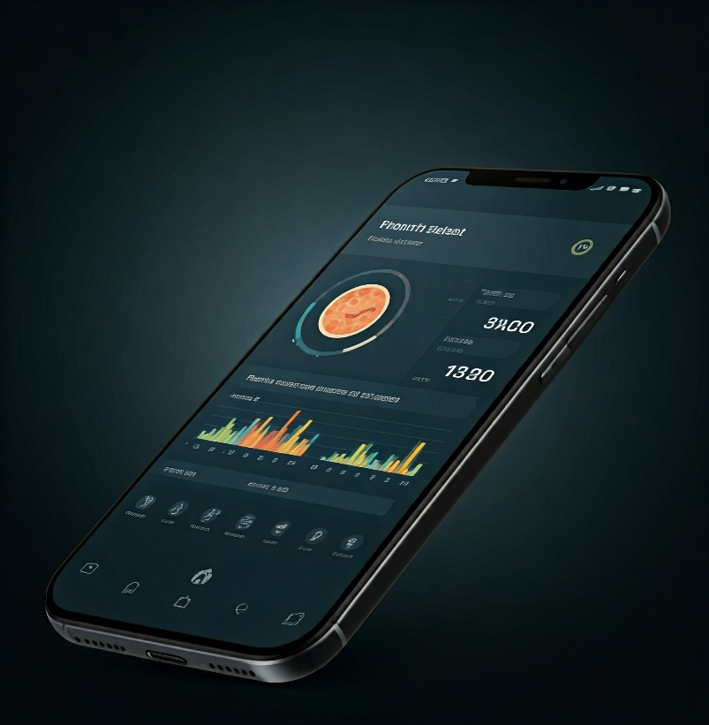
Methodology
The app collects user input for daily food intake, water consumption, and physical activities. Its core functionality lies in machine learning-driven nutritional analysis, predicting calorie intake and assessing vitamin and protein consumption based on logged data. The app identifies potential nutrient deficiencies and health risks over time, offering personalized feedback for dietary adjustments. It provides long-term health monitoring by detecting patterns in habits, recommending nutrient-rich foods, and encouraging physical activity. Users stay engaged through notifications and visual progress tracking with charts and graphs for overall health insights.

Slide 8
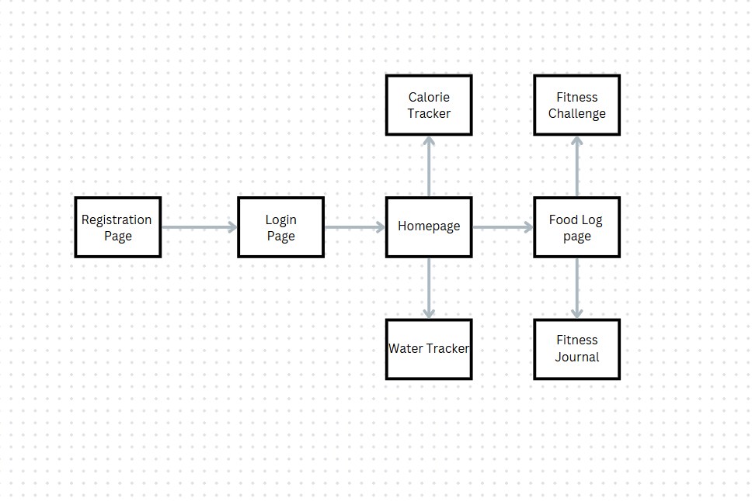
Flow Chart

Slide 9


Hardware/Software components
Hardware:
Smartphone/Tablet: The app is primarily developed for mobile platforms, requiring users to have a smartphone or tablet with support for modern operating systems like Android or iOS.
Cloud Storage/Server: Data from the app, such as user health metrics and food intake history, will be stored and processed using Firebase for secure and efficient cloud-based data management.
Software:
Flutter SDK: The app is developed using Flutter, a cross-platform framework that enables the creation of a single codebase for both Android and iOS platforms.
Dart Programming Language: As Flutter's primary language, Dart is used to build the logic, user interface, and functionalities of the app.
Firebase: The app uses Firebase for authentication (login/registration), real-time database management, and cloud storage.

Slide 10
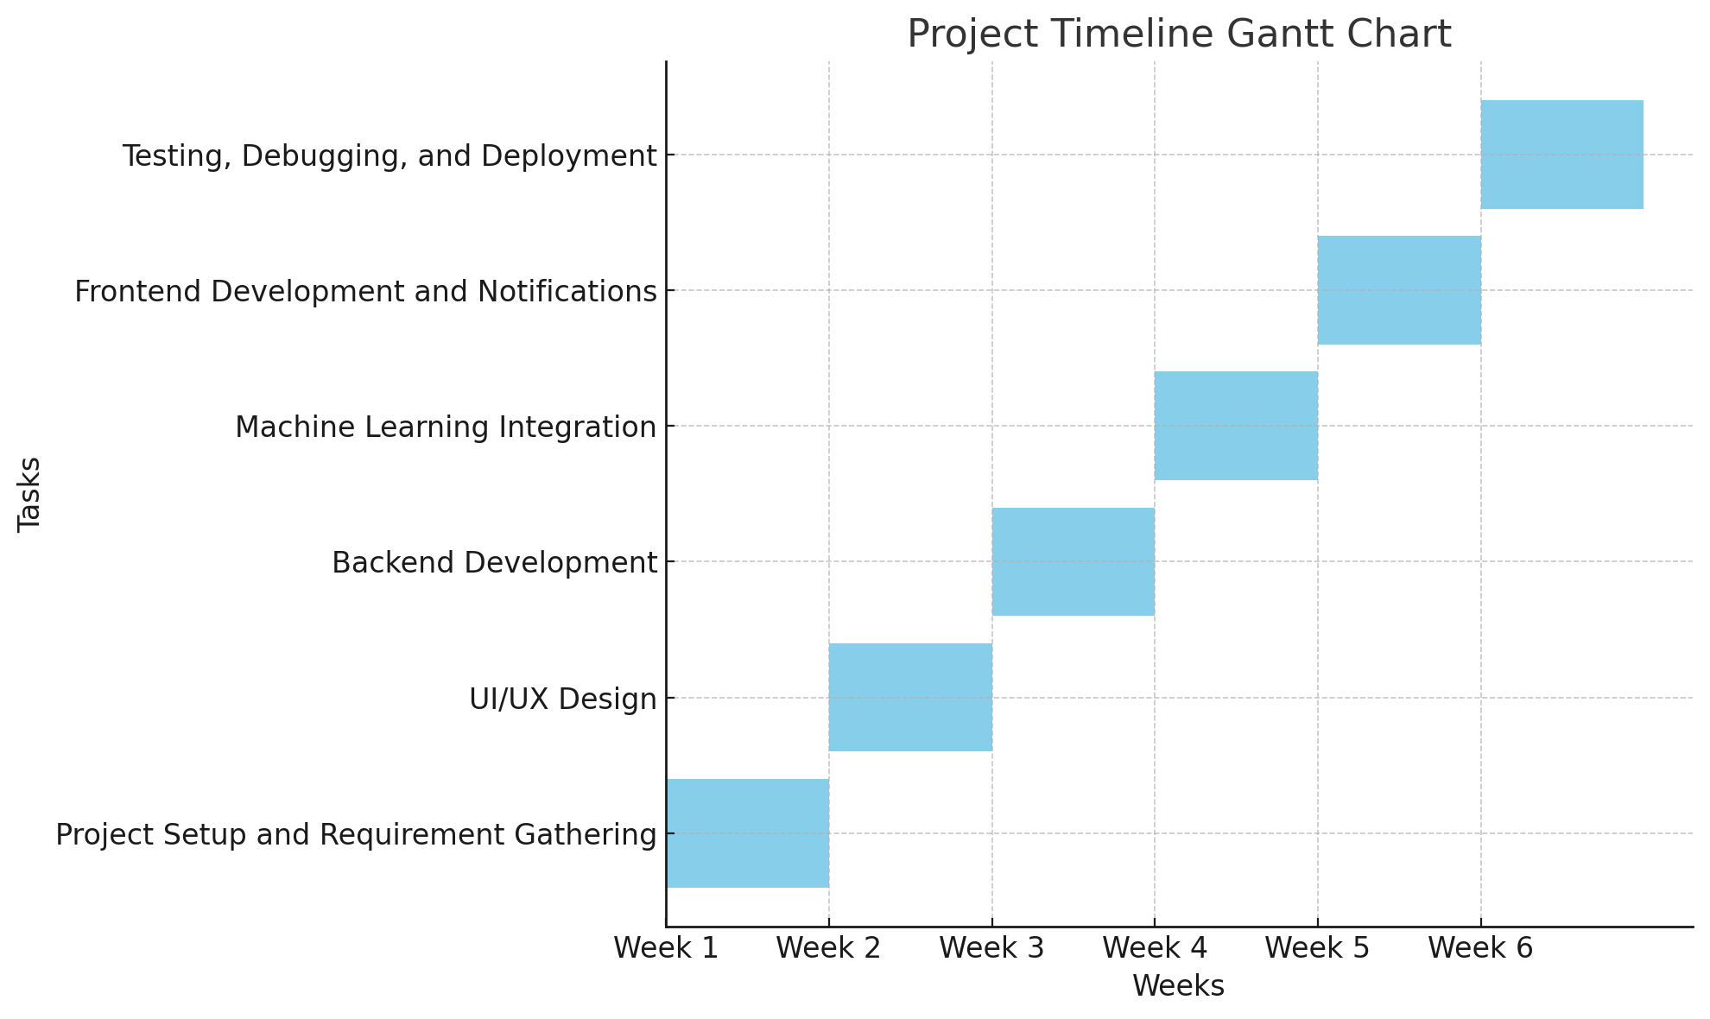
Timeline of Project

Slide 11
Expected Outcomes
By developing this health and fitness app, we aim to create a platform where users can easily track their daily food intake, physical activities, and hydration habits. The app will automatically record steps and calories burned through in-built functions, while also allowing users to manually log their water intake. One of the main features we plan to implement is an API that will predict food details like vitamins, and proteins based on the food data entered by the user. This model will provide personalized insights into required nutrients, enabling users to make better dietary choices. Users will be able to monitor their progress, helping them track their health over time and adjust their routines as needed. Ultimately, this project will allow us to build a practical, data-driven app that promotes healthier habits through predictive analysis and personalized recommendations.

Slide 12
Conclusion
This project focuses on building a health and fitness app that helps users track their daily food intake, water consumption, and physical activities. By incorporating a machine learning model, the app will provide personalized feedback on calorie intake, nutritional content, and possible vitamin deficiencies. With features like real-time notifications, reminders, and visual progress charts, the app encourages users to stay on top of their health and reach their fitness goals.

Slide 13
Github Link
The Github link provided should have public access permission.
Github Link
https://github.com/HealthBuddy99/HealthBuddy

Slide 14
References
• Sampson, M., Munro, C., & Chong, J. (2017). Using mobile health apps to promote
health and manage chronic conditions: A systematic review. Journal of Medical
Internet Research.
• Zhu, F., Bosch, M., Khanna, N., & Boushey, C. J. (2015). Machine learning
approaches for dietary assessment: A systematic review of existing models. Journal of
Biomedical Informatics.
• Morrison, L. G., Yardley, L., Powell, J., & Michie, S. (2018). User engagement with
digital health apps: Insights from a mixed-methods study. Digital Health.
• Sardi, L., Idri, A., & Fernández-Alemán, J. L. (2017). The impact of gamification on
user motivation and engagement in mobile health apps: A systematic literature review.
Journal of Medical Systems.
• Kooiman, T. J., Dontje, M. L., Sprenger, S. R., Krijnen, W. P., Van der Schans, C. P.,
& de Groot, M. (2015). Tracking physical activity with mobile apps: Reliability and
accuracy across different types of exercises. JMIR mHealth and uHealth.
• Suh, M., Chen, C. A., Woodbridge, J., Kim, J., & Sarrafzadeh, M. (2016). Personalized
recommendations in mobile health apps: Leveraging AI for enhanced user experience.
Pervasive and Mobile Computing.

Slide 15
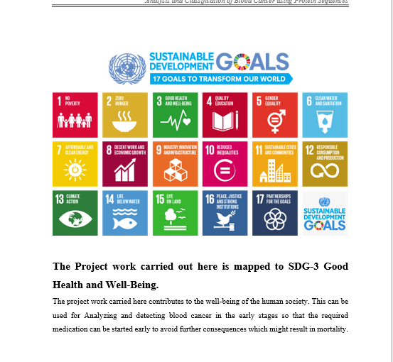
Project work mapping with SDG

Slide 16
Thank You

