Slide 1

Stress Management App
Dimitri DeBarnes
Alex Achenbach
Miguel Botet
Thisha Glover
Software Hardware co-design
Ravi Shankar

Slide 2
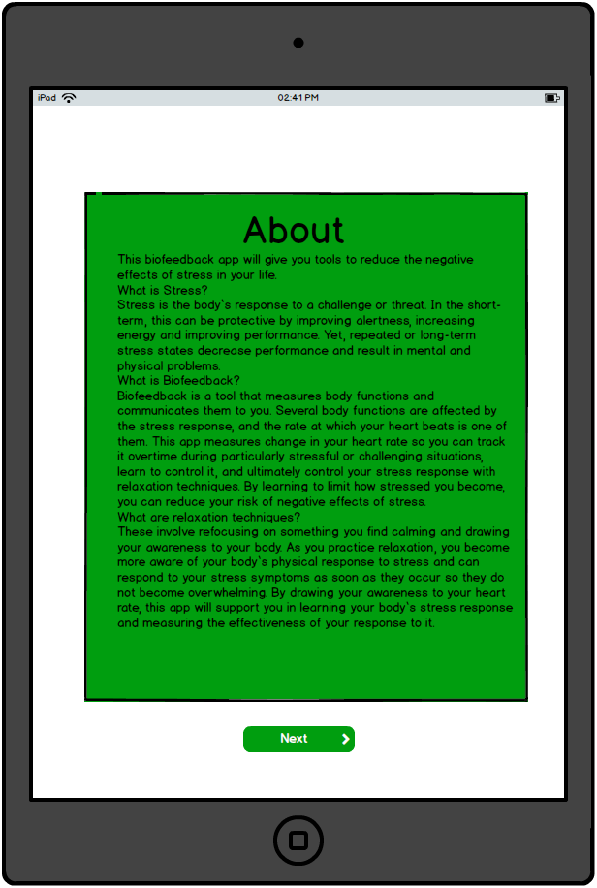
First Time using : About
When using the application for the first time the user will be presented with the about screen. The ABOUT screen tells what the application does. The user will be able to press the next button

Slide 3
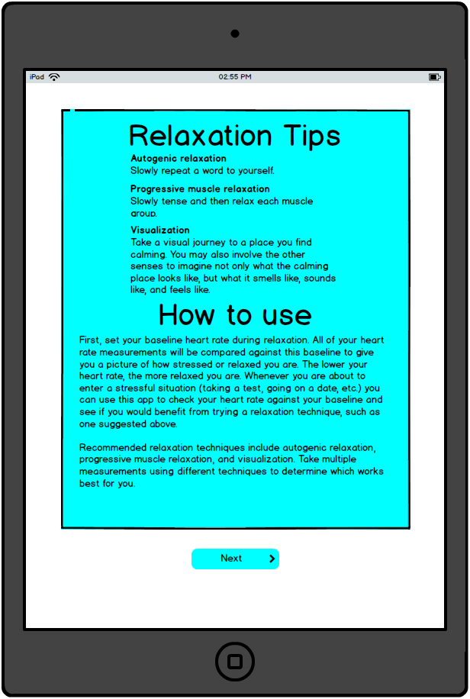
First Time using : Tips / HowTo’s
From the initial About screen the user is presented with a How To screen with written instructions on how to use the sensor with the App. The tips section illustrates to the user how to measure their base as well as recommended relaxation techniques.

Slide 4
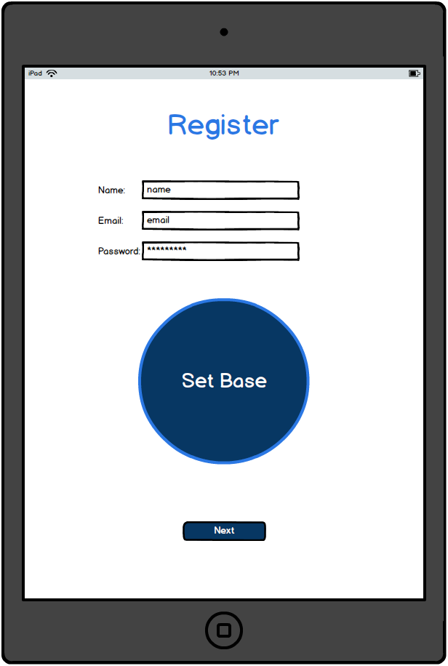
First Time using : Registration
From the initial Tips/HowTo’s screen the user will be able to register on the Register screen. The user will enter his name, email and password and also measure his base stress score following the tips showed on the previous screen.

Slide 5
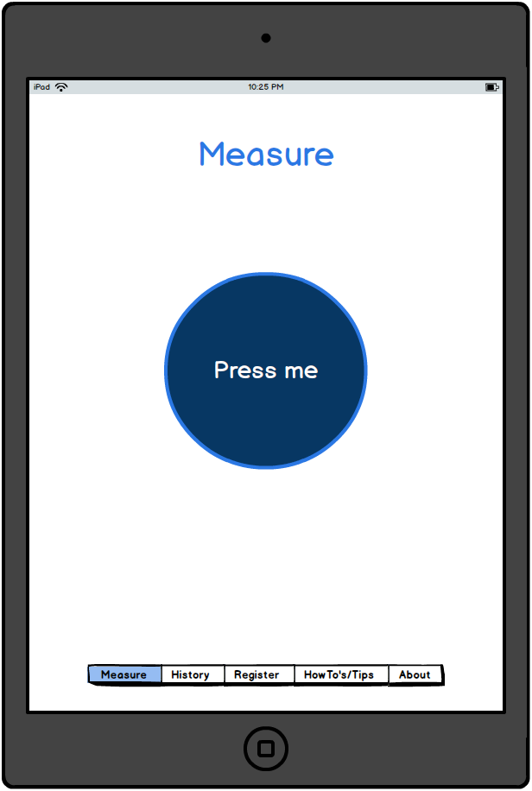
Measure screen
The measure screen will be the first screen with tabs that the user sees after the first three “First time using” screens. The measure screen will also be the visible screen that the user will see when he opens the on a every day use. It will allow the user to measure their stress score.

Slide 6
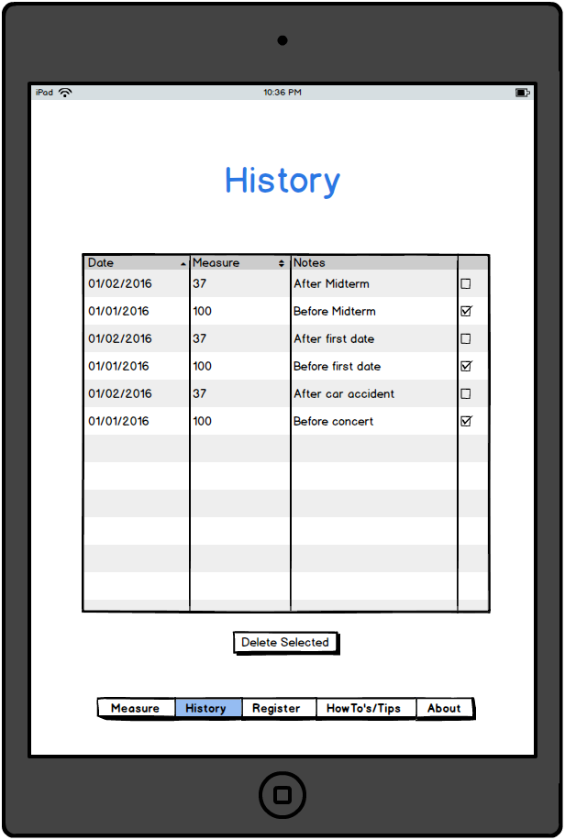
History
The user will be able to access the History screen from the tabs menu. On the History screen the user will be able to see a table with the times the user measured his stress score. The table will have a date, score and notes column.

Slide 7
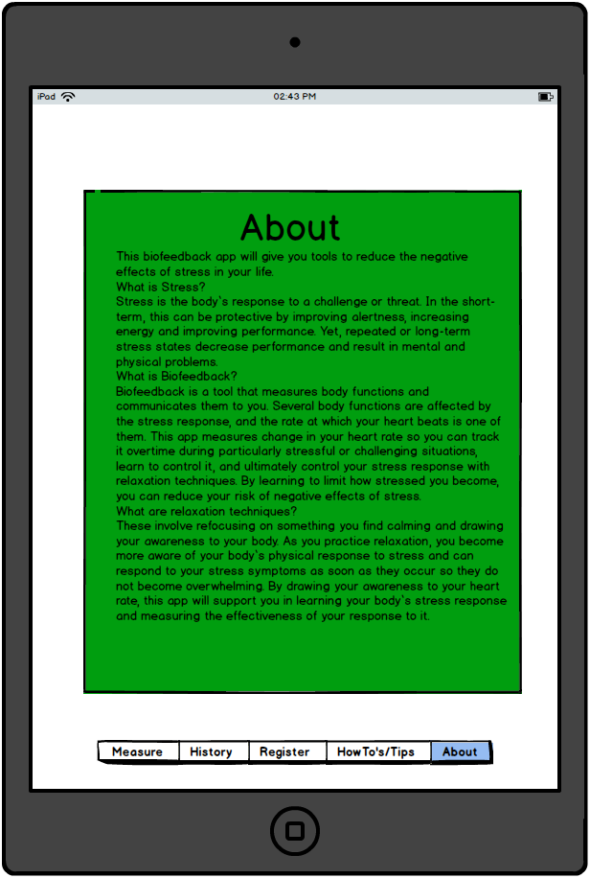
About
The user will be able to access the ABOUT screen again using the menu. On the About screen the user is presented with a How To screen with written instructions on how to use the sensor with the App.

Slide 8
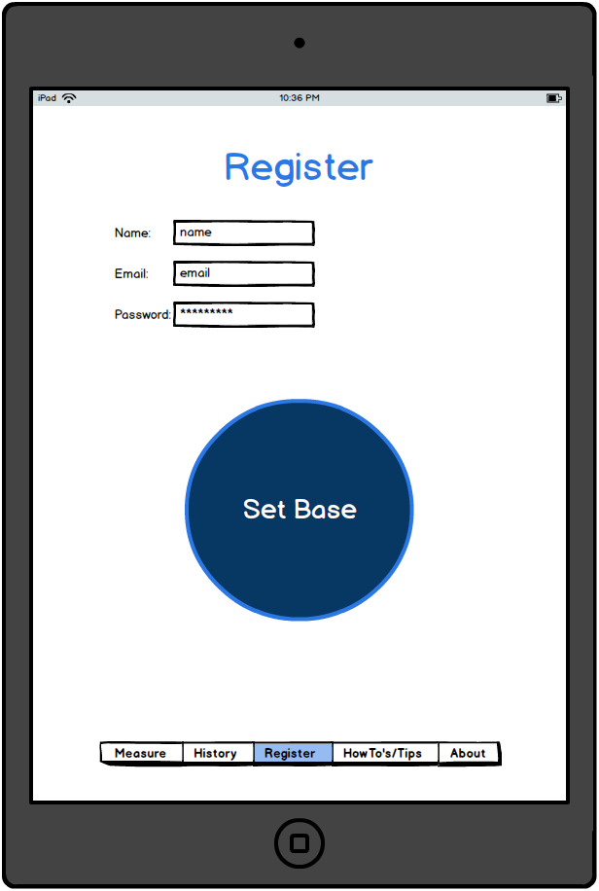
Register
The user will be able to access the Registration screen again using the menu. The user will access the logout screen to create a new account. The user will enter his name, email and password and also measure his base stress score following the tips showed on the previous screen.

Slide 9
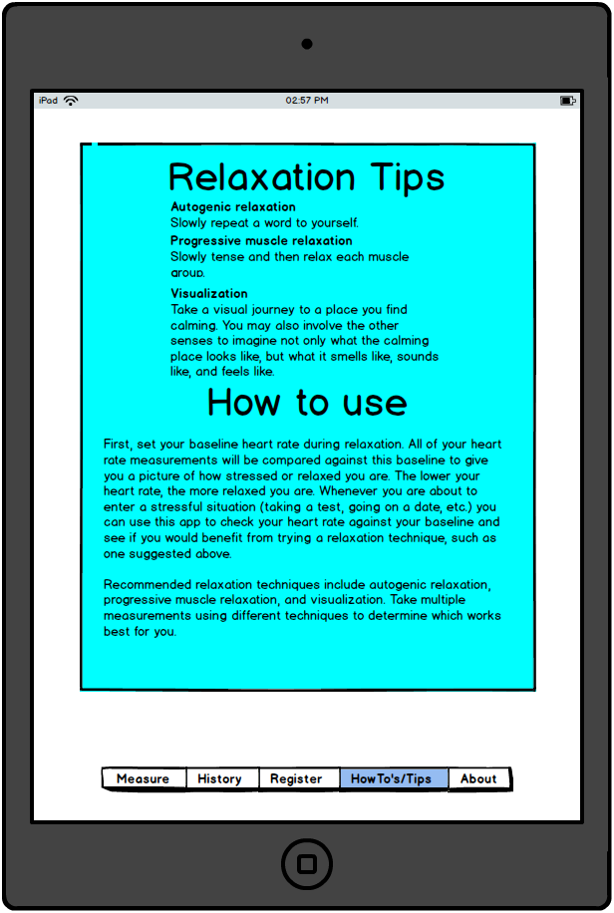
Tips / HowTo’s
The user will be able to access the Tips/HowTo’s screen from the tabs menu. The How To screen will have written instructions on how to use the sensor with the App. The tips section illustrates to the user how to measure their base as well as recommended relaxation techniques.

Slide 10
The End

