Slide 1

Android Physical Therapy
An interactive physical rehabilitation application

Slide 2
Contributors
Felipe Soares (FAU Engineering Student)
Leanna Myers (FAU Engineering Student)
Quintin Warren (FAU Engineering Student)
Arielle Labiner (FAU Nursing Student)
Vinicius Sandins (FAU Art Student)

Slide 3
Dual Interface Application
Healthcare Provider Web Interface
The healthcare provider is able to add new patients to the database online.
The healthcare provider is able to prescribe exercises and time intervals through the web interface that the patient will be able to access through the application.
The patient will be able to log into their application and see the exercise tutorials for the exercises they have been prescribed.
The time spent on each exercise will be recorded with a timer and that information will be logged in a database for the healthcare provider to access in their next appointment.
Patient Android Application

Slide 4
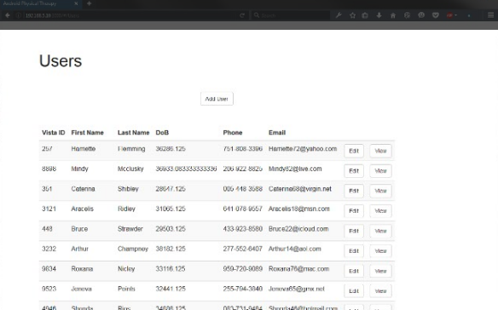
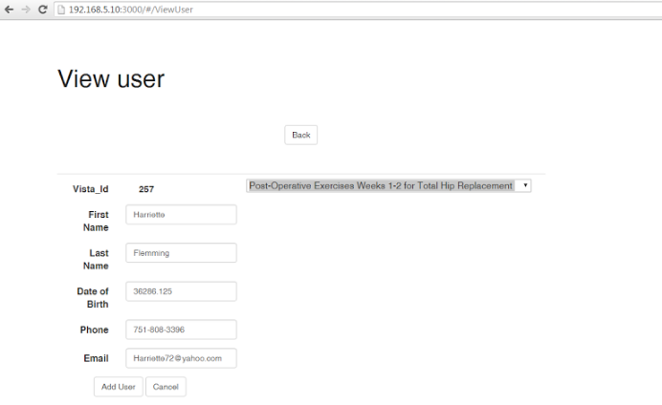
Healthcare Provider Interface
The healthcare provider will be able to add, edit and view users.
The prescribed exercises will be added here for each patient, the healthcare professional will then be able to edit those exercises based on the patients progress.
The healthcare provider will not need to access the Android application, making it easier to integrate into the medical field.

Slide 5
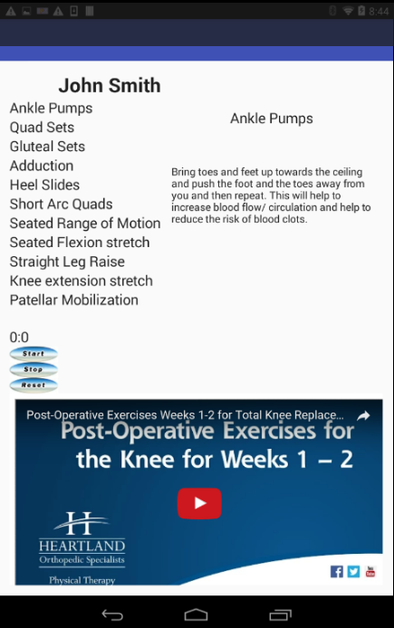
Patient Interface
The patient will see a list of exercises that their healthcare provider has prescribed. The patient will be able to select those exercises and view details and videos that explain how to complete the exercise. The patient will be able to play the video directly inside the app.
The patient will keep track of these exercises by clicking the timer which will keep a record in the database of how long the exercise was performed.

Slide 6
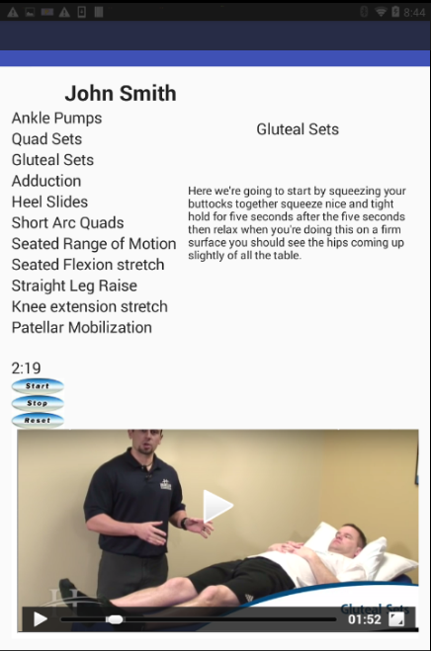
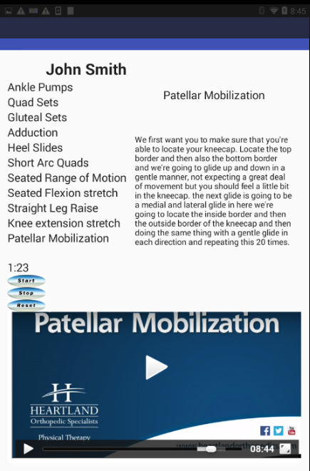
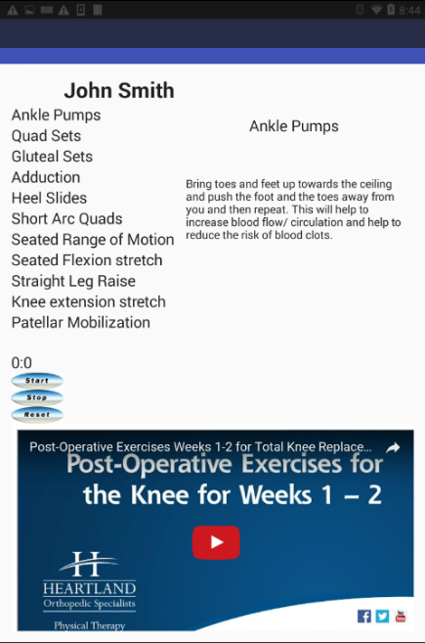
Embedded video to show the patient how exercise is properly done.
Timer for easy record keeping.
Exercise description to explain proper procedure for completing the exercise.

Slide 7
End

