Slide 1
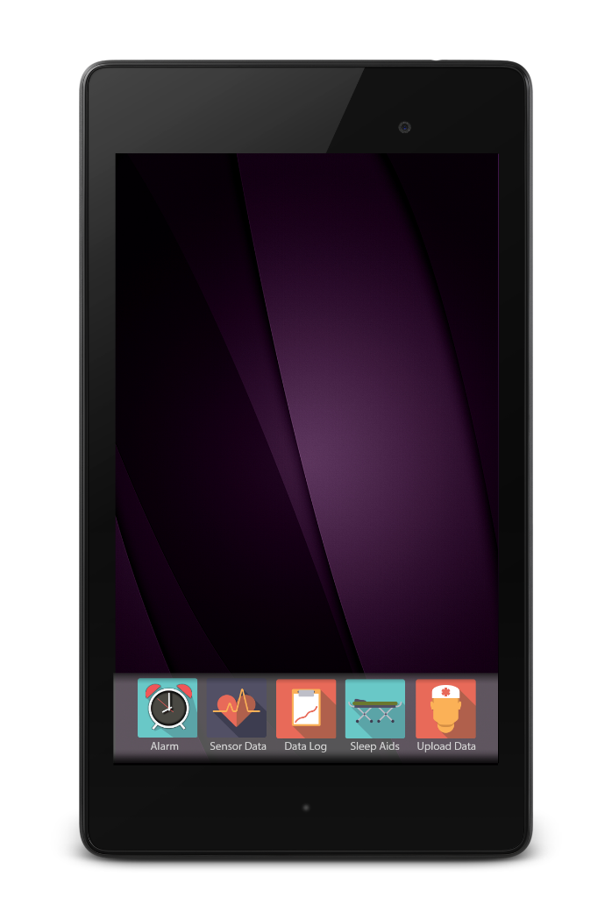
SleepFit

Slide 2
SleepFit Team Agenda
Bob Fennell – Program Manager : Product Concept and Competition
Leslie Yane - Nurse: Importance of sleep
CharlesFlorestal – Programming Engineer: Demonstration
Santiago Agudelo –Interface Engineer: Demonstration
Bob Fennell - Questions
Ivan Kalytovskyy- Artist.

Slide 3
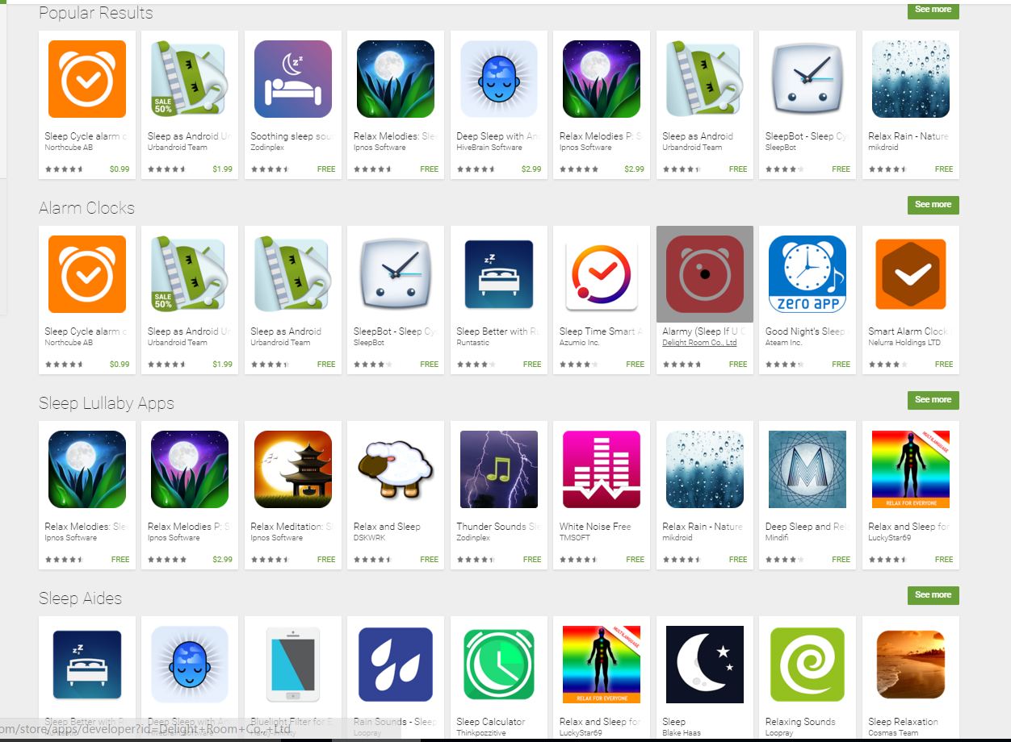
Sleep Apps

Slide 4
Basic Concepts
1) Are you sleeping well?
2) Why not ?
3) What to do about it? What can be done to Help?
4) Medical Implications?
5) Market size? What will people pay ?

Slide 5
Nearest Competition : Sense App with Hardware
Key Features:
Movement -Accelerometer clipped on Pillow
Communication: Low power Bluetooth, WiFi
Room Sensors: Temperature, particles, light detector, sound
Analyses sleep pattern with online registration
Has a soothing wake up alarm with lights
Downloadable App with sleep pattern on iOS or Android
Price: $129 for Ball and Pill : Pill $49.

Slide 6
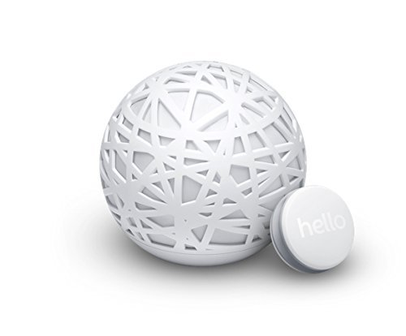
Sense with Pill

Slide 7
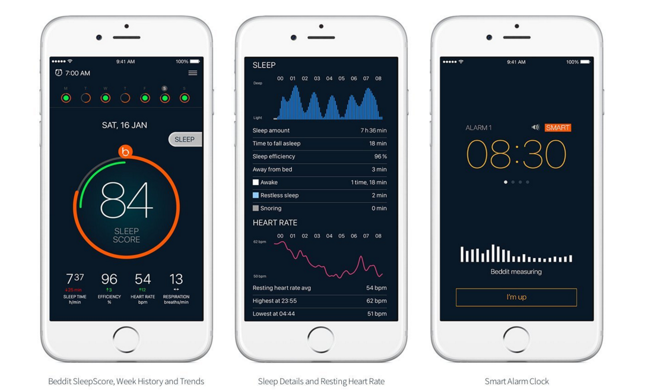
Beddit Smart 2.0 Sleep Monitor
Accelerometer strap on Bed
Price: $149

Slide 8
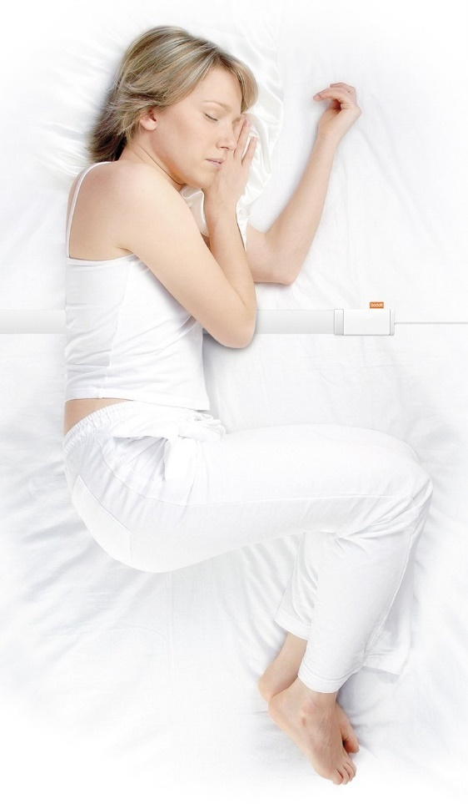
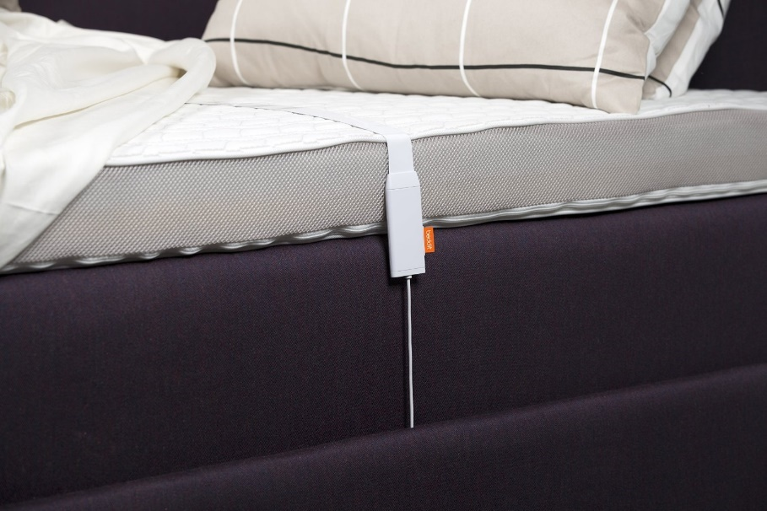
Strap Sensor Across Bed

Slide 9
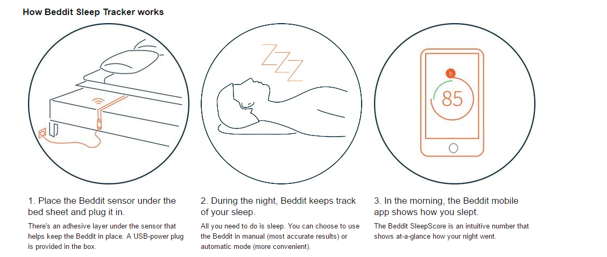
Beddit Sensor

Slide 10
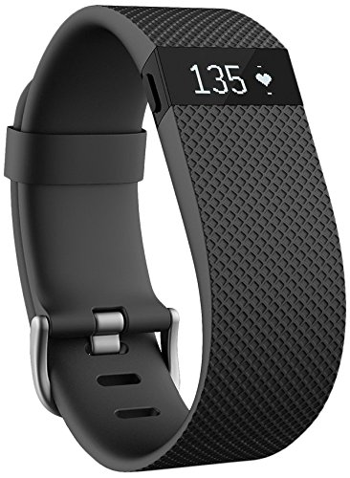
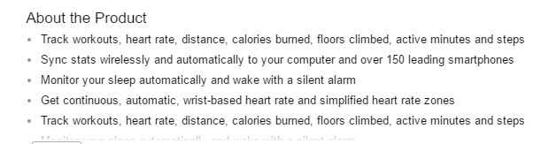
Portable, wearable, electronics
Fitbit
Download via Bluetooth to portable device which then uploads data to the cloud.

Slide 11
Bluetooth Low Energy
Android 4.3 (API Level 18) introduces built-in platform support for Bluetooth Low Energy
Energy (BLE) is designed to provide significantly lower power consumption.
BLE devices that have low power requirements, such as proximity sensors, heart rate monitors, fitness devices, and so on.
Service—A service is a collection of characteristics. For example, you could have a service called "Heart Rate Monitor" that includes characteristics such as "heart rate measurement." You can find a list of existing GATT-based profiles and services on bluetooth.org.
Operating systems
iOS 5 and later
Windows Phone 8.1
Windows 8 and later
Android 4.3 and later[
BlackBerry 10
Linux 3.4 and later through BlueZ]
Unison OS 5.2

