Slide 1
HEALTHY THINKING LOOKING AT LIFE THROUGH A BALANCED PERSPECTIVE
Khalil Millwood
Avinash Rao
Steven Smodish
Ariana Santiago

Slide 2
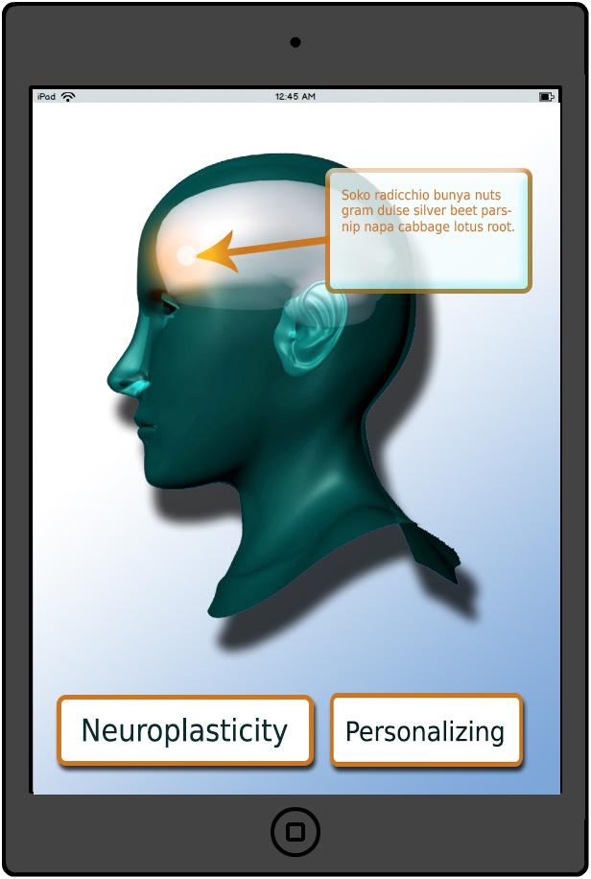
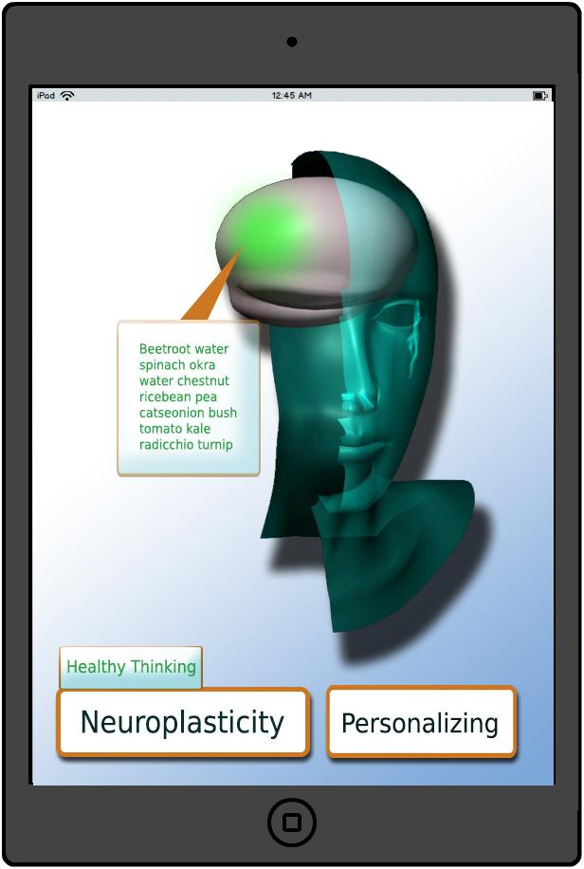

Slide 3
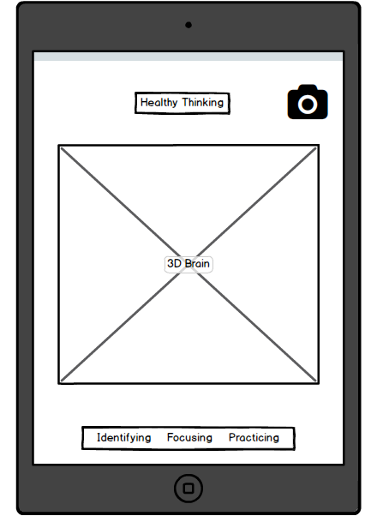

Slide 4
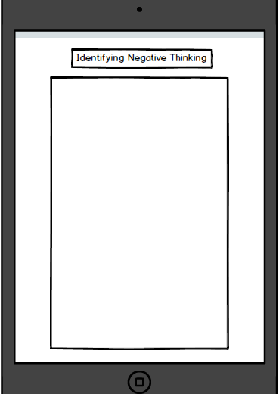
IDENTIFYING NEGATIVE THINKING
Mind Reading: Jumping to conclusion
Filtering: Focusing only on the negative parts
Personalization/Labeling: Blaming yourself for everything
Catastrophizing/Fortune Telling: Always anticipating that something bad will happen
Polarizing/Black and White Thinking: Things only appear good or bad. No middle ground.
Notes:
Negative thinking can also be referred to as an unbalanced thinking pattern.
This line of negative thinking can be caused by numerous things such as feeling sad, angry, or stressed. You also are more vulnerble to negative thinking when one practices bad dietry and sleeping habits
Mind reading is basically when an individual jumps to a conclusion without any form of evidence.
For example if you pass someone in a hallway and they ignore your hello, telling yourself they hate you is a form of negative thinking
FIltering your thoughts basically means out of a series of events you just focus on the negative aspects and ignore all the positive things

Slide 5
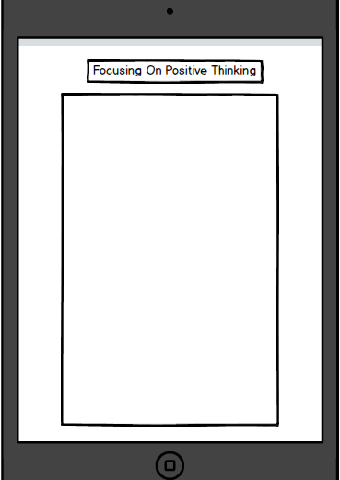
FOCUSING ON POSITIVE THINKING
Identify Areas to Change/Identify Thinking Traps
Check Yourself/Challenge Those Thinking Traps
Be Open to Humor
Follow a Healthy Lifestyle
Surround Yourself With Positive People
Notes:
Learn to notice irrational thoughts about yourself
Learn to stop these thoughts
Rather than focusing on negative thoughts, replace them with accurate thoughts

Slide 6
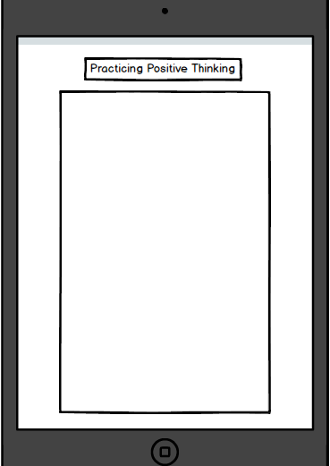
PRACTICING POSITIVE THINKING
Training Your Mind for Intentional Thought
Helps Fight Off Stress
List Benefits of Positive Thinking
Tips/Motivation to Guide User to Positive Thinking
Notes:
Practicing positive thinking is the stage that comes after realizing one is in a series of unbalanced thinking traps

Slide 7
AUGMENTED REALITY IDEAS
Neuroplasticity
Motivational Message
Wearables

