Slide 1
Health Data Analysis
Technology Review
CSE 583
11/14/2023

Slide 2
•Next Thu. every project will present
•Max 5 minutes – I will cut you off
•
•Everyone in the team will speak
•Background: your application and why you want to use it, 1 slide
•What technologies you considered: 1 slide
•Choice: what you chose to use, summary of how it works, 1 slide
•Appeal of choice: 1 slide
•Drawbacks of choice: 1 slide
•
•Things to think about, as a starting point:
–Availability of relevant examples
–Look at open issues on GitHub
•
•Questions?

Slide 3
Background
All of Us
Health data from one million or more people living in the United States by NIH
Demographics, survey, EHR, genomics, etc.
Social determinants of health
Income level
Healthcare coverage
Housing status
Notes:
Social determinants of health are societal systems, their components, and the social resources and hazards for health that societal systems control and distribute, allocate and withhold, such that the demographic distribution or trend of health outcomes is changed. (https://www.ncbi.nlm.nih.gov/pmc/articles/PMC8672311/)
Include governments, institutions and other organizations, regulations and processes → resources and hazards for health that these systems control, allocate, withhold, and distribute include:
food/lack of food
sanitation/unsanitation
education
employment
law and justice
law enforcement
transportation
health information/ dis-information
Our interests are the linkage of SDOH to health outcomes, especially chronic disease, and the distribution of SDOH across space and time.
Can we identify emerging trends?

Slide 4

Background
All of Us (NIH)
Health data from one million or more people living in the United States
Demographics, survey, EHR, genomics, etc.
Interactive Visualizations
Maps (e.g., choropleth)
Time-series
Bar plots
Goal: Linking SDOH to health outcomes, especially chronic disease, and visualizing the distribution of SDOH across space and time. Can we identify emerging trends?
Notes:
Brian

Slide 5
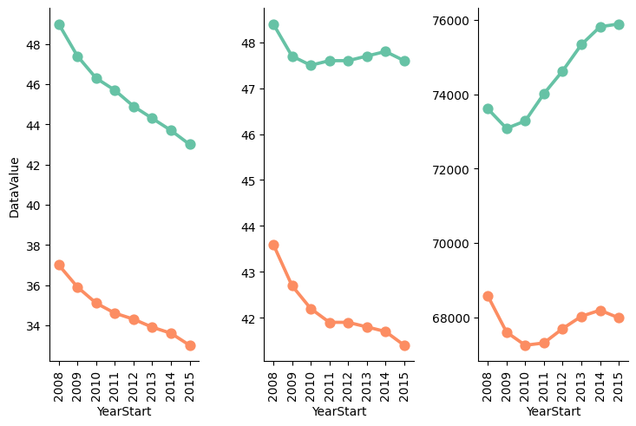
Technologies Considered
Data visualization tools
matplotlib (Python)
seaborn (Python)
Altair (Python)
D3 (Javascript)
Plotly (Python)
colorectal cancer incidence in the U.S. (seaborn)

Slide 6
Why we didn’t pick these
Plotly (Python)
Put something here
D3 (JavaScript)
Put something here

Slide 7
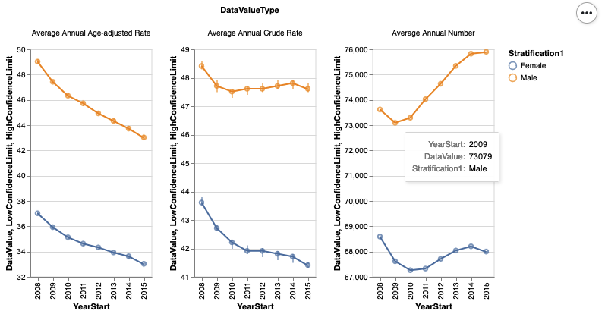
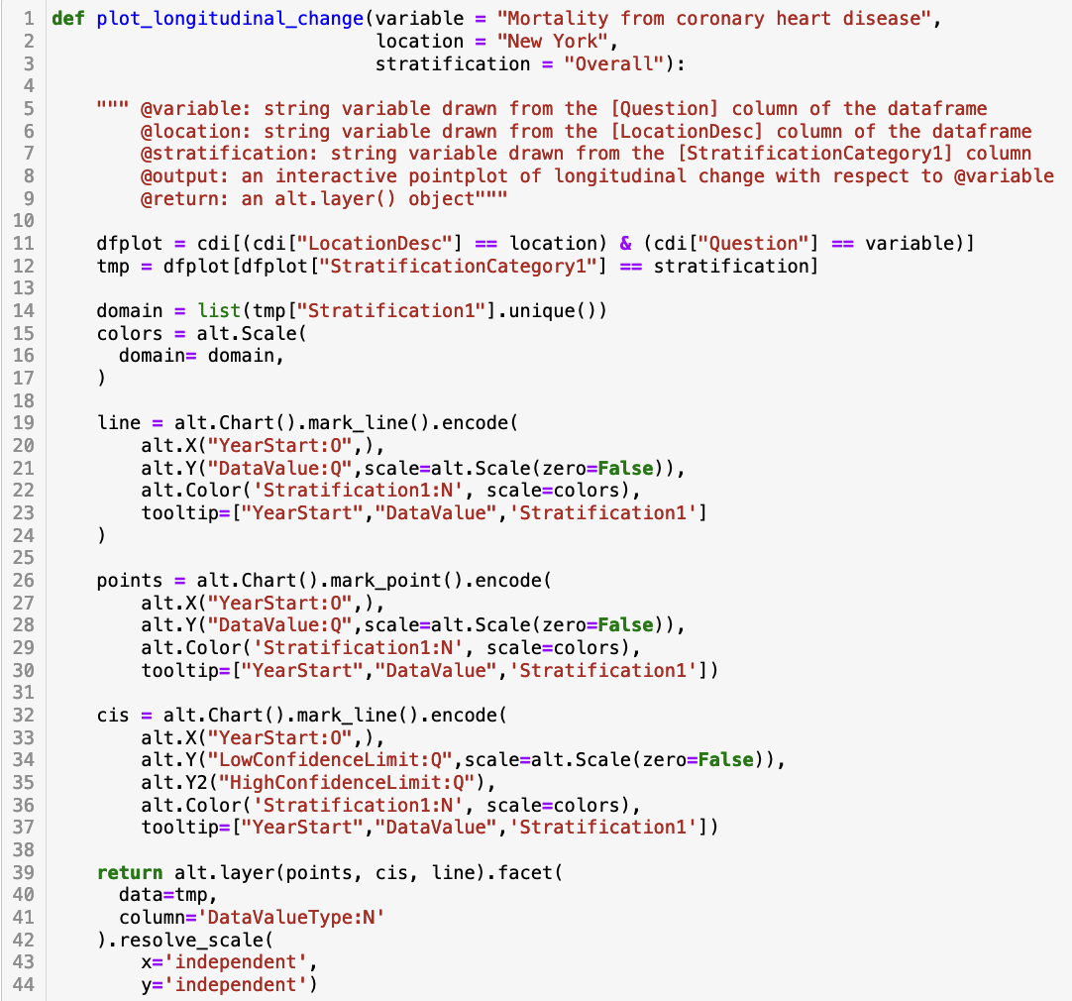
Altair
high level compared to matplotlib
More customization than seaborn
Syntactic simple compared to D3 & Plotly
colorectal cancer incidence in the U.S.

Slide 8
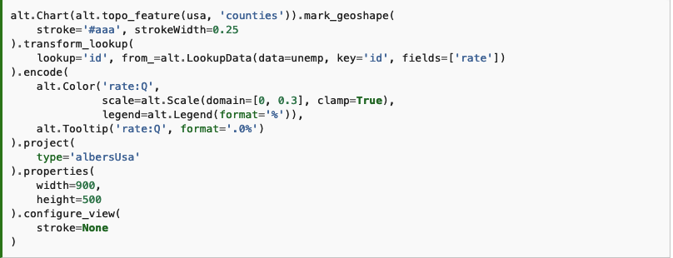
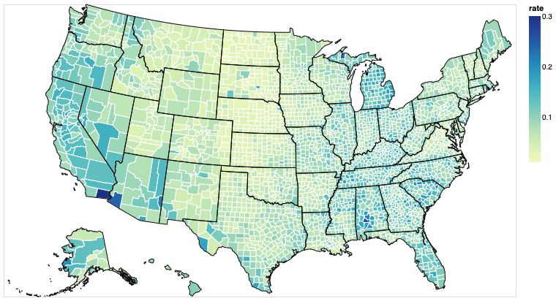
Altair - Interactive Geomap

Slide 9
Pros
Interactive visualizations
Integration with Python ecosystem
Declarative syntax allows for ease of use
Transportable format
Notes:
Altair exels in creating interactive charts - beneficial large datasets
Being a python library, altair integrates seamlessly with other data analysis tools commonly used in health research, like pandas/numpy
With its declarative nature, Altair can plot complex datasets with only several lines of code. Easier for researchers without extensive programming experience to use.

Slide 10
Cons
Performance with large datasets
Limited 3D capabilities
Declarative means not as customizable
Notes:
Peter
Altair faces challenges with large datasets due to its browser-based rendering mechanism (JSON specification), which can lead to performance issues and browser memory constraints when dealing with substantial amounts of data. This design makes it less suitable for efficiently visualizing large-scale datasets.
Preference for Long Format Data: Altair is optimized for 'long' or 'tidy' data formats. If your raw data is in a 'wide' format, you may need to reshape it before visualization. This additional data manipulation step can be inconvenient and time-consuming, especially for large datasets.
No Support for 3D Plotting: Altair, being a declarative visualization library based on Vega-Lite, does not support 3D plotting. Vega-Lite, the underlying grammar of graphics for Altair, is designed for concise and clear 2D visualizations and does not include 3D capabilities.
Limited Customization Due to Declarative Nature: As a declarative visualization library, Altair simplifies the process of creating charts by abstracting away many low-level details. However, this abstraction can limit how much a user can customize their visualizations. If highly specific or unique customizations are needed, Altair might not be able to accommodate them easily.

Slide 11
Summary
SDOH represents multiple contributors to health outcomes; better explored using visualizations.
Visualizations can help users identify underlying patterns in an intuitive (visual > tabular) way.
Pros: interactive, ease of use, transportable format
Cons: performance with large dataset, customizability, lack of 3D plotting

