Slide 1
HDCD: Health Determinants for Chronic Diseases
CSE 583
Team: Brian Chang, Peter Ju, Wesley Surento, Su Xian 12/13/2023
Notes:
Slide titles from https://uwseds.github.io/projects.html

Slide 2


Background
Social Determinants of Health (SDOH):
Societal systems controlling/distributing resources impact health outcomes
Challenges exist in establishing direct causal relationships between SDOH and health outcomes
Interactive Visualizations:
Aids in establishing associations and causality, as they allow for direct data manipulation and analysis
Goal:
Link SDOH to health outcomes and visualize distribution of SDOH across space and time. Can we identify emerging trends and/or establish associations?
Notes:
Describe the problem or area being addressed.
Societal systems include governments, institutions, and other organizations
Examples of SDOH: food, income, employment, education, and health information

Slide 3

Data Used
All of Us
NIH Initiative
Health data from 1 million+ people living in the United States
Demographics, survey, EHR, genomics, etc.
Data obtained through Researcher Workbench
Controlled tier (participant level) requires training and approval
Limitations: location data, confined to workbench
Workspace
Cohort Builder
Dataset Builder
Jupyter Notebook
Notes:
What data did you use? How was it obtained? What are its limitations?

Slide 4


Data Used
Chronic Disease Index (CDI), 500 Cities Project & PLACES
Released by CDC
City-, county-, and state-level data
Health indicators, outcomes, risk behaviors, and SDOH
Limitations
Short time frame (10 years maximum)
Only aggregate data
Notes:
What data did you use? How was it obtained? What are its limitations?
CDI: uniformly defined state-level data for chronic diseases and risk factors that have a substantial impact on public health
124 indicators in 18 topic groups, like alcohol, CVD, COPD, diabetes, mental health, etc.
201 individual measures are included for the 124 indicators
500 CS: city- and census tract-level data and used small area estimation methods to obtain 27 chronic disease measures for the 500 largest American cities
PLACES provides model-based, population-level analysis and community estimates of health measures to all counties, places (incorporated and census designated places), census tracts, and ZIP Code Tabulation Areas (ZCTAs) across the United States
Health outcomes, risk behaviors, and SDOH

Slide 5
Use Cases
Medical doctor
Observe, hypothesize → grant apps
Data to support clinical research
Informed treatment for target pop
Data scientist
Explore & analyze
Health behavior → public health
Downstream: sampling & targeted solutions
Public Health Department official
Visualize state-level trends in binge drinking
Discover highly correlated variables
Interventional policies
t
Notes:
How users will interact with your system in a way that addresses the problem area.

Slide 6
Demo
Step-by-step walkthrough using Chronic Disease Index (CDI) data
Adaptations and visualizations using All of Us data (download the html file under the examples folder).
Examples
Conditions GeoMap
Median Income GeoMap
*As a note, we can’t demo any work on All of US directly as it is not “public”.
Notes:
Demonstrate your software.

Slide 7
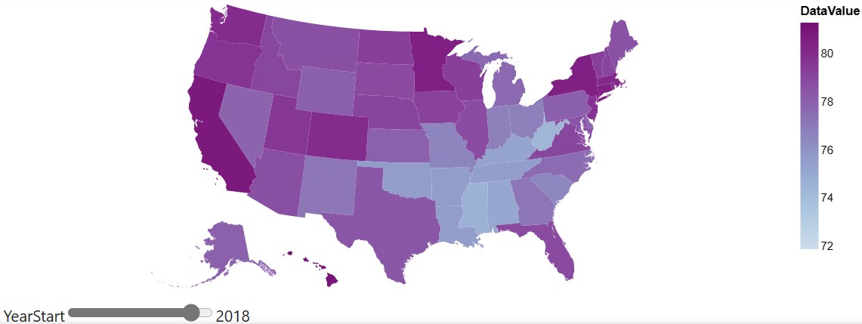
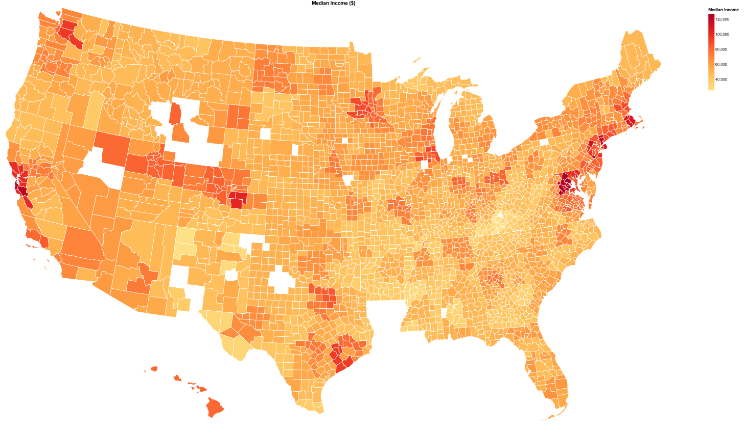
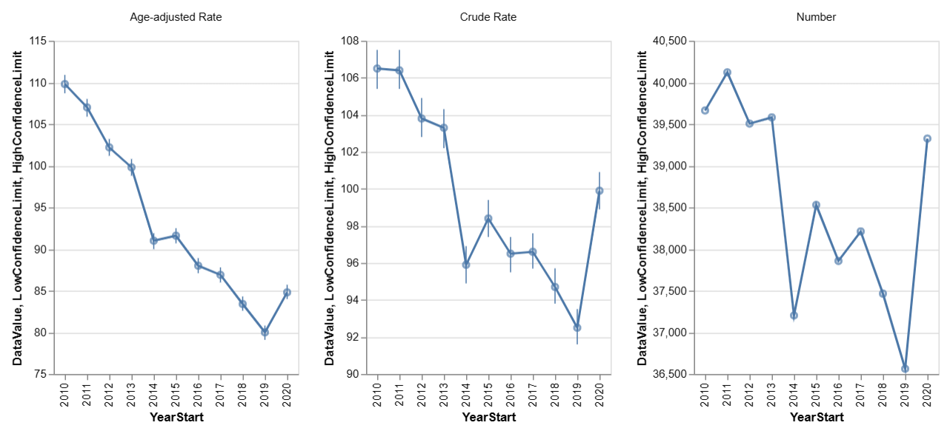
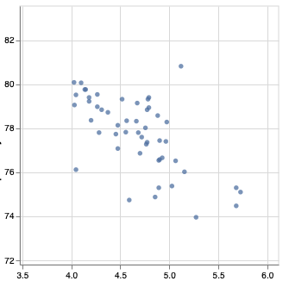
Design
Life expectancy
Visualize trends (state level)
Summary statistics and description of variables in datasets, specifically for SDOH variables, US states, years.
Short statement
A.
summary.py
Median income
Visualize trends
(county level)
def plot_geomap
def plot_geomap_socioeconomic
B.
plot.py
Mortality (coronary heart disease)
Dive into a place (state) of interest
def plot_longitudinal_change
def plot_corr
Association: behavior and health outcome
Life expectancy vs binge drinking
Pre.
data_ wrangling.py
Produces county-level socioeconomic and conditions data for plot.py
Preprocess & data cleaning (All of Us example)
Notes:
Describe the components and how they interact to accomplish the use cases.
Purple: Life expectancy at birth
Orange: median income by county level (white areas are missing data, corresponds to tribal lands and military bases)
Longitudinal 3 plots: Mortality from coronary heart disease, Age-adjusted rate, crude rate, raw value
Scatter plot: life expectancy vs binge drinking

Slide 8
Project Structure
hdcd
data_ wrangling.py
plot.py
summary.py
dfdfdfd
data
Sample datasets for testing & developing functions
main
docs
Text docs for software components & use cases
examples
Example output (visualizations)
notebook
Jupyter notebooks to implement functions
tests
Test functions
Notes:
Show the structure of your github repository.

Slide 9
Project Structure
HDCD/
┣ .github/
┃ ┗ workflows/
┃ ┗ python-package-conda.yml
┣ data/
┃ ┣ cdi_dummy.csv
┃ ┣ condition_data.csv
┃ ┣ observation_data.csv
┃ ┣ person_data.csv
┃ ┣ places_dummy.csv
┃ ┗ survey_data.csv
┣ docs/
┃ ┣ 2023-11-14.pptx
┃ ┣ component_specification.md
┃ ┣ design.md
┃ ┗ functional_specification.md
┣ examples/
┃ ┣ education.html
┃ ┣ health_insurance.html
┃ ┣ Lets Get Started....html
┃ ┣ median_income.html
┃ ┗ poverty.html
┣ hdcd/
┃ ┣ data_wrangling.py
┃ ┣ plot.py
┃ ┣ summary.py
┃ ┗ __init__.py
┣ notebook/
┃ ┣ dummy_data.ipynb
┃ ┣ Lets Get Started....ipynb
┃ ┗ test_geomap.ipynb
┣ tests/
┃ ┗ test.py
┣ .gitignore
┣ environment.yml
┣ LICENSE
┣ main.py
┗ README.md
dfdfdfd
data
dummy_data
Notes:
Show the structure of your github repository.

Slide 10
Lessons learned & Future work
Lessons learned
GitHub
Developing unit tests for plot functions
Exceptions
Lack of customization with Altair
Future work
GUI (?)
User studies
Test on other datasets (customize)
Notes:
Focus on software engineering lessons.
GitHub: ownership, push permissions, merging branches
Altair requires a highly specified data structure for visualization wrt selection and interactions
Function and components are highly connected. One single modification can lead to many changes (where CI comes to play an important role)

Slide 11
Thank you!

