Slide 1



Slide 2
heemod - Health Ecomomic Evaluation MODelling
“an R package for Markov models implementing most of the modelling and reporting features described in reference textbooks and guidelines: deterministic and probabilistic sensitivity analysis, heterogeneity analysis, time dependency on state-time and model-time (semi-Markov and non-homogeneous Markov models), etc”
Markov Models for Health Economic Evaluations: The R Package heemod (2017) Antoine Filipović-Pierucci, Kevin Zarca, Isabelle Durand-Zaleski, arXiv

Slide 3
Main features:
Accounting for time-dependency:
For both model time and state time.
Time-varying transition probabilities.
Time-varying values attached to states.
Probabilistic uncertainty analysis (PSA).
With correlated resampling.
Covariance analysis for PSA.
Expected value of perfect information (EVPI).
Deterministic sensitivity analysis (DSA).
Other features:
Multiple state membership correction methods (life-table, custom method, etc.).
Demographic analysis to compute population-level results.
Heterogeneity analysis.
Parallel computing support.
Features for budget impact analysis.
Interface with SAVI and BCEA.

Slide 4
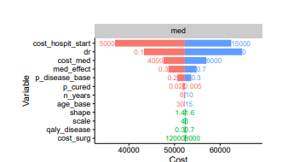
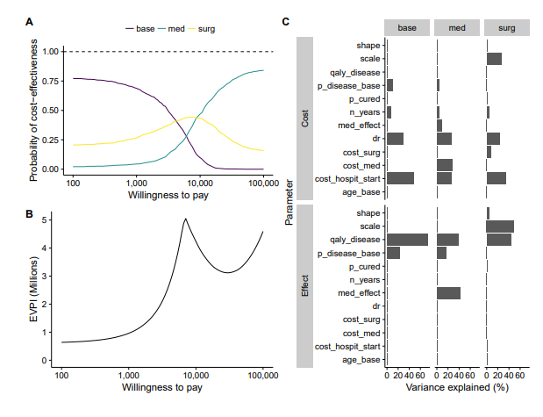
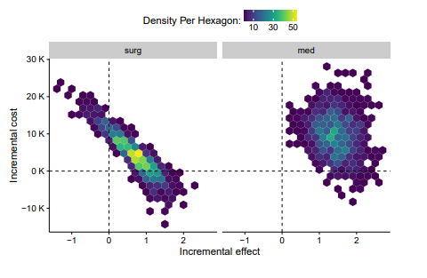
Plotting

Slide 5
