Slide 1
E-cigarettes compared with nicotine replacement therapy within the UK Stop Smoking Services: the TEC RCT
Nathan Green
Imperial College London

Slide 2
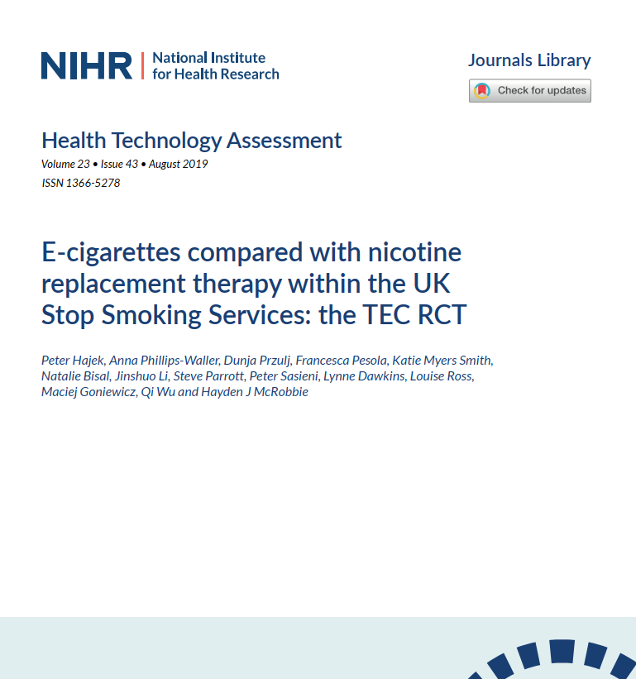

Slide 3
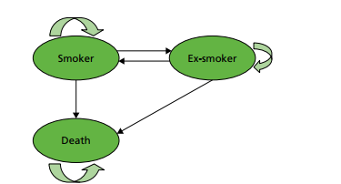
Markov model structure

