Slide 1


Slide 2
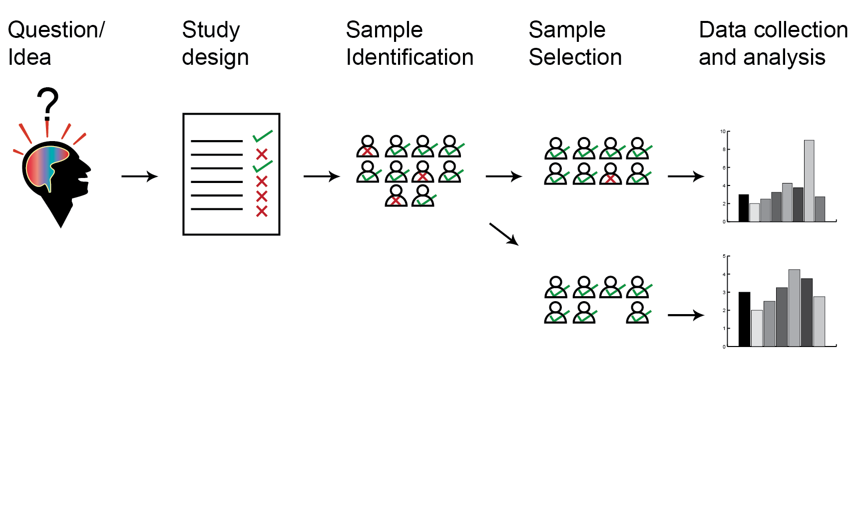
The Problem
Research Question
Notes:
Hello everyone, my name is Divya Ramnath and I am a researcher. My project involves collaborating with clinicians and clinical nurses to access patient samples for medical research. A research study is carefully designed to investigate a particular question or idea. The sample conditions suitable for the study are listed by the researcher and then passed onto a clinician or a clinical nurse who uses this information to identify and select the samples for the study. The selected samples are then used for research to generate data. Now, the sample selection process is the most critical process in any clinical study. Therefore, if an unsuitable sample, for example a patient with an infectious disease, is included in the study, the data may not be powerful and/or usable. If the study had excluded the unsuitable patient, the data becomes powerful and the interpretation is accurate. But, as a researcher, I do not have direct access to the clinical information due to patient confidentiality issues and the clinicians or clinical nurses may not be aware of all the relevant criteria for a research study. So, key information may be lost during this process of sample selection. Therefore, I would like to propose an app or a form that can be used to filter out samples by particular fields that are suitable for a particular research purpose. I am able to provide an excel database of the clinical samples to get help with my problem.

Slide 3
The Problem
Design Study Criteria
Notes:
Hello everyone, my name is Divya Ramnath and I am a researcher. My project involves collaborating with clinicians and clinical nurses to access patient samples for medical research. A research study is carefully designed to investigate a particular question or idea. The sample conditions suitable for the study are listed by the researcher and then passed onto a clinician or a clinical nurse who uses this information to identify and select the samples for the study. The selected samples are then used for research to generate data. Now, the sample selection process is the most critical process in any clinical study. Therefore, if an unsuitable sample, for example a patient with an infectious disease, is included in the study, the data may not be powerful and/or usable. If the study had excluded the unsuitable patient, the data becomes powerful and the interpretation is accurate. But, as a researcher, I do not have direct access to the clinical information due to patient confidentiality issues and the clinicians or clinical nurses may not be aware of all the relevant criteria for a research study. So, key information may be lost during this process of sample selection. Therefore, I would like to propose an app or a form that can be used to filter out samples by particular fields that are suitable for a particular research purpose. I am able to provide an excel database of the clinical samples to get help with my problem.

Slide 4
The Problem
Sample Identification
Notes:
Hello everyone, my name is Divya Ramnath and I am a researcher. My project involves collaborating with clinicians and clinical nurses to access patient samples for medical research. A research study is carefully designed to investigate a particular question or idea. The sample conditions suitable for the study are listed by the researcher and then passed onto a clinician or a clinical nurse who uses this information to identify and select the samples for the study. The selected samples are then used for research to generate data. Now, the sample selection process is the most critical process in any clinical study. Therefore, if an unsuitable sample, for example a patient with an infectious disease, is included in the study, the data may not be powerful and/or usable. If the study had excluded the unsuitable patient, the data becomes powerful and the interpretation is accurate. But, as a researcher, I do not have direct access to the clinical information due to patient confidentiality issues and the clinicians or clinical nurses may not be aware of all the relevant criteria for a research study. So, key information may be lost during this process of sample selection. Therefore, I would like to propose an app or a form that can be used to filter out samples by particular fields that are suitable for a particular research purpose. I am able to provide an excel database of the clinical samples to get help with my problem.

Slide 5
The Problem
Sample Selection
Notes:
Hello everyone, my name is Divya Ramnath and I am a researcher. My project involves collaborating with clinicians and clinical nurses to access patient samples for medical research. A research study is carefully designed to investigate a particular question or idea. The sample conditions suitable for the study are listed by the researcher and then passed onto a clinician or a clinical nurse who uses this information to identify and select the samples for the study. The selected samples are then used for research to generate data. Now, the sample selection process is the most critical process in any clinical study. Therefore, if an unsuitable sample, for example a patient with an infectious disease, is included in the study, the data may not be powerful and/or usable. If the study had excluded the unsuitable patient, the data becomes powerful and the interpretation is accurate. But, as a researcher, I do not have direct access to the clinical information due to patient confidentiality issues and the clinicians or clinical nurses may not be aware of all the relevant criteria for a research study. So, key information may be lost during this process of sample selection. Therefore, I would like to propose an app or a form that can be used to filter out samples by particular fields that are suitable for a particular research purpose. I am able to provide an excel database of the clinical samples to get help with my problem.

Slide 6
The Problem
Sample Selection
Notes:
Hello everyone, my name is Divya Ramnath and I am a researcher. My project involves collaborating with clinicians and clinical nurses to access patient samples for medical research. A research study is carefully designed to investigate a particular question or idea. The sample conditions suitable for the study are listed by the researcher and then passed onto a clinician or a clinical nurse who uses this information to identify and select the samples for the study. The selected samples are then used for research to generate data. Now, the sample selection process is the most critical process in any clinical study. Therefore, if an unsuitable sample, for example a patient with an infectious disease, is included in the study, the data may not be powerful and/or usable. If the study had excluded the unsuitable patient, the data becomes powerful and the interpretation is accurate. But, as a researcher, I do not have direct access to the clinical information due to patient confidentiality issues and the clinicians or clinical nurses may not be aware of all the relevant criteria for a research study. So, key information may be lost during this process of sample selection. Therefore, I would like to propose an app or a form that can be used to filter out samples by particular fields that are suitable for a particular research purpose. I am able to provide an excel database of the clinical samples to get help with my problem.

Slide 7
The Problem
Notes:
Hello everyone, my name is Divya Ramnath and I am a researcher. My project involves collaborating with clinicians and clinical nurses to access patient samples for medical research. A research study is carefully designed to investigate a particular question or idea. The sample conditions suitable for the study are listed by the researcher and then passed onto a clinician or a clinical nurse who uses this information to identify and select the samples for the study. The selected samples are then used for research to generate data. Now, the sample selection process is the most critical process in any clinical study. Therefore, if an unsuitable sample, for example a patient with an infectious disease, is included in the study, the data may not be powerful and/or usable. If the study had excluded the unsuitable patient, the data becomes powerful and the interpretation is accurate. But, as a researcher, I do not have direct access to the clinical information due to patient confidentiality issues and the clinicians or clinical nurses may not be aware of all the relevant criteria for a research study. So, key information may be lost during this process of sample selection. Therefore, I would like to propose an app or a form that can be used to filter out samples by particular fields that are suitable for a particular research purpose. I am able to provide an excel database of the clinical samples to get help with my problem.

Slide 8
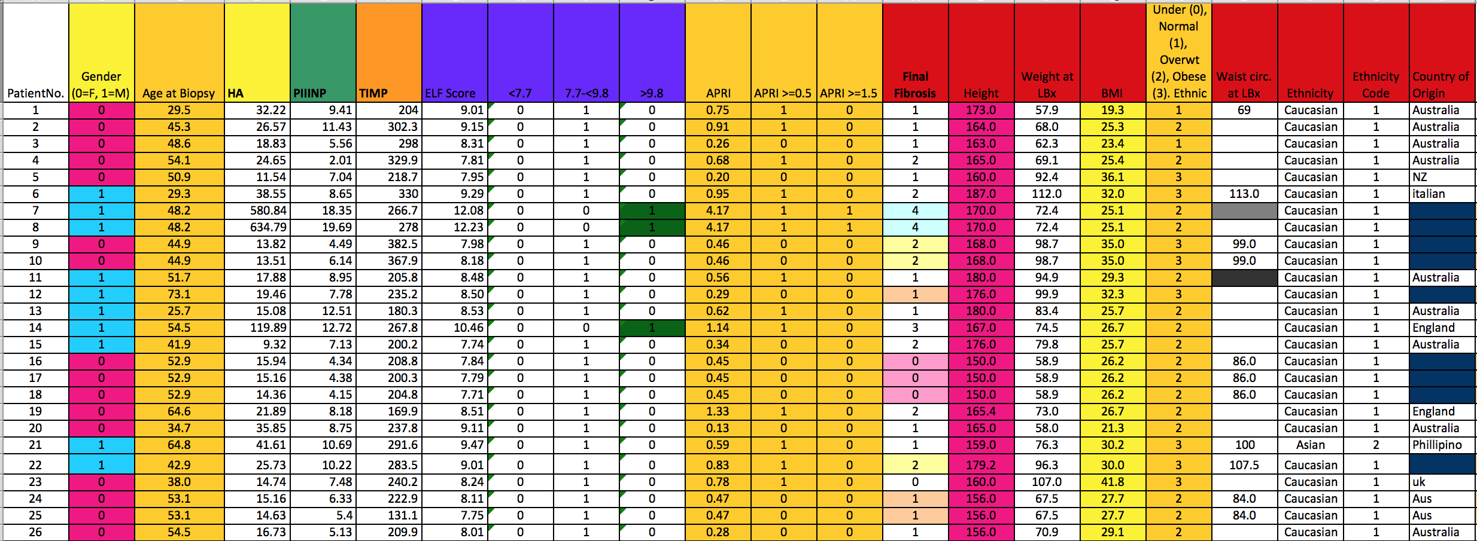
Problem
Notes:
This is my problem. This is the database that I get provided with to search for my clinical samples. As you can see, it is very complex, inconsistent in data entry and there are about 200 more columns in this spreadsheet to screen through. So you can imagine that it would be very time consuming for me or other clinicians to filter through every column to find clinical samples that are suitable for a research study.
Current methods of sample selection for research studies are time consuming and often fail to identify which samples qualify for analysis and does not screen unsuitable samples effectively.
Out of the box tools for accurate data sorting are not available or where available require costly modifications.
Precious time is spent manually sorting dataset.
Limited accuracy in selection.

Slide 9
Solution: Parasort
A tool for researchers to upload, map, validate and query clinical data.
www.parasort.org
Notes:
Parasort is a tool for researchers to be able to upload their data, map and validate it and run queries to filter the data. So, here’s an example of what parasort can do. We have already uploaded my clinical database and mapped and validated the relevant information. So, I can run a query such as

Slide 10
Parasort Advantages
Manage Search Criteria
Applicable for any Excel Database
Reports Errors
Multiple Search Criteria
Saves Time!

