Slide 1


COMMODITY DEMAND PREDICTION MODEL
This Photo by Unknown author is licensed under CC BY-ND.
Group : Apex

Slide 2
WHAT IS THE PROBLEM? The restocking of Malaria commodities is
currently done based on 6 month averages
computed by MoH officials from the KHIS
system data. These averages do not paint a
clear picture of trends related to consumption
such as seasonality, increases or decreases as
well as other confounding factors.

Slide 3

The Setup "before state of the data"

Slide 4
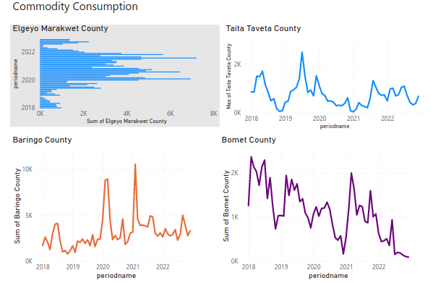

Slide 5
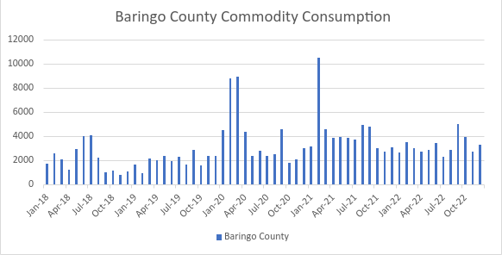

Slide 6
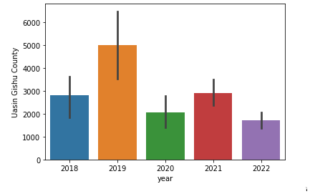
Conflict "what is causing the data to change"

Slide 7
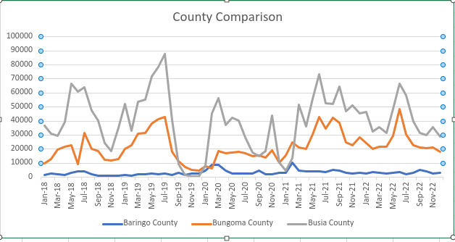

Slide 8
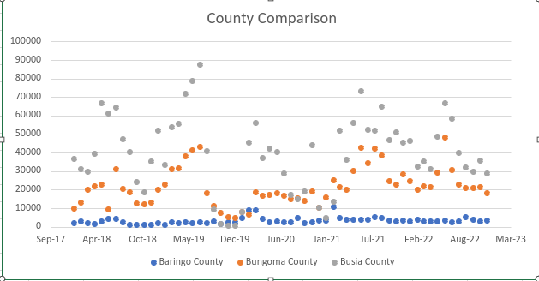

Slide 9

Resolution The 'after' state
To develop a commodity demand prediction model based on historical data for use in restocking decision making.

