Slide 1
NASCOP
Data collection tools.

Slide 2
DATA STORY
The client user/ their needs described :
NACSCOP is currently transitioning its data collection tools, and as a result, there will be two different sets of tools used for data collection and reporting. It is important to have an unbiased approach in selecting indicators that takes into account relevant facility characteristics. The client; the NASCOP personnel need to make a non-bias decision based on a machine learning model that advises on the indicator to use based on historical data values, facility characteristics, changes in the indicator etc. in making a choice of what indicator to use.

Slide 3
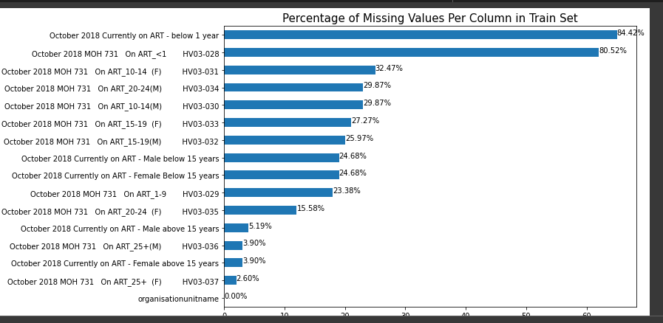
DATA ENGINEERING Data cleaning and feature extraction

Slide 4
Data cleaning and feature extraction
This was achieved through:
The rows with all missing values was dropped.
The data was unpivoted (To convert columns into rows, so as to undo a pivot operation.) to create the data that is useable.
We added columns age, gender, type as a data dictionary in order to facilitate with the development of the model.

Slide 5
MODEL DEVELOPMENT AND DEPLOYMENT
The cleaned data was fed through the Random forest Regressor algorithm to create a trained model.
The algorithm was to take input age, gender and type from the user and produce the value as an output.
Model Training: The model was trained using forest regressor algorithim.
Model evaluation: After training and testing the model had an accuracy of 0.15

Slide 6
THE WEB APPLICATION DEMO
The model was deployed on a web application using Streamlit.
Streamlit is a free and open-source framework to rapidly build and share beautiful machine learning and data science web apps
The link to the deployed web application is :-https://healthit.streamlit.app/

