Slide 1
Prelim Results on 15 cases
031726
Wenyuan Chen

Slide 2
Understanding LLM Performance in UTI Phenotyping
Understanding LLM Performance in UTI Phenotyping
Compare LLM-extracted symptoms vs physician ground truth
Goal: explain how and why models succeed or fail
Key Challenge
UTI diagnosis is subjective
LLM disagreement ≠ always wrong (maybe incomplete documentation)
Missing documentation → incomplete evidence for LLM
Core Insight
Performance depends on both:
  Model reasoning
  What clinicians document (availability of evidence)

Slide 3
UTI Prediction Accuracy
Model | Accuracy | Errors
GPT-5 | 100% | 0 / 15
Claude 3.7 | 93.3% | 1 / 15
Gemini 2.5 Pro | 93.3% | 1 / 15
Missingness Insight (All Models Agree)
Dysuria (low uncertainty = 0.11)
→ Absence is informative → UTI unlikely
Perineal pain, incontinence, suprapubic pain (high uncertainty)
→ Absence not reliable
Takeaway
Not all missing symptoms are equal weighted
Some absences carry real diagnostic signal

Slide 4
Why Models Fail & What to Fix
Feature-Level Error Drivers
  Claude: Dysuria mismatch → error signal (r = 0.44)
  Gemini: Hematuria mismatch → strongest predictor (r = 0.68, p = 0.005)
  GPT-5: No errors (small sample)
Key Insight
  Hematuria:
    Hematuria mismatch → strongly associated with error (Gemini) Hematuria → rarely documented (~20%)
    → Critical blind spot ?(but small sample size)
Actionable Output
Focus improvement on symptoms that are:
  Highly diagnostic
  Poorly documented or mis-extracted
→ Highest ROI for prompt + extraction refinement (rule iteration for phenotyping)

Slide 5
Develop and validate automated methods to electronic phenotype UTIs
021926
Wenyuan Chen

Slide 6
Previous work on this aim
1. Electronic Phenotyping of Urinary Tract Infections as a Silver Standard Label for Machine Learning

Slide 7
Silver label
Context: human label 100 cases (gold labels), each case takes 15 minutes
Objective: derive electronic phenotyping rules to create more accurate labels in large scale(apply to 2.4M datapoints)
How:
  1. looked at clinical patterns in gold standard and derive “if-then” logic
    "If a patient has a positive culture and the doctor kept them on antibiotics for more than 48 hours, they likely have a real UTI.”
  2. rule iteration against gold labels
    Previous rule = Positive Culture + Antibiotics
    Investigation: They find 50 patients where the Doctor said "No UTI" but the Rule said "Yes UTI." 4. The Investigation: They look closer and realize these 50 patients were pregnant. In pregnancy, doctors often give antibiotics for bacteria even if there is no infection (to protect the baby).
    New rule = Positive Culture + Antibiotics AND Patient is NOT pregnant.”
  3. refinement until results matches expert level as close as possible

Slide 8
Evaluation:
  Label the 2.4 million dataset with this new rules and with traditional labeling(ICD10 or positive culture)
  Train the same model (e.g. XGBoost) with these two set of labellings and validate against the 100 gold labels set
Result:
  0.84 AUPRC vs 0.47 AUPRC (old models)
Takeaway: label/phenotype data just as important as the model architecture

Slide 9
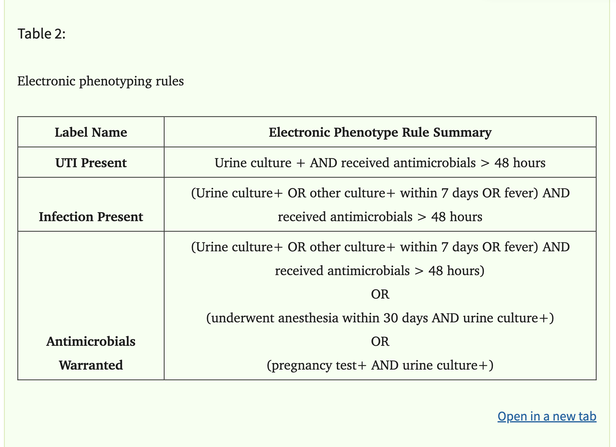
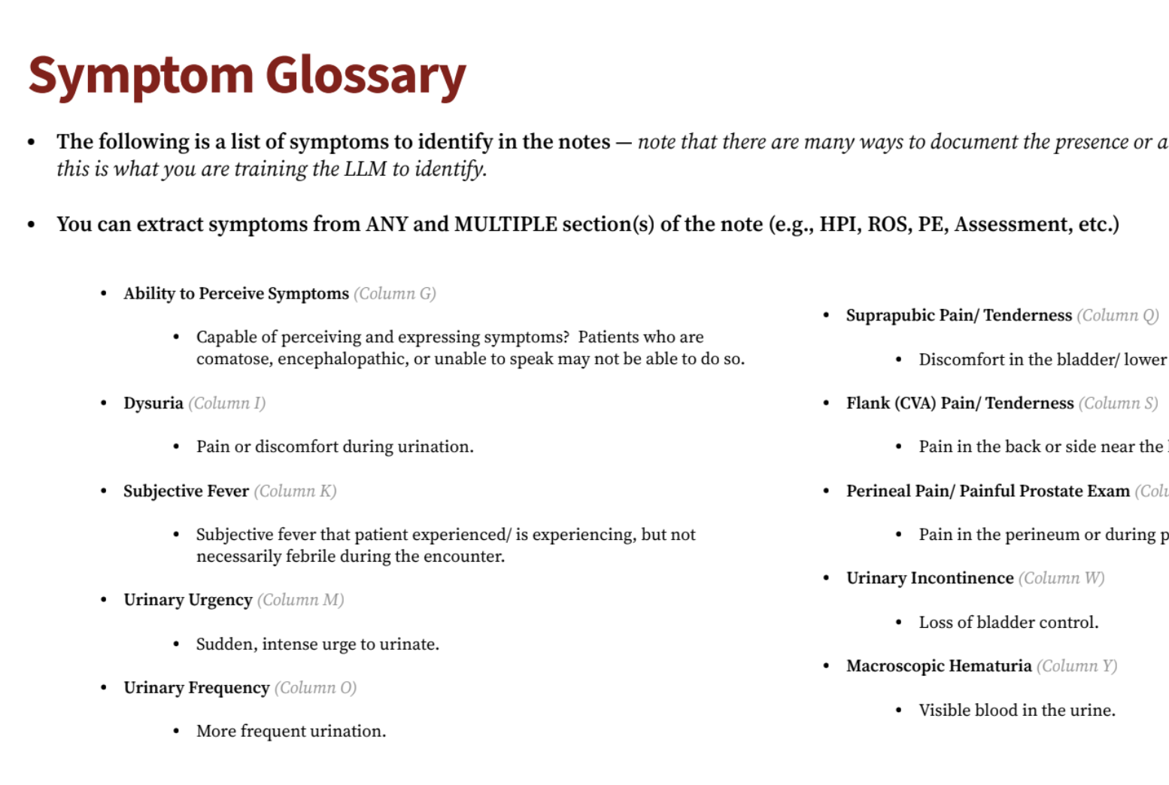
Extension

Slide 10
Questions
Classification vs. Prediction
Retrospective vs. Prospective
Aim Statement vs. previous submission to ID week

Slide 11
Design
Similar methodology for phenotyping; Use the LLM to extract symptoms and contextual reasoning to fill the blind spot of the silver label
Rule base vs. contextual reasoning

Slide 12
Innovation: Uncertainty of Absence ?
Context: Most current models treat a missing symptom as a negative symptom. Documentation is messy
  True Negative: The patient was asked and did not have the symptom.
  Information Bias/Omission: The clinician was busy, forgot to ask, or didn't think the symptom was relevant to the specific visit (e.g., a patient visiting for a broken arm who also happens to have a silent UTI).
By quantifying this uncertainty, move from a binary "Yes/No" label to a probabilistic label.
- "Uncertainty of Missingness" defines how much we can trust the record when that evidence is missing.
- Diagnostic Power vs. their Documentation Frequency.
Notes:
Uncertain as label
Probabilisitc model

Slide 13
Prelim steps
Step | Action Item | Input(s) | Output(s)
1 | Structured Logic Baseline | Patient MRN, Lab results (Culture+), Meds (Antimicrobials), Vitals (Fever) | Rule-Based "Silver Label" (e.g., "UTI Present" = True)
2 | LLM Deep Extraction | Clinical Notes (HPI, ROS, Assessment sections) | LLM Symptom Matrix (Yes/Negation/No for Dysuria, Urgency, etc.)
3 | Uncertainty Quantification | Note structure (Note Type, Length), LLM Symptom Matrix, Diagnostic Power Weights | Confidence Score (CS) and Uncertainty of Absence (UoA) label
4 | Hybrid Phenotyping | Rule-Based Silver Label + LLM Symptom Matrix + Confidence Score | Enhanced Deep Phenotype (Refined UTI classification)
5 | Gold-Label Validation | 358 Adjudicated Gold Labels | Performance Metrics (Precision, Recall, F1, and CS-Calibration)

