Slide 1
Patients with at
least one
diagnosis of MCI
11,528 MCI Patients
3.6M diagnosis records
1.5M medication records
7.4M procedure records
Stanford Healthcare EHR
1 year data availability.
1 year prediction window
case control matching based on age and gender.
Demographics
Procedures
Medications
Patient ID
Diagnoses
MCI label
Recommended procedures
diagnose records
4,637 cases
93583 controls
procedure records
medication records
demographic records
Institute for Biomedical Informatics
Department of Computer Science

Slide 2
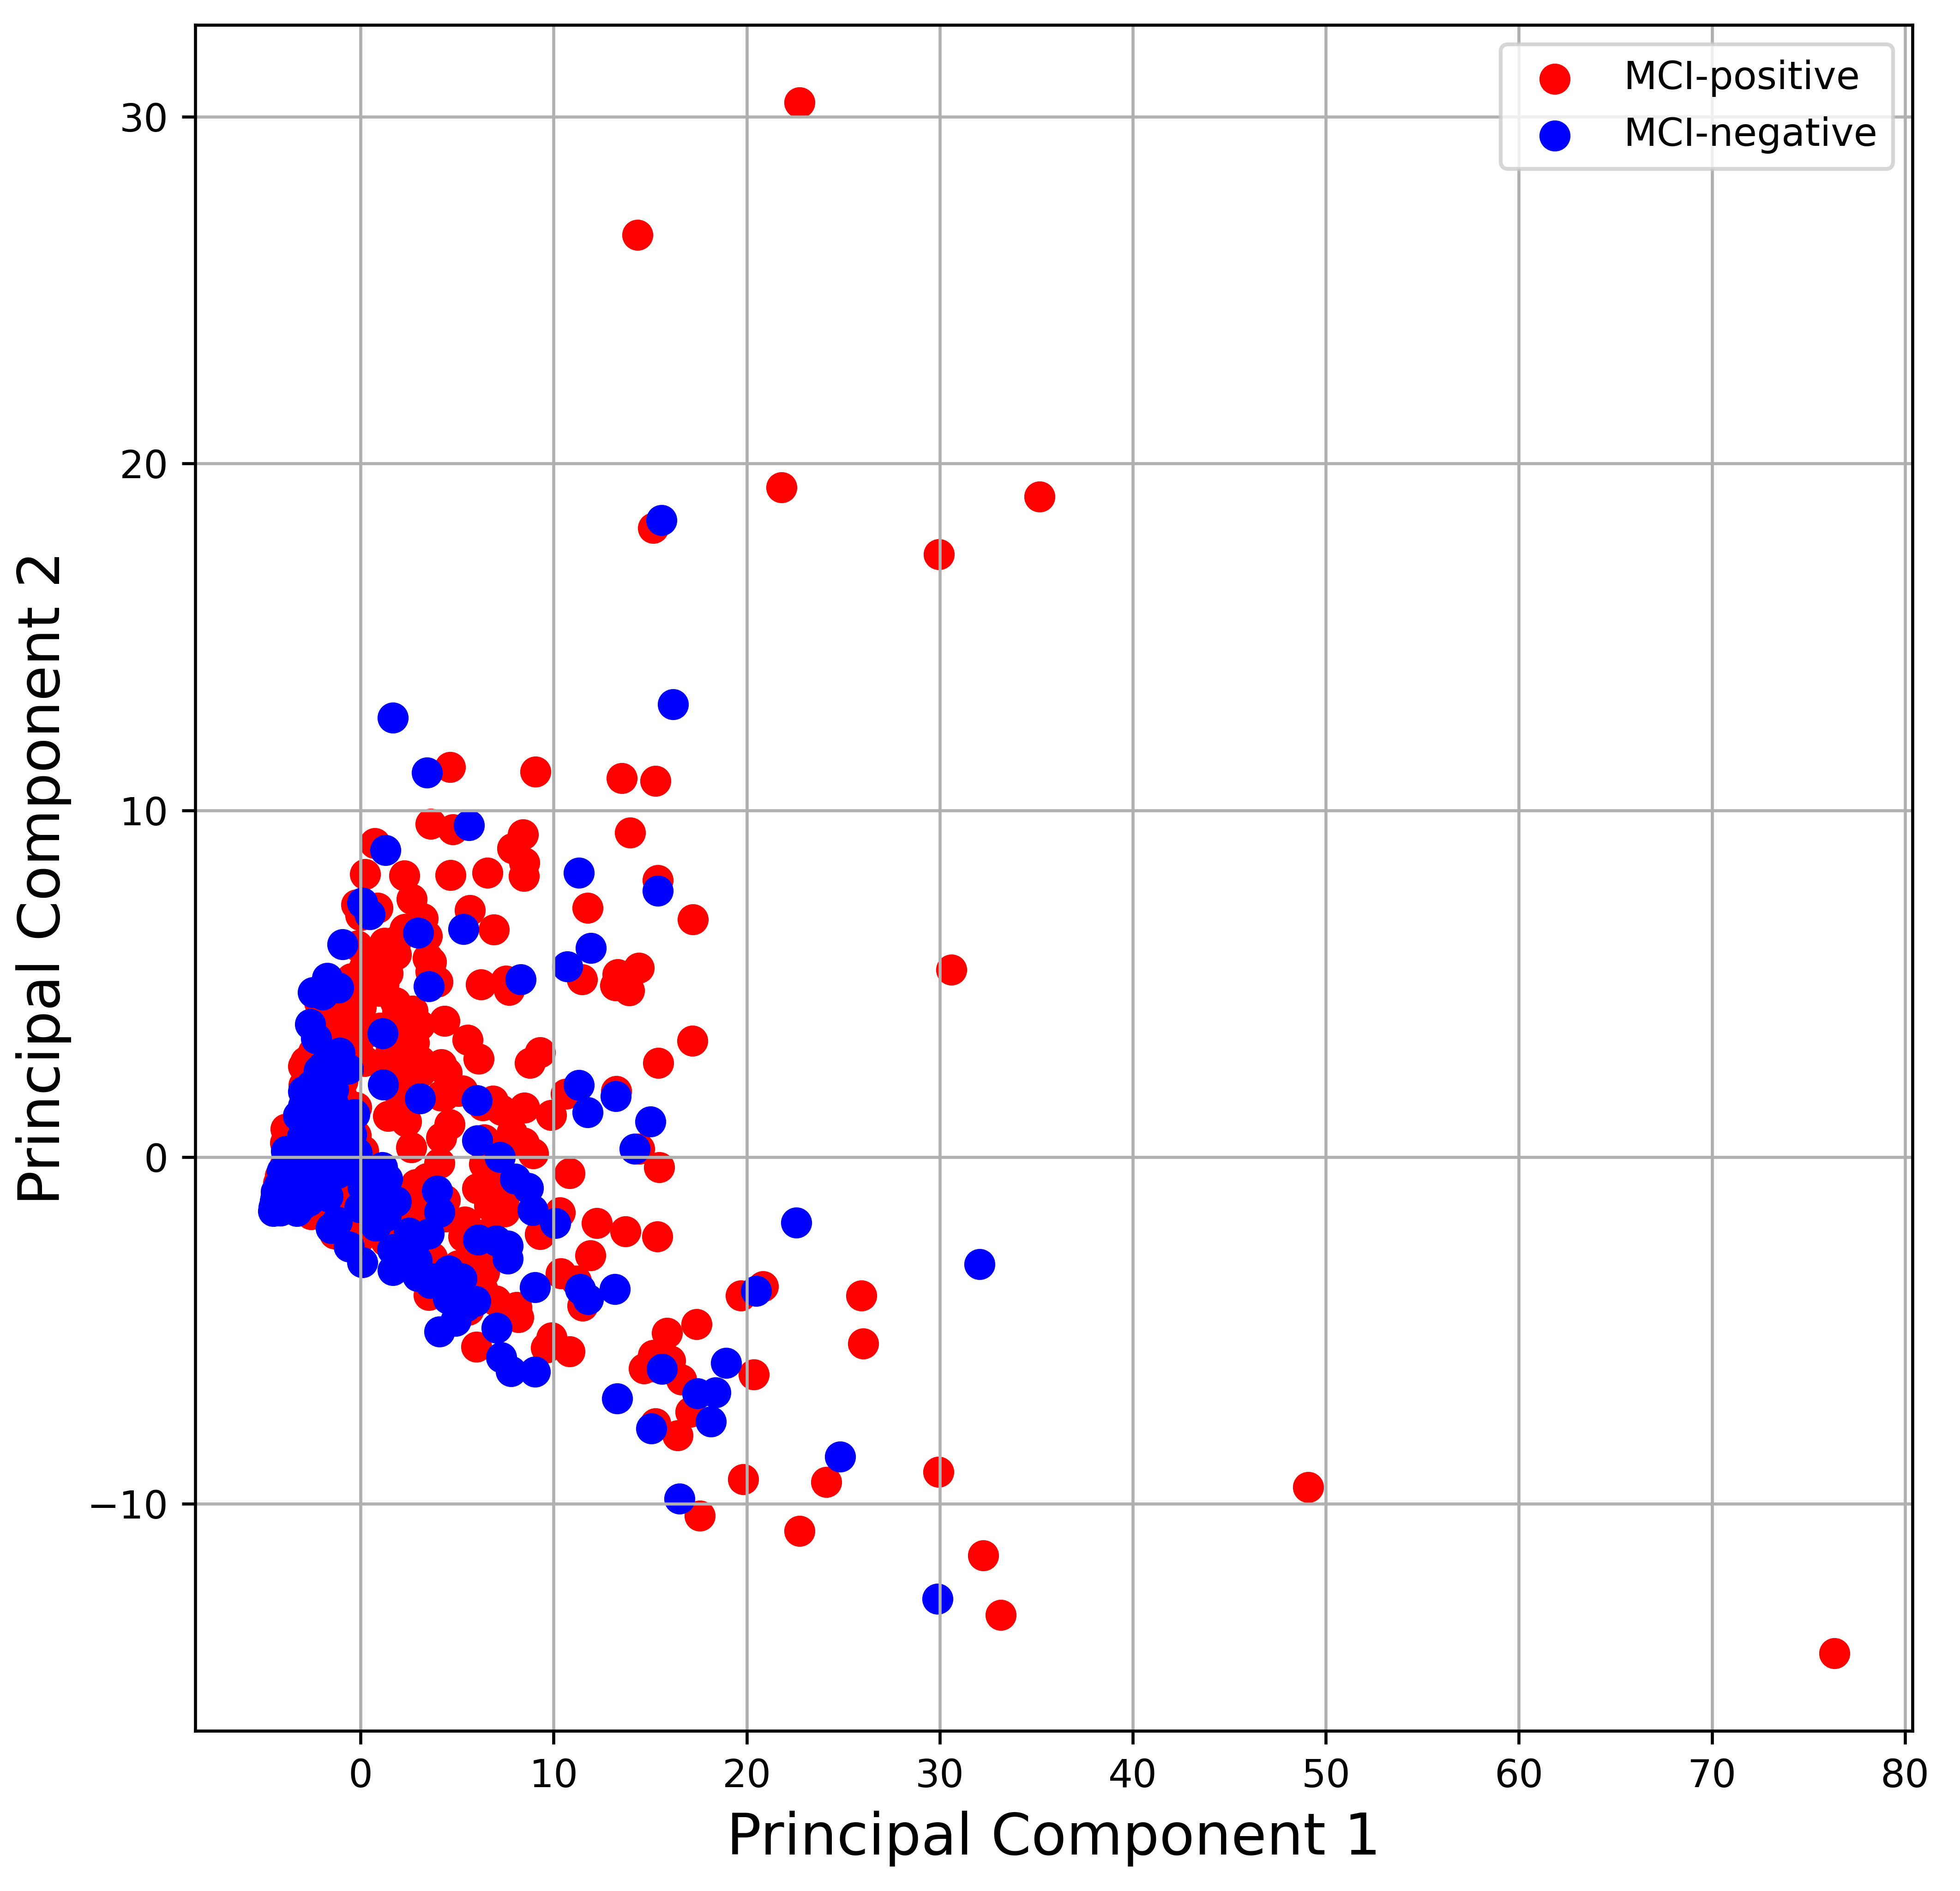


11,528 MCI Patients
3.6M diagnosis records
1.5M medication records
7.4M procedure records
1 year data availability.
1 year prediction window.
Age >= 50
Stanford Healthcare EHR
Patients with at
least one
diagnosis of MCI
4,637 cases
93583 controls
case control matching based on age and gender.
MCI label
Diagnoses
Demographics
Procedures
Medications
Procedures
Patient ID
Diagnoses
Medications
Recommended procedures
Demographics
First record date
Prediction date
Index date
Institute for Biomedical Informatics
Department of Computer Science
1 year $≥$
1 year for MCI prediction
2 months for recommender
1 year $≥$

Slide 3


11,528 MCI Patients
3.6M diagnosis records
1.5M medication records
7.4M procedure records
1 year data availability.
1 year prediction window.
Age >= 50
Stanford Healthcare EHR
Patients with at
least one
diagnosis of MCI
4,637 cases
93583 controls
(a)
case control matching based on age and gender.
MCI label
Diagnoses
MCI prediction
Demographics
Procedures
Medications
Procedures
Patient ID
Diagnoses
(b)
Medications
Recommended procedures
Procedure recommendation
Demographics
…
First record date
Prediction date
Index date
(c)
Institute for Biomedical Informatics
Department of Computer Science
1 year $≥$
1 year for MCI prediction
2 months for recommender
1 year $≥$

