Slide 1

Mercy ASM Discovery & Assessment
Project Kickoff
06/01/2026

Slide 2
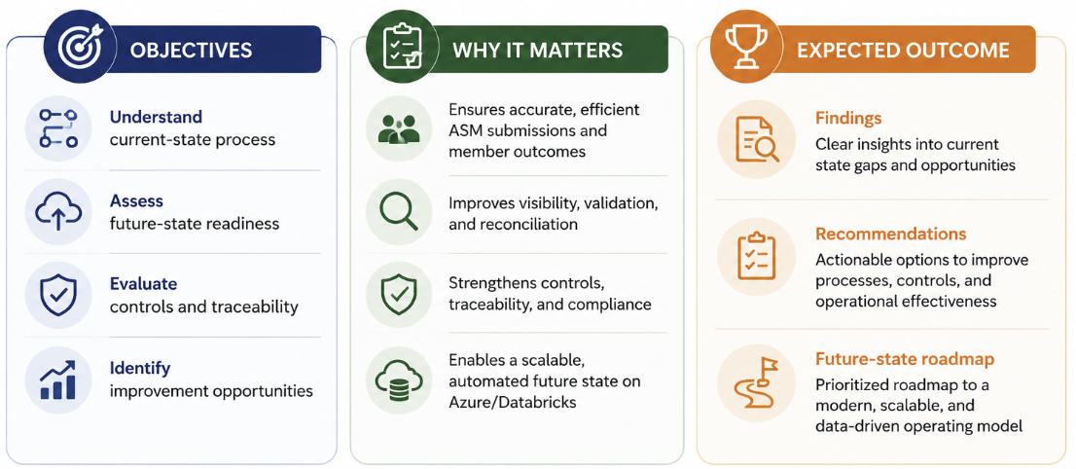
Introduction
Mercy is evaluating its ASM direct-submission operating model as and when it is transitioning toward an Azure/Databricks future state.

Slide 3

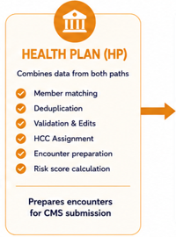
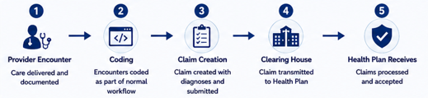
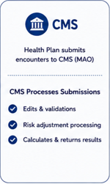
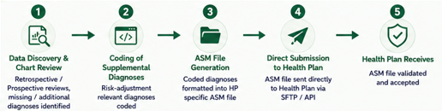

ASM Discovery & Assessment Overview
Compare CMS and HP response against submission
Investigate Rejects, edits, and member/clinical issues
Address issues and resubmit as needed
Outcome and Impact
Project Scope: Evaluate the ASM direct-submission lifecycle—from ASM file generation through Health Plan validation, processing, and CMS response reconciliation—to identify process, control, traceability, operational, and future-state improvement opportunities.

Slide 4



Stakeholders
Executive Sponsors
Gavin Helton
Michael Sarli
Project Lead
Sandra Weiler
Primary Discovery Resources
Fred Chen
Jennifer Oldfather
Linda Reed
Ronald Goode
Supporting Participants
Amber Bruno
Emily Hogan
Kalli Castille
Kate Barker
Marie Collins Hespen
Melissa Liehr
Project Lead
Kate McClure
Kenny Misir
Lou Steinberg
Jay Ahlmer
Consulting Resources:
Supporting Participants
Samir Rawat
Aaron Peterson (PTO)
Vinod Gnawali
Jay Baker

Slide 5


