Slide 1
Establishing the Correlation Between Bio-Data and Concentration Level Utilizing EEG Data
Team HoT
Byeongsoo Min, Jeongmin Seo, Seojeong Park, Seungah Jang, Yunhui Lim, and
Martin Kim

Slide 2






Team members
Byeongsoo Min
min121@purdue.edu
Jeongmin Seo
seo140@purdue.edu
Seojeong Park
park1725@purdue.edu
Seungah Jang
jang240@purdue.edu
Yunhui Lim
lim440@purdue.edu
Martin Kim
kim3540@purdue.edu

Slide 3
Agenda
1
Introduction
2
Literature Reviews
3
Methodology
4
Future Plan

Slide 4
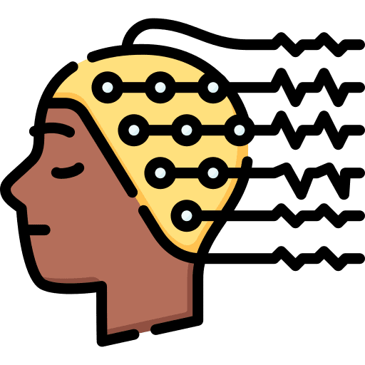
Introduction
Definition
EEG
Short for Electroencephalogram, a measurement of potentials that reflect the electrical activity of the human brain.
Alpha, α | Relaxation
Beta, β | Focusing, Active thinking
Theta, θ | Drowsiness, Idleness
Delta, δ | Deep sleep, Wakefulness, Attention
Gamma, γ | Memory

Slide 5


Introduction
Definition
HRV
Short for Heart Rate Variability, the beat-to-beat variation in between each heart rate.
EDA
Short for Electrodermal activity, the variation of the electrical properties of the skin in response to sweat secretion.

Slide 6
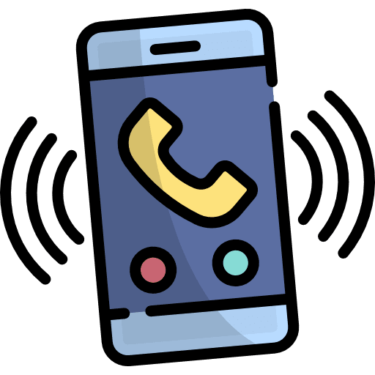

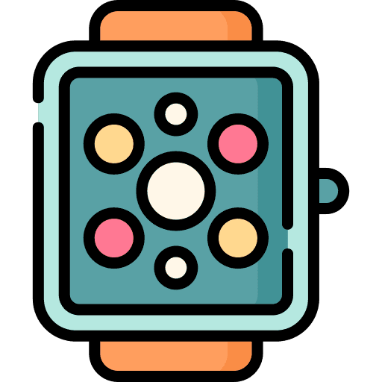
Introduction
Background of Study
In modern society, concentration levels and attention spans have shortened.
This study believes that the assessment of concentration using bio-data could be of great importance.

Slide 7
Introduction
Purpose and Brief Plan
Purpose
Evaluate the correlation between bio-data and concentration
Brief Plan
1. Find out the correlation between EEG and concentration
2. Analyze the correlation between bio-data and EEG
3. Predict concentration level using the correlation between
bio-data and concentration

Slide 8
Literature Reviews
Goal
Evaluate the correlation between bio-data and concentration
The correlation between EEG and concentration
- Find out which brain waves are associated with concentration
- Figure out the indicators to quantify concentration
3. The correlation between bio-data and concentration
- Existing papers only shown an ambiguous relationship between them.
- We’re going to find out concrete correlation between bio-data and concentration
Concentration
EEG
2. The correlation between bio-data and EEG
- Search for bio information that influences EEG signals
- Investigate which bio-data affects what kind of EEG signals and how it does
EEG
Bio-Data
Notes:
3. The correlation between bio-data and concentration
Existing papers only shown an ambiguous relationship between them.
We’re going to find out concrete correlation between bio-data and concentration

Slide 9
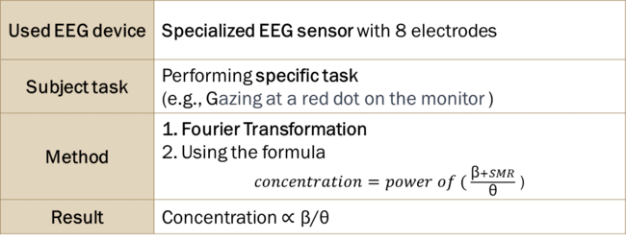
Literature Reviews
EEG
Bio-Data
Concent-ration
1. The Correlation Between EEG and Concentration
This study demonstrated that the beta waves increased and theta waves decreased while focusing [1].
[Concentration Measurement Experiment]
Used EEG device | Specialized EEG sensor with 8 electrodes
Subject task | Performing specific task (e.g., Gazing at a red dot on the monitor )
Method | Fourier Transformation Using the formula $concentration=power of ( \frac{\text{β}+SMR}{\text{θ}}$ )
Result | Concentration$\text{∝} \text{β}\text{/}\text{θ}$

Slide 10
Literature Reviews
Bio-Data
Concent-ration
EEG
1. The Correlation Between EEG and Concentration
The concentration levels were classified into four classes [2].
[Concentration Measurement Experiment]
Used EEG device | Wearable device (Muse headband)
Subject task | Everyday life (e.g., Reading articles, listening to the podcasts)
Method | Using 5 different ML models (AdB, NB, ANN, SVM, DT ) Concentration criteria: self-assessment
Result | ANN model -> Multiclass classification, accuracy of 71.46%.

Slide 11
Literature Reviews
EEG
Bio-Data
Concent-ration
1. The Correlation Between EEG and Concentration
The concentration levels were classified into two classes using SVM [3].
[Concentration Measurement Experiment]
Used EEG device | Wearable device (Mindset)
Subject task | Specific task (e.g., Answering English questions)
Method | Fourier Transformation Using SVM Concentration criteria: evaluator’s judgement
Result | SVM model -> Binary classification, accuracy of 76.82%.

Slide 12
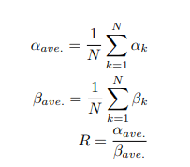
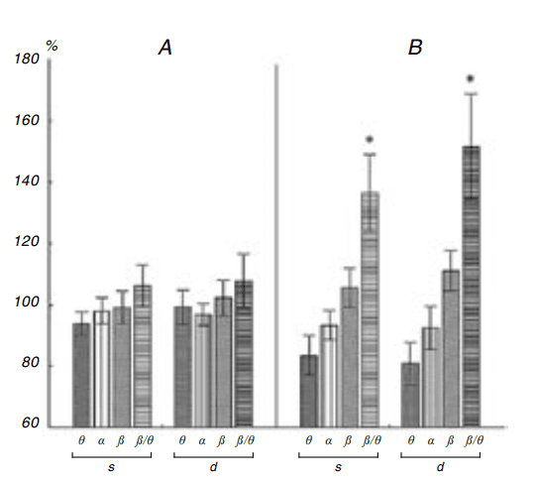
Literature Reviews
EEG
Bio-Data
Concent-ration
1. The Correlation Between EEG and Concentration
- Concentration Criteria
R index
β/θ Spectral Powers
Fig. 1. R index deprived from the alpha/beta ratio [4]
Fig. 2. Diagrams of the power of the EEG rhythms [5]

Slide 13

Literature Reviews
EEG
Bio-Data
Concent-ration
2. The Correlation Between Bio-data and EEG
(HRV)
There is correlation between HRV and beta wave and theta wave [6].
$$\text{HRV} \text{∝} \text{β}\text{/}\text{θ}$$
Table 1. Correlation analysis of the parameters of surgeons

Slide 14
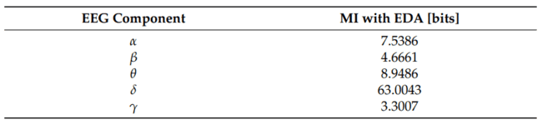

Literature Reviews
EEG
Bio-Data
Concent-ration
2. The Correlation Between Bio-data and EEG
(EDA)
EDA is the value most associated with delta waves particularly during focus [7].
EDA $\text{∝} \text{δ}$
Table 2. Mutual information between EEG components and EDA

Slide 15

Literature Reviews
EEG
Bio-Data
Concent-ration
2. The Correlation Between Bio-data and EEG
(Sleep Duration)
The alpha wave decreased when the participants had insufficient sleep [8].
S$l\text{eep} \text{Duration} \text{∝} \text{α}$
Notes:
EEG activity of neural areas concerned with deficient attention, hyperactivity, and insufficient sleep, show relatively lower alpha activity.

Slide 16



Literature Reviews
EEG
Bio-Data
Concent-ration
3. The Correlation Between Bio-data and Concentration
The concentration has powerful relations with bio-data especially with HRV, EDA, and sleep duration [9] [10] [11].
HRV $\text{∝} \text{Concentration}$
EDA $\text{∝} \text{Concentration}$
Sleep Duration $\text{∝} \text{Concentration}$
Numerical relationship?
X
Find out the concrete relationship !
Notes:
The Relationship Between Heart Rate Variability and Electroencephalography Functional Connectivity Variability Is Associated With Cognitive Flexibility [9]
Driver Attention Assessment Using Physiological Measures from EEG, ECG, and EDA Signals [10]
The Cumulative Cost of Additional Wakefulness: Dose-Response Effects on Neurobehavioral Functions and Sleep Physiology From Chronic Sleep Restriction and Total Sleep Deprivation [11]

Slide 17
Literature Reviews
Novelty
Tool
Using a wearable device in daily life
Method
Everyday life as the experimental background
Extracted brainwaves can be used as a direct indicator of concentration without Fourier transform
Result
Using quantified figures instead of subjective self-assessment
The correlation is clearly provided through the formula

Slide 18
Methodology
Agenda of Methodology
1
Experiment procedure
2
Data pre-processing
3
Merging data

Slide 19
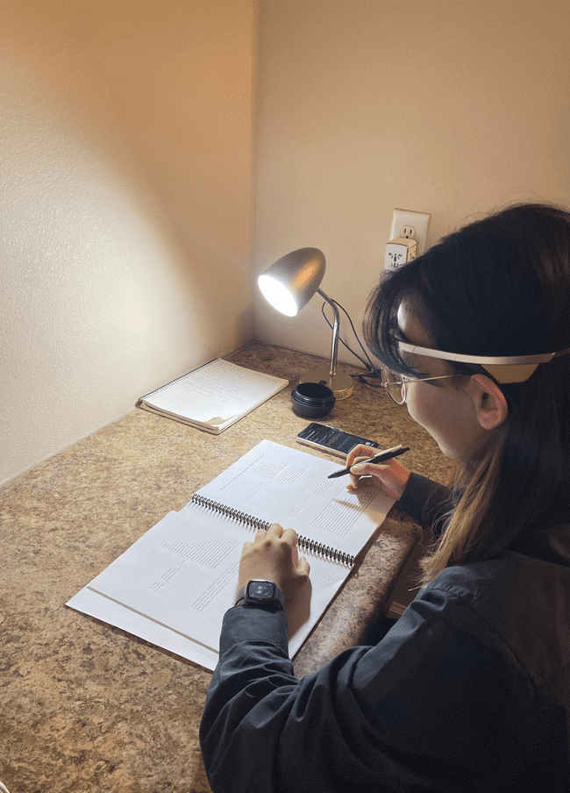
Methodology
Experiment Procedure
Experimental Condition
6 subjects, 6 tests a day,
20 minutes experiment
Wearing EEG sensor & wearable device
5 various tasks & 1 concentration game a day
Survey after each experiment
To compare the results we calculated through our ML model.

Slide 20
Methodology
Data Preprocessing - Features in Each Device
EEG Sensor
[103.8581, 103.8959,
Time information, Heart rate, Heart rate variability,
Attention score, Coherence, 5 kinds of brain waves
Start_time | Finish_time | HR | HRV | attention | Coherence | α_wave | β_wave | δ_wave | θ_wave | γ_wave
10.14 22:40 | 10.14 23:00 | [80,79,] | [32,34,] | [73,72,] | [0,0,1,] | [96.052, 95.9382,] | [103.858, 103.895,] | [87.0649, 87.0414,] | [96.184, 95.9262,] | [96.0618, 96.1266,]
10.15 13:25 | 10.15 13:45 | [78,77,] | [27,28,] | [60,66,] | [1,1,0,] | [99.3606, 99.3606 | [92.689, 92.689,] | [97.361, 97.361,] | [96.4491, 96.4491,] | [81.4179, 81.4179,]
Fitbit
Body movement, Deep sleep in minutes, EDA, Wrist temperature
TimeStamp | Body Movement | Deep sleep | EDA | Wrist Temperature
10.14 22:45 | 0 | 95 | 2.86 | -2.111261
10.14 22:46 | 0 | 95 | 2.87 | -1.691261
Notes:
Good good

Slide 21
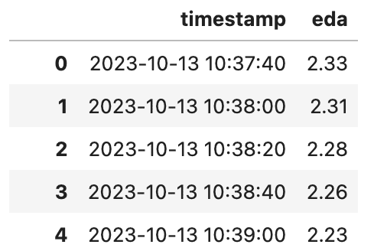
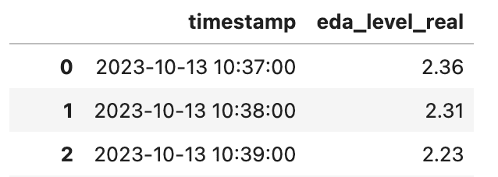
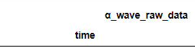
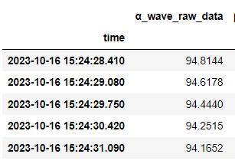
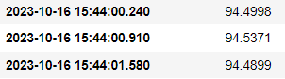
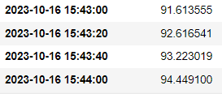
Methodology
Data Preprocessing - Synchronize Time Interval of Each Device
Unified time interval of 20 seconds
Fitbit : Originally collected every minute
Divide a minute data to 20 seconds
EEG Sensor : Originally recorded every 0.6 seconds
0.6 seconds to 20 seconds (substituted with the representative value)

Slide 22
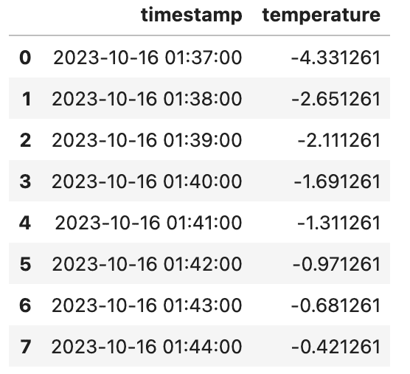
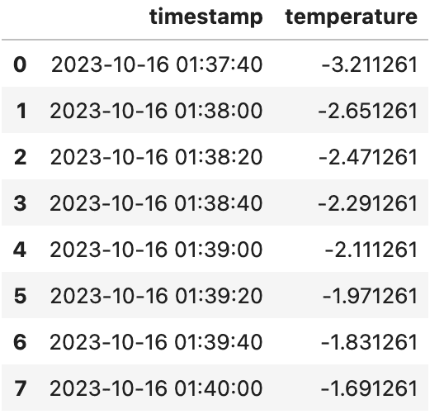
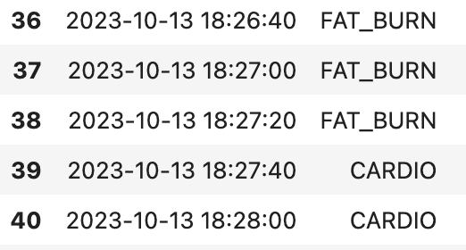
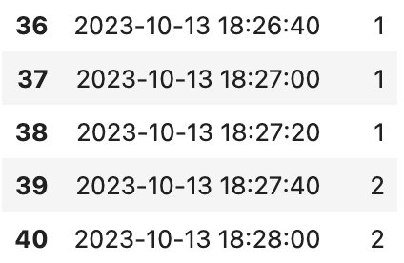
Methodology
Data Preprocessing - Fitbit Data Preprocessing
Manage the Fitbit dataset feature by feature
EDA and Wrist Temperature : Linear Interpolation considering ratio
Body movement : Mapping
Normal : 0 / Fat-burn : 1 / Cardio : 2

Slide 23
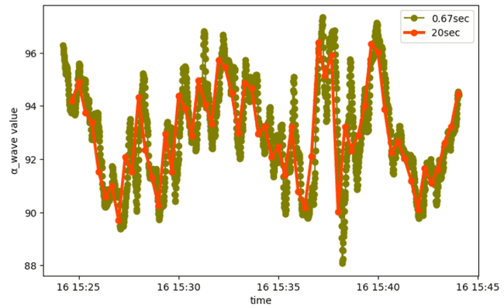
Methodology
Data Preprocessing - EEG Data Preprocessing
Remove the initial part of the whole EEG data that indicates the instability.
Dispose errors in each feature and calculate representative value for each group.
- Used 15% trimmed mean based on Dynamic Time Warping (DTW)
- DTW distance Similarity
Trimmed mean percentage | 5% | 10% | 15% | 20% | 25%
DTW distance | 7.11 | 7.97 | 8.67 | 9.82 | 10.6
Notes:
Good good

Slide 24
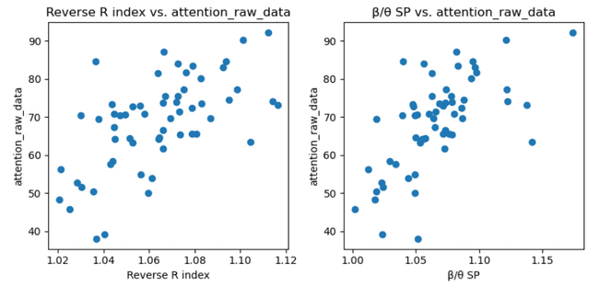
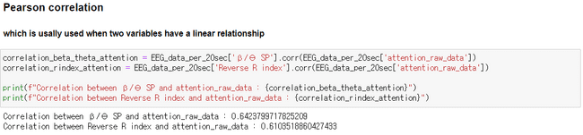
Methodology
Data Preprocessing - Concentration Level
1. Correlation between β/θ Spectral Powers (SP) and attention
Versus
2. Correlation between Reverse R index and attention
Both indices have positive linear relationship with the attention
Notes:
Lastly, we draw out concentration levels.
There were 2 Indexes which have positive linear relationship with the attention levels based on literature reviews.
Compared to the second indicator, β/θ Spectral Powers (SP) has a stronger correlation with attention scores we got from EEG device.
So, we decided to use β/θ SP index for the concentration level.

Slide 25
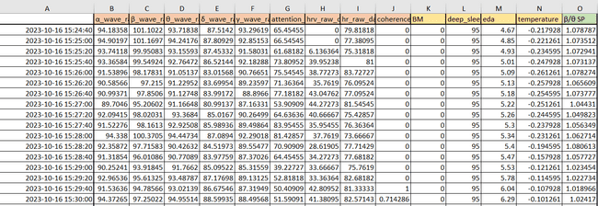
Methodology
Merging Data - Total Dataset
Notes:
Lastly, we draw out concentration levels.
There were 2 Indexes which have positive linear relationship with the attention levels based on literature reviews.
Compared to the second indicator, β/θ Spectral Powers (SP) has a stronger correlation with attention scores we got from EEG device.
So, we decided to use β/θ SP index for the concentration level.

Slide 26
Future Plan
Additional pre-processing
Processing error value
Tuning hyperparameter
Evaluate the model
Build machine-learning models
Make a service
about concentration
Y label for concentration level
based on analysis of β/θ SP feature

Slide 27
References
[1] Choi, T. J., Kim, J. O., Jin, S. M., & Yoon, G. (2014).8 Determination of the concentrated state using multiple EEG channels. International Journal of Computer, Electrical, Automation, Control and Information Engineering, 8(8), 1373-1376.
[2] Lokare, V.T., Netak, L.D. (2021). Concentration Level Prediction System for the Students Based on Physiological Measures Using the EEG Device. In: Singh, M., Kang, DK., Lee, JH., Tiwary, U.S., Singh, D., Chung, WY. (eds) Intelligent Human Computer Interaction. IHCI 2020. Lecture Notes in Computer Science(), vol 12615. Springer, Cham. https://doi.org/10.1007/978-3-030-68449-5_3
[3] Liu NH, Chiang CY, Chu HC. Recognizing the degree of human attention using EEG signals from mobile sensors. Sensors (Basel). 2013 Aug 9;13(8):10273-86. doi: 10.3390/s130810273. PMID: 23939584; PMCID: PMC3812603.
[4] C. Hasegawa and K. Oguri, "The effects of specific musical stimuli on driver~s drowsiness," 2006 IEEE Intelligent Transportation Systems Conference, Toronto, ON, Canada, 2006, pp. 817-822, doi: 10.1109/ITSC.2006.1706844.
[5] Lutsyuk, N.V., Éismont, E.V. & Pavlenko, V.B. Modulation of attention in healthy children using a course of EEG-feedback sessions. Neurophysiology 38, 389–395 (2006). https://doi.org/10.1007/s11062-006-0076-0
[6] Kwon JW, Sung S, Lee SB, Lee HM, Moon SH, Lee BH. Intraoperative real-time stress in degenerative lumbar spine surgery: simultaneous analysis of electroencephalography signals and heart rate variability: a pilot study. Spine J. 2020 Aug;20(8):1203-1210. doi: 10.1016/j.spinee.2020.02.006. Epub 2020 Feb 14. PMID: 32061939.
[7] Martínez Vásquez DA, Posada-Quintero HF, Rivera Pinzón DM. Mutual Information between EDA and EEG in Multiple Cognitive Tasks and Sleep Deprivation Conditions. Behavioral Sciences. 2023; 13(9):707. https://doi.org/10.3390/bs13090707
Notes:
[8] Kim SC, Lee MH, Jang C, Kwon JW, Park JW. The effect of alpha rhythm sleep on EEG activity and individuals' attention. J Phys Ther Sci. 2013 Dec;25(12):1515-8. doi: 10.1589/jpts.25.1515. Epub 2014 Jan 8. PMID: 24409009; PMCID: PMC3885828.
[9] Alba G, Vila J, Rey B, Montoya P, Muñoz MÁ. The Relationship Between Heart Rate Variability and Electroencephalography Functional Connectivity Variability Is Associated With Cognitive Flexibility. Front Hum Neurosci. 2019 Feb 25;13:64. doi: 10.3389/fnhum.2019.00064. PMID: 30858800; PMCID: PMC6397840.
[10] [Aminosharieh Najafi, T., Affanni, A., Rinaldo, R., & Zontone, P. (2023). Driver Attention Assessment Using Physiological Measures from EEG, ECG, and EDA Signals. Sensors, 23(4), 2039, 2-2. https://doi.org/10.3390/s23042039]
[11] Aminosharieh Najafi T, Affanni A, Rinaldo R, Zontone P. Driver Attention Assessment Using Physiological Measures from EEG, ECG, and EDA Signals. Sensors. 2023; 23(4):2039. https://doi.org/10.3390/s23042039

Slide 28
References
[8] Kim SC, Lee MH, Jang C, Kwon JW, Park JW. The effect of alpha rhythm sleep on EEG activity and individuals' attention. J Phys Ther Sci. 2013 Dec;25(12):1515-8. doi: 10.1589/jpts.25.1515. Epub 2014 Jan 8. PMID: 24409009; PMCID: PMC3885828.
[9] Alba G, Vila J, Rey B, Montoya P, Muñoz MÁ. The Relationship Between Heart Rate Variability and Electroencephalography Functional Connectivity Variability Is Associated With Cognitive Flexibility. Front Hum Neurosci. 2019 Feb 25;13:64. doi: 10.3389/fnhum.2019.00064. PMID: 30858800; PMCID: PMC6397840.
[10] [Aminosharieh Najafi, T., Affanni, A., Rinaldo, R., & Zontone, P. (2023). Driver Attention Assessment Using Physiological Measures from EEG, ECG, and EDA Signals. Sensors, 23(4), 2039, 2-2. https://doi.org/10.3390/s23042039]
[11] Hans P.A. Van Dongen, Greg Maislin, Janet M. Mullington, David F. Dinges, The Cumulative Cost of Additional Wakefulness: Dose-Response Effects on Neurobehavioral Functions and Sleep Physiology From Chronic Sleep Restriction and Total Sleep Deprivation, Sleep, Volume 26, Issue 2, March 2003, Pages 117–126
Notes:
[8] Kim SC, Lee MH, Jang C, Kwon JW, Park JW. The effect of alpha rhythm sleep on EEG activity and individuals' attention. J Phys Ther Sci. 2013 Dec;25(12):1515-8. doi: 10.1589/jpts.25.1515. Epub 2014 Jan 8. PMID: 24409009; PMCID: PMC3885828.
[9] Alba G, Vila J, Rey B, Montoya P, Muñoz MÁ. The Relationship Between Heart Rate Variability and Electroencephalography Functional Connectivity Variability Is Associated With Cognitive Flexibility. Front Hum Neurosci. 2019 Feb 25;13:64. doi: 10.3389/fnhum.2019.00064. PMID: 30858800; PMCID: PMC6397840.
[10] [Aminosharieh Najafi, T., Affanni, A., Rinaldo, R., & Zontone, P. (2023). Driver Attention Assessment Using Physiological Measures from EEG, ECG, and EDA Signals. Sensors, 23(4), 2039, 2-2. https://doi.org/10.3390/s23042039]
[11] Aminosharieh Najafi T, Affanni A, Rinaldo R, Zontone P. Driver Attention Assessment Using Physiological Measures from EEG, ECG, and EDA Signals. Sensors. 2023; 23(4):2039. https://doi.org/10.3390/s23042039

Slide 29

Q& A

Slide 30
Thank you
Team HoT
Byeongsoo Min, Jeongmin Seo, Seojeong Park, Seungah Jang, Yunhui Lim, and
Martin Kim

