Slide 1
Exact Match (EM) Evaluation for Large Language Models
Measuring the accuracy of LLM answers through exact matching
Group 1 | LLM Performance Evaluation
Notes:
Welcome, everyone. Today we are introducing Exact Match evaluation, commonly known as EM, for Large Language Models.
This session covers what EM measures, how the binary scoring works, how to normalize answers, and how to implement it in code.

Slide 2
My team
CHHENG Sothean — e20220686
Duk Pagnarith — e20220184
DOEUN Bunheng — e20221528
SOPHON Rachana — e20220725
PHAN WAYOTEP — e20220850

Slide 3
Contents
1
Introduction
2
Theory of Exact Match
3
Practical examples
4
Python implementation
5
Experiment
6
Advantages and Limitations
7
Conclusion

Slide 4
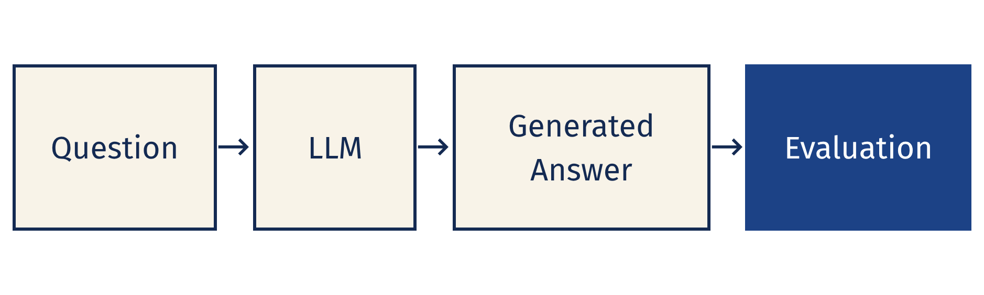
1. Introduction
LLM outputs need systematic evaluation
Large Language Models generate human-like text from prompts.
Examples: GPT, Gemini, Claude, Llama, and Qwen.
Evaluation metrics help compare models consistently.
Diagram: Question → LLM → Generated Answer → Evaluation
1
Notes:
Language models generate open-ended text, which makes evaluation essential.
Whether we evaluate GPT, Gemini, Claude, Llama, or Qwen, we need standardized metrics to track performance systematically.
The standard pipeline feeds a prompt into an LLM to generate an answer, which is then scored against ground truth.

Slide 5
2. Theory
Exact Match asks one strict question
Core Definition
Example Comparison
Score 1: exact text match
Score 0: no exact text match
Strict EM checks equality, not semantic meaning
Reference: “Phnom Penh”
Prediction A: “Phnom Penh”
EM = 1 (Exact match)
Prediction B: “The answer is Phnom Penh”
EM = 0 (Not an exact match)
2
Notes:
Exact Match is a strict test: does the model output match the target text character-for-character?
Notice Prediction B: even though the semantic answer is correct, strict EM gives it a zero because extra conversational words were included.

Slide 6

2. Theory
EM is built for precise short answers
Evaluate short-answer question answering.
Measure exact answer agreement.
Compare LLMs on the same dataset.
Produce simple, reproducible results.
Best fit: tasks where one exact answer is expected.
3
Notes:
Exact Match is primarily used in benchmarks with factual, closed-domain short answers like SQuAD, TriviaQA, or arithmetic datasets.
It provides complete reproducibility and zero ambiguity across research teams.

Slide 7

2. Theory
EM turns each answer into a binary score
1
2
3
4
5
Prepare
Generate
Compare
Score
Average
Prepare a question and reference answer.
Generate a prediction from an LLM.
Compare prediction with reference.
Assign 1 for a match or 0 for no match.
Average the scores across questions.
The step-by-step procedure for calculating exact match across an evaluation set.
4
Notes:
Here is the five-step evaluation lifecycle for Exact Match.
Each prediction is scored as an isolated binary decision: 1 or 0. Finally, those values are aggregated into a dataset-level average.

Slide 8
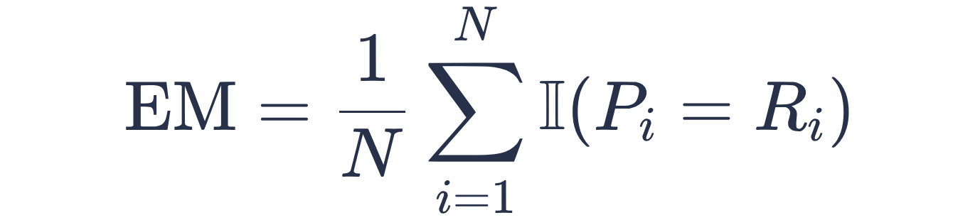
2. Theory
MATHEMATICAL DEFINITION
The dataset EM score is an average of matches
EM: Exact Match score
N: total number of questions
Pᵢ: prediction for question i
Range: 0–1, or 0%–100%
Rᵢ: reference answer for question i
𝟙: 1 if answers match, otherwise 0
The indicator function 𝟙 returns 1 if string equality holds, and 0 otherwise.
5
Notes:
This formula formalizes the evaluation. N is sample size, P sub i is the model prediction, and R sub i is the reference string.
The indicator function converts equality into a discrete binary 1 or 0, yielding a final percentage between 0 and 100 percent.

Slide 9
3. Practical Examples
Five questions produce an EM score of 80%
MANUAL CALCULATION
Question | Reference | Prediction | EM
Capital of France? | Paris | Paris | 1
2 + 2? | 4 | 4 | 1
Largest planet? | Jupiter | Jupiter | 1
Chemical formula of water? | H2O | Water | 0
Capital of Cambodia? | Phnom Penh | Phnom Penh | 1
EM = (1 + 1 + 1 + 0 + 1) / 5 = 0.80 = 80%
6
Notes:
This table demonstrates manual EM scoring over five questions.
Four out of five questions have exact matches. Question 4 fails because the model output 'Water' does not equal 'H2O', giving an overall score of 80 percent.

Slide 10
3. Practical Examples
Normalization changes what counts as a match
Strict EM: case, punctuation, and spaces matter.
Normalized EM: apply documented preprocessing before comparison.
Common rules may lowercase text, remove punctuation and articles, and normalize whitespace.
Reference | Prediction | Strict EM | Normalized EM
Paris | paris | 0 | 1
Phnom Penh | Phnom Penh! | 0 | 1
The United States | United States | 0 | 1
Illustrative English normalization removes articles, punctuation, and capitalization differences.
7
Notes:
Strict EM penalizes trivial casing or punctuation differences. Normalization strips articles, lowercases strings, and standardizes spacing.
Notice how all three examples score 0 under Strict EM, but achieve a perfect 1 under Normalized EM.

Slide 11
4. Python Implementations
A minimal Python implementation makes EM reproducible
Compare each prediction with its reference, convert the result to 1 or 0, then average the scores.
def exact_match(prediction, reference):
return int(prediction == reference)
def calculate_em(predictions, references):
if len(predictions) != len(references):
raise ValueError("Lists must have equal lengths")
if not references:
raise ValueError("Dataset cannot be empty")
scores = [
exact_match(pred, ref)
for pred, ref in zip(predictions, references)
]
return sum(scores) / len(scores)
Python 3 implementation of strict string Exact Match evaluation.
8
Notes:
Here is an end-to-end Python script implementing EM calculation.
The helper function evaluates string equality, and calculate_em validates dataset bounds before returning the sample mean.

Slide 12
5. Experiment
One demonstration separates two model outcomes
references = ["Paris", "4", "Jupiter", "H2O"]
model_a = ["Paris", "4", "Jupiter", "H2O"]
model_b = ["Paris", "Four", "Jupiter", "Water"]
print(calculate_em(model_a, references))
print(calculate_em(model_b, references))
Model A: 1.00 (100%)
4 of 4 exact matches
Model B: 0.50 (50%)
2 of 4 exact matches
Illustrative predictions, not results from actual API calls.
9
Notes:
In this test comparison, Model A hits 100 percent strict EM.
Model B drops to 50 percent because it spells out 'Four' instead of '4' and 'Water' instead of 'H2O'.
Thank you for listening. We welcome any questions.

Slide 13
6. Advantages and Limitations
EM is simple, but strict
Exact Match offers clear benefits and specific drawbacks.
Advantages of EM
Limitations of EM
Highly objective: Binary scoring leaves no room for interpretation.
Reproducible: Easy to implement and yields consistent results.
Efficient: Fast to compute, suitable for large datasets.
Focused: Excellent for tasks requiring precise, factual answers.
Overly strict: Penalizes semantically correct but different answers.
Sensitive: Small variations in wording (e.g., punctuation, synonyms) result in a 0.
Limited scope: Not suitable for open-ended or creative text generation.
No partial credit: Fails to capture degrees of correctness.
10

Slide 14
7. Conclusion
Recap of Exact Match Evaluation and Open Discussion
EM is a strict, binary metric.
It's either a perfect match or not, leaving no room for interpretation.
Normalization improves flexibility.
Preprocessing helps capture semantic correctness for common variations.
Ideal for precise, short answers.
Best suited for tasks where exact agreement is the goal.
11

