Slide 1

CPBPB&T2025
R you ready fa dis
December 11, 2025
Light Hall 439
Vanderbilt University
Nashville, Tennessee
Post-test assessment: http://tiny.cc/cpbpdata8306
#CPBPB&T2025

Slide 2
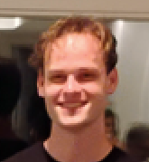

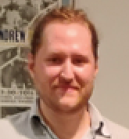
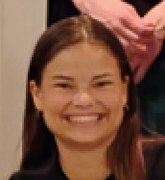
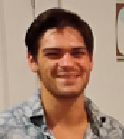
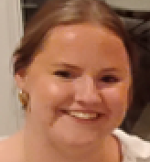

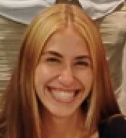
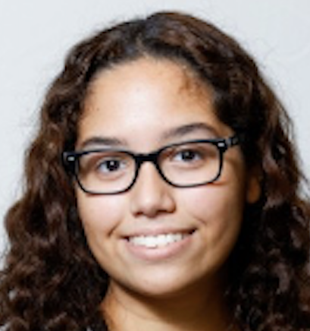
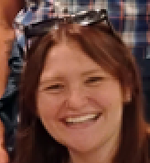
Joseph
Cramer
Malcolm
Diaz Garcia
Alec
Hopkirk
SPEAKERS
Allison
Kurtz
Remi
Labielle
Julie
Libby
Emily
Peak
Amit
Sela
Heather
Tejeda
Madison
Yarbrough

