Slide 1

SESSION 9
Exploratory
Data Analysis
look.R
ggplot(group_a, aes(systolic)) +
geom_histogram(binwidth = 5)
Look before you test
# a second bump, on the low side
The plot Session 1 needed all along.
CPBP 8306: Coding for Research
Joshua Borycz & Daniel Genkins | TA: Peyton Coleman
Thursdays 10:00–10:55am · Light Hall 439
Notes:
Open before class: patients.csv loaded and cleaned once in an R console and once in a Python console, so the histogram on slide 7 is drawn live and not shown pre-rendered. This slide previews the payoff: one plot would have shown the Session 1 problem.

Slide 2

Clean data can still hide a problem
Session 8 fixed group, sex and age, and you can now filter, join and reshape a table. A column can have the right type and still hide a shape that will break the test you plan to run.
Today: a first look at every variable, in numbers and in plots, then three kinds of problem to hunt for. An AI cannot do this step for you, because it has never seen your data.
DATA FOR TODAY (the Session 8 cleaning, in a few lines)
load.R (penguins comes from the package)
load.py
library(dplyr); library(readr); library(stringr)
import pandas as pd, seaborn as sns
library(palmerpenguins); library(ggplot2)
df = pd.read_csv("penguins.csv")
patients <- read_csv("patients.csv", trim_ws = FALSE) %>%
patients = pd.read_csv("patients.csv")
mutate(group = str_trim(group),
patients["group"] = patients["group"].str.strip()
sex = str_to_upper(sex),
patients["sex"] = patients["sex"].str.upper()
age = as.numeric(age))
patients["age"] = pd.to_numeric(patients["age"],
df <- penguins
errors="coerce")
2
Notes:
Ask the room to name one thing they would want to know about a column before trusting it. Take two answers, then move on. Everyone loads the data now: the same patients cleaning as Session 8, written as a few lines, and penguins from the package in R or from penguins.csv in Python. In R, read_csv() trims spaces unless you set trim_ws = FALSE, so keep that argument. R also turns the impossible date 2026-02-30 into NA with a warning, while pandas keeps visit_date as text. That difference comes back on slide 9. df is the penguins table in both languages.

Slide 3
By the end of today you can…
1
Summarize every variable in numbers and read the summary like a diagnostic.
WHY THIS SESSION MATTERS
2
Plot a histogram, a box plot and a scatter plot to see what the numbers hide.
A test runs without complaint on data it should never see. Looking first is the cheapest way to avoid an error you could have prevented.
3
Compute a correlation matrix and read it without over-claiming.
4
Spot three kinds of problem by name: missing values, outliers and impossible values.
Milestone
Your cleaned project dataset and cleaning script go on GitHub before Session 10. Run today's checks on your own data during the activity.
5
Notice when EDA has ruled out the test you were about to run.
3
Notes:
Fifteen seconds on the list, then point at the milestone box. The cleaned data and the cleaning script go on GitHub before Session 10. Anyone who is not done should treat the activity time as catch-up time, and run today's checks on their own project data.

Slide 4
The one-shot summary: Read it like a diagnostic
patients | age | systolic | diastolic | cholesterol
n | 244 | 241 | 243 | 228
mean | 56.4 | 131.8 | 81.6 | 195.4
sd | 12.6 | 13.8 | 10.0 | 34.1
min | 22 | 87.5 | 52.2 | 106.5
max | 89 | 170.9 | 110.9 | 292.1
summary.R
summary(patients)
library(skimr)
skim(patients) # adds mini histograms
summary.py
250 patients after the Session 8 cleaning. The n row is the number of values that are not missing: cholesterol has 228, so 22 are missing.
patients.describe() # numeric columns
patients.describe(include="all") # text ones too
patients.isna().sum() # missing values per column
READ IT LIKE THIS: is the mean plausible, and is the range possible? Is the median far from the mean, a sign of skew? How many values are missing? Cholesterol is missing in 22 of 250 patients, 8.8%. That is usable, but say so in the write-up.
4
Notes:
Run summary(patients) in R and patients.describe() in pandas live. Walk the questions in order: is the mean plausible, is the range possible (a systolic pressure of 25 would be impossible, ours runs from 87.5 to 170.9), is the median far from the mean, how many values are missing. skim() in R is worth showing once, because it adds missing counts and tiny histograms, which previews the next slide. pandas has no built-in equivalent, but describe(include='all') and isna().sum() cover the same ground. DataExplorer's introduce() gives the same overview in one table, and slide 10 shows the rest of that package.

Slide 5
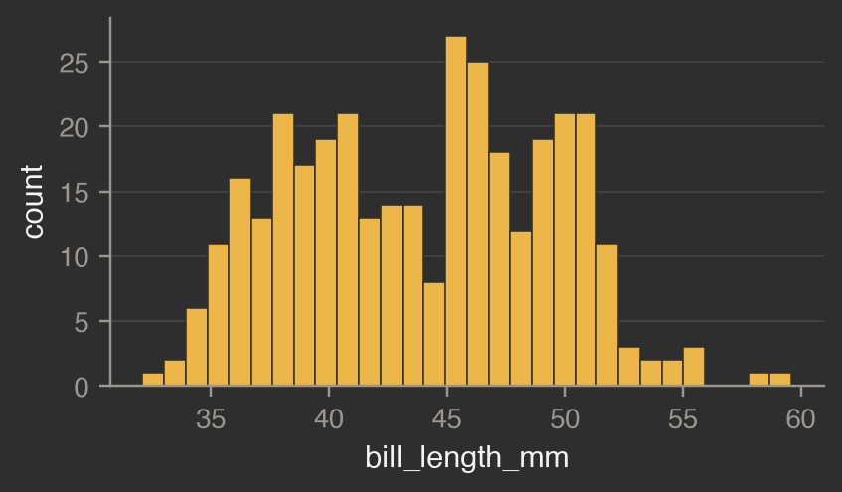
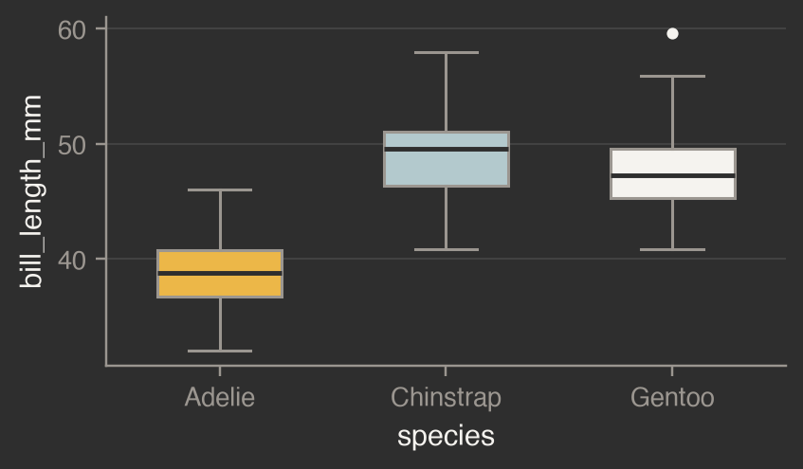
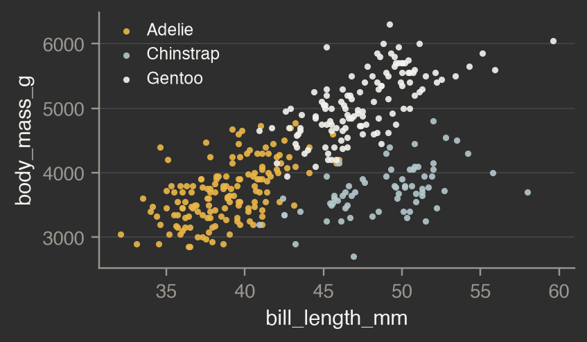
Three plots you make every time you touch new data
HISTOGRAM: the shape of one variable
Two peaks, a long tail, or a spike at one value.
BOX PLOT: one variable across groups
Do the groups overlap? Any dots beyond the whiskers?
SCATTER: two variables, colored by group
Direction, curves, and whether the groups differ.
plots.R
plots.py
df <- penguins
df = pd.read_csv("penguins.csv")
ggplot(df, aes(bill_length_mm)) + geom_histogram(bins = 30)
sns.histplot(df, x="bill_length_mm", bins=30)
ggplot(df, aes(species, bill_length_mm)) + geom_boxplot()
sns.boxplot(df, x="species", y="bill_length_mm")
ggplot(df, aes(bill_length_mm, body_mass_g,
sns.scatterplot(df, x="bill_length_mm", y="body_mass_g",
color = species)) + geom_point()
hue="species")
5
Notes:
Build all three on penguins live. Today the plots are diagnostics. Session 10's grammar of graphics covers making them presentable. The histogram shows two clusters in bill length, which is a hint that a second variable is hiding in there. The box plot says species differ and Gentoo has one dot beyond the whisker. The scatter, colored by species, shows three clouds. Then move straight to the next slide: coloring by group is the habit to take away.

Slide 6
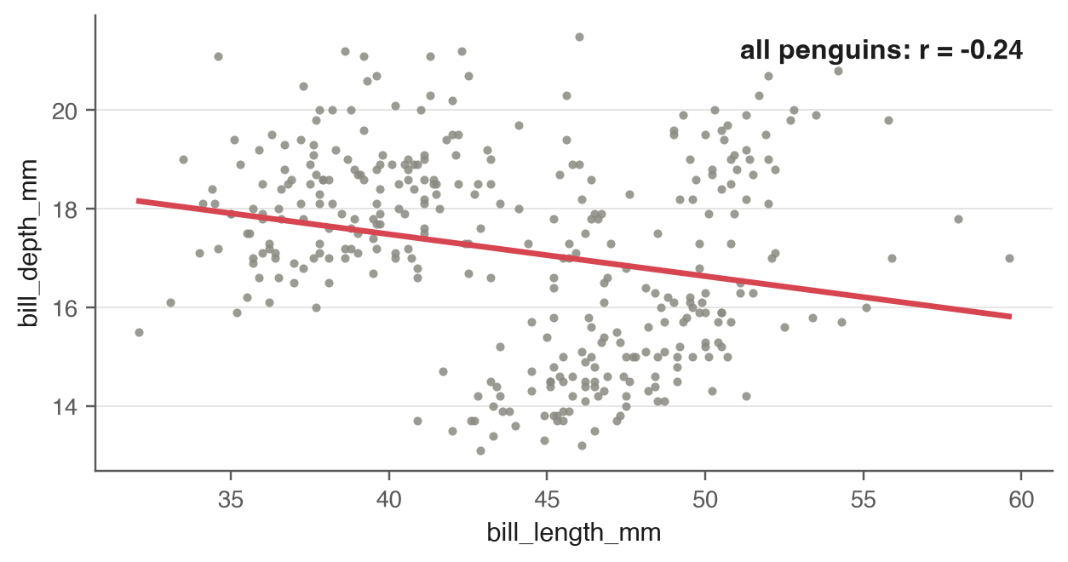
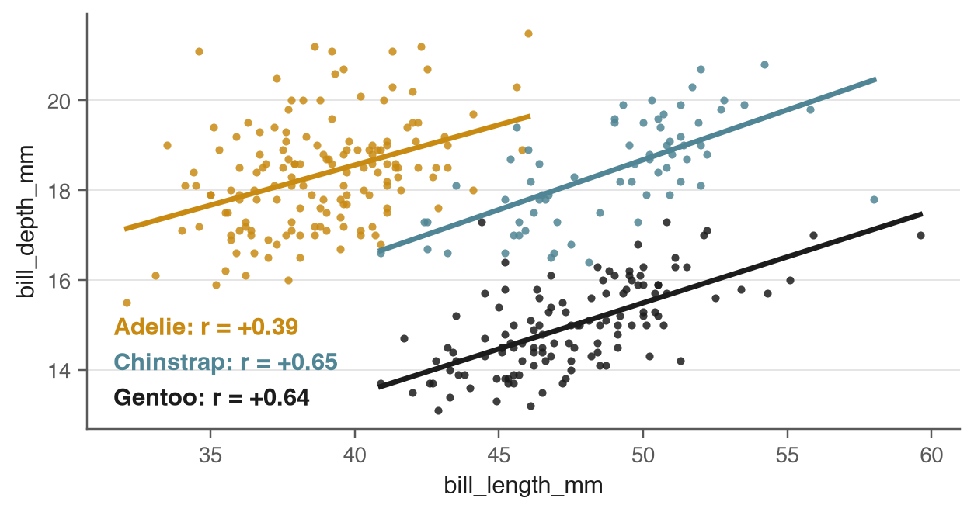
Simpson's paradox: Color by group before you trust a trend
ALL PENGUINS TOGETHER: r = -0.24. Deeper bills go with shorter ones.
SPLIT BY SPECIES: r is +0.39, +0.65 and +0.64. Within each species, deeper bills go with longer ones.
simpson.R
simpson.py
df %>% group_by(species) %>%
for name, d in df.groupby("species"):
summarise(r = cor(bill_length_mm, bill_depth_mm,
print(name, d.bill_length_mm.corr(d.bill_depth_mm))
use = "complete.obs"))
# overall: df.bill_length_mm.corr(df.bill_depth_mm)
6
Notes:
Give this thirty seconds of airtime. The overall trend runs downhill (r = -0.24), but inside every species it runs uphill. The species differ in both measurements, and that difference hides the within-species pattern. The defense is a habit: color the scatter plot by every grouping variable you have before you believe the overall trend. R's cor() drops missing values with use = 'complete.obs'. pandas' .corr() skips them by default.

Slide 7
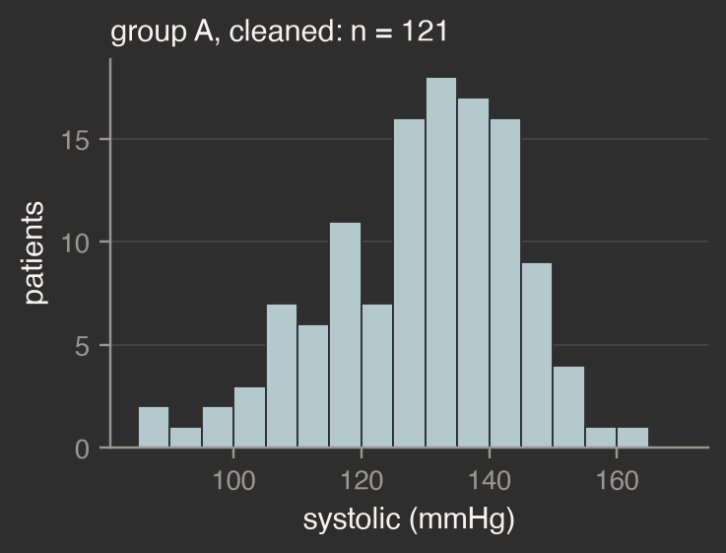
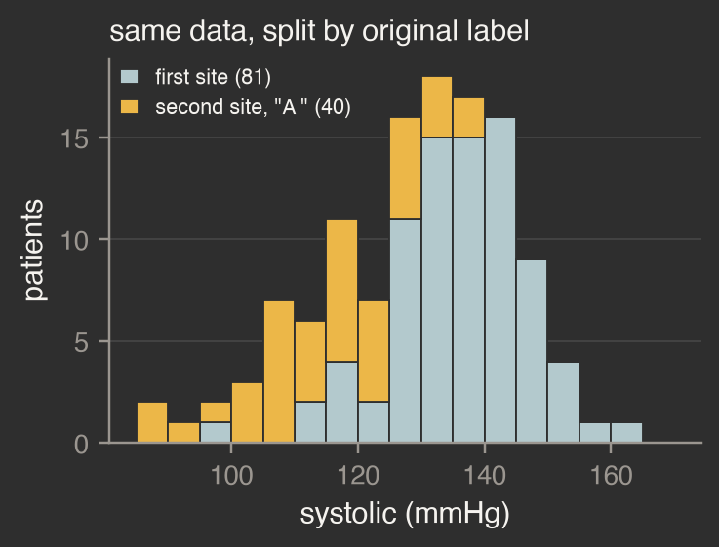
The plot Session 1 was missing
reveal.R
a <- patients %>% filter(group == "A")
ggplot(a, aes(systolic)) +
geom_histogram(binwidth = 5)
reveal.py
a = patients[patients.group == "A"]
FIRST SITE n = 81, mean 136.2
SECOND SITE n = 40, mean 115.5
sns.histplot(a, x="systolic", binwidth=5)
Systolic pressure in mmHg, group A. n counts patients with a recorded value.
THE LESSON: the 40 rows with the trailing space in Session 1 are a second recruitment site whose patients run lower. The naive test dropped them without a warning (n = 81, p = 0.2152). With them restored it finds the difference (n = 121, mean 129.4 against 134.2, p = 0.0064). A histogram drawn before the test would have shown two groups of patients mixed together.
7
Notes:
Protect this slide. Draw the histogram of cleaned group A live and let the room see the second bump on the low side before you say anything about it. Then connect to Session 1: the 40 rows that read 'A ' with a trailing space are a second recruitment site, and the right-hand plot splits the same histogram by the original label. To color by site in your own code, keep the raw group value in its own column before you clean it, for example site2 = group == 'A ' ahead of str_trim. The naive test is the one from Lecture 1: group A n = 81, mean 136.2 against group B 134.2, p = 0.2152. The corrected test has n = 121, mean 129.4, p = 0.0064.

Slide 8
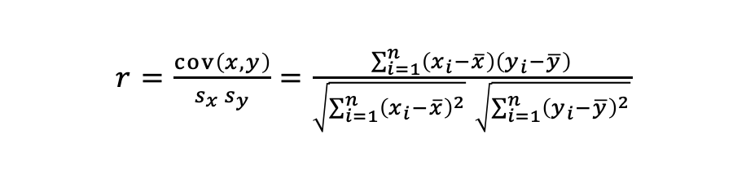
A correlation matrix: read half of it
penguins | bill length | bill depth | flipper | body mass
bill length | 1.00 | -0.24 | 0.66 | 0.60
bill depth | -0.24 | 1.00 | -0.58 | -0.47
flipper | 0.66 | -0.58 | 1.00 | 0.87
body mass | 0.60 | -0.47 | 0.87 | 1.00
cor.R
df %>% select(bill_length_mm:body_mass_g) %>%
cor(use = "pairwise.complete.obs")
cor.py
cols = ["bill_length_mm", "bill_depth_mm",
Pairwise correlations for the four penguin measurements. Gold is positive, blue is negative.
"flipper_length_mm", "body_mass_g"]
$r=\frac{cov\left(x,y\right)}{s_{x} s_{y}}=\frac{\sum_{i=1}^{n}{\left(x_{i}−\overline{x}\right)}\left(y_{i}−\overline{y}\right)}{\sqrt{\sum_{i=1}^{n}{{\left(x_{i}−\overline{x}\right)}^{2}}} \sqrt{\sum_{i=1}^{n}{{\left(y_{i}−\overline{y}\right)}^{2}}}}$
df[cols].corr()
sns.heatmap(df[cols].corr(), annot=True,
cmap="RdBu_r", center=0)
READ HALF OF IT: the diagonal is always 1 and the matrix is symmetric. A correlation beyond about 0.7 deserves a second look: flipper length and body mass are at 0.87. Two predictors above 0.9 should not go into one regression. Correlation is not causation, and r near 0 only rules out a straight-line relationship.
8
Notes:
Select the four measurement columns by name. Taking every numeric column would pull in year in R, and the row-number column that the CSV carries in Python. The matrix is symmetric, so read one triangle. Flipper length and body mass at 0.87 is the strongest pair, and it makes physical sense. Bill depth is negatively related to the other three, which is the Simpson's paradox from slide 6 showing up in the matrix. For patients, systolic and diastolic sit at 0.88 and cholesterol is near zero with everything (0.03 to 0.04): a real variable that genuinely is not related to the others is a legitimate finding. A correlation near zero does not rule out a curved relationship, so plot it too. The dashed frame is for the Pearson formula.

Slide 9
Three problems, and what each one is called
MISSING VALUES
OUTLIERS
IMPOSSIBLE VALUES
Where are they, how many, and why?
A real extreme value, or an entry error?
Could this value exist at all?
Cholesterol is missing in 22 of 250 patients (8.8%), 11 in each group. In the schools file, 1,667 of 2,535 grade cells are empty because a school does not offer every grade.
Systolic has 8 values beyond the box-plot whiskers. Four of them belong to the second site, so they are real patients. Never drop one just because the p-value improves.
One visit_date is 2026-02-30. Find it, then trace it upstream. Do not just filter it out. R turns it into NA while reading; pandas keeps it as text.
R colSums(is.na(patients))
R boxplot.stats(patients$systolic)$out
R patients %>% filter(is.na(visit_date))
py patients.isna().sum()
py s = patients.systolic
py d = pd.to_datetime(patients.visit_date,
q1, q3 = s.quantile([.25, .75])
errors="coerce")
lo = q1 - 1.5 * (q3 - q1)
patients[d.isna()]
hi = q3 + 1.5 * (q3 - q1)
s[(s < lo) | (s > hi)]
ONE RULE FOR ALL THREE: every value you drop or fill in gets one sentence in your notebook saying why.
9
Notes:
Missing values: ask where and why. The cholesterol gaps split evenly across the two groups, so nothing obvious is going on. The schools gaps are structural, because a middle school has no grade 9 and a high school has no pre-K, so the pattern follows the school level. Outliers: eight systolic values fall beyond the whiskers, and half of the low ones come from the second site, so deleting them would delete real patients. Impossible values: 2026-02-30 does not exist. pandas raises an error on pd.Timestamp('2026-02-30') and to_datetime(errors='coerce') returns NaT. In R, read_csv guesses the column is a date and turns the row into NA with a warning, and as.Date('2026-02-30') errors. Either way the row has to be found and traced upstream. Say the rule at the bottom out loud.

Slide 10
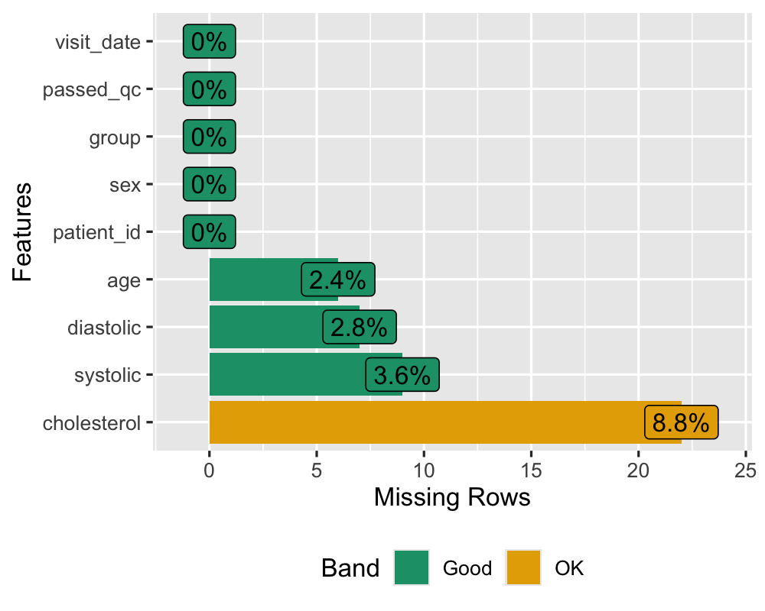
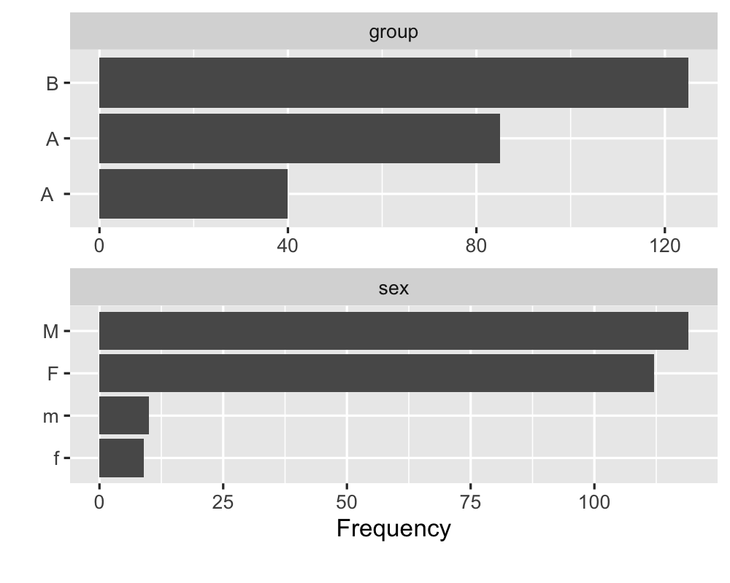
DataExplorer: The whole first look in one call
explore.R
library(DataExplorer)
introduce(patients) # rows, columns, missing
plot_intro(patients) # the same, as bars
plot_missing(patients) # % missing per column
plot_histogram(patients) # every numeric column
plot_bar(patients) # every text column
plot_correlation(nums, cor_args =
list(use = "pairwise.complete.obs"))
plot_missing(patients) Cholesterol has the most gaps, 8.8%.
plot_bar(raw) Two bars both labeled A (85 and 40) and four spellings of sex.
create_report(patients, y = "group")
create_report() writes one HTML file with these sections
Python: ydata-profiling, ProfileReport(patients)
Basic statistics
Data structure
Missing data profile
Univariate distributions
Correlation analysis
PCA
Bivariate distributions
RUN IT ON THE RAW FILE: plot_bar() shows two A bars and four spellings of sex, so the Session 1 bug is visible in seconds. The report cannot say why a column looks odd, though. plot_correlation() also needs cor_args = list(use = "pairwise.complete.obs"), or every pair with a missing value turns grey.
10
Notes:
Optional shortcut, one to two minutes. Everything on slides 4 to 9 can be produced in one go: introduce() is the numbers on slide 4 in a one-row table, plot_missing() is the missing-value check from slide 9, plot_histogram() and plot_bar() draw every numeric and every text column at once, and plot_correlation() is the matrix on slide 8. create_report() bundles all of it into one HTML file with seven sections: basic statistics, data structure, missing data profile, univariate distributions (histograms, bar charts and QQ plots), correlation analysis, principal component analysis, and bivariate distributions (box plots and scatter plots, split by the y column you name). Run it on patients.csv read with trim_ws = FALSE and plot_bar() draws two bars labeled A, 85 and 40 rows, plus sex in four spellings (M, F, m, f). That is the Session 1 problem, visible in seconds. Run it on the cleaned data and that problem is gone, but the second bump in group A is still unexplained, because the report shows the shape of each column and says nothing about the cause. Gotcha: plot_correlation() uses all rows by default, so any pair that includes a column with an NA comes out grey. Pass cor_args = list(use = 'pairwise.complete.obs'). create_report() already does this for you. For text columns with more than 50 distinct values (patient_id, visit_date) the bar charts skip them and say so. In Python the closest tool is ydata-profiling, which is a heavier install. If you are short on time, skip this slide and point students to it in the activity.

Slide 11
Vocabulary from today
EDA
Distribution / skew
Outlier
Exploratory data analysis: the first look, before any test.
How a variable's values spread out. Skew means one tail is longer than the other.
A value far from the rest. Check it before you keep it or drop it.
Correlation
Missingness
Simpson's paradox
A number from -1 to 1 for straight-line association. It says nothing about cause.
Where the NAs are: completely at random, at random given other columns, or not at random.
A trend that reverses once you split the data by group.
11
Notes:
Leave this up while students settle into the activity. Say once that it is there for reference. If asked about missingness types: missing completely at random means nothing systematic, missing at random means related to another column you observed, and missing not at random means related to the missing value itself, which no imputation can fix.

Slide 12
Your activity, and next week
THIS WEEK'S PROBLEM SET
NEXT WEEK · SESSION 10
Download penguins.csv, patients.csv and schools_tibble.csv from Brightspace if you don't have them, open the Course Tutor (general_tutor_gpt.md) and paste in 09_eda_problems.md
It will restate the first problem, ask what you expect, then show you the code and walk it through. You run it, tweak it, and save your own copy.
Data Visualization
Today's plots were quick looks. Next week you learn the grammar behind them and make figures that belong in a paper.
Your cleaned project dataset and cleaning script go on GitHub before Session 10. Paste your tutor transcript to Brightspace before then too.
12
Notes:
Say the milestone out loud again: the cleaned project dataset and the cleaning script go on GitHub before Session 10. The lecture should end around minute 27, which leaves about 28 minutes for the tutor activity. Guard that time.

