Slide 1

SESSION 10
Data
Visualization
plot.R
ggplot(df, aes(x, y,
color = species)) +
geom_point()
# data, aes, geom, stat, coord
Five choices make every plot
Last week's plots were for you.
CPBP 8306: Coding for Research
Joshua Borycz & Daniel Genkins | TA: Peyton Coleman
Thursdays 10:00–10:55am · Light Hall 439
Notes:
Have a ggplot2 console and a seaborn console warm. Today's plots build live, one layer at a time, in whichever language the room prefers. Say the premise once: Session 9's plots were for you, and today's are for a reader who owes you no attention.

Slide 2

Last week's plots were for you. Today's are for a reader
Session 9's histograms and scatter plots were diagnostics: quick, disposable and aimed at you. A figure in a paper has about three seconds to make its point before the reader moves on, and that changes what you optimize.
Today: the grammar behind those plots, how to pick the right one, and how to label, save and check what you drew. The last plot checks a model.
DATA FOR TODAY (Session 9's setup, plus the schools file)
load.R (penguins comes from the package)
load.py
library(dplyr); library(readr); library(stringr)
library(palmerpenguins); library(ggplot2)
raw <- read_csv("patients.csv", trim_ws = FALSE)
patients <- raw %>% mutate(group = str_trim(group))
schools <- read_csv("schools_tibble.csv") %>%
mutate(school_level = str_replace(school_level, " - Hybrid$", ""))
df <- penguins
import numpy as np, pandas as pd, seaborn as sns
import matplotlib.pyplot as plt
df = pd.read_csv("penguins.csv")
raw = pd.read_csv("patients.csv")
patients = raw.assign(group=raw["group"].str.strip())
schools = pd.read_csv("schools_tibble.csv")
schools["school_level"] = (schools["school_level"]
.str.replace(" - Hybrid", "", regex=False))
2
Notes:
Ask what the difference is between a plot for yourself and a plot for a reader. Take two answers and land on audience. Then have everyone run the setup. It is Session 9's cleaning trimmed to what today needs. raw keeps the original group labels so a plot can still color by the trailing space. The two schools lines merge Non-Traditional - Hybrid into Non-Traditional, the same fix as Session 8.

Slide 3
By the end of today you can…
1
Describe any plot in five parts: data, aesthetics, geometry, statistics and coordinates.
WHY THIS SESSION MATTERS
Build one plot in ggplot2 and in seaborn, adding a layer at a time.
"Make a nice bar chart" names none of the five parts, so you get the default. A prompt that names all five gets the plot you meant. This session is what makes the second prompt possible.
2
3
Choose the plot that fits the variable types, and say why a bar chart of means is rarely it.
4
Label, facet and save a figure a reader can follow, and name the three plotting sins.
Milestone
Your project's first key figure starts here. Bring your cleaned data to the activity if it is ready.
5
Read a QQ plot and a residual plot to check a model before you trust it.
3
Notes:
Read the five objectives quickly. The point of the session is objective 1, and everything else follows from it. If students have a cleaned project dataset, they should try today's plots on it during the activity.

Slide 4
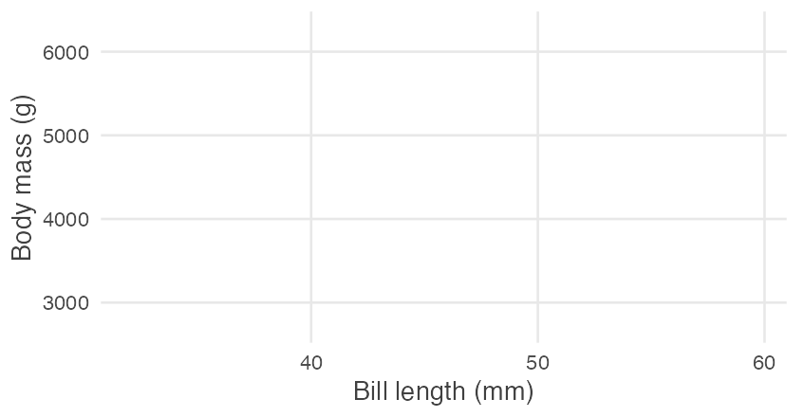
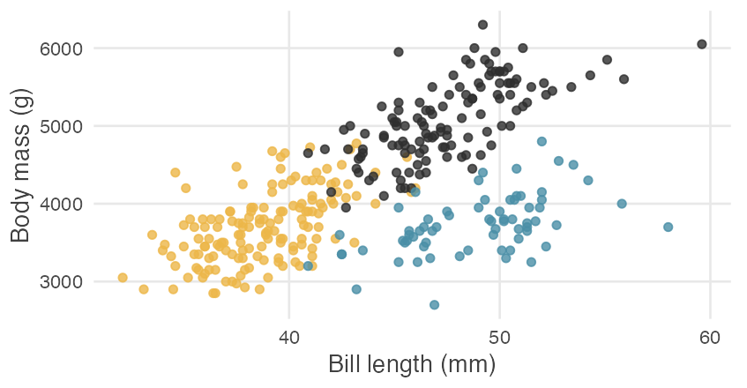
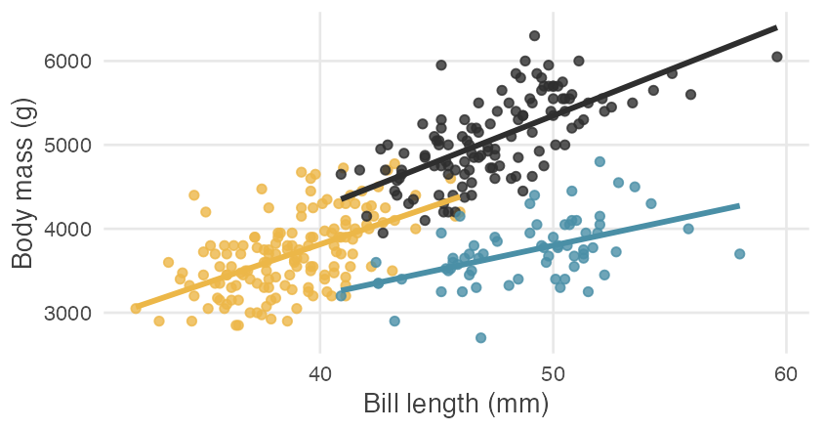
Five choices: every plot you will ever make
Data
the tidy table you plot (df)
five_parts.R
Aesthetics
which column goes to x, y, color, size or shape
ggplot(df, # 1 data
aes(x = bill_length_mm, # 2 aesthetics
y = body_mass_g,
color = species)) +
geom_point() + # 3 geometry
geom_smooth(method = "lm") + # 4 statistics
scale_x_log10() # 5 coordinates
Geometry
the mark: point, line, bar or box
Statistics
a summary the plot computes: a count, a fitted line
Coordinates
the axes (linear, log, flipped) and the facets
data + aesthetics axes and a grid, nothing to draw yet
+ geom_point() now the marks appear
+ geom_smooth(method = "lm") same data and aesthetics, a fitted line per species
4
Notes:
Write the five components on the board, then show the code. Every plot is a choice about each one. The strip along the bottom builds a plot a layer at a time: with no geometry there is nothing but axes, geom_point() adds the marks, and geom_smooth() adds a statistic. The plot is composable. Base R's hist(), boxplot() and plot() draw the same plots in one line and suit a quick look in the console, as in Session 9. Last point is about AI: every one of these parts can go in a prompt. "Geom_col, x = species, y = mean_mass, fill = sex, position dodge, error bars from sd_mass" gets the plot you meant. "Make a nice bar chart" gets the default. In Python, seaborn.objects (0.12 and newer) builds plots from the same parts with .add(), and the classic seaborn functions draw the same plots in one call.

Slide 5
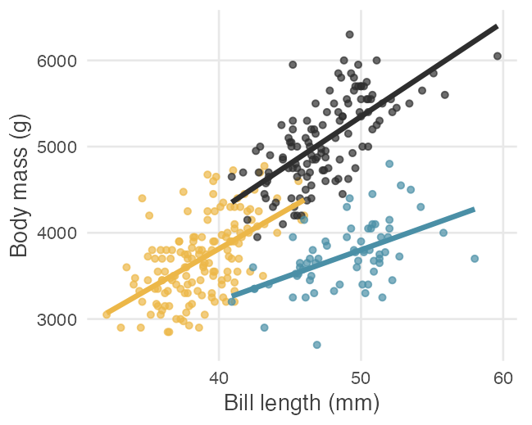
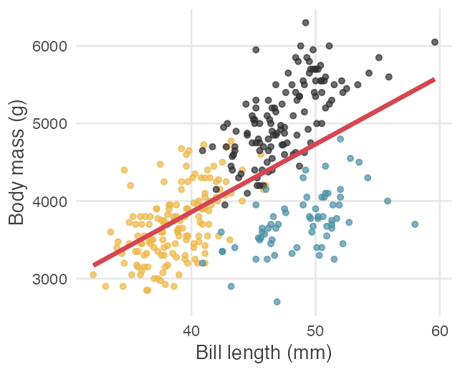
Build it in layers, and mind where the aesthetic lives
layers.R
# color inside ggplot(): every layer inherits it
ggplot(df, aes(bill_length_mm, body_mass_g, color = species)) +
geom_point() + geom_smooth(method = "lm")
# color inside one layer: only that layer uses it
ggplot(df, aes(bill_length_mm, body_mass_g)) +
geom_point(aes(color = species)) + geom_smooth(method = "lm")
layers.py (seaborn.objects)
Inside ggplot(): three lines, one per species. Slopes in g per mm: Adelie 94.5, Chinstrap 59.1, Gentoo 109.5.
Inside one layer: one line through all 342 penguins, slope 87.4 g per mm.
# color in so.Plot(): every layer inherits it
(so.Plot(df, x="bill_length_mm", y="body_mass_g", color="species")
.add(so.Dot()).add(so.Line(), so.PolyFit()))
# color in one .add(): only that layer uses it
(so.Plot(df, x="bill_length_mm", y="body_mass_g")
.add(so.Dot(), color="species").add(so.Line(), so.PolyFit()))
WHERE THE AESTHETIC LIVES: inside ggplot() every layer inherits it, and inside one geom only that layer uses it. The overall line mixes the difference between species into its slope, the same trap as Session 9's Simpson's paradox.
5
Notes:
Build the same plot live in both languages: penguin bill length against body mass, colored by species. Walk through it in grammar terms. Then add geom_smooth(method = "lm") and let the room see that it is a new geometry with a statistic behind it. The thing that trips people up is where the aesthetic lives. Put color in ggplot() and every layer inherits it, so geom_smooth draws a line per species. Put it in geom_point() and the smooth sees all penguins together. Both plots are correct and they tell different stories. Connect it to Simpson's paradox from Session 9. Three ways of handing the data to ggplot draw the same plot: inside ggplot(), inside one geom, or piped in with %>%. A + belongs at the end of a line, never the start of the next.

Slide 6
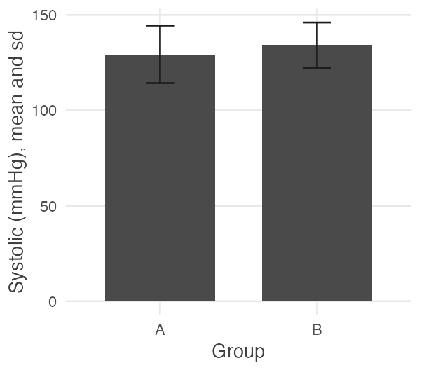
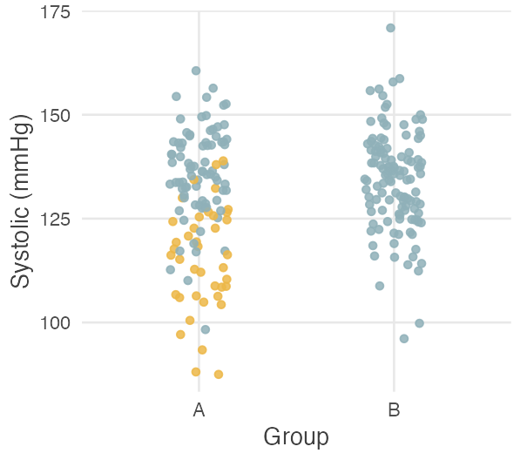
What plot, for what question
What you have | ggplot2 | seaborn
One continuous | geom_histogram(), geom_density() | histplot, kdeplot
One categorical | geom_bar() | countplot
Two continuous | geom_point(), geom_smooth() | scatterplot, regplot
Continuous by categorical | geom_boxplot(), geom_violin() | boxplot, violinplot
Two categorical | geom_bar(position = "dodge") | countplot(hue=)
Over time | geom_line() | lineplot
Many variables | color, shape, size, facets | hue, style, size, col
Bars: A 129.4, B 134.2, error bars overlap. The groups look alike.
Points: the 40 rows labeled "A " sit near 115. A is two sites.
THE ANTI-PATTERN TO NAME: a bar chart of means with a t-test asterisk hides the distribution, the sample size and every outlier. Here two bars hid the second recruitment site from Session 1. With fewer than about 30 points per group, plot the points. With more, draw a box plot at least, and keep the points when they are not a blur.
6
Notes:
Go down the table: one continuous variable gets a histogram or density, one categorical gets a bar chart of counts, and so on. geom_bar() counts the rows for you, which is the statistics part of the grammar. With long labels, put the categories on the y axis and sort the bars by count, as with the schools (76 elementary, 31 charter, 31 middle, 17 high). Then the anti-pattern. Draw the bar chart of systolic pressure by group first and ask what the room learned: two similar bars. Then draw the points colored by the original label. The 40 patients whose group read "A " with a trailing space cluster near 115, the second recruitment site: mean 115.5 against 136.2 for the first site. The bars hid it.

Slide 7
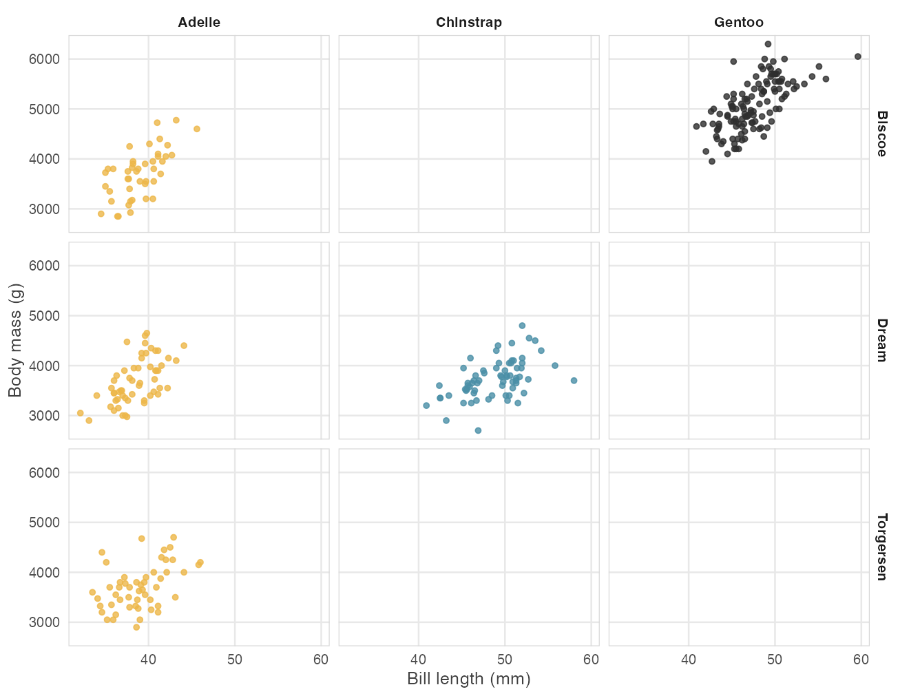
Facets: when color runs out
facet.R
ggplot(df, aes(bill_length_mm, body_mass_g)) +
geom_point() +
facet_grid(island ~ species) # rows ~ columns
# one grouping variable: facet_wrap(~ species)
facet.py
sns.relplot(df, x="bill_length_mm", y="body_mass_g",
row="island", col="species")
# one grouping variable: col="species"
A GRID SHOWS WHAT EXISTS: 9 panels, 5 with data. Adelie lives on all three islands (44, 56, 52). Chinstrap is only on Dream (68) and Gentoo only on Biscoe (124).
PAST 3 OR 4 GROUPS, FACET: eyes cannot tell eight shades of one color apart, but they can scan eight small plots.
Every panel shares the same axes, so the panels compare honestly.
7
Notes:
facet_wrap splits one plot into a row of small plots, one per level. facet_grid uses two variables, rows and columns. facet_grid(island ~ species) makes nine panels and only five hold data. A grid shows which combinations exist, which a color legend cannot. For Chinstrap and Gentoo an island effect cannot be separated from a species effect, so say so in a write-up. Past three or four groups, facet instead of coloring. Panels share axes by default, which is what makes them comparable.

Slide 8
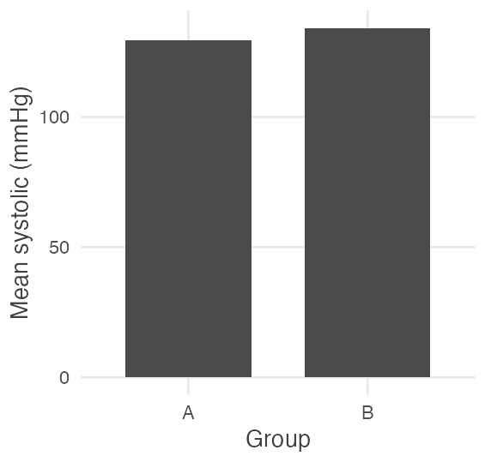
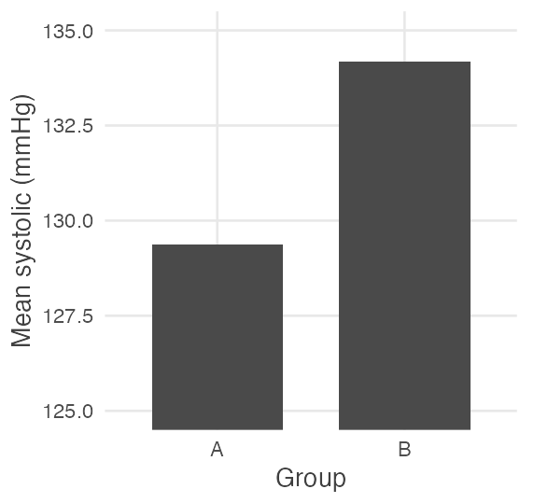
Label it, then delete the three sins
polish.R and polish.py
R ggplot(df, aes(bill_length_mm, body_mass_g, color = species)) +
geom_point(alpha = 0.7) + scale_color_viridis_d(end = 0.85) +
labs(title = "Longer bills go with heavier penguins",
x = "Bill length (mm)", y = "Body mass (g)") + theme_minimal()
py sns.set_theme(style="ticks")
ax = sns.scatterplot(df, x="bill_length_mm", y="body_mass_g",
hue="species", palette="viridis")
ax.set(title="...", xlabel="Bill length (mm)", ylabel="Body mass (g)")
viridis survives grayscale printing and most kinds of color blindness. A title that states the finding does more than one that names the variables.
From zero: A and B look alike.
Cut at 125: B looks 2.1 times as tall, for a 3.7% difference.
SIN 1
SIN 2
SIN 3
Chart junk
Ambiguous labels
Misleading scales
3D bars, shadows and gridlines that carry no data. theme_minimal() removes most of it.
"value" and "y" are not labels. "Body mass (g)" is: the variable, with its units.
Bars start at zero, because their length is the data. Points can start anywhere, because their position is.
8
Notes:
A figure for a reader names what is on each axis, with units, and states the finding in the title. The viridis palette survives grayscale printing and most color blindness. Then the three sins. Chart junk is anything that is not data. Ambiguous labels are the column names left in place. Misleading scales are the one to show: the group means are 129.4 and 134.2, a 3.7% difference. Draw the bars from zero and they look alike. Cut the axis at 125 and B's bar is 2.1 times as tall as A's. Bars must start at zero because their length is the data, while points do not, because their position is the data. AI-written plot code often arrives with the junk already in it, so ask what the one thing is that the plot must show and delete the rest.

Slide 9
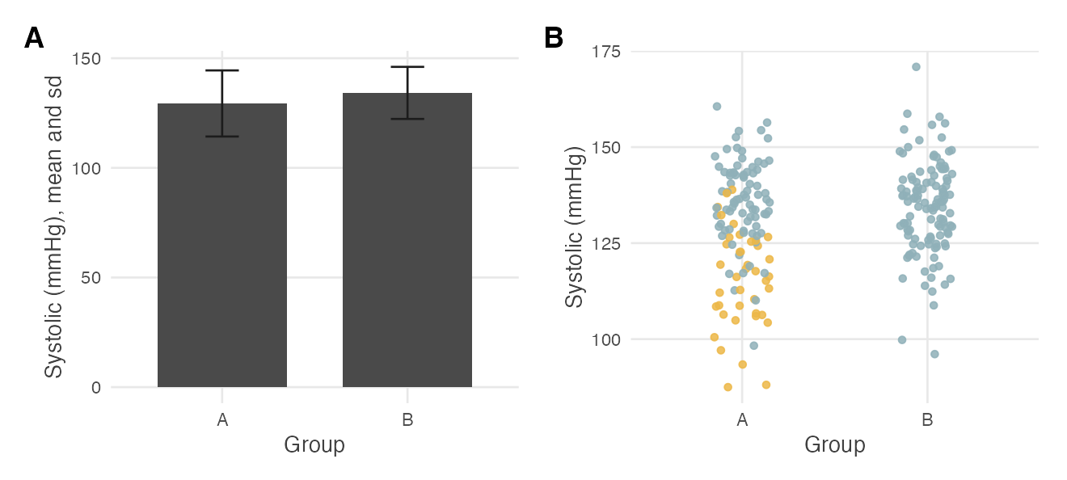
Save it at the size it will be printed
export.R
ggsave("figure1.png", p, width = 7, height = 4, dpi = 300)
ggsave("figure1.pdf", p, width = 7, height = 4)
library(patchwork) # optional
(panel_a | panel_b) + plot_annotation(tag_levels = "A")
export.py
fig.savefig("figure1.png", dpi=300, bbox_inches="tight")
fig.savefig("figure1.pdf", bbox_inches="tight")
fig, axes = plt.subplots(1, 2, figsize=(9, 3.8))
axes[0].set_title("A", loc="left", fontweight="bold")
Two panels, one figure. patchwork places plots side by side (a | b) or stacked (a / b) and adds the letters. Python uses plt.subplots. Session 13 adds annotations.
SAVE WITH CODE, NOT THE EXPORT BUTTON: a script rebuilds the figure in one run when a reviewer asks for a change. Sizes are in inches, so text stays readable on the page. 7 inches at 300 dpi is 2,100 pixels wide. Many journals ask for about 3.5 inches (one column) or 7 (two columns), so check the author guidelines. A PDF has no resolution to run out of.
9
Notes:
ggsave sets the size in inches, and that is the point: text that is readable at the size on the page. Many journals ask for about 3.5 inches wide for one column or 7 for two, and the author guidelines say which. 300 dpi is the usual minimum for a raster figure. A PDF or SVG is a vector format with no resolution, so it stays sharp at any size. Save with code and not with the export button, which is the reproducibility point from Session 6. For two plots in one figure, R has patchwork and Python uses plt.subplots. Session 13 comes back to combined figures and adds statistical annotations, so today only show that it exists.

Slide 10
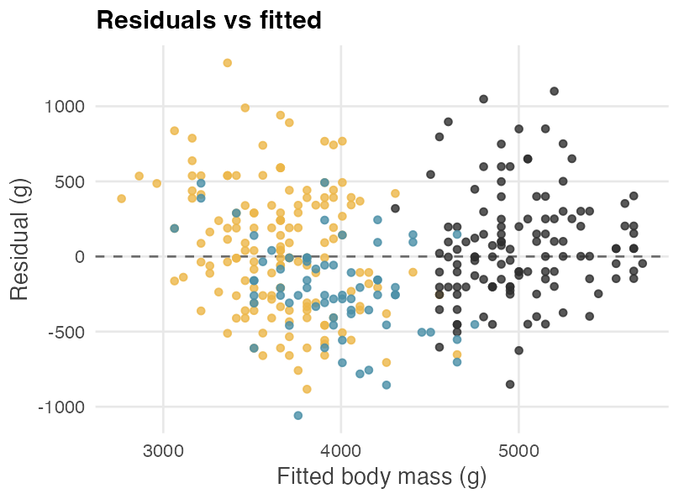
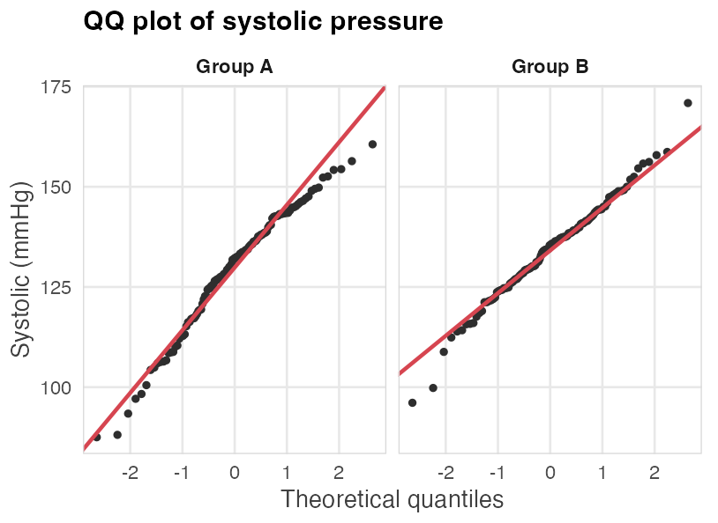
Plots that check a model: residuals and the QQ plot
diagnostics.R / .py
fit <- lm(body_mass_g ~ flipper_length_mm, df)
plot(fit) # four plots
ggplot(df, aes(sample = systolic)) +
stat_qq() + stat_qq_line()
# py
b, a = np.polyfit(x, y, 1) # line: a + b*x
resid = y - (a + b * x)
stats.probplot(vals, plot=ax) # QQ
RESIDUALS VS FITTED
QQ PLOT
ALSO IN plot(fit)
Want a shapeless cloud around zero
Points on the line mean normal
Spread and influence
A curve means the line is the wrong shape. A funnel means unequal spread. Colored by species, Chinstrap sits 216 g below the line, and adding species lifts R-squared from 0.759 to 0.783.
Ends that peel away mean skew or extreme values. Group A curls away (Shapiro-Wilk p = 0.018). Group B follows the line (p = 0.471). The Session 1 t-test assumes normal groups.
Scale-location shows whether the spread changes. Residuals vs leverage and Cook's distance show how hard one point pulls the fit. The next slide reads all four on a real model. DataExplorer's plot_qq() draws a QQ plot per column.
10
Notes:
Plots are also how you check a model. A residual is what the model did not explain: the observed value minus the fitted value. The model here is body mass from flipper length, R-squared 0.759. In the residuals-versus-fitted plot you want a shapeless cloud around zero. Colored by species, Chinstrap penguins sit below the line with a mean residual of minus 216 grams, against plus 44 for Adelie and plus 66 for Gentoo, which is a hint to add species. For the QQ plot, use the Session 1 data. Group A's points curl away from the line at both ends and Shapiro-Wilk agrees, p = 0.018. Group B hugs the line, p = 0.471. A QQ plot drawn before the t-test would have flagged group A, the same message as Session 9's histogram. plot(fit) draws four plots, and the next slide reads them on a real model. If time is short, show only the QQ plot here.

Slide 11
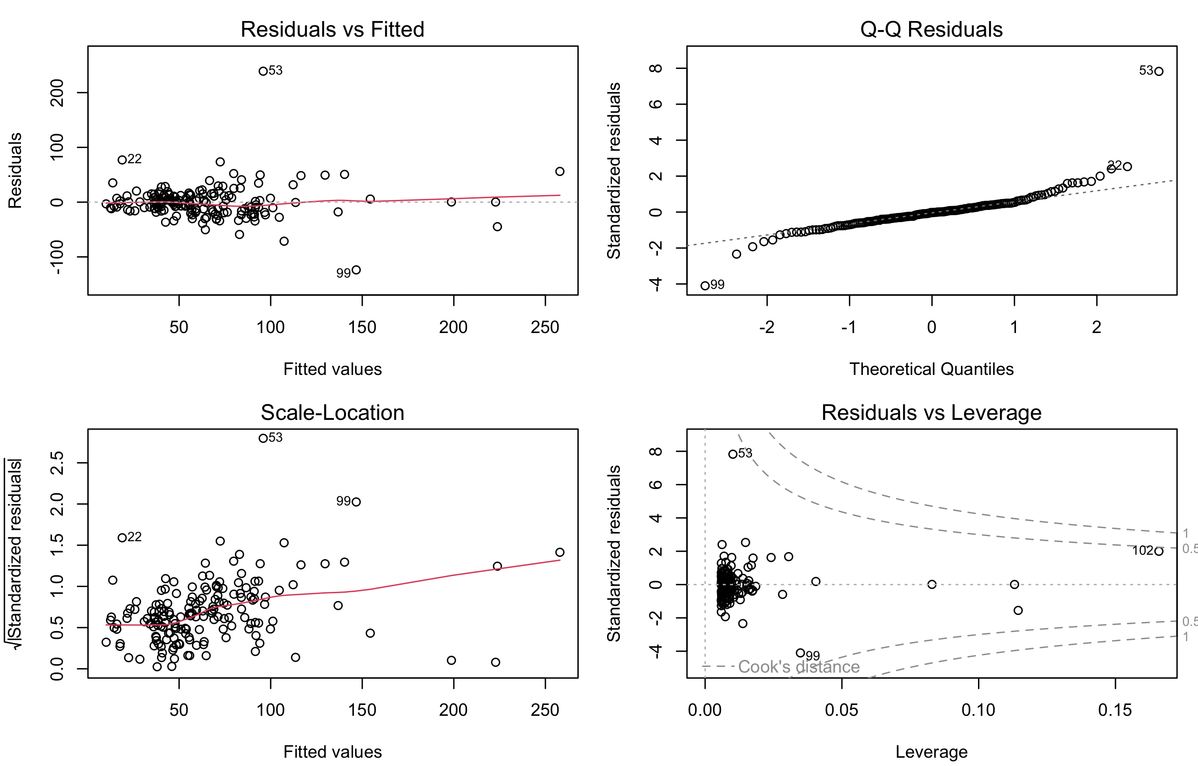
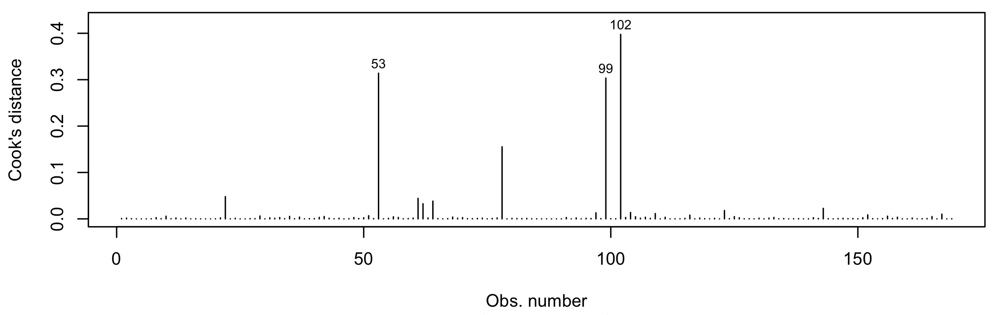
Reading the four plots from plot(fit)
The model is disabilities against total enrollment at 169 Metro Nashville schools (R-squared 0.598). Each panel checks a different assumption, and the same school can show up in several.
Residuals vs Fitted
Linearity and equal spread: look for a curve or a funnel. Harris-Hillman Special Education (53) sits 239 students above the line.
Q-Q
Normal residuals: points should follow the dotted line. Harris-Hillman is the extreme point at the top right, and Martin Luther King Jr School (99) the lowest.
Scale-Location
Equal spread: the red line should be flat. It climbs a little, and 53 and 99 stand above the rest.
Residuals vs Leverage
Influence: points past the dashed Cook's contours (0.5 and 1) are influential. McGavock High (102) has the most leverage, with 2,276 students, and sits nearest the 0.5 contour.
Cook's distance plot(fit, which = 4)
The tallest bars are 102 (0.40), 53 (0.31) and 99 (0.30). None reaches 0.5.
LOOK AT THE UNUSUAL POINTS BEFORE YOU READ ANY P VALUE. Is each one a mistake? Refit without it and report both fits. Without McGavock High the slope goes from 0.110 to 0.104 and R-squared from 0.598 to 0.533.
11
Notes:
Plot(fit) draws four plots, and each one checks a different assumption. Residuals vs fitted checks linearity and equal spread: look for a curve or a funnel. Harris-Hillman Special Education is observation 53, and it sits 239 students above the line. That is a real school that enrolls students with disabilities, so it is no data error. Q-Q: points near the dotted line mean the residuals are roughly normal, and Harris-Hillman is the extreme point at the top right. Scale-location is the square root of the absolute standardized residual against the fitted value, and a flat red line means equal spread. This one climbs a little. Residuals vs leverage puts leverage on the x axis and the standardized residual on the y axis, with dashed Cook's distance contours at 0.5 and 1, and points beyond a contour are influential. McGavock High, observation 102, is the largest school at 2,276 students, so it has the most leverage (0.166), and it sits nearest the 0.5 contour. Cook's distance is plot(fit, which = 4), the same information as bars: the tallest are 102 at 0.40, 53 at 0.31 and 99 at 0.30, and none is past 0.5. Point out the difference between a large residual (Harris-Hillman) and high leverage (McGavock). Influence needs both, and neither school has enough of both to be past the contour. What to do: check whether each point is a mistake, refit without it, and report both fits. Without McGavock High the slope goes from 0.110 to 0.104 disabilities per student and R-squared from 0.598 to 0.533. Without Harris-Hillman the slope is 0.106 and R-squared rises to 0.686.

Slide 12
Vocabulary from today
Grammar of graphics
Aesthetic mapping
Geometry / geom
Data, aesthetics, geometry, statistics and coordinates: the five parts of a plot.
A data column assigned to a visual property such as x, y or color.
The type of mark: point, line, bar or box.
Facet
Chart junk
Residual
A subplot split out by a categorical variable.
Visual decoration that is not data.
Observed minus fitted: the part the model did not explain.
QQ plot
Leverage
Cook's distance
Sorted values against a normal distribution. Points on the line mean the data look normal.
How far a point's x value sits from the rest. High leverage gives a point more pull on the fit.
How hard one point pulls on the fit. Above 0.5 deserves a look, and above 1 is influential.
12
Notes:
Leave this up while students settle in for the activity.

Slide 13
Your activity, and next week
THIS WEEK'S PROBLEM SET
NEXT WEEK · SESSION 11
Download penguins.csv, patients.csv and schools_tibble.csv from Brightspace if you don't have them, open the Course Tutor (general_tutor_gpt.md) and paste in 10_visualization_problems.md
It will restate the first problem, ask what you expect, then show you the code and walk it through. You run it, tweak it, and save your own copy.
Univariate Statistics
Picking the right test takes judgment, and running it takes one line. Session 11 starts with the group A against group B test that today's QQ plot questioned.
Paste your tutor transcript to Brightspace before Session 11.
13
Notes:
Students download any datasets they do not have, open the Course Tutor and paste in the problem set. Anyone with a cleaned project dataset should plot it with the same five parts. Next week is Univariate Statistics, which starts from the test that Session 9's histogram and today's QQ plot both questioned.

