Slide 1

CPBPB&T2024
R you ready fa dis
December 5, 2024
Light Hall 306A/B
Nashville, Tennessee
http://tiny.cc/cpbpbandt2024
#CPBPB&T2024

Slide 2
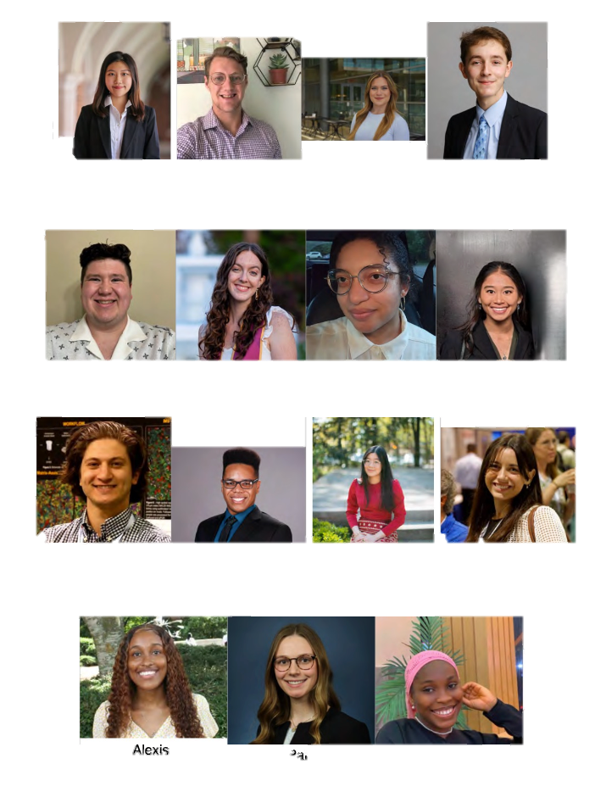
Erika Cao
Tonnar
Castellano
Aleksya
Drobshoff
Ethan Durham
SPEAKERS
James
Evans
Katie Jo
Gelasco
Porcia
Haynes
Liane
Lee
Morad
Malek
Kole
Martin
Jessica
Myat
Ellie
Pingry
Alexis Roberson
Paige
Schiebel
Salimat
Sofela

