Slide 1
Graphs without Ontologies
Clifford Anderson
Suellen Stringer-Hye
Ed Warga
Vanderbilt University Library
@suellenshye
@mrwargames @andersoncliffb

Slide 2
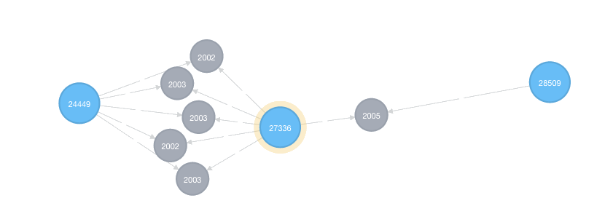
What is a Graph?
A graph is a representation of a set of objects where some pairs of objects are connected by links.*
*at least according to Wikipedia

Slide 3
Directed Property Graph
Properties
Node
(Vertex)
Node
(Vertex)
Relationship (Edge)
Properties
Properties

Slide 4
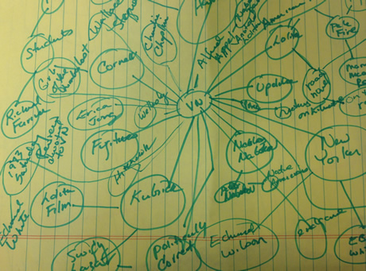
Modeling the Graph

Slide 5
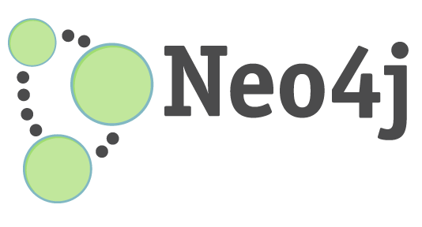
Neo4J
Native Graph Database
ACID-Compliant*
Primarily Written in Java/Scala
Open Source:
Community Edition: GPLv3
Enterprise Edition: AGPLv3
Two Versions
Neo4j Embedded
Neo4j Server
*Atomicity, Consistency, Isolation, Durability

Slide 6
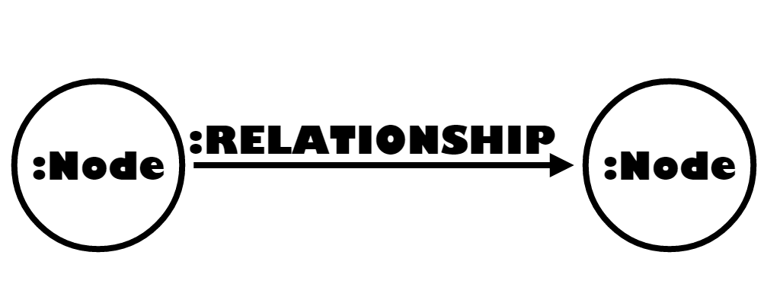
Pattern Matching
match (a:Node)-[r:RELATIONSHIP]->(b:Node) return a,r,b

Slide 7
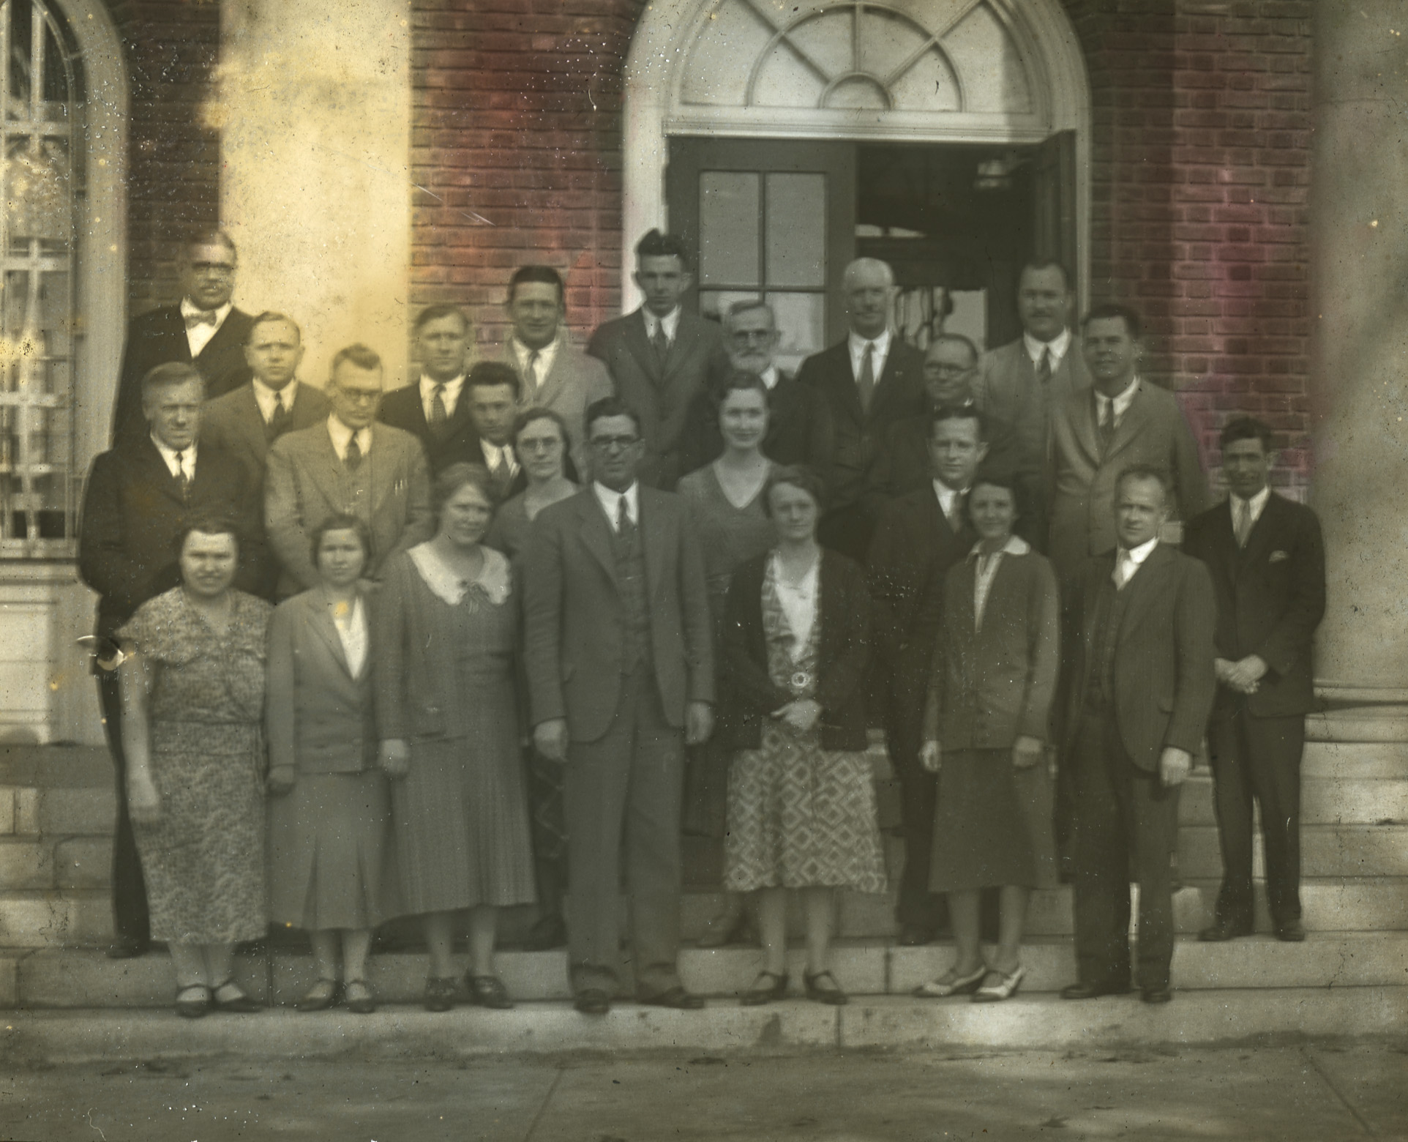
Scholarly Patterns
Notes:
https://www.flickr.com/photos/belkarchives/7365996856

Slide 8
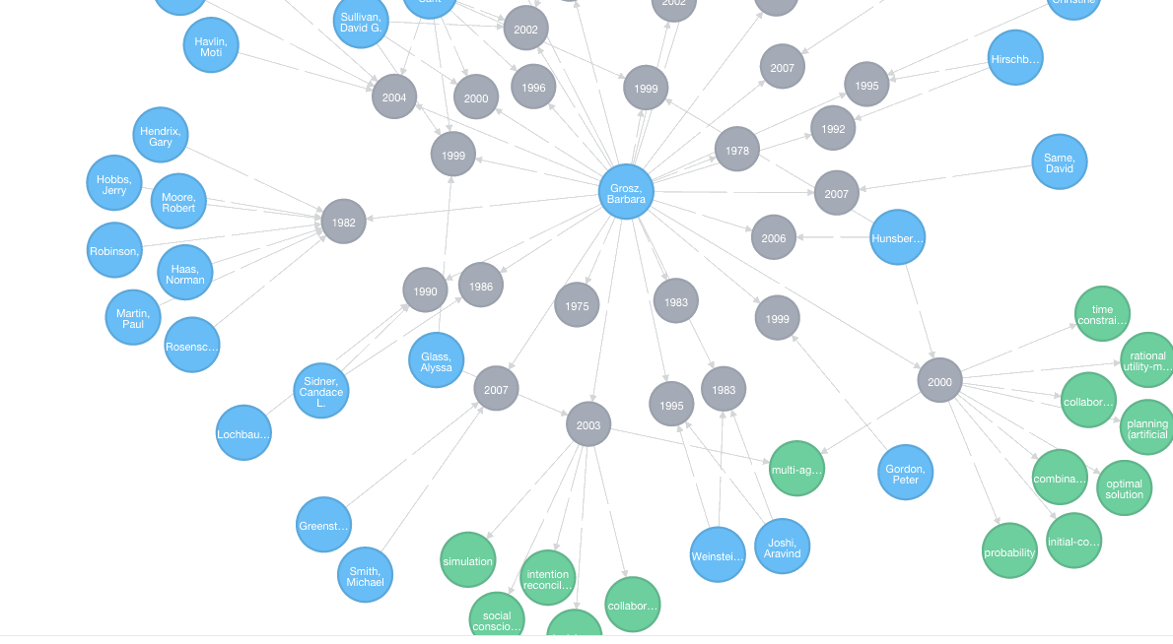
Graphing Faculty Interests

Slide 9




Analyzing IR Data

Slide 10
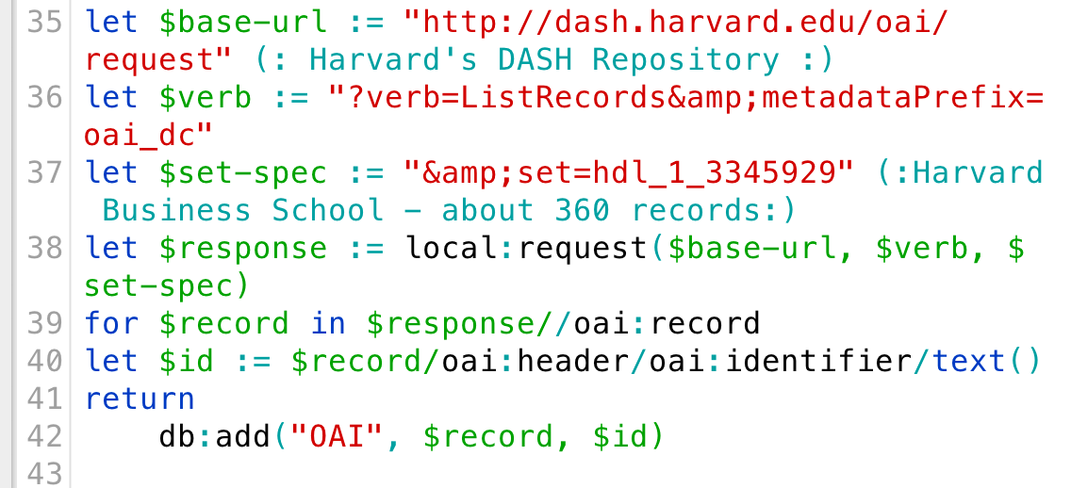
get-oai-data.xqy

Slide 11
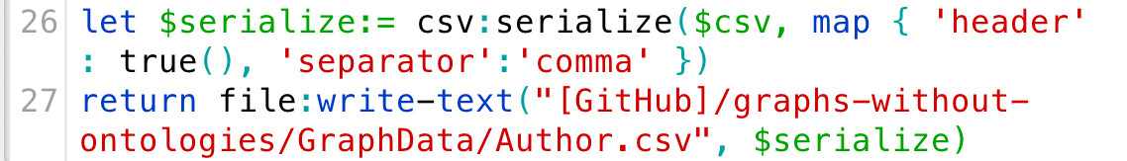
OAI => CSV

Slide 12
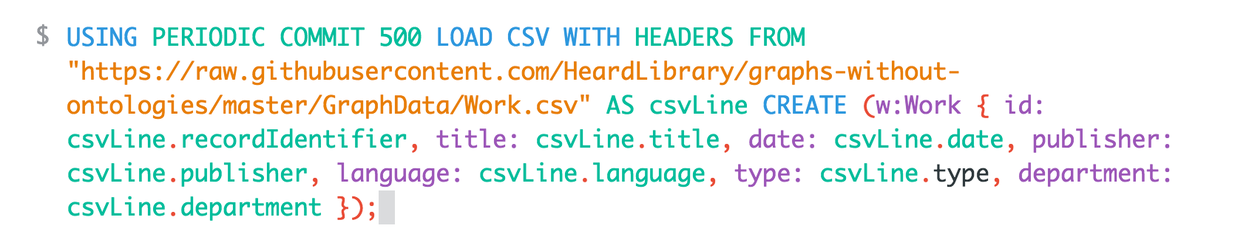
Load Data in Neo4j

Slide 13

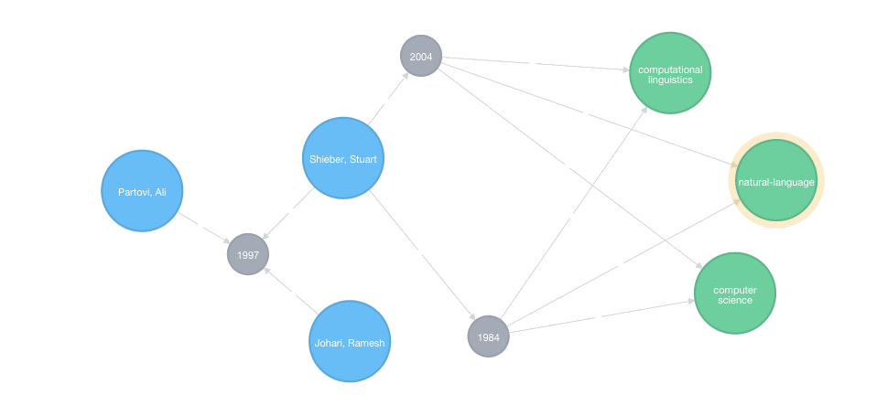
Data Model

Slide 14
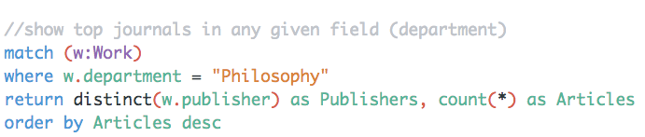
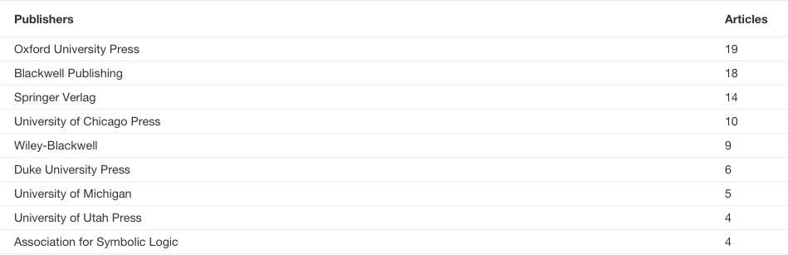
Top Journals in Philosophy

Slide 15
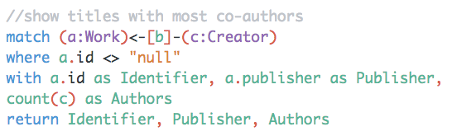
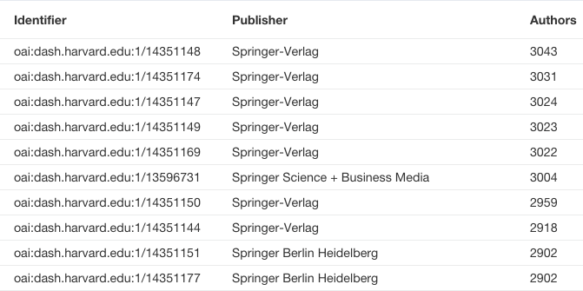
Show Papers with Most Co-Authors

Slide 16
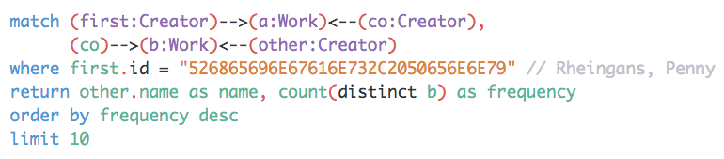
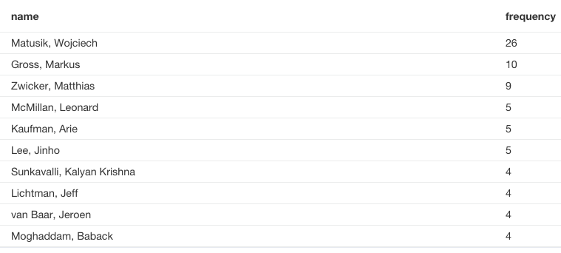
Recommendation Engine

Slide 17
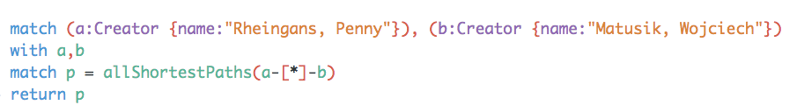
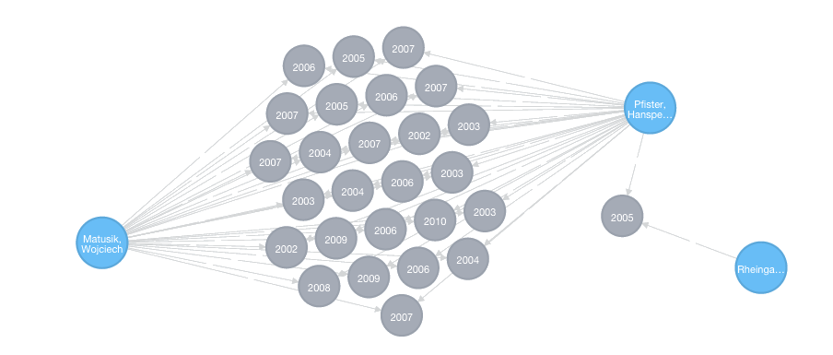
Recommendation Engine

Slide 18
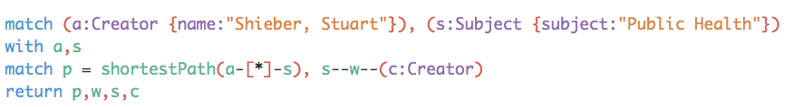
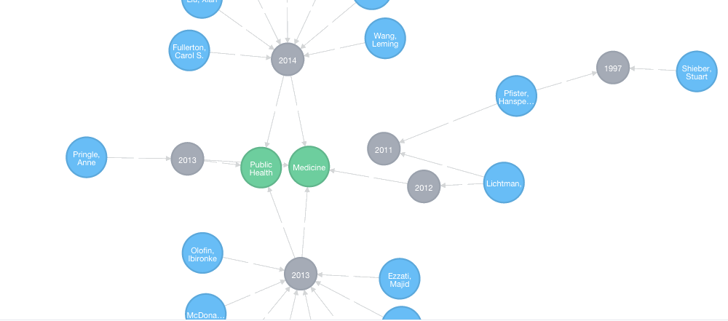
Shortest Path Analysis

Slide 19
Challenges & Prospects
Challenges
Authority Control in Repositories
Limited Subject Analysis
How Much Metadata Cleanup to Perform?
Prospects
Gather Data from all Institutional Repositories
Associate Creators with ORCID IDs

